Slide 1
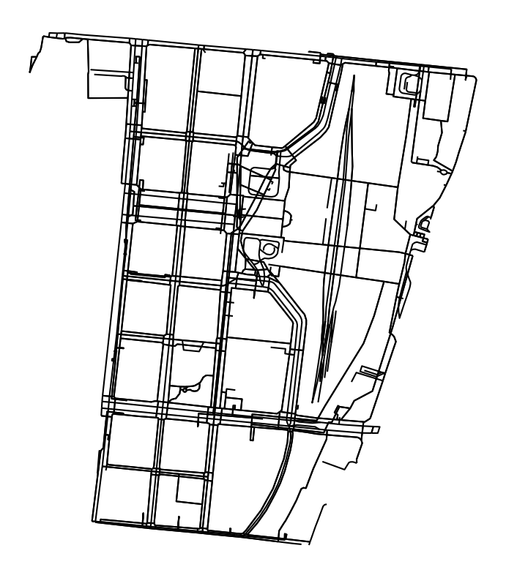
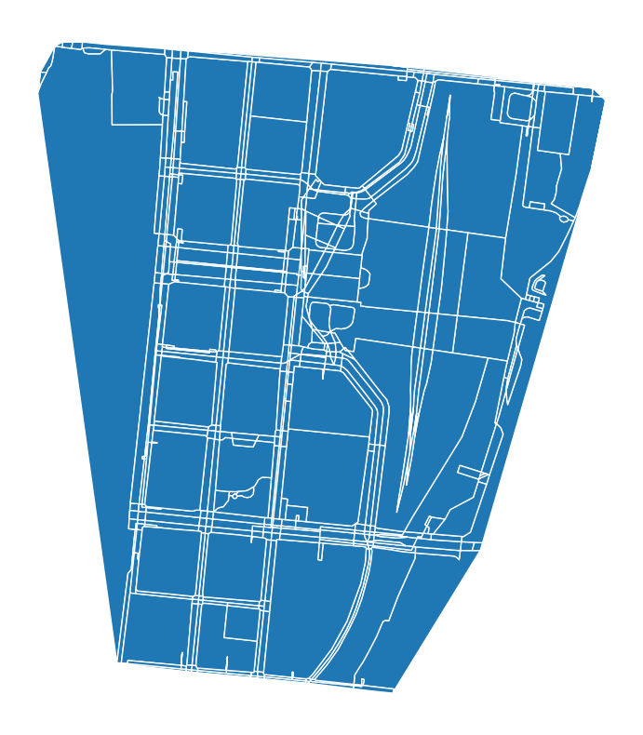
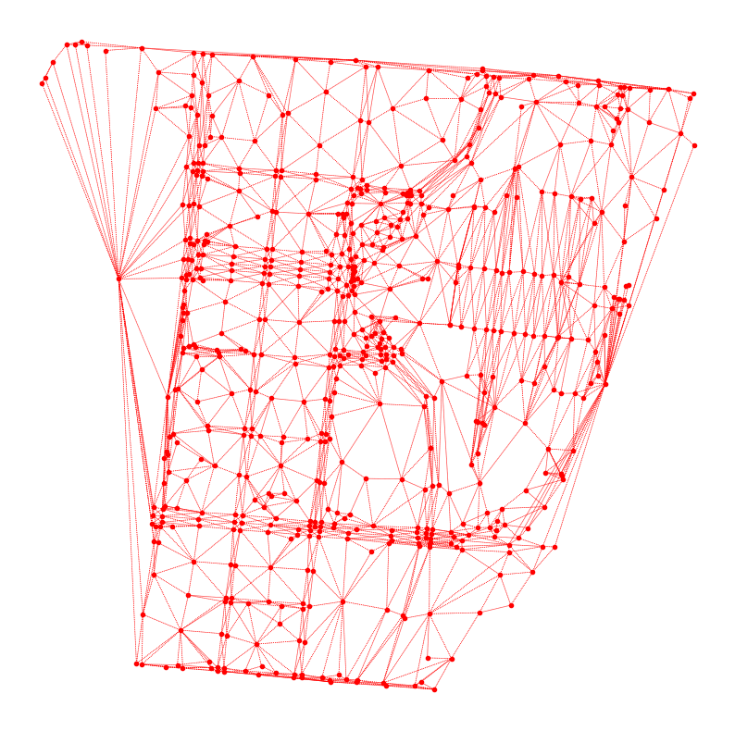
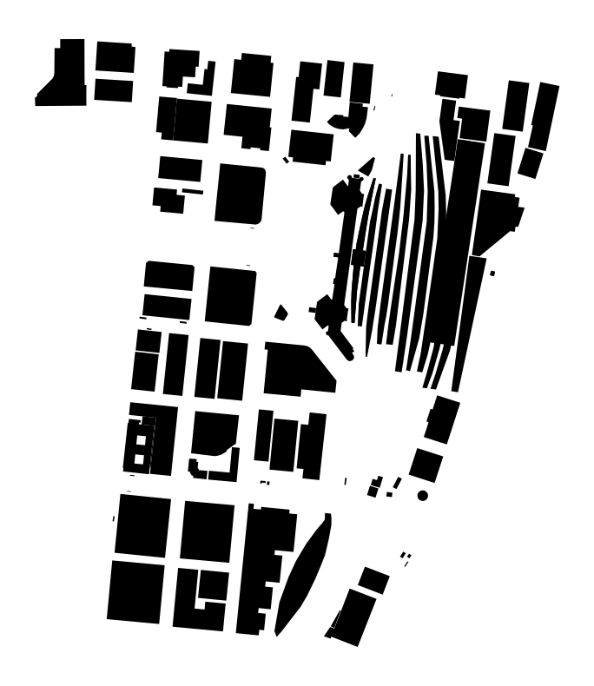




$$n_{1}$$
$$n_{2}$$
Urban Form
Urban Function
Graph Conv.
Graph Conv.
Graph Conv.
Barriers
…
…
Enclosed Tessellation Cells
Contiguity Matrix
Graph-represented Characters
Graph-represented Spatial Signatures
$$G^{0}=\left(V^{0},E^{0}\right), V_{i}^{0}∈ ℝ^{n_{1}+n_{2}}$$
$$G^{l}=\left(V^{l},E^{l}\right), V_{i}^{l}∈ ℝ^{k}$$
Anchors

