Slide 1

Hotel Booker
M5261176
Yuta Uchida

Slide 2
Introduction
The reason why I chose this theme is because I was curious about how hotel reservation systems work when I have a chance to travel during the upcoming summer vacation period.
The targeted features of this application are hotel availability management and a user-friendly booking method.

Slide 3

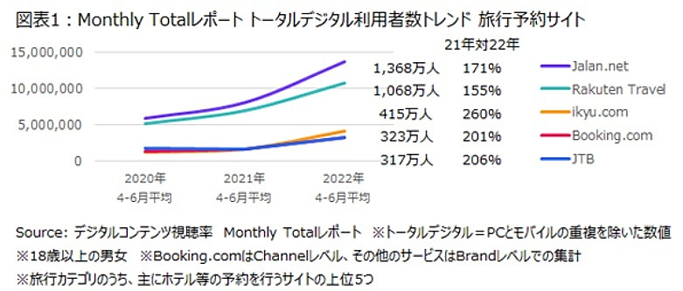
Market Research & TARGET Audience
Referring to the graph on the right, the use of online travel agencies (OTA) has increased in recent years.
With this increase, we thought it was important to create a system that is easy to use for a wide range of people.
Notes:
https://www.google.com/url?sa=i&url=https%3A%2F%2Fwww.travelvoice.jp%2F20220804-151742&psig=AOvVaw25aGb2zwSCiH_sVfgPceEG&ust=1690530138011000&source=images&cd=vfe&opi=89978449&ved=0CBEQjRxqFwoTCKjwyNSxroADFQAAAAAdAAAAABAE

Slide 4
Technology Stack
Frontend
HTML/CSS
Bootstrap5
Backend
Django
Database
sqlite3

Slide 5
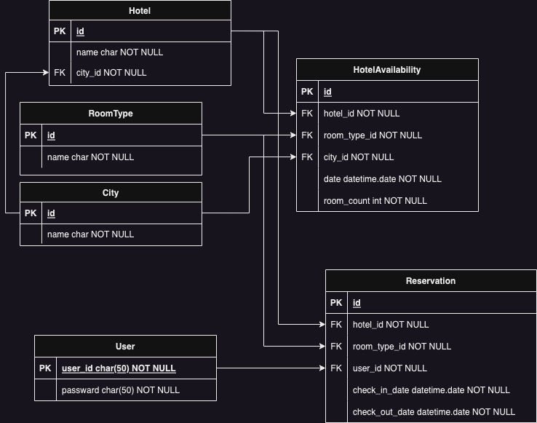

Database structure

Slide 6
Key Features
User Authentication
Create accounts, log in, and log out using Django authentication.
Personalized experiences and reservation management for users.
Hotel Search
Search for hotels based on city, check-in, check-out, and room type.
Find available hotels that match user criteria.
Real-time Room Availability
Display real-time room availability for selected hotels and room types.
Users can see which hotels have available rooms for desired dates.

Slide 7
Key Features
Multiple Date Selection
Choose check-in and check-out dates for reservations.
System checks room availability for the entire selected period.
Continuous Stay Check
Verify enough available rooms for consecutive nights.
Users can book reservations without switching hotels.
Reservation Creation
Create reservations with hotel, room type, and dates.
Store reservation details securely in the database.

Slide 8
Key Features
Reservation Validation
Validate reservation requests for room availability.
Confirm reservations only if enough rooms are available.
Room Count Management(For avoid overbooking)
Automatically reduce room count after successful bookings.
Accurate tracking of room availability.
User Dashboard (My Page)
Authenticated users access a personalized dashboard.
View existing reservations and manage their accounts.
User-friendly Date Picker
Intuitive date picker for easy date selection.
Helps users choose suitable booking dates.

Slide 9

Demo

Slide 10

Thank you for listening!

