Slide 1
Design and Simulation of a Smart Parking Slot Availability and Entry Control System Using Combinational Logic
DIGITAL DESIGN & COMPUTER ARCHITECTURE · 26EC1202E
Team Members:
2620040055 Yuthikhaa Bellamkonda
2620030310 Vayyala Dhikshitha
2620030311 Neerukonda Charishma

Slide 2
SLIDE 2 OF 7
Problem Statement & Objectives
System Objectives
1
Binary Representation
2
Availability Detection
Represent each parking slot state as a binary value:
0 = Empty, 1 = Occupied
Indicate whether at least one parking slot remains empty and available
3
Full Parking Detection
4
Entry Control
Assert a FULL signal when all four slots are simultaneously occupied
Permit vehicle entry only when a request is present AND availability is confirmed

Slide 3

SLIDE 3 OF 7
System Inputs, Outputs & Logic
System Logic Flow
Availability Logic
S1–S4 indicate at least one empty
Entry Decision Logic
Entry Control Logic
Full Detection Logic
AVAILABLE and E produce ENTRY
S1–S4 all occupied

Slide 4
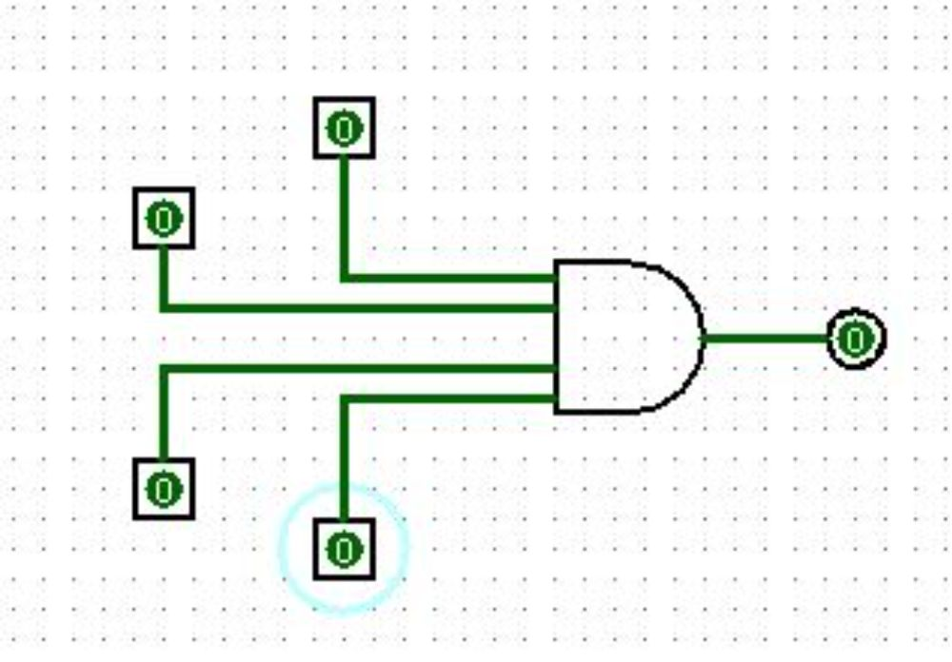
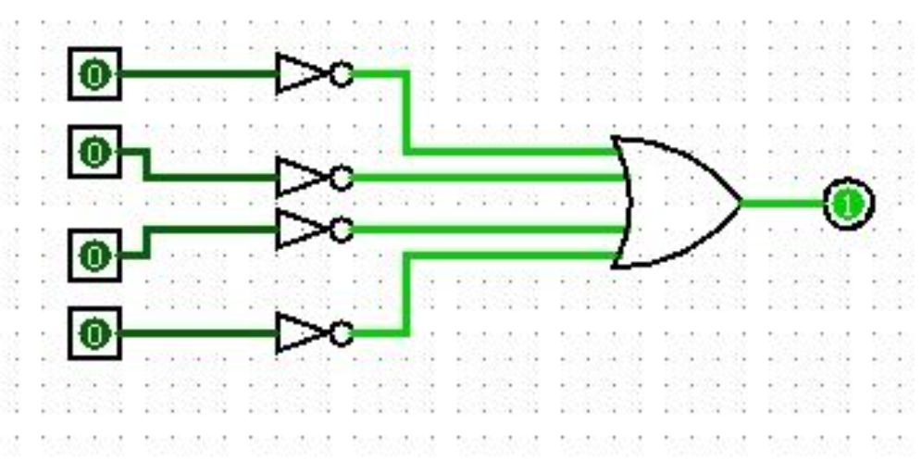
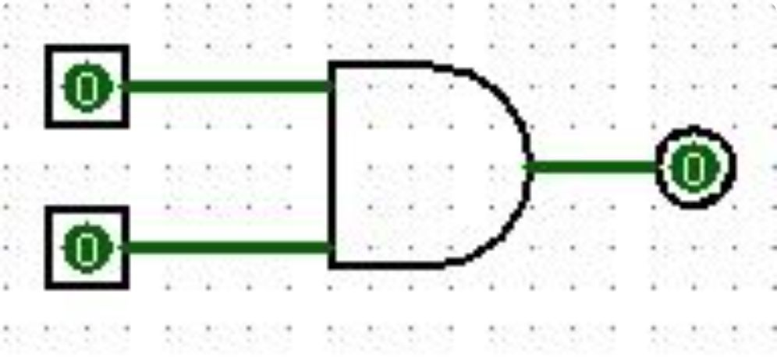
SLIDE 4 OF 7
Boolean Logic Design
Parking Availability
Full Parking Detection
Entry Control
AVAILABLE = ¬S1 + ¬S2 + ¬S3 + ¬S4
Empty = 0 | Full = 1 | = Input
Avaliability = Output
FULL = S1 · S2 · S3 · S4
Full = 1 | Empty = 0
ENTRY = R · AVAILABLE
Avaliable | Request = Input
Entry = Output

Slide 5
SLIDE 5 OF 7
Truth Table & System Verification
Parking Slot Status — Representative Cases
Entry Control — All Combinations
S1 | S2 | S3 | S4 | AVAILABLE | FULL
0 | 0 | 0 | 0 | 1 | 0
0 | 0 | 0 | 1 | 1 | 0
0 | 0 | 1 | 1 | 1 | 0
1 | 1 | 1 | 0 | 1 | 0
1 | 1 | 1 | 1 | 0 | 1
E | AVAILABLE | ENTRY
0 | 0 | 0
0 | 1 | 0
1 | 0 | 0
1 | 1 | 1

Slide 6
Thank You!
Smart Parking System · Combinational Logic Design
System Summary
Boolean Expressions
A fully combinational digital circuit with 5 inputs and 3 outputs, implemented using NOT, OR, and AND gates — no memory elements required.
AVAILABLE = ¬S1 + ¬S2 + ¬S3 + ¬S4
FULL = S1 · S2 · S3 · S4
ENTRY = E · AVAILABLE

