Slide 1
<House Sales prediction in King Country, usa>
<Yuting du>, CPSC 541, PRP 2

Slide 2
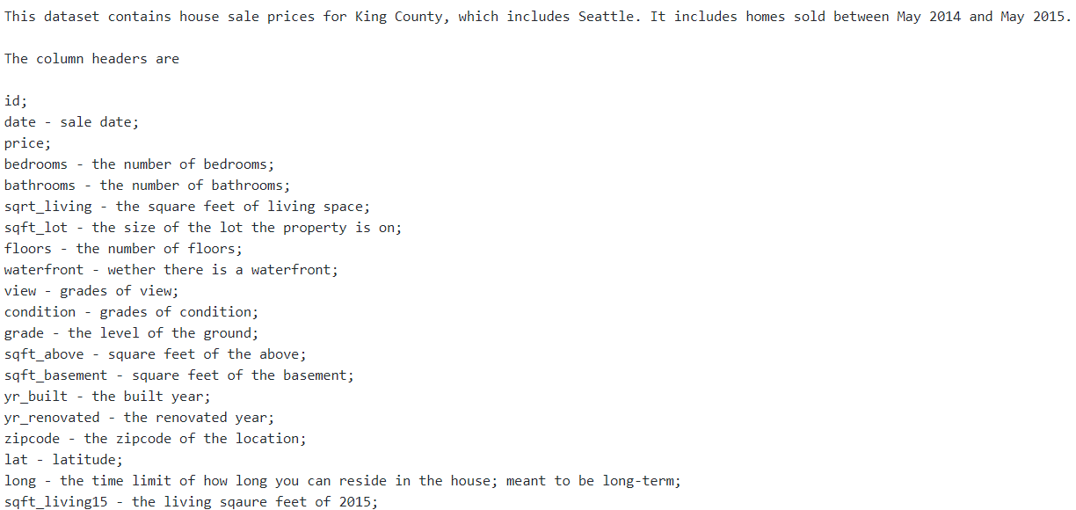
DATA DESCRIPTION & Experimental Design
CPSC 541
<house sales prediction>
# of features - 21
# of treatments -21613 obs
Hypothesis being tested
Prediction of house sales
Data Description

Slide 3
AnAlytical APPROACH
CPSC 541
Model proposal
1. Normalized data; Modified the variables to become more informative;
2. Feature selection (weakly relation; multicollinearity)
3. Model fitting (stepwise; cross validation)
Model evaluation
R-squared; visualization

Slide 4
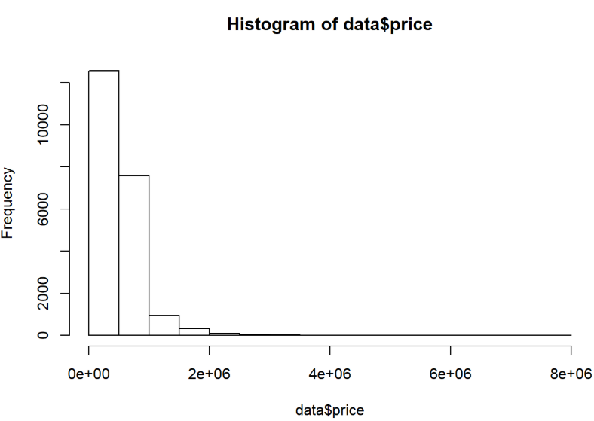
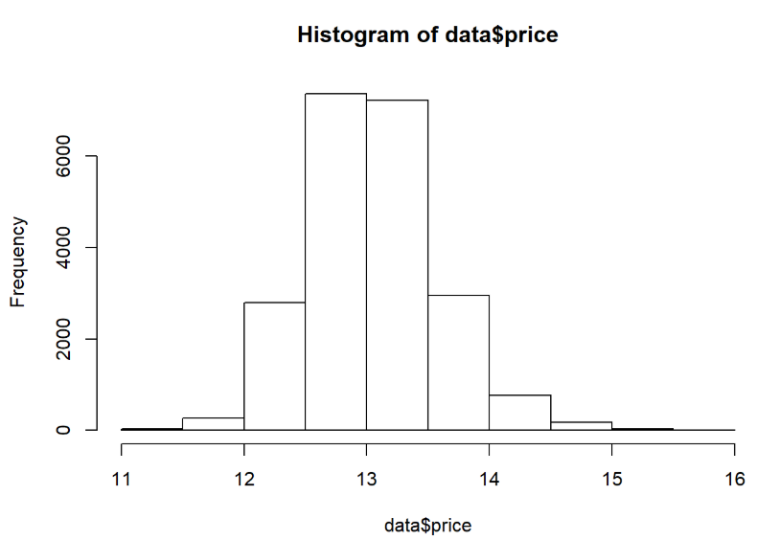
RESULTS
Data normalization (normalizing residuals by transforming data).

Slide 5
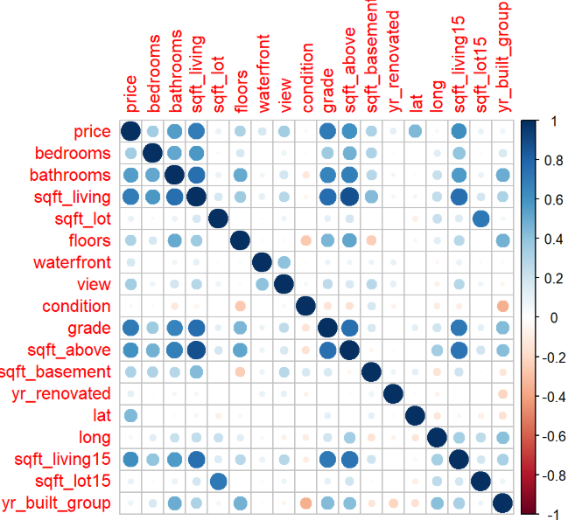
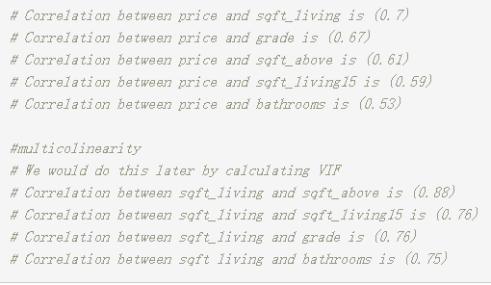
Obtained correlation coefficients for all features;
Removed weakly related ones (<0.4);
Recorded highly related ones (keep) and multicollinearity (need modification)

Slide 6
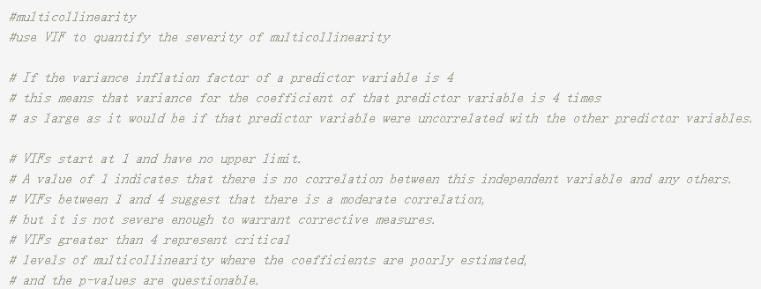
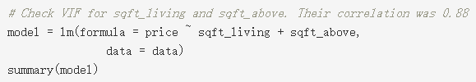
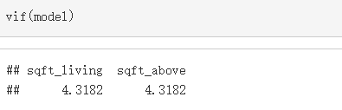
Checked the severity of multicollinearity (VIF)
If VIF < 4, keep both features; if VIF > 4, remove one feature;

Slide 7
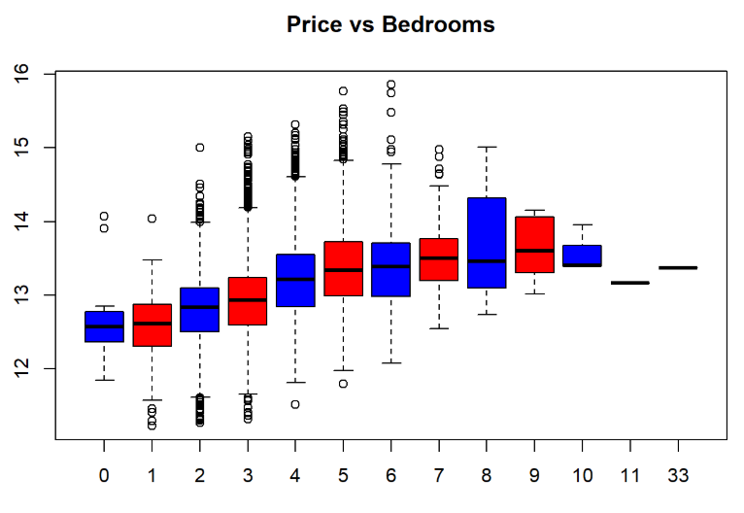
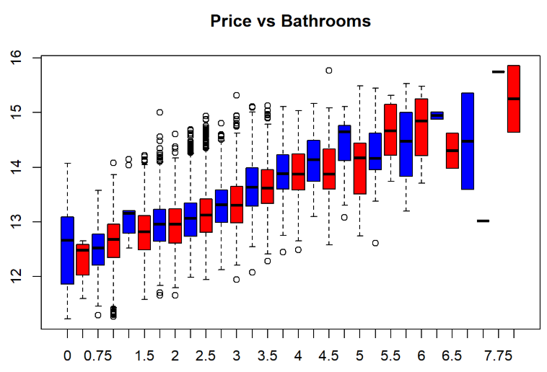
Used boxplots to visualize the linear correlation between price and features;
If a linear relationship present, keep numeric values
If nonlinear relationship present, convert into factor feature

Slide 8
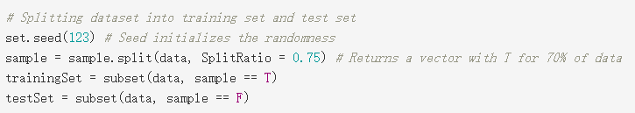
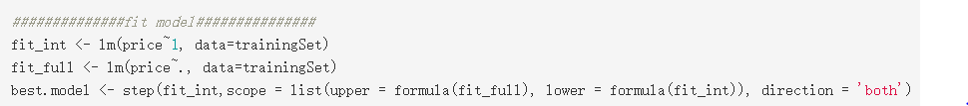
Separated data into training and testing data sets (split_ratio = 0.75);
Used step() to find the best model (lm, might not be a good model)

Slide 9
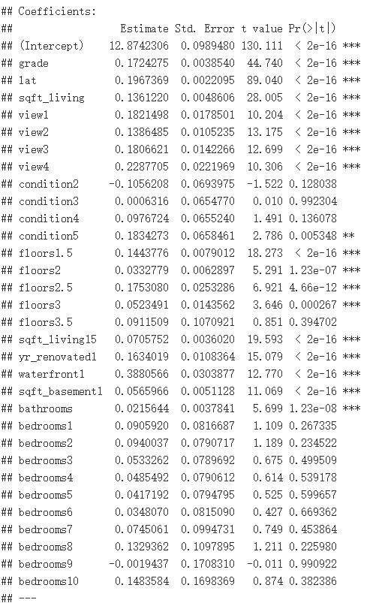

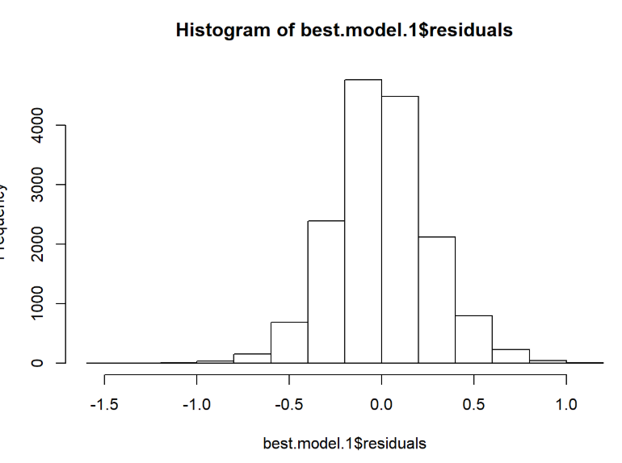
Removed insignificant features (condition, #bedrooms)
Refitted the model
R-squared 0.7442
Plotted residuals distribution (normal distribution)

Slide 10
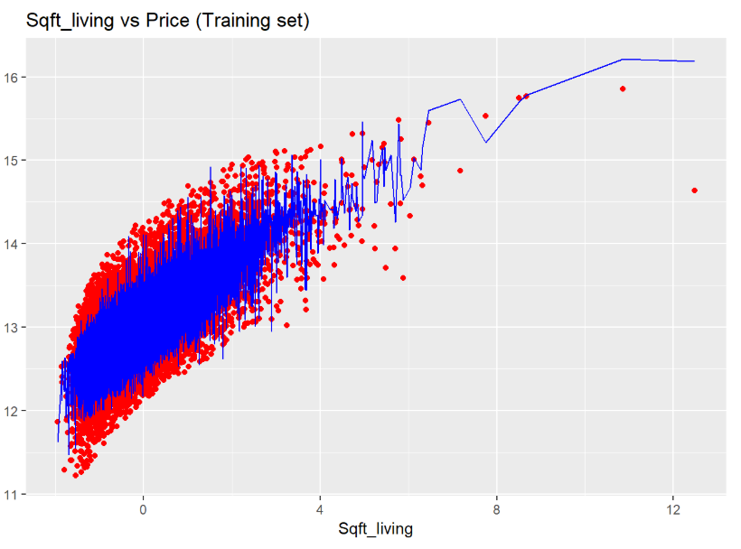
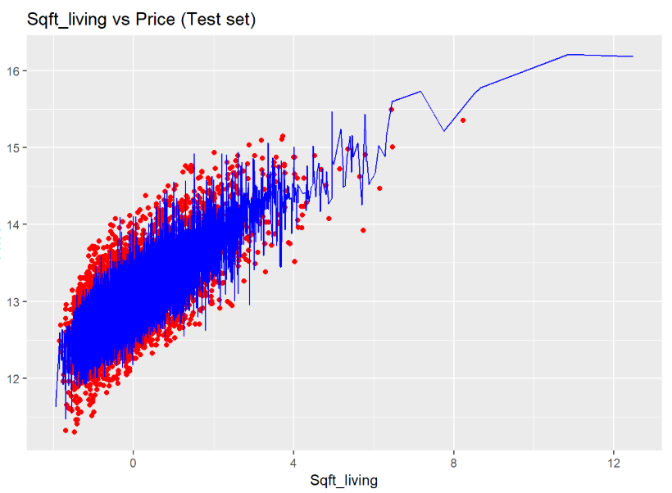
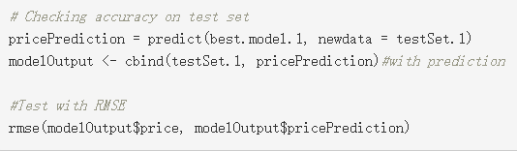

Visualization
MSE

Slide 11
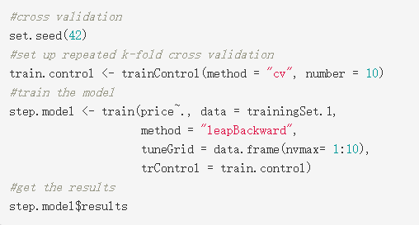

10-fold cross validation
RESULTS
Model R-squared 0.7442
MSE 0.2670

