Slide 1
Trend check in VADE
Algorithm
Marius Zabulionis,
Connect Data Science Product, Automation team
2019.04

Slide 2
What is a trend check
Before delivering new period RMS data to clients it should be validated
  At individual market level
  At individual product level
  For specific facts
“Trend check” is a new period validation algorithm which is assessing if this data is in line with back period data
  Consistent in terms of level
  Reflect seasonal behavior
  Reflect effect of irregular events
Markets*Items*Facts*Periods with data not consistent with back periods are flagged as exceptions

Slide 3
Trend check approach
IDEA
Predict new period data and establish Lower and Upper bounds of tolerance.
Build time series model by Market*Product*Fact.
Validate actual new period data against tolerance bounds.

Slide 4
Time series model

Slide 5
Data/Inputs
Irregular event calendar
  It covers:
      Events/holidays that are present every year but at different time (e.g. Easter, Ramadan, etc.)
      Big events that are happening once (e.g. Olympic games, Football world cup, etc.)
  Event calendar is transformed into dichotomous indicator variables (one variable per event), showing if given event is present in specific period (1) or not (0)
Data of given fact for specific product in specific market in historical periods
  Data of non-additive facts or additive facts for Total country and Total category is used as is
  Data of additive facts for more granular MBDs or products is first transformed into relative form by dividing it by Total country*Total category value in a given period (i.e. calculating contribution or share). This is used to perform validation

Slide 6
concept
Model combines 2 techniques
Regression method
Exponential smoothing (Holt Winters)
Capture effect of irregular events
capture level/trend/ regular seasonality

Slide 7

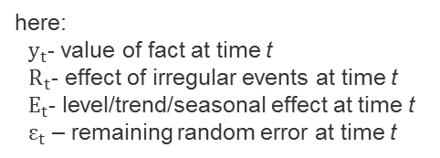
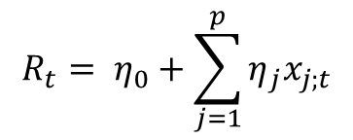
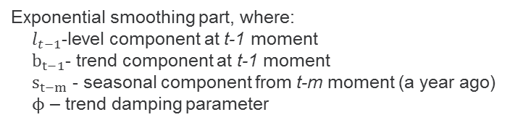
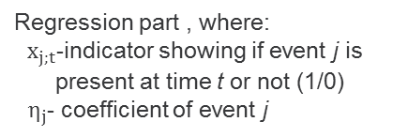

Concept
Additive combination of both methods
$$y_{t}=R_{t}+E_{t}+ε_{t}$$
here:
$y_{t}$- value of fact at time t
$R_{t}$- effect of irregular events at time t
$E_{t}$- level/trend/seasonal effect at time t
$ε_{t}$ – remaining random error at time t
$$R_{t}= η_{0}+\sum_{j=1}^{p}{η_{j}x_{j;t}}$$
$$E_{t}= l_{t−1}+φb_{t−1}+s_{t−m}$$
Regression part , where:
$x_{j;t}$-indicator showing if event j is present at time t or not (1/0)
$η_{j}$- coefficient of event j
Exponential smoothing part, where:
$l_{t−1}$-level component at t-1 moment
$b_{t−1}$- trend component at t-1 moment
$s_{t−m}$ - seasonal component from t-m moment (a year ago)
$ϕ$ – trend damping parameter
Note: if historical periods contain less than 2 years of data regression part and seasonal components are not used - set to 0

Slide 8
Modeling Process
Build regression model
Exclude regression effect from original series
Initialize Exponential smoothing
Run Exponential smoothing
Predict back periods based on combined model
Assess model precision

Slide 9
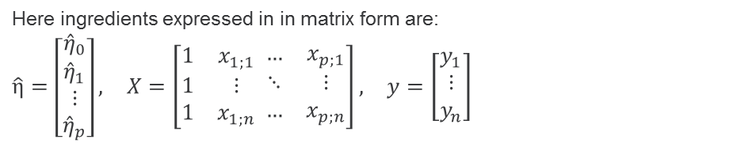

Regression part
Regression model is constructed separately from Exponential smoothing
It use entire history of original data and indicator-transformed calendar.
Regression coefficients by event estimated using ordinary least square method in the following way
Note: if historical periods contain less than 2 years of data regression part is not used – regression coefficients set to 0
$$\hat{η}={\left(X^{T}X\right)}^{−1}X^{T}y$$
Here ingredients expressed in in matrix form are:
$$\begin{matrix}\hat{η}=\left[\begin{matrix}\begin{matrix}{\hat{η}}_{0} \\ {\hat{η}}_{1}\end{matrix} \\ ⋮ \\ {\hat{η}}_{p}\end{matrix}\right], & X=\left[\begin{matrix}1 & x_{1;1} \\ 1 & ⋮ \\ 1 & x_{1;n}\end{matrix} \begin{matrix}… & x_{p;1} \\ ⋱ & ⋮ \\ … & x_{p;n}\end{matrix}\right], & y=\left[\begin{matrix}y_{1} \\ ⋮ \\ y_{n}\end{matrix}\right]\end{matrix}$$

Slide 10
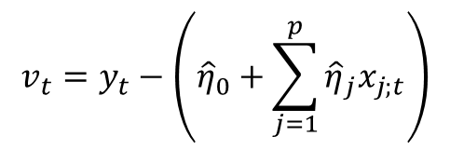
excluding regression effect
In order to remove effect of irregular events from original series, results of regression model are subtracted tom original series.
$$v_{t}=y_{t}−\left({\hat{η}}_{0}+\sum_{j=1}^{p}{{\hat{η}}_{j}x_{j;t}}\right)$$

Slide 11
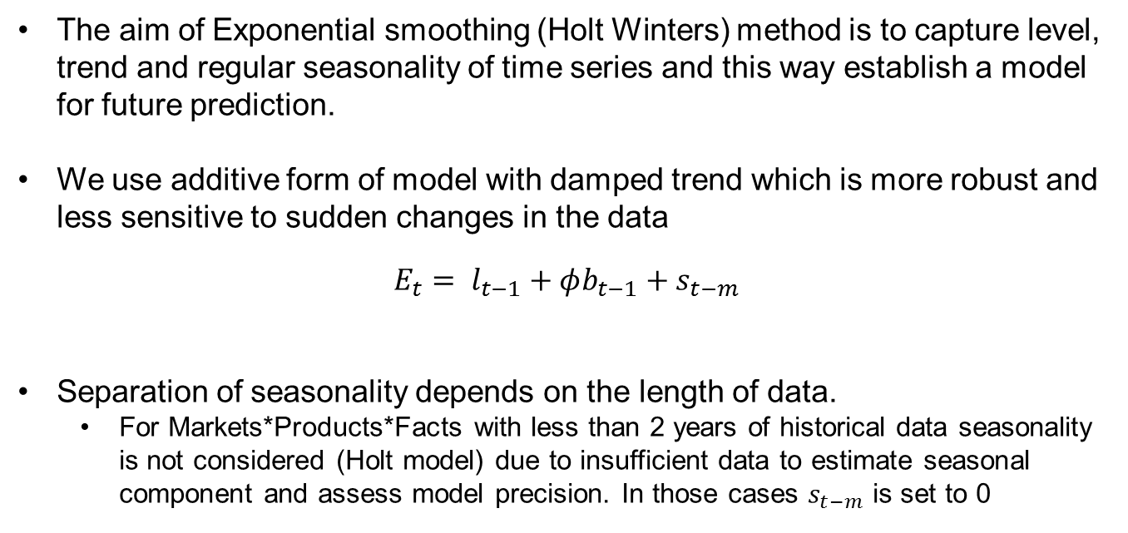
Exponential smoothing
The aim of Exponential smoothing (Holt Winters) method is to capture level, trend and regular seasonality of time series and this way establish a model for future prediction.
We use additive form of model with damped trend which is more robust and less sensitive to sudden changes in the data
$$E_{t}= l_{t−1}+φb_{t−1}+s_{t−m}$$
Separation of seasonality depends on the length of data.
  For Markets*Products*Facts with less than 2 years of historical data seasonality is not considered (Holt model) due to insufficient data to estimate seasonal component and assess model precision. In those cases $s_{t−m}$ is set to 0

Slide 12
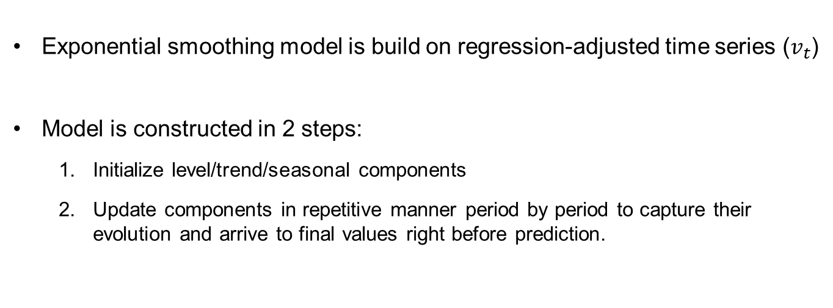
Exponential smoothing
  Exponential smoothing model is build on regression-adjusted time series ($v_{t}$)
Model is constructed in 2 steps:
  Initialize level/trend/seasonal components
  Update components in repetitive manner period by period to capture their evolution and arrive to final values right before prediction.

Slide 13
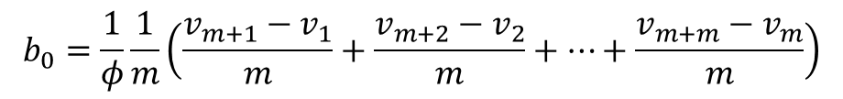

Exponential smoothing - initialization
  Initial trend
  By default initial trend calculation is using first 2 years of data
  If 2 years are not available initial trend calculation is simplified to:
$$b_{0}=\frac{1}{φ}\frac{1}{m}\left(\frac{v_{m+1}−v_{1}}{m}+\frac{v_{m+2}−v_{2}}{m}+…+\frac{v_{m+m}−v_{m}}{m}\right)$$
here:
$m$- number of periods in one year
$φ$ – is a damping parameter. By default it is set to 0.8
$$b_{0}=\frac{1}{φ}\left(v_{2}−v_{1}\right)$$

Slide 14
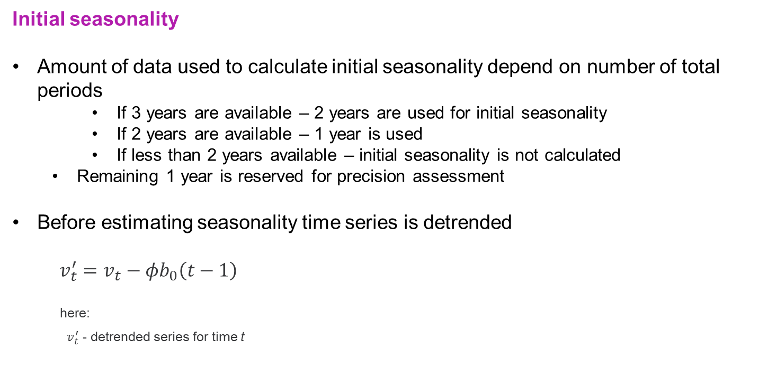
Exponential smoothing - initialization
  Initial seasonality
  Amount of data used to calculate initial seasonality depend on number of total periods
      If 3 years are available – 2 years are used for initial seasonality
      If 2 years are available – 1 year is used
      If less than 2 years available – initial seasonality is not calculated
    Remaining 1 year is reserved for precision assessment
  Before estimating seasonality time series is detrended
  $$v_{t}^{′}=v_{t}−{φb}_{0}\left(t−1\right)$$
here:
$v_{t}^{′}$ - detrended series for time t

Slide 15
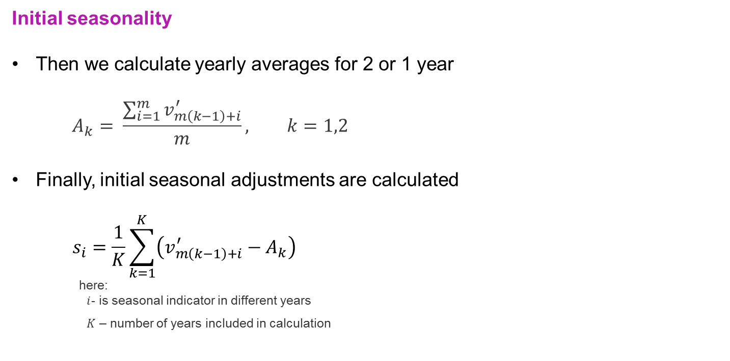
Exponential smoothing - initialization
  Initial seasonality
  Then we calculate yearly averages for 2 or 1 year
$$A_{k}= \frac{\sum_{i=1}^{m}{v_{m\left(k−1\right)+i}^{′}}}{m}, k=1,2$$
  Finally, initial seasonal adjustments are calculated
  $$s_{i}=\frac{1}{K}\sum_{k=1}^{K}{\left(v_{m\left(k−1\right)+i}^{′}−A_{k}\right)}$$
here:
$i$- is seasonal indicator in different years
$K$ – number of years included in calculation

Slide 16
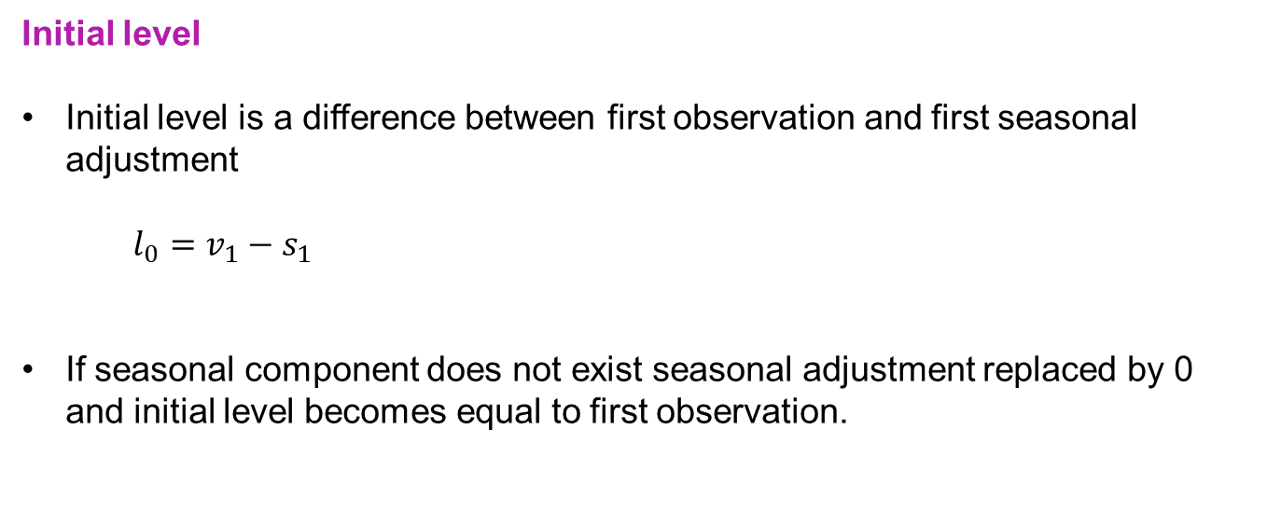
Exponential smoothing - initialization
  Initial level
  Initial level is a difference between first observation and first seasonal adjustment
$$l_{0}=v_{1}−s_{1}$$
  If seasonal component does not exist seasonal adjustment replaced by 0 and initial level becomes equal to first observation.

Slide 17
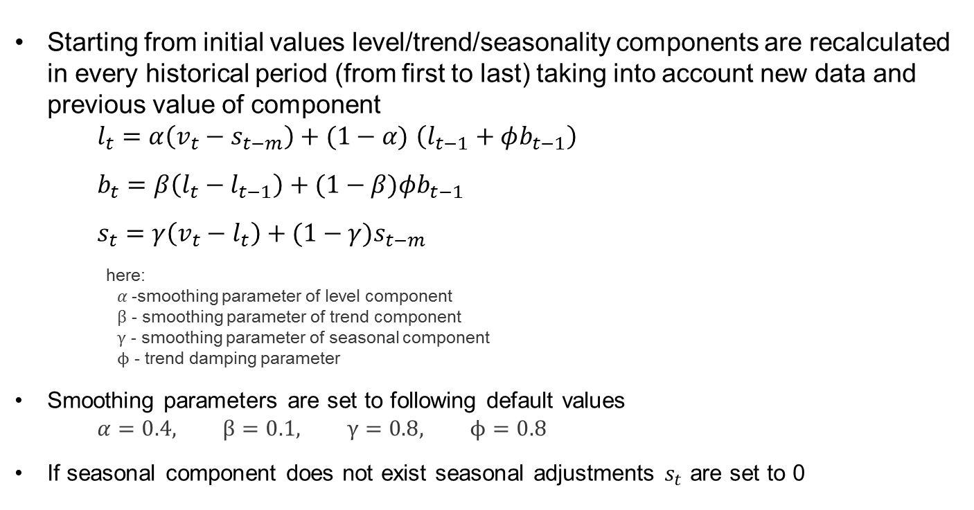
Exponential smoothing - recalculation
  Starting from initial values level/trend/seasonality components are recalculated in every historical period (from first to last) taking into account new data and previous value of component
$l_{t}=α\left(v_{t}−s_{t−m}\right)+(1−α)$ $\left(l_{t−1}+φb_{t−1}\right)$
$$b_{t}=β\left(l_{t}−l_{t−1}\right)+(1−β)φb_{t−1}$$
$$s_{t}=γ\left(v_{t}−l_{t}\right)+(1−γ)s_{t−m}$$
here:
$α$-smoothing parameter of level component
$β$ - smoothing parameter of trend component
$γ$ - smoothing parameter of seasonal component
$ϕ$ - trend damping parameter
  Smoothing parameters are set to following default values
$$α=0.4, β=0.1, γ=0.8, ϕ=0.8$$
  If seasonal component does not exist seasonal adjustments $s_{t}$ are set to 0

Slide 18
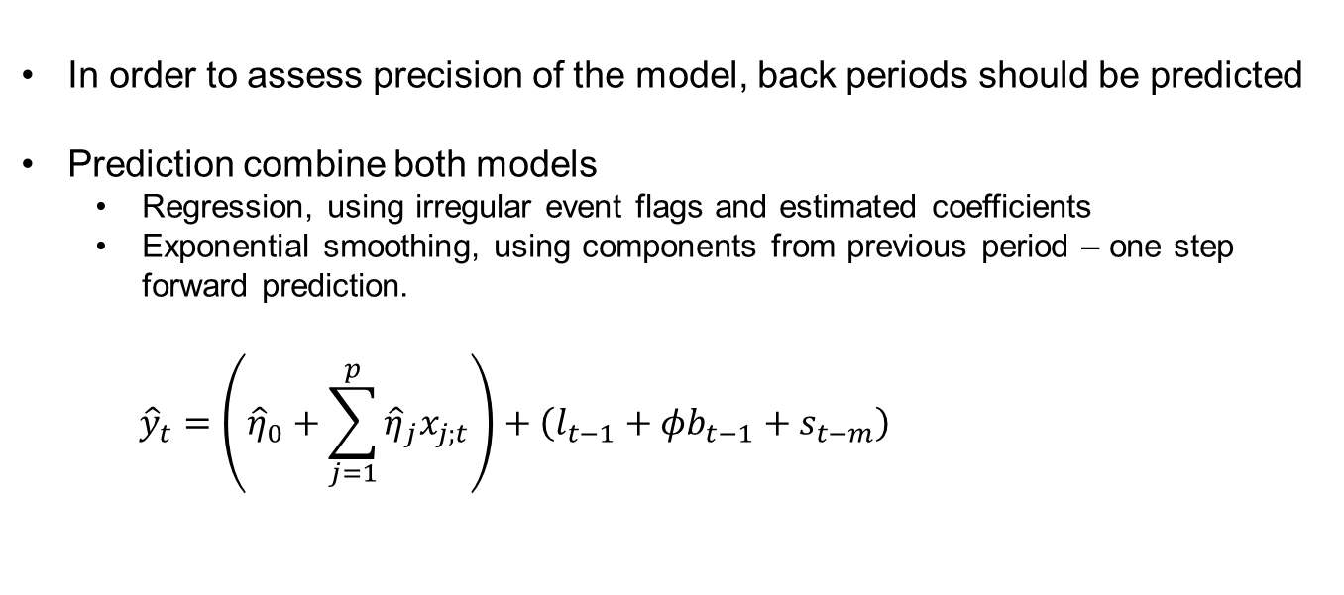
Back period prediction
  In order to assess precision of the model, back periods should be predicted
  Prediction combine both models
    Regression, using irregular event flags and estimated coefficients
    Exponential smoothing, using components from previous period – one step forward prediction.
$${\hat{y}}_{t}=\left({\hat{η}}_{0}+\sum_{j=1}^{p}{{\hat{η}}_{j}x_{j;t}}\right)+\left(l_{t−1}+φb_{t−1}+s_{t−m}\right)$$

Slide 19
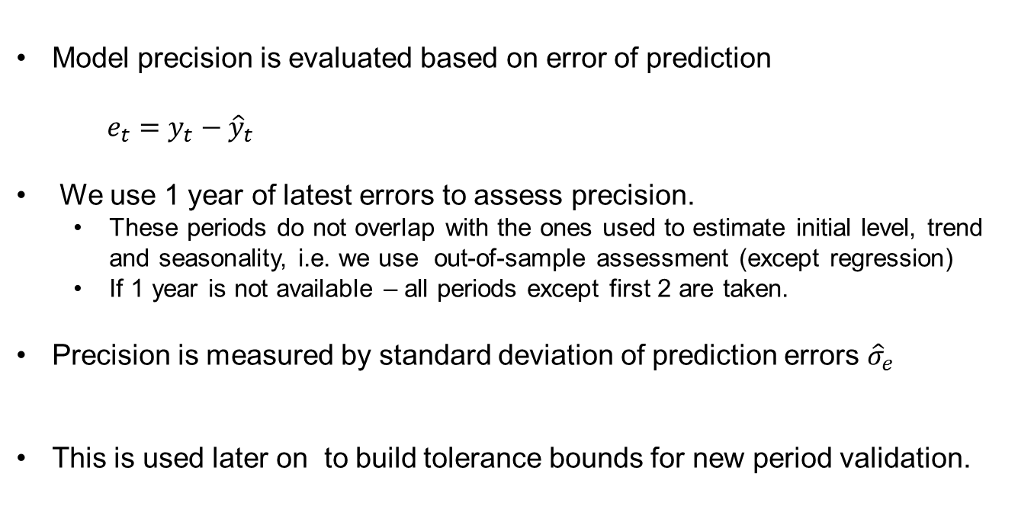
Model precision assessment
  Model precision is evaluated based on error of prediction
  $$e_{t}=y_{t}−{\hat{y}}_{t}$$
  We use 1 year of latest errors to assess precision.
    These periods do not overlap with the ones used to estimate initial level, trend and seasonality, i.e. we use out-of-sample assessment (except regression)
    If 1 year is not available – all periods except first 2 are taken.
  Precision is measured by standard deviation of prediction errors ${\hat{σ}}_{e}$
  This is used later on to build tolerance bounds for new period validation.

Slide 20
Tolerance bound construction and new data validation

Slide 21
Data validation Process
Predict new periods
Construct tolerance bounds
Validate new period data

Slide 22
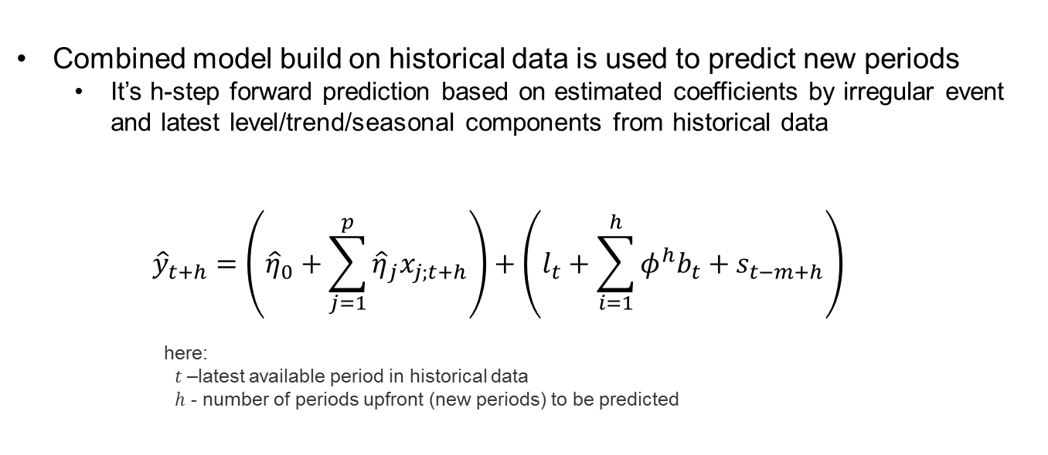
New period prediction
  Combined model build on historical data is used to predict new periods
    It’s h-step forward prediction based on estimated coefficients by irregular event and latest level/trend/seasonal components from historical data
  $${\hat{y}}_{t+h}=\left({\hat{η}}_{0}+\sum_{j=1}^{p}{{\hat{η}}_{j}x_{j;t+h}}\right)+\left(l_{t}+\sum_{i=1}^{h}{φ^{h}b_{t}}+s_{t−m+h}\right)$$
here:
$t$–latest available period in historical data
$h$ - number of periods upfront (new periods) to be predicted

Slide 23
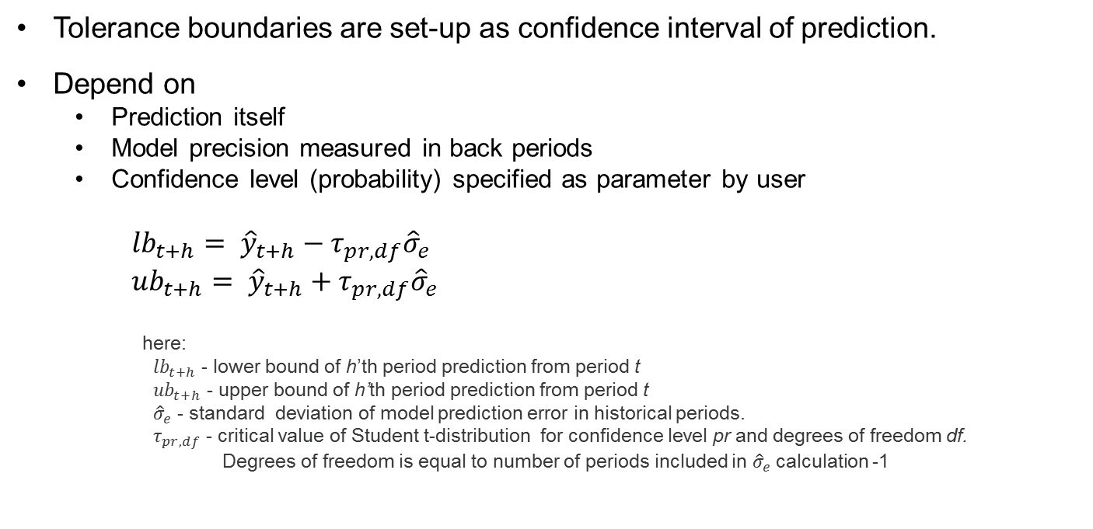
Tolerance boundary set-up
  Tolerance boundaries are set-up as confidence interval of prediction.
  Depend on
    Prediction itself
    Model precision measured in back periods
    Confidence level (probability) specified as parameter by user
$${lb}_{t+h}= {\hat{y}}_{t+h}−τ_{pr,df}{\hat{σ}}_{e}$$
$${ub}_{t+h}= {\hat{y}}_{t+h}+τ_{pr,df}{\hat{σ}}_{e}$$
here:
${lb}_{t+h}$ - lower bound of h’th period prediction from period t
${ub}_{t+h}$ - upper bound of h’th period prediction from period t
${\hat{σ}}_{e}$ - standard deviation of model prediction error in historical periods.
$τ_{pr,df}$ - critical value of Student t-distribution for confidence level pr and degrees of freedom df.
Degrees of freedom is equal to number of periods included in ${\hat{σ}}_{e}$calculation -1

Slide 24
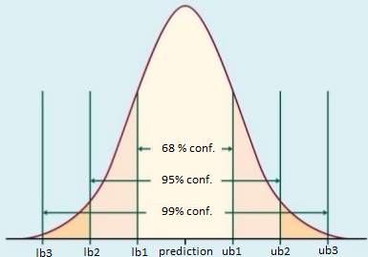
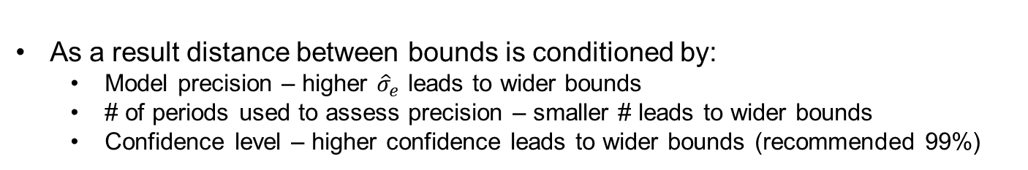
Tolerance boundary set-up
  As a result distance between bounds is conditioned by:
    Model precision – higher ${\hat{σ}}_{e}$ leads to wider bounds
    # of periods used to assess precision – smaller # leads to wider bounds
    Confidence level – higher confidence leads to wider bounds (recommended 99%)

Slide 25
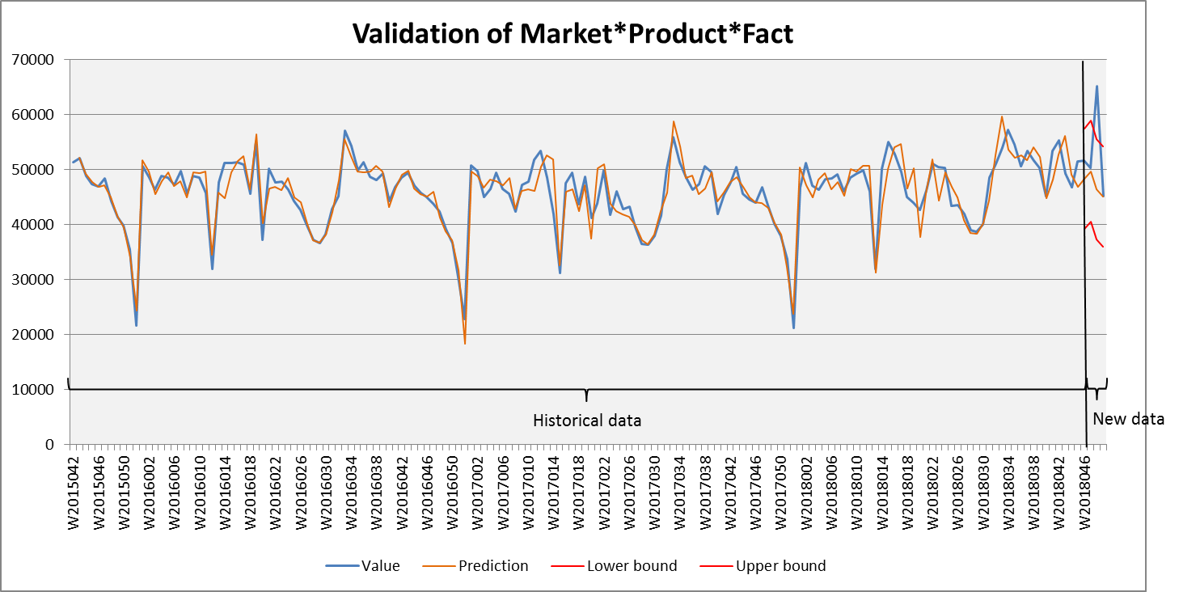
New period data validation
  Real observed data in new periods compared to established upper and lower tolerance boundaries
    Observed values outside boundaries are considered as exceptions
Exception

Slide 26
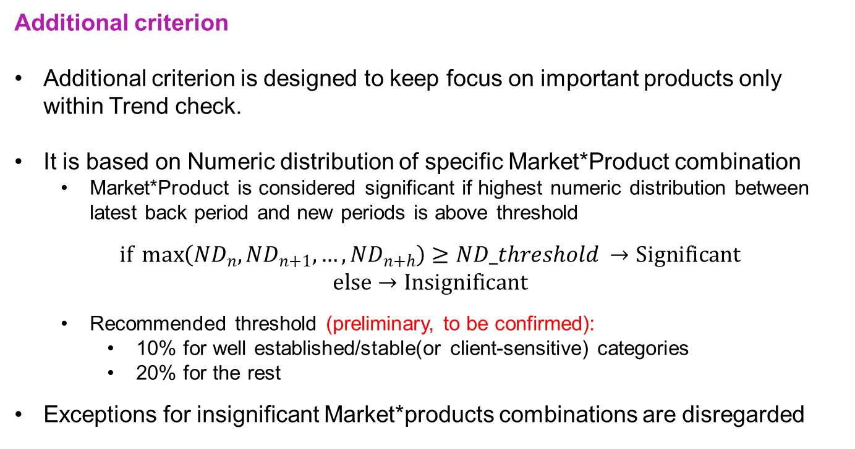
New period data validation
  Additional criterion
  Additional criterion is designed to keep focus on important products only within Trend check.
  It is based on Numeric distribution of specific Market*Product combination
    Market*Product is considered significant if highest numeric distribution between latest back period and new periods is above threshold
$if\max\left({ND}_{n},{ND}_{n+1},…,{ND}_{n+h}\right)≥ND_threshold →Significant$
$$else→Insignificant$$
    Recommended threshold (preliminary, to be confirmed):
      10% for well established/stable(or client-sensitive) categories
      20% for the rest
  Exceptions for insignificant Market*products combinations are disregarded

Slide 27
Excel - Example
  Algorithm replicated in Excel

Slide 28
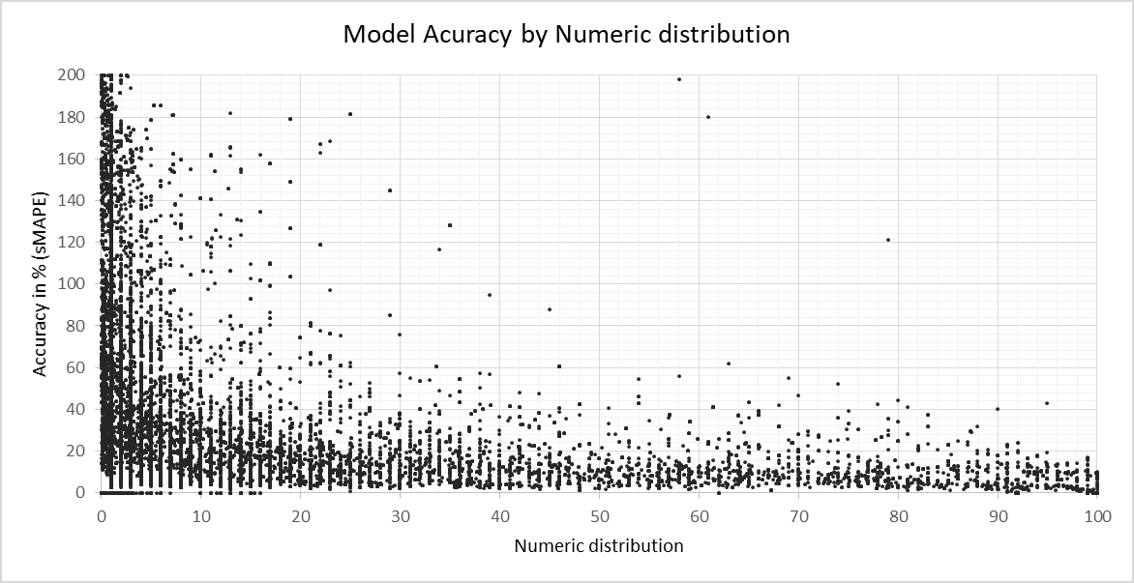
Testing results
Model accuracy based on data of 13 categories:
Details: Summary:
Products with Numeric distribution above 10% have much better accuracy than small ones
 | sMAPE*
Product level | ND > 10% | ND < 10% | All
Category | 6% |  | 6%
Manufacturer | 11% | 18% | 15%
Brand | 12% | 33% | 20%
Sub-Brand | 13% | 38% | 24%
Item | 17% | 42% | 32%
All | 14% | 37% | 26%
* Median of symmetric MAPE for products
grouped by Product hierarchy
grouped by Numeric distribution level

