Slide 1
Final Presentation (INFSCI 2415)
Diamonds Plots
Yutong Tang

Slide 2
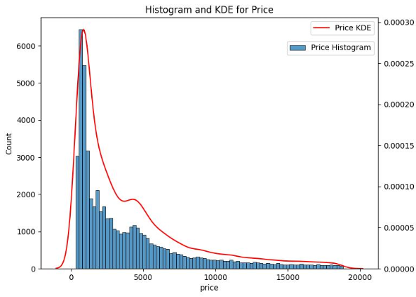
Histogram and KDE for Diamond Price
Most Common Price Range: The tallest bar indicates the most common price range, which appears to be between $0 to $1000, suggesting that most of the diamonds in this dataset are at the lower end of the price spectrum.
High-Price Rarity: The decreasing height of bars as the price increases indicates that higher-priced diamonds are less common.
Smoothness of KDE: The KDE (Kernel Density Estimate,) line provides a smooth approximation of the histogram, helping to visualize the probability density of diamonds across different prices.

Slide 3
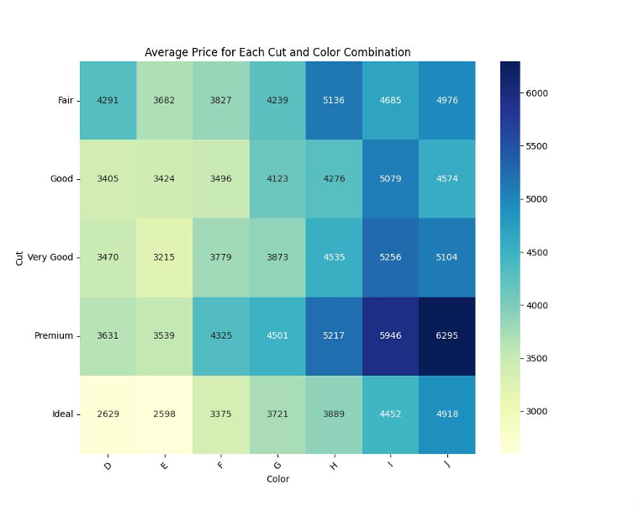
Heatmap of average price of cut & color combination
Color Gradient: The colors range from light green (lower prices) to dark blue (higher prices), representing the average price for each combination of cut and color.
Cut Quality: The 'Ideal' cut typically has lower average prices across all colors, which might seem counterintuitive as 'Ideal' cut is generally considered to be of higher quality. This could be due to other factors such as carat weight, clarity, or market availability affecting the average price.
Price Range: The premium cut diamonds, particularly in the higher color grades (G through I), show the highest average prices on this heatmap.
Color Impact: The variation in color from D to J shows a fluctuating pattern of prices with certain color grades like H and I consistently commanding higher average prices across various cuts.
Inconsistencies: While one might expect a gradual change in prices from fair to ideal cuts, the heatmap shows inconsistencies.

Slide 4
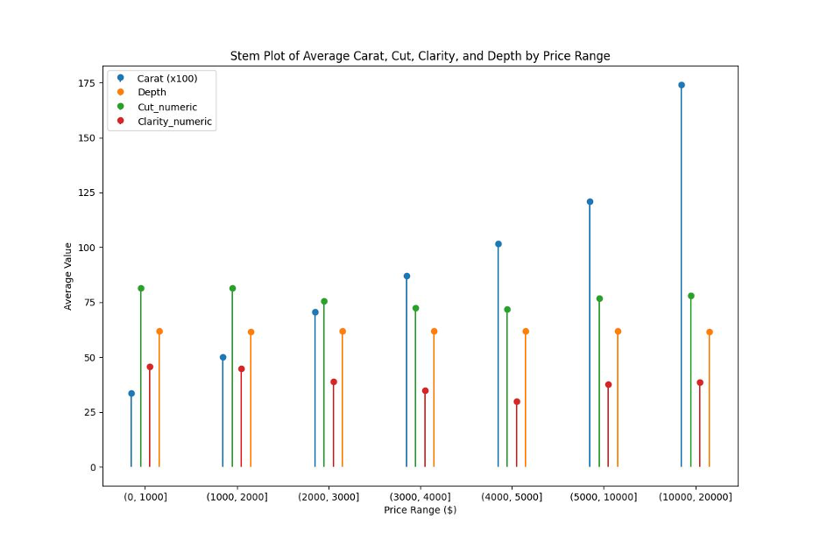
Stem plot of Average Carat/Cut/ Clarity/Depth by Price Range
Carat Size: Carat size increases with price. The largest average carat size is in the highest price range.
Depth: Depth varies less across price ranges and remains relatively stable.
Cut Quality: Cut quality, on average, does not show a clear trend with price range, suggesting that cut may be less of a price determinant within this dataset.
Clarity: Clarity shows a slight increase with price but is not as pronounced as carat size.

Slide 5
Thank you!
Yutong Tang
Data From: https://www.kaggle.com/datasets/joebeachcapital/diamonds
Source Code: https://github.com/Yutong89/INFSCI_2415_Final

