Slide 1
Super Learning (SL) and sl3
Rachael Phillips
rachaelvphillips@berkeley.edu
ENAR 2023
Notes:
Explain R6 in terms of how they will interact with it, eg Lrnr_rf$train vs randomForest
what you can do with trained learners, eg predict, importance,
S4 methods bundled at class level, eg predict.randomForest, instead of class level

Slide 2
Overview of Super Learner

Slide 3
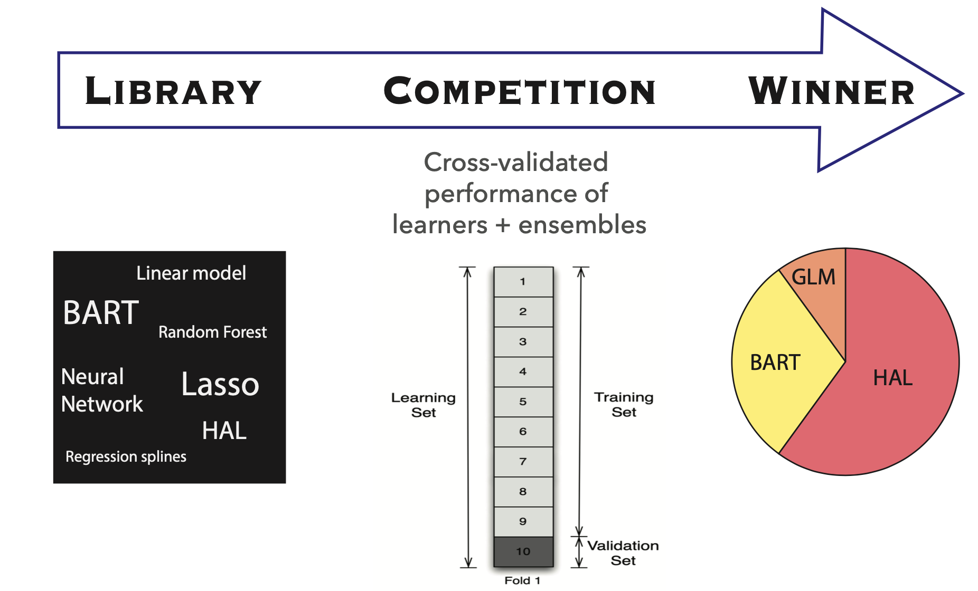
Super Learner (SL)
Notes:
Advantages
Rich search over solution space
Lessen reliance on model assumptions mitigates model misspecification bias
Aggregate weak learners = strong learner
Cross validation has optimality properties

Slide 4
Super Learner (SL)
Notes:
Advantages
Rich search over solution space
Lessen reliance on model assumptions mitigates model misspecification bias
Aggregate weak learners = strong learner
Cross validation has optimality properties

Slide 5
Super Learner (SL)
Notes:
Advantages
Rich search over solution space
Lessen reliance on model assumptions mitigates model misspecification bias
Aggregate weak learners = strong learner
Cross validation has optimality properties

Slide 6
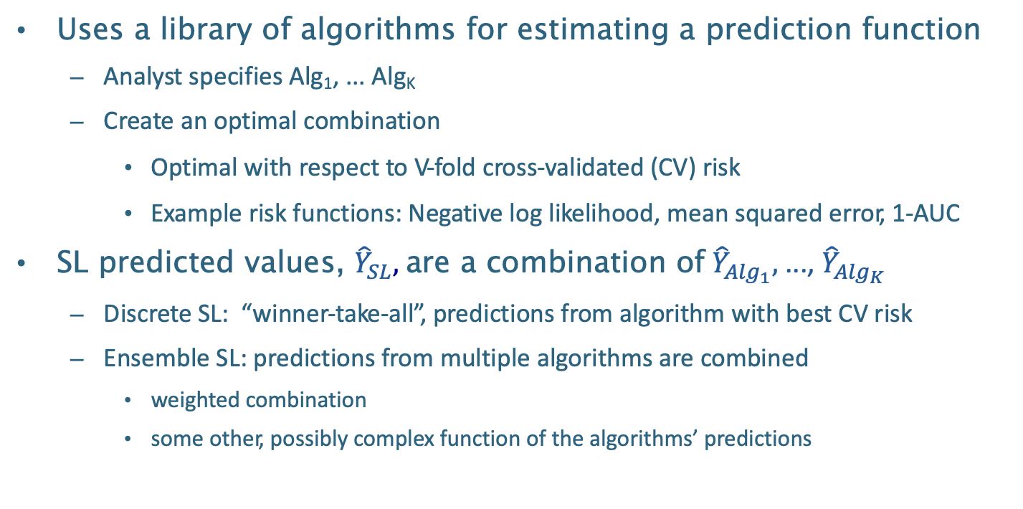
Super Learner (SL)
Uses a library of algorithms for estimating a prediction function
Analyst specifies Alg₁, ... Alg_{K}
Create an optimal combination
Optimal with respect to V-fold cross-validated (CV) risk
Example risk functions: Negative log likelihood, mean squared error, 1-AUC
SL predicted values, ${\hat{Y}}_{SL},$ are a combination of ${\hat{Y}}_{{Alg}_{1}},$ ..., ${\hat{Y}}_{{Alg}_{K}}$
Discrete SL: “winner-take-all”, predictions from algorithm with best CV risk
Ensemble SL: predictions from multiple algorithms are combined
weighted combination
some other, possibly complex function of the algorithms’ predictions
Notes:
Advantages
Rich search over solution space
Lessen reliance on model assumptions mitigates model misspecification bias
Aggregate weak learners = strong learner
Cross validation has optimality properties

Slide 7
Defining prediction problem for estimation
Notes:
Our method for estimation should reflect the choice of the statistical target parameter.
For example, to learn about the conditional mean of disease incidence, we could estimate the joint conditional distribution of regional characteristics and disease incidence, which would imply an estimate of the conditional mean. However, such a procedure is not targeted towards the goal of estimating the conditional mean.
To ensure parsimony between our estimation procedure and our target parameter, we introduce the notion of a loss function.

Slide 8
Defining prediction problem for estimation
A performance metric quantifies the success of an estimated prediction function (i.e., a trained algorithm)
Expectation of the squared error loss / MSE
The area under the ROC curve, AUC
Notes:
Our method for estimation should reflect the choice of the statistical target parameter.
For example, to learn about the conditional mean of disease incidence, we could estimate the joint conditional distribution of regional characteristics and disease incidence, which would imply an estimate of the conditional mean. However, such a procedure is not targeted towards the goal of estimating the conditional mean.
To ensure parsimony between our estimation procedure and our target parameter, we introduce the notion of a loss function.

Slide 9
Defining prediction problem for estimation
A performance metric quantifies the success of an estimated prediction function (i.e., a trained algorithm)
The chosen metric needs to be optimized (minimized or maximized) by the true prediction function
This guarantees that the evaluation corresponds to the trained algorithm's success in approximating the true prediction function
Notes:
Our method for estimation should reflect the choice of the statistical target parameter. For example, to learn about the conditional mean of disease incidence, we could estimate the joint conditional distribution of regional characteristics and disease incidence, which would imply an estimate of the conditional mean. However, such a procedure is not targeted towards the goal of estimating the conditional mean. To ensure parsimony between our estimation procedure and our target parameter, we introduce the notion of a loss function.

Slide 10
Defining prediction problem for estimation
A performance metric quantifies the success of an estimated prediction function (i.e., a trained algorithm)
The chosen metric needs to be optimized (minimized or maximized) by the true prediction function
This guarantees that the evaluation corresponds to the trained algorithm's success in approximating the true prediction function
The chosen metric should align with the intended real-world use of the predictions
Notes:
Our method for estimation should reflect the choice of the statistical target parameter. For example, to learn about the conditional mean of disease incidence, we could estimate the joint conditional distribution of regional characteristics and disease incidence, which would imply an estimate of the conditional mean. However, such a procedure is not targeted towards the goal of estimating the conditional mean. To ensure parsimony between our estimation procedure and our target parameter, we introduce the notion of a loss function.

Slide 11
Why super learner (SL)?
No need to select the one “right” strategy
Can consider diverse set
Grounded in statistical optimality theory
Pre-specified also flexible
Mitigate statistical model misspecification
Asymptotic linearity of an accompanying estimator
Notes:
Alleviates concerns over selecting the one “right” algorithm while benefiting from considering a diverse set making collabs satisfied
Grounded in optimality theory that guarantees for large sample sizes the SL will perform as well as possible, given the algorithms in the library
Pre-specified and flexible
Conveying knowledge about DGP through the library can mitigate statistical model misspecification
Asymptotic linearity of estimators that rely on fast convergence of nuisance parameters

Slide 12
What does user specify for SL?
Measure of performance
Cross-validation scheme
Diverse library of candidate learners

Slide 13
Super learner
What are you learning from the data? What do you want to optimize for?
Performance measure should be valid (i.e., optimized by underlying target), bounded, corresponds to desired goal
Specify
Measure of performance
Cross-validation scheme
Diverse library of candidate learners

Slide 14
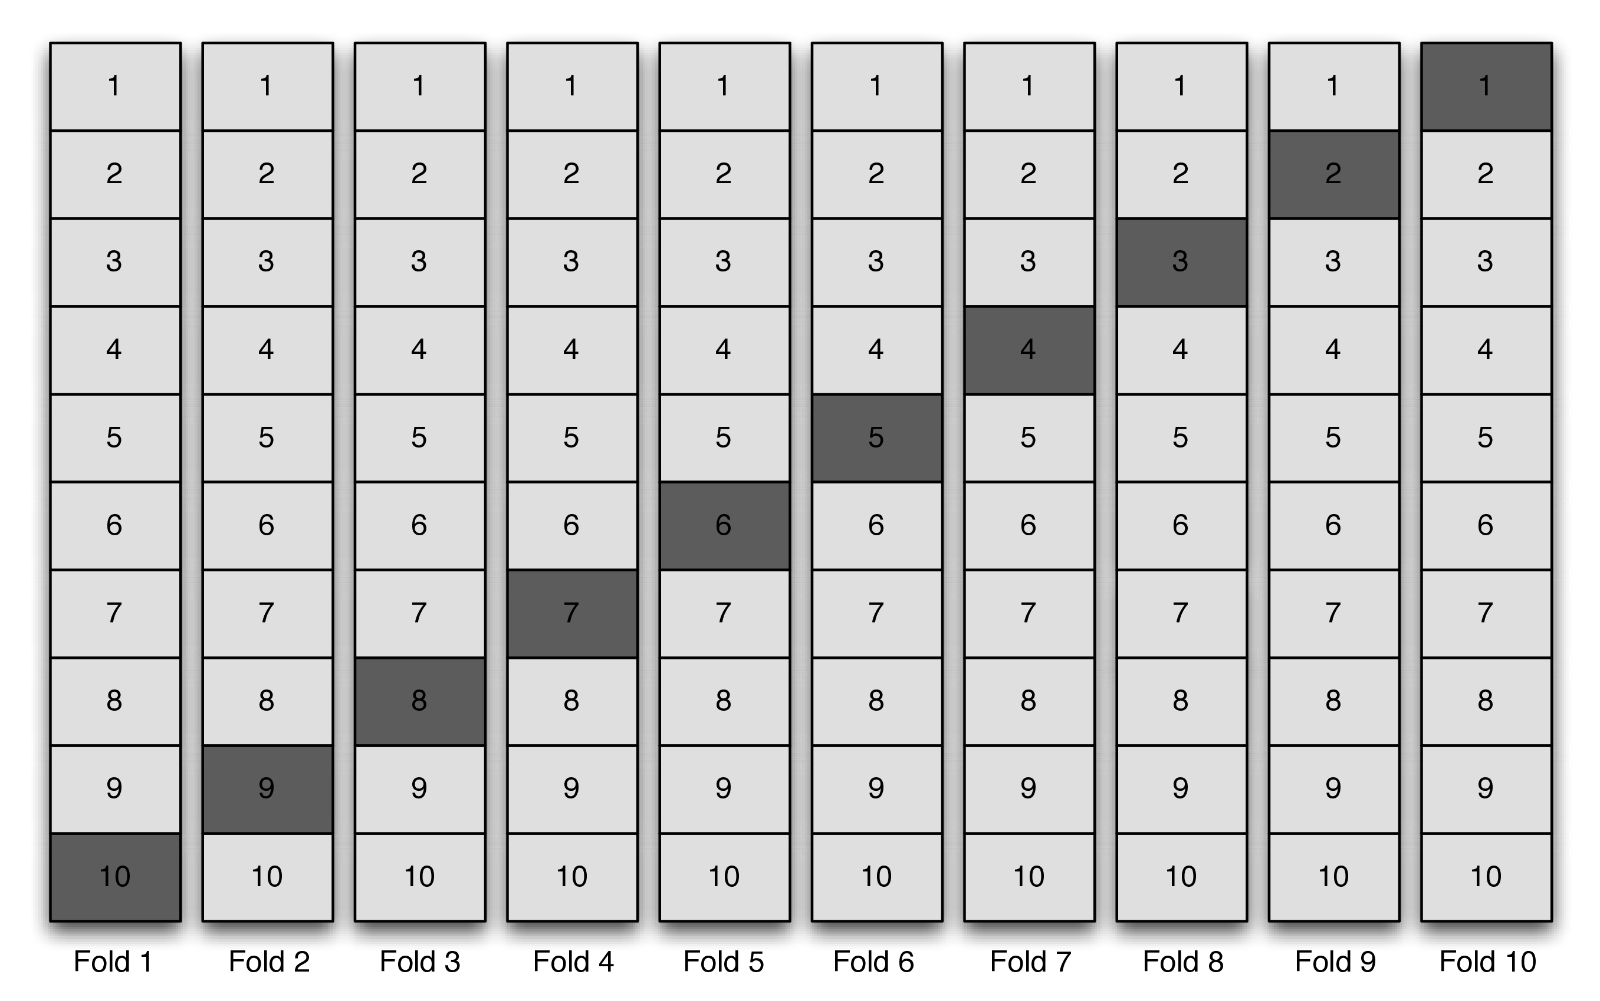
Super learner
e.g. V-fold cross-validation
Specify
Measure of performance
Cross-validation scheme
Diverse library of candidate learners

Slide 15
Super learner
e.g. rolling origin cross-validation
(cross-validation for time series data)
Specify
Measure of performance
Cross-validation scheme
Diverse library of candidate learners

Slide 16
Overview of the algorithm
Make metalevel dataset with cross-validated candidate predictions and validation set outcomes
Fit meta-learner to the metalevel dataset
Full-fit candidates
Define the SL

Slide 17
Practical considerations for specifying SL
Rachael V Phillips, Mark J van der Laan, Hana Lee, Susan Gruber, Practical considerations for specifying a super learner, International Journal of Epidemiology, 2023.
https://doi.org/10.1093/ije/dyad023

Slide 18
sl3 SL software package in tlverse

Slide 19
Introductory overview of sl3
Task
Learners
Functions

Slide 20
Introductory overview of sl3
Task
Learners
Functions

Slide 21
Tasks in sl3
What is the prediction task?
data, covariates, outcome,
weights, id, outcome_type,offset, drop_missing_outcome, folds
https://tlverse.org/sl3/reference/sl3_Task.html

Slide 22
Introductory overview of sl3
Task
Learners
Functions

Slide 23
Learners in sl3
How to estimate prediction function?
https://tlverse.org/sl3/reference/index.html#sl-learners

Slide 24
Exercise: Training learner with sl3 wrapper versus package’s function
Prediction tasks in sl3
Comparison of R6 methods and S3 methods
sl3 R package function, Lrnr_earth
earth R package function, earth
Looking up learners, the sl3 wrapper, and arguments
Modifying learner parameters
Data example: Collaborative Perinatal Project (CPP) was a multisite prospective cohort study designed to identify the effects of complications during either pregnancy or the perinatal period on birth and child outcomes.

Slide 25
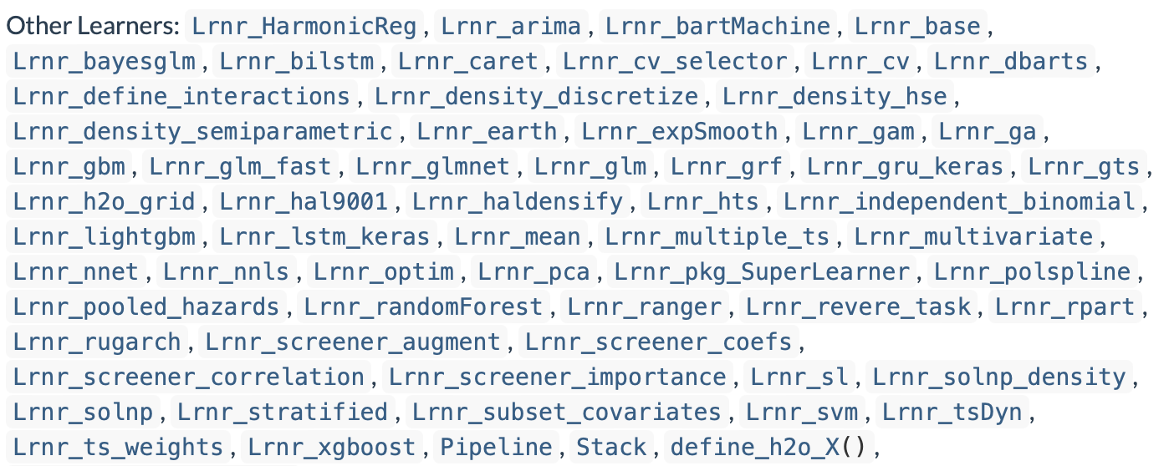
Learners in sl3
How to estimate prediction function?
https://tlverse.org/sl3/reference/index.html#sl-learners

Slide 26
Learners in sl3
How to estimate prediction function?
https://tlverse.org/sl3/reference/index.html#sl-learners

Slide 27
Learners in sl3
How to estimate prediction function?
https://tlverse.org/sl3/reference/index.html#sl-learners

Slide 28
Learners in sl3
How to estimate prediction function?
https://tlverse.org/sl3/reference/index.html#sl-learners

Slide 29
Learners in sl3
How to estimate prediction function?
https://tlverse.org/sl3/reference/index.html#sl-learners

Slide 30
Learners in sl3
How to estimate prediction function?
https://tlverse.org/sl3/reference/index.html#sl-learners

Slide 31
Learners in sl3
How to estimate prediction function?
https://tlverse.org/sl3/reference/index.html#sl-learners

Slide 32
Learners in sl3
How to estimate prediction function?
https://tlverse.org/sl3/reference/index.html#sl-learners

Slide 33
Learners in sl3
How to estimate prediction function?
https://tlverse.org/sl3/reference/index.html#sl-learners

Slide 34
Learners in sl3
How to estimate prediction function?
https://tlverse.org/sl3/reference/index.html#sl-learners

Slide 35
Learners in sl3
How to estimate prediction function?
https://tlverse.org/sl3/reference/index.html#sl-learners

Slide 36
Learners in sl3
How to estimate prediction function?
2
1
https://tlverse.org/sl3/reference/index.html#sl-learners

Slide 37
Introductory overview of sl3
Task
Learners
Other functions

Slide 38
Other sl3 Functions
Performance measures:
loss functions (e.g., squared error, negative log-likelihood, multinomial log-likelihood )
metrics based on ROCR software package, like AUC, AUCPR, accuracy, sensitivity, with custom_ROCR_risk()
Variable importance with importance
Table with each candidate learner’s cross-validated predictive performance with cv_risk
Cross-validated SL with cv_sl

Slide 39
Live coding exercise with sl3 using WASH Benefits data

Slide 40
WASH Benefits Bangladesh Example Dataset
Study aiming to understand the effect of water quality, sanitation, hand washing, and nutritional interventions on child development in rural Bangladesh (WASH Benefits Bangladesh): a cluster randomized controlled trial (Tofail et al. 2018).
Enrolled pregnant women in their first or second trimester from the rural villages of Gazipur, Kishoreganj, Mymensingh, and Tangail districts of central Bangladesh, with an average of 8 women per cluster.

Slide 41
WASH Benefits Bangladesh Example Dataset
Groups of eight geographically adjacent clusters were block randomized, using a random number generator, into
six intervention groups (all received weekly visits from a community health promoter for the first 6 months, and every 2 weeks for next 18 months) and
a double-sized control group (no intervention or health promoter visit).

Slide 42
WASH Benefits Bangladesh Example Dataset
Six intervention groups:
chlorinated drinking water;
improved sanitation;
hand-washing with soap;
combined water, sanitation, and hand washing;
improved nutrition through counseling and provision of lipid-based nutrient supplements; and
combined water, sanitation, handwashing, and nutrition.
We concentrate on child growth (size for age) as the outcome of interest.

Slide 43
Exercise: Training a super learner with sl3
https://tlverse.org/tlverse-handbook/sl3.html
http://tlverse.org/enar2023-workshop/sl3.html

