Slide 1
Super Learning (SL) and sl3
Rachael Phillips
rachaelvphillips@berkeley.edu
ENAR 2023

Slide 2
Overview of Super Learner

Slide 3
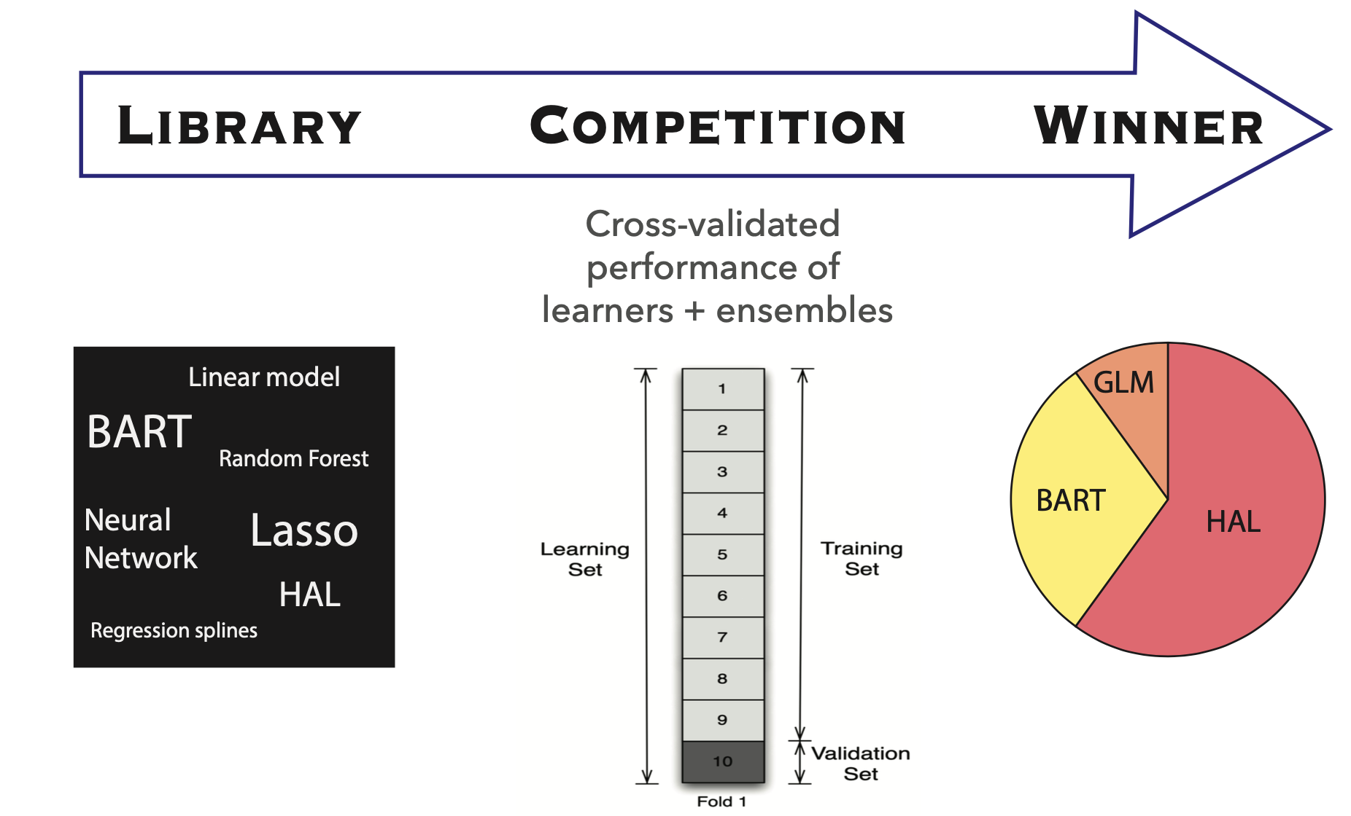
Super Learner (SL)
Notes:
Advantages
Rich search over solution space
Lessen reliance on model assumptions mitigates model misspecification bias
Aggregate weak learners = strong learner
Cross validation has optimality properties

Slide 4
Super Learner (SL)
Notes:
Advantages
Rich search over solution space
Lessen reliance on model assumptions mitigates model misspecification bias
Aggregate weak learners = strong learner
Cross validation has optimality properties

Slide 5
Super Learner (SL)
Notes:
Advantages
Rich search over solution space
Lessen reliance on model assumptions mitigates model misspecification bias
Aggregate weak learners = strong learner
Cross validation has optimality properties

Slide 6
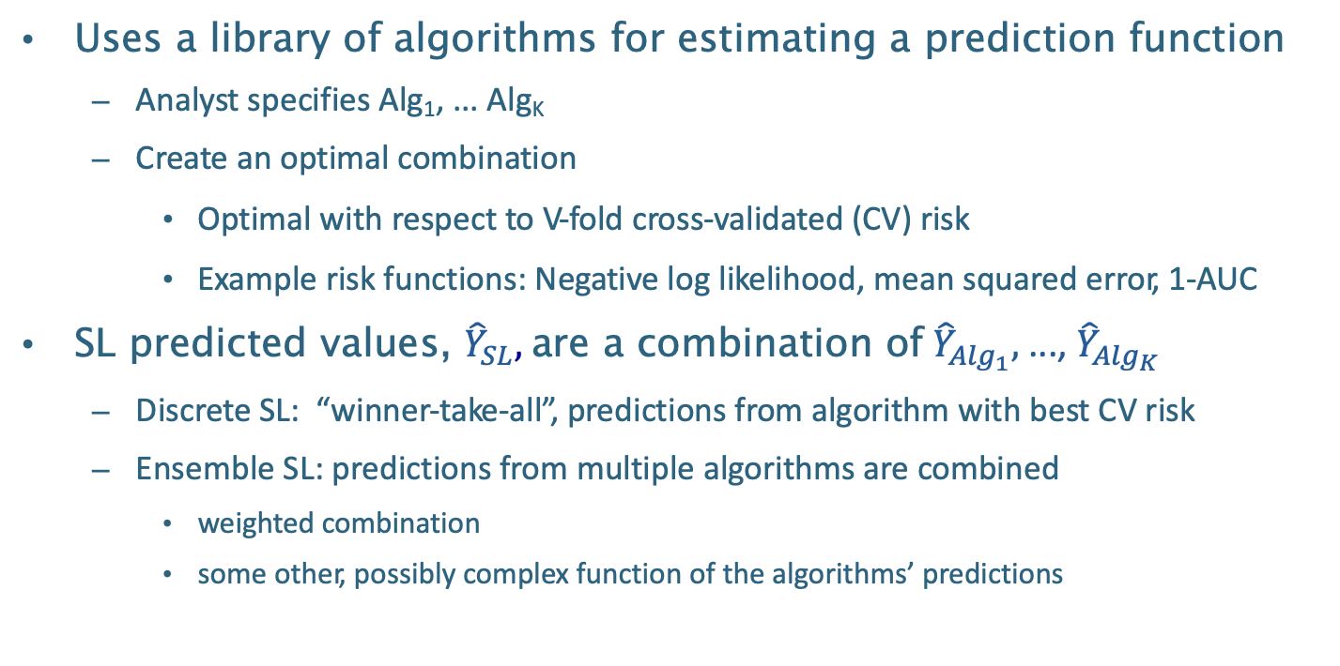
Super Learner (SL)
Uses a library of algorithms for estimating a prediction function
Analyst specifies Alg₁, ... Alg_{K}
Create an optimal combination
Optimal with respect to V-fold cross-validated (CV) risk
Example risk functions: Negative log likelihood, mean squared error, 1-AUC
SL predicted values, ${\hat{Y}}_{SL},$ are a combination of ${\hat{Y}}_{{Alg}_{1}},$ ..., ${\hat{Y}}_{{Alg}_{K}}$
Discrete SL: “winner-take-all”, predictions from algorithm with best CV risk
Ensemble SL: predictions from multiple algorithms are combined
weighted combination
some other, possibly complex function of the algorithms’ predictions
Notes:
Advantages
Rich search over solution space
Lessen reliance on model assumptions mitigates model misspecification bias
Aggregate weak learners = strong learner
Cross validation has optimality properties

Slide 7
Defining prediction problem for estimation
Notes:
Our method for estimation should reflect the choice of the statistical target parameter.
For example, to learn about the conditional mean of disease incidence, we could estimate the joint conditional distribution of regional characteristics and disease incidence, which would imply an estimate of the conditional mean. However, such a procedure is not targeted towards the goal of estimating the conditional mean.
To ensure parsimony between our estimation procedure and our target parameter, we introduce the notion of a loss function.

Slide 8
Defining prediction problem for estimation
A performance metric quantifies the success of an estimated prediction function (i.e., a trained algorithm)
Expectation of the squared error loss / MSE
The area under the ROC curve, AUC
Notes:
Our method for estimation should reflect the choice of the statistical target parameter.
For example, to learn about the conditional mean of disease incidence, we could estimate the joint conditional distribution of regional characteristics and disease incidence, which would imply an estimate of the conditional mean. However, such a procedure is not targeted towards the goal of estimating the conditional mean.
To ensure parsimony between our estimation procedure and our target parameter, we introduce the notion of a loss function.

Slide 9
Defining prediction problem for estimation
A performance metric quantifies the success of an estimated prediction function (i.e., a trained algorithm)
The chosen metric needs to be optimized (minimized or maximized) by the true prediction function
This guarantees that the evaluation corresponds to the trained algorithm's success in approximating the true prediction function
Notes:
Our method for estimation should reflect the choice of the statistical target parameter. For example, to learn about the conditional mean of disease incidence, we could estimate the joint conditional distribution of regional characteristics and disease incidence, which would imply an estimate of the conditional mean. However, such a procedure is not targeted towards the goal of estimating the conditional mean. To ensure parsimony between our estimation procedure and our target parameter, we introduce the notion of a loss function.

Slide 10
Defining prediction problem for estimation
A performance metric quantifies the success of an estimated prediction function (i.e., a trained algorithm)
The chosen metric needs to be optimized (minimized or maximized) by the true prediction function
This guarantees that the evaluation corresponds to the trained algorithm's success in approximating the true prediction function
The chosen metric should align with the intended real-world use of the predictions
Notes:
Our method for estimation should reflect the choice of the statistical target parameter. For example, to learn about the conditional mean of disease incidence, we could estimate the joint conditional distribution of regional characteristics and disease incidence, which would imply an estimate of the conditional mean. However, such a procedure is not targeted towards the goal of estimating the conditional mean. To ensure parsimony between our estimation procedure and our target parameter, we introduce the notion of a loss function.

Slide 11
Why super learner (SL)?
Alleviates concerns over selecting the one “right” algorithm while benefiting from considering a diverse set
Grounded in optimality theory that guarantees for large sample sizes the SL will perform as well as possible, given the algorithms in the library
Pre-specified and data-adaptive
Conveying knowledge about DGP through the library can mitigate statistical model misspecification
Notes:
In practice it is difficult to choose a single algorithm (or “learner”). There are many options, and no one is expert in all of them. Moreover, it is impossible to know in advance which learner is most suitable for the particular dataset and prediction task at hand. The super learner (SL) solves the issue of algorithm selection by considering a large set of user-specified algorithms, from parametric regressions to nonparametric machine learning algorithms (e.g., neural nets, support vector machines, and decision and regression trees). It alleviates concerns over selecting the one “right” algorithm while benefiting from considering a diverse set, including those recommended by collaborators, used in related research, or specified by subject-matter experts. The SL is grounded in optimality theory that guarantees for large sample sizes the SL will perform as well as possible, given the specified algorithms considered ². The robustness of this entirely pre-specified and data-adaptive approach is supported by numerous practical applications ^{1, 3–10}.
If the DGP does not reside in the statistical model space then the statistical model is misspecified, and this can lead to mild or severe bias in estimates and misleading results. Conveying knowledge about the DGP through the library can mitigate statistical model misspecification with the SL. For example, if it’s known that there are interactions among covariates then the analyst can include learners in the library that pick up on that explicitly (e.g., by including in the library a parametric regression learner with interactions specified in a formula) or implicitly (e.g., by including in the library tree-based algorithms that learn interactions empirically). When little is known about the DGP, the library should be as rich and diverse as possible, with respect to $n_{eff}$ and computational feasibility, to accommodate a range of possible underlying functional forms for the true prediction function.

Slide 12
Super learner
Specify
Measure of performance
Cross-validation scheme
Diverse library of candidate learners

Slide 13
Super learner
What are you learning from the data? What do you want to optimize for?
Performance measure should be valid (i.e., optimized by underlying target), bounded, corresponds to desired goal
Specify
Measure of performance
Cross-validation scheme
Diverse library of candidate learners

Slide 14
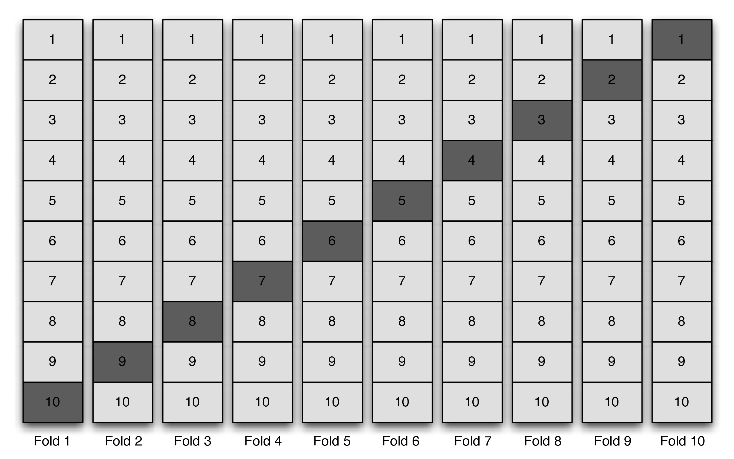
Super learner
e.g. V-fold cross-validation
Specify
Measure of performance
Cross-validation scheme
Diverse library of candidate learners

Slide 15
Super learner
e.g. rolling origin cross-validation
(cross-validation for time series data)
Specify
Measure of performance
Cross-validation scheme
Diverse library of candidate learners

Slide 16
Overview of the algorithm
Make metalevel dataset with cross-validated candidate predictions and validation set outcomes
Fit meta-learner to the metalevel dataset
Full-fit candidates
Define the SL

Slide 17
Super learner
Specify
Measure of performance
Cross-validation scheme
Diverse library of learning strategies
Obtain cross-validated predictions for each learner in the library
Fit meta-learner to the metalevel dataset
“meta”: cleverly self-referential
Metalearner: a learner that learns from what other learners have learned
Figure 2 in Phillips et al. Practical considerations for specifying a super learner. 2022.

Slide 18
Super learner
Specify
Measure of performance
Cross-validation scheme
Diverse library of learning strategies
Obtain cross-validated predictions for each learner in the library
Fit meta-learner to the metalevel dataset
“meta”: cleverly self-referential
Metalearner: a learner that learns from what other learners have learned
Figure 2 in Phillips et al. Practical considerations for specifying a super learner. 2022.

Slide 19
Super learner
Specify
Measure of performance
Cross-validation scheme
Diverse library of learning strategies
Obtain cross-validated predictions for each learner in the library
Fit meta-learner to the metalevel dataset
Figure 2 in Phillips et al. Practical considerations for specifying a super learner. 2022.

Slide 20
“meta”: cleverly self-referential
Metalearner: a learner that learns from what other learners have learned

Slide 21
Super learner
Specify
Measure of performance
Cross-validation scheme
Diverse library of learning strategies
Obtain cross-validated predictions for each learner in the library
Fit meta-learner to the metalevel dataset
“meta”: cleverly self-referential
Metalearner: a learner that learns from what other learners have learned

Slide 22
Practical considerations for specifying SL
Phillips RV, van der Laan MJ, Lee H, Gruber S. Practical considerations for specifying a super learner. arXiv preprint arXiv:2204.06139. 2022.
https://arxiv.org/abs/2204.06139

Slide 23
Figure 1 in Phillips RV, van der Laan MJ, Lee H, Gruber S. Practical considerations for specifying a super learner. arXiv preprint arXiv:2204.06139. 2022.

Slide 24
Phillips RV, van der Laan MJ, Lee H, Gruber S. Practical considerations for specifying a super learner. arXiv preprint arXiv:2204.06139. 2022.

Slide 25
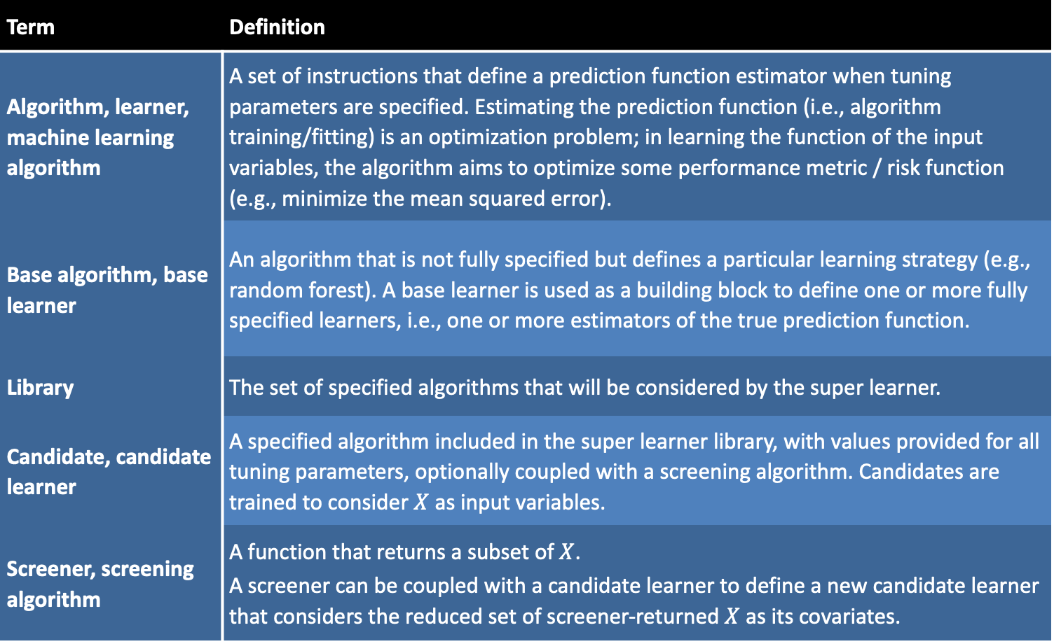
Term | Definition
Algorithm, learner, machine learning algorithm | A set of instructions that define a prediction function estimator when tuning parameters are specified. Estimating the prediction function (i.e., algorithm training/fitting) is an optimization problem; in learning the function of the input variables, the algorithm aims to optimize some performance metric / risk function (e.g., minimize the mean squared error).
Base algorithm, base learner | An algorithm that is not fully specified but defines a particular learning strategy (e.g., random forest). A base learner is used as a building block to define one or more fully specified learners, i.e., one or more estimators of the true prediction function.
Library | The set of specified algorithms that will be considered by the super learner.
Candidate, candidate learner | A specified algorithm included in the super learner library, with values provided for all tuning parameters, optionally coupled with a screening algorithm. Candidates are trained to consider $X$ as input variables.
Screener, screening algorithm | A function that returns a subset of $X$. A screener can be coupled with a candidate learner to define a new candidate learner that considers the reduced set of screener-returned $X$ as its covariates.
Table 1 in Phillips et al. Practical considerations for specifying a super learner. 2022.

Slide 26
Term | Definition
Algorithm, learner, machine learning algorithm | A set of instructions that define a prediction function estimator when tuning parameters are specified. Estimating the prediction function (i.e., algorithm training/fitting) is an optimization problem; in learning the function of the input variables, the algorithm aims to optimize some performance metric / risk function (e.g., minimize the mean squared error).
Base algorithm, base learner | An algorithm that is not fully specified but defines a particular learning strategy (e.g., random forest). A base learner is used as a building block to define one or more fully specified learners, i.e., one or more estimators of the true prediction function.
Library | The set of specified algorithms that will be considered by the super learner.
Candidate, candidate learner | A specified algorithm included in the super learner library, with values provided for all tuning parameters, optionally coupled with a screening algorithm. Candidates are trained to consider $X$ as input variables.
Screener, screening algorithm | A function that returns a subset of $X$. A screener can be coupled with a candidate learner to define a new candidate learner that considers the reduced set of screener-returned $X$ as its covariates.
Table 1 in Phillips et al. Practical considerations for specifying a super learner. 2022.

Slide 27
Term | Definition
Algorithm, learner, machine learning algorithm | A set of instructions that define a prediction function estimator when tuning parameters are specified. Estimating the prediction function (i.e., algorithm training/fitting) is an optimization problem; in learning the function of the input variables, the algorithm aims to optimize some performance metric / risk function (e.g., minimize the mean squared error).
Base algorithm, base learner | An algorithm that is not fully specified but defines a particular learning strategy (e.g., random forest). A base learner is used as a building block to define one or more fully specified learners, i.e., one or more estimators of the true prediction function.
Library | The set of specified algorithms that will be considered by the super learner.
Candidate, candidate learner | A specified algorithm included in the super learner library, with values provided for all tuning parameters, optionally coupled with a screening algorithm. Candidates are trained to consider $X$ as input variables.
Screener, screening algorithm | A function that returns a subset of $X$. A screener can be coupled with a candidate learner to define a new candidate learner that considers the reduced set of screener-returned $X$ as its covariates.
Table 1 in Phillips et al. Practical considerations for specifying a super learner. 2022.

Slide 28
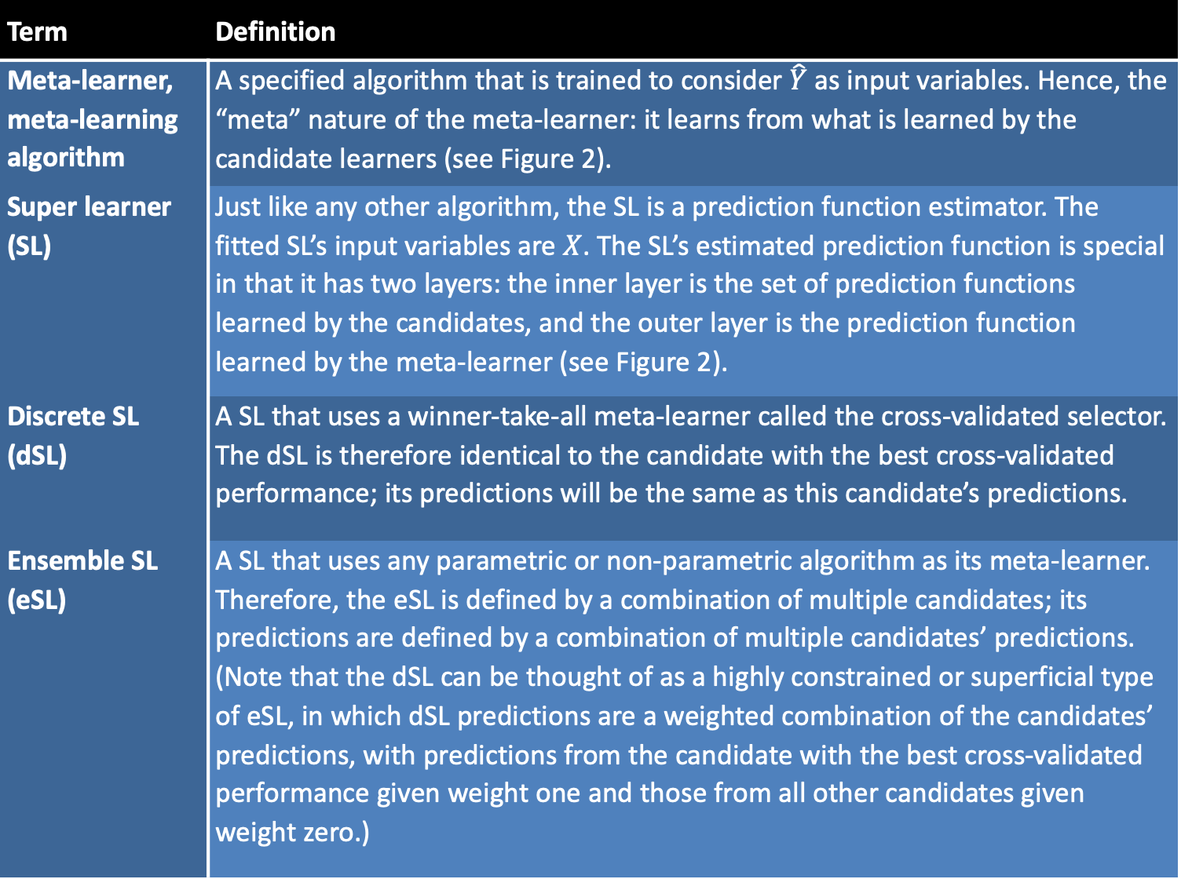
Term | Definition
Meta-learner, meta-learning algorithm | A specified algorithm that is trained to consider $\hat{Y}$ as input variables. Hence, the “meta” nature of the meta-learner: it learns from what is learned by the candidate learners (see Figure 2).
Super learner (SL) | Just like any other algorithm, the SL is a prediction function estimator. The fitted SL’s input variables are $X$. The SL’s estimated prediction function is special in that it has two layers: the inner layer is the set of prediction functions learned by the candidates, and the outer layer is the prediction function learned by the meta-learner (see Figure 2).
Discrete SL (dSL) | A SL that uses a winner-take-all meta-learner called the cross-validated selector. The dSL is therefore identical to the candidate with the best cross-validated performance; its predictions will be the same as this candidate’s predictions.
Ensemble SL (eSL) | A SL that uses any parametric or non-parametric algorithm as its meta-learner. Therefore, the eSL is defined by a combination of multiple candidates; its predictions are defined by a combination of multiple candidates’ predictions. (Note that the dSL can be thought of as a highly constrained or superficial type of eSL, in which dSL predictions are a weighted combination of the candidates’ predictions, with predictions from the candidate with the best cross-validated performance given weight one and those from all other candidates given weight zero.)
Table 1 in Phillips et al. Practical considerations for specifying a super learner. 2022.

Slide 29
Term | Definition
Meta-learner, meta-learning algorithm | A specified algorithm that is trained to consider $\hat{Y}$ as input variables. Hence, the “meta” nature of the meta-learner: it learns from what is learned by the candidate learners (see Figure 2).
Super learner (SL) | Just like any other algorithm, the SL is a prediction function estimator. The fitted SL’s input variables are $X$. The SL’s estimated prediction function is special in that it has two layers: the inner layer is the set of prediction functions learned by the candidates, and the outer layer is the prediction function learned by the meta-learner (see Figure 2).
Discrete SL (dSL) | A SL that uses a winner-take-all meta-learner called the cross-validated selector. The dSL is therefore identical to the candidate with the best cross-validated performance; its predictions will be the same as this candidate’s predictions.
Ensemble SL (eSL) | A SL that uses any parametric or non-parametric algorithm as its meta-learner. Therefore, the eSL is defined by a combination of multiple candidates; its predictions are defined by a combination of multiple candidates’ predictions. (Note that the dSL can be thought of as a highly constrained or superficial type of eSL, in which dSL predictions are a weighted combination of the candidates’ predictions, with predictions from the candidate with the best cross-validated performance given weight one and those from all other candidates given weight zero.)

Slide 30
sl3 SL software package in tlverse

Slide 31
Introductory overview of sl3
Task
Learners
Functions

Slide 32
Introductory overview of sl3
Task
Learners
Functions

Slide 33
Tasks in sl3
What is the prediction task?
data, covariates, outcome,
weights, id, outcome_type,offset, drop_missing_outcome, folds
https://tlverse.org/sl3/reference/sl3_Task.html

Slide 34
Introductory overview of sl3
Task
Learners
Functions

Slide 35
Learners in sl3
How to estimate prediction function?
https://tlverse.org/sl3/reference/index.html#sl-learners

Slide 36
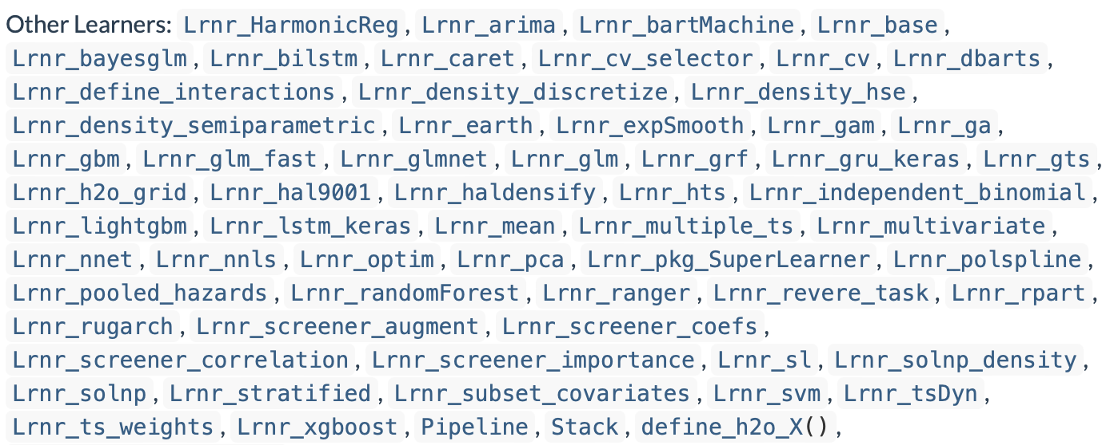
Learners in sl3
How to estimate prediction function?
https://tlverse.org/sl3/reference/index.html#sl-learners

Slide 37
Learners in sl3
How to estimate prediction function?
https://tlverse.org/sl3/reference/index.html#sl-learners

Slide 38
Learners in sl3
How to estimate prediction function?
https://tlverse.org/sl3/reference/index.html#sl-learners

Slide 39
Learners in sl3
How to estimate prediction function?
https://tlverse.org/sl3/reference/index.html#sl-learners

Slide 40
Learners in sl3
How to estimate prediction function?
https://tlverse.org/sl3/reference/index.html#sl-learners

Slide 41
Learners in sl3
How to estimate prediction function?
https://tlverse.org/sl3/reference/index.html#sl-learners

Slide 42
Learners in sl3
How to estimate prediction function?
https://tlverse.org/sl3/reference/index.html#sl-learners

Slide 43
Learners in sl3
How to estimate prediction function?
https://tlverse.org/sl3/reference/index.html#sl-learners

Slide 44
Learners in sl3
How to estimate prediction function?
https://tlverse.org/sl3/reference/index.html#sl-learners

Slide 45
Learners in sl3
How to estimate prediction function?
https://tlverse.org/sl3/reference/index.html#sl-learners

Slide 46
Learners in sl3
How to estimate prediction function?
2
1
https://tlverse.org/sl3/reference/index.html#sl-learners

Slide 47
Introductory overview of sl3
Task
Learners
Other functions

Slide 48
Other sl3 Functions
Performance measures:
loss functions (e.g., squared error, negative log-likelihood, multinomial log-likelihood )
metrics based on ROCR software package, like AUC, AUCPR, accuracy, sensitivity, with custom_ROCR_risk()
Variable importance with importance
Table with each candidate learner’s cross-validated predictive performance with cv_risk
Cross-validated SL with cv_sl

Slide 49
Live coding exercise with sl3 using WASH Benefits data

Slide 50
WASH Benefits Bangladesh Example Dataset
Study aiming to understand the effect of water quality, sanitation, hand washing, and nutritional interventions on child development in rural Bangladesh (WASH Benefits Bangladesh): a cluster randomized controlled trial (Tofail et al. 2018).

Slide 51
WASH Benefits Bangladesh Example Dataset
Study aiming to understand the effect of water quality, sanitation, hand washing, and nutritional interventions on child development in rural Bangladesh (WASH Benefits Bangladesh): a cluster randomized controlled trial (Tofail et al. 2018).
Enrolled pregnant women in their first or second trimester from the rural villages of Gazipur, Kishoreganj, Mymensingh, and Tangail districts of central Bangladesh, with an average of 8 women per cluster.

Slide 52
WASH Benefits Bangladesh Example Dataset
Groups of eight geographically adjacent clusters were block randomized, using a random number generator, into
six intervention groups (all received weekly visits from a community health promoter for the first 6 months, and every 2 weeks for next 18 months) and
a double-sized control group (no intervention or health promoter visit).

Slide 53
WASH Benefits Bangladesh Example Dataset
Six intervention groups:
chlorinated drinking water;
improved sanitation;
hand-washing with soap;
combined water, sanitation, and hand washing;
improved nutrition through counseling and provision of lipid-based nutrient supplements; and
combined water, sanitation, handwashing, and nutrition.
We concentrate on child growth (size for age) as the outcome of interest.

Slide 54
Live coding exercise with sl3
https://tlverse.org/tlverse-handbook/sl3.html

