Slide 1

transition
Conv(k=1)
A2 _{×2}
A2 _{×2}
A2 _{×2}
Concatenation
scaling
$$\text{⊕}$$

Slide 2



Input
Conv
Conv
$$=$$
Conv 2d
$$+$$
BatchNorm
$$+$$
SiLU
Conv
C3k2
A2C2f
Detect
Conv
Concat
Conv
C3k2
Upsample
Concat
Conv
A2C2f
A2C2f
Detect
A2C2f
Concat
Conv
Conv
Upsample
Concat
A2C2f
C3k2
Detect
Backbone
Neck
Head

Slide 3

RCM
RCA
Dwconv
Avg Pool | W
RCA
Avg Pool | H
BN
Conv2d
BN
MLP
RELU
$$\text{⊕}$$
Conv2d
Sigmoid

Slide 4







$$X_{in}$$
Manhattan Block
Q Conv
K Conv
V Conv
$$D_{manhattan}$$
$$D_{cosine}$$
$$D_{prior}$$
$$γ∣x_{i}​−x_{j}​∣+∣y_{i}​−y_{j}​∣$$
$D_{hybrid}=λD_{man}$ + $\left(1−λ\right)D_{cos}$ + $D_{prior}$
Softmax(${−D}_{hybrid}$)
$$⊗$$
Attention Output
$$X_{out}$$

Slide 5

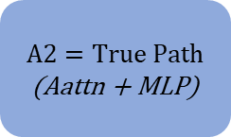

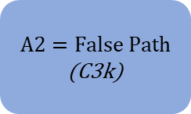

Input Tensor $x$
Conv(k=1)
$$Initialize List$$
$$Y=[Y0]$$
Block Loop
(repeated n times)
$$A2=True Path$$
(Aattn + MLP)
$$A2=False Path$$
(C3k)
Appended output to List
Concatenation
Conv(k=1)
Residual OFF
Residual ON
$$Output Tensor$$

Slide 6
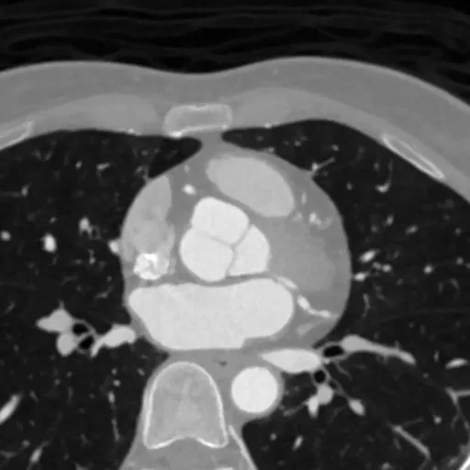
Conv
Conv
C3k2
A2C2f
Detect
Input CT Image (640×640×3)
Conv
Concat
Conv
C3k2
Upsample
Concat
Conv
★A2C2f_Manhattan
A2C2f
Detect
A2C2f
Concat
Conv
Conv
Upsample
Concat
A2C2f
C3k2
Detect
Backbone
Neck
Head

Slide 7










$$X_{in}$$
Manhattan Block
Q Conv
K Conv
V Conv
$AdaptiveAvgPool2d$($14×14$)
$AdaptiveAvgPool2d$($14×14$)
$$PE$$
$$DW−Conv 5×5$$
$$D_{manhattan}$$
Softmax($\frac{D_{manhattan}}{\sqrt{d_{k}}}$)
Attention × V
$$Upsample$$
$$(Ns × Ns → N × N)$$
$$⊗$$
$$\text{⊕}$$
Proj Conv
$$X_{out}$$
⊕ : Element-wise Addition
⊗ : Matrix Multiplication

Slide 8











C3k2, c3k=False
bottleNeck*n
$$X_{in}$$
Conv(k=1)
split
Conv(k=1)
$$X_{out}$$
$$C$$
C3k2, c3k=True
C3k*n
$$X_{in}$$
Conv(k=1)
split
Conv(k=1)
$$X_{out}$$
$$C$$
Conv(k=1)
bottleNeck*2
C3k
$$X_{in}$$
Conv(k=1)
Conv(k=1)
$$X_{out}$$
$$C$$
BottleNeck
$$X_{in}$$
Conv(k=3)
Conv(k=3)
$$X_{out}$$
$$A$$

Slide 9








Backbone
C : Concatenation
A : Residual Addition
$$\text{×}γ (Learnable Layer Scale)$$
A2C2f (A2=True)
*n;*2
*$C2_{weight}$
$$X_{in}$$
y0
Conv(k=1)
$$X_{out}$$
ABlock
Conv(k=1)
$$A$$
y1
y2
ABlock
ABlock
ABlock
ABlock
Concate
(y0, y1, y2)
ABlock
$$X_{in}$$
$$X_{out}$$
Aattn
$$A$$
MLP
$$A$$

Slide 10
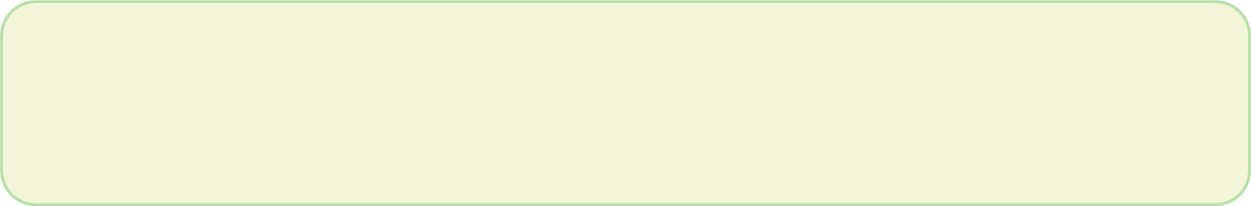






β denotes the learnable attention scaling parameter (attn_scale).
C : Concatenation
A : Residual Addition
Neck
A2C2f_Manhattan (A2=False)
$$\text{×}γ (Learnable Layer Scale)$$
×β (Learnable)
*n;*2
*$C2_{weight}$
$$X_{in}$$
Manhattan
Block
$$X_{out}$$
Conv(k=1)
C3k
Conv(k=1)
$$A$$
$$A$$
Conv(k=1)
BottleNeck*2
C3k
$$X_{in}$$
Conv(k=1)
Conv(k=1)
$$X_{out}$$
$$C$$
BottleNeck
$$X_{in}$$
Conv(k=3)
Conv(k=3)
$$X_{out}$$
$$A$$

