Slide 1
“Droplets” (1997) Medoruma Shun (1960-)
水滴
目取真俊

Slide 2
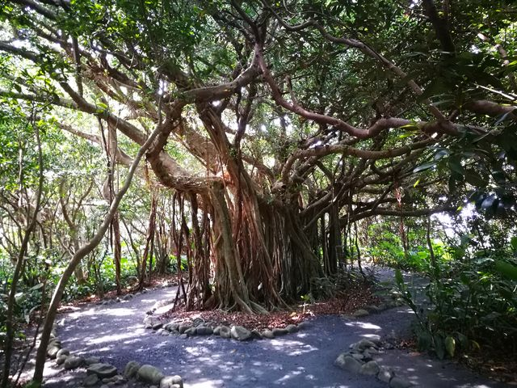
Banyan (Gajumaru)

Slide 3
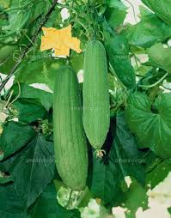
Hechima gourd

Slide 4
Keywords
Akutagawa Prize, 1997 (Matayoshi Eiki won it in 1996 for “Pig’s Revenge”)
Critical of mainland Japanese, US, and fellow Okinawans
Magic realism
Blood and Iron Imperial Service Corps: Tokushô and Ishimine
Student Nurse Corps: Miyagi Setsu
“shattered jewel” gyokusai
Oral history, public memory, 1995 (50th anniversary of end of war)
Ôe Kenzaburô, Franz Kafka, Gabriel Garcia-Marquez

Slide 5
A few key passages
“It was during a dry spell in mid-June, the rainy season, when Tokushô’s leg suddenly swelled up.” (255)
“Then his leg started to itch as if an army of ants were crawling across it, and although he was desperate to scratch, he couldn’t move a muscle.”
“Basically, it’s just water, but it appears to contain a slightly higher level of lime.” (259)
“In the water floated a few dead insects.” (282)

Slide 6
“Ishimine, forgive me!”
The color had begun to return to Ishimine’s pale face, and his lips regained their luster. Tokushô, despite his fear and self-hatred,
grew aroused. Ishimine’s tongue glided across the opening on his toe, and then Tokushô let out a small cry with his sexual release.
The lips pulled away. Lightly wiping his mouth with his index finger, Ishimine stood up. He was still seventeen. A smile took
shape— around those eyes that stared out beneath the long lashes, on the spare cheeks, on the vermilion lips.
Tokushô burst into anger. “Don’t you know how much I’ve suffered these past fifty years?” Ishimine merely continued to smile,
nodding slightly at Tokushô, who flailed his arms in an effort to sit up.
“Thank you. At last the thirst is gone.” Speaking in well-accented, standard Japanese, Ishimine held back a smile, saluted, and
bowed deeply. He never turned to look back at Tokushô as he slowly vanished into the wall. A newt scampered across the wall’s
stained surface and caught an insect.
At dawn, Tokushô’s wail echoed throughout the village. (281-282)

Slide 7
Discussion Questions
Compare and contrast “Turtleback Tombs” and “Droplets”.
What is the central theme in “Droplets”? What is the subtheme?
Analyze the passage on pages 281-282. What accounts for Tokushô’s outburst? Why does the author include the line about the newt (gecko, yamori) and insect?
Why does Tokushô revert to his old ways of drinking, gambling, and womanizing? What does the yellow flower at story’s end symbolize?

