Slide 1
Yamagusuku Seichû Kunenbo (1911)
山城正忠
九年母

Slide 2
History in a Nutshell
1500s Ryûkyû Kingdom
1609 Satsuma invasion
1879 Okinawa incorporated into Japan
1945 August 15, 1945 Japan’s defeat
Atomic bombing of Nagasaki: August 9, 1945
Atomic bombing of Hiroshima: August 6, 1945
Battle of Okinawa: April 1-June 22 1945
1972 Okinawa returns to Japanese sovereignty
1995 12-year-old schoolgirl rape/SACO Agreement
2022 50 year anniversary of Okinawa’s return to Japan

Slide 3
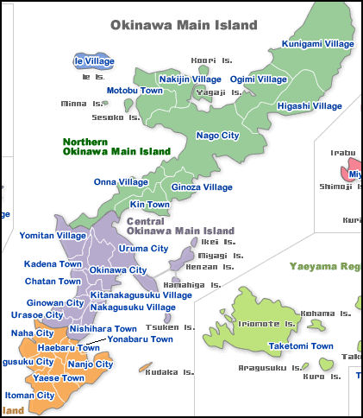
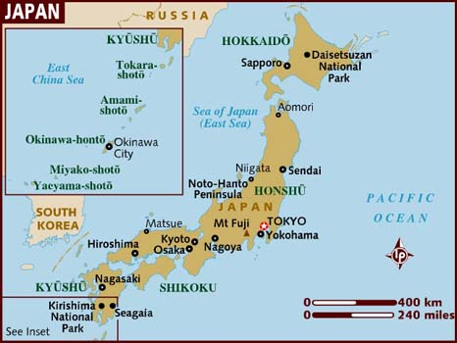
Maps

Slide 4
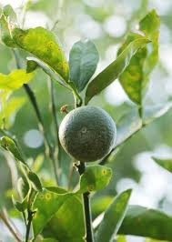
Kunenbo 九年母

Slide 5
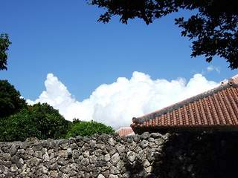
Red tiled roof

Slide 6
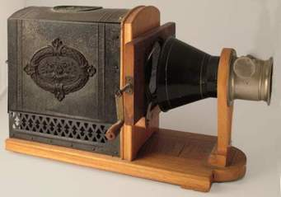
Magic lantern
Notes:
Invented in 17th century, used for education in 19th century (introduced by Dutch)

Slide 7
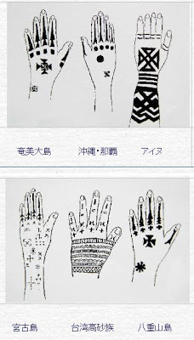
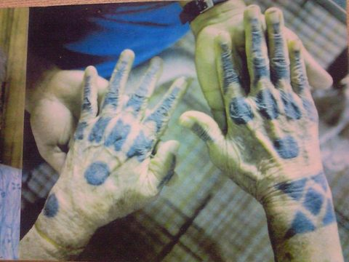
Tattoos ハジチ（針突）
Notes:
On back of hands of women in Okinawa,

Slide 8
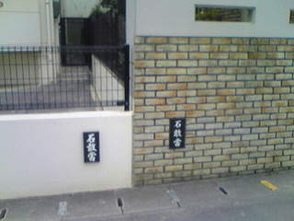
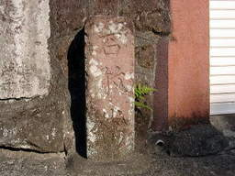
Ishigantô 石敢当

Slide 9

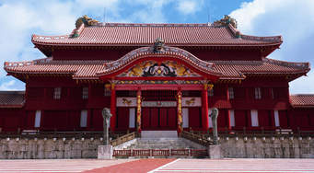
Shuri Castle 2000 yen bill

Slide 10
Keywords
Kunenbo, kunibu
Local color
Naha
Shuri
Tsuji
Sino-Japanese War 1894-95
Yamato, samurai, geisha
foreshadowing
Tokugawa period
Meiji period
Okinawan fiction

Slide 11
Discussion Questions
Analyze the opening passage of the story. What does it suggest will follow? Why?
Critics praised “Kunenbo Orange Trees” for its local color. Find a passage that best demonstrates this key characteristic of Yamagusuku’s story.
Consider identity in the story. How is Japanese identity characterized? How is Chinese identity characterized? How is Okinawan identity characterized?
Analyze the closing passages of the story. What do they tell us about Okushima? What is the riddle of the locked black door?

