Slide 1
“Mabuigumi” (1999) Medoruma Shun (1960-)
魂込め
目取真俊

Slide 2
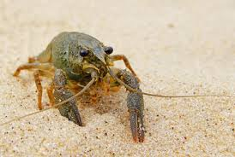
Land hermit crab

Slide 3
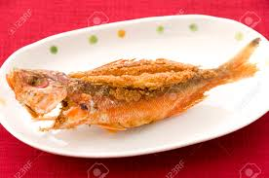
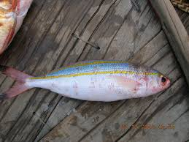
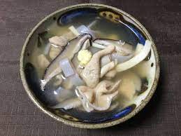
Gurukun
Nakami jiru

Slide 4
Utaki (L, C) Hinpun (R)

Slide 5
Keywords
Nakijin
Community ties
focal character, Uta
NHK radio calisthenics (mainland Japanese practice)
Language (age, gender, class)
intertextuality
Late 1990s, cultural renaissance, resurgence of interest in language, music, cultural practices
Critique of magic realist label, denial of reality (Orientalizing)
Battle of Okinawa, “friendly forces”=mainland Japanese soldiers
“afterworld” (gusô, ano yo), 49 days

Slide 6
Discussion Questions
Compare and contrast “Droplets” and “Mabuigumi.”
In what ways is Uta depicted?
What does the sea turtle symbolize? What does the land crab symbolize?
Explain the significance of the ending, particularly Uta’s ineffective prayer.

