Slide 1
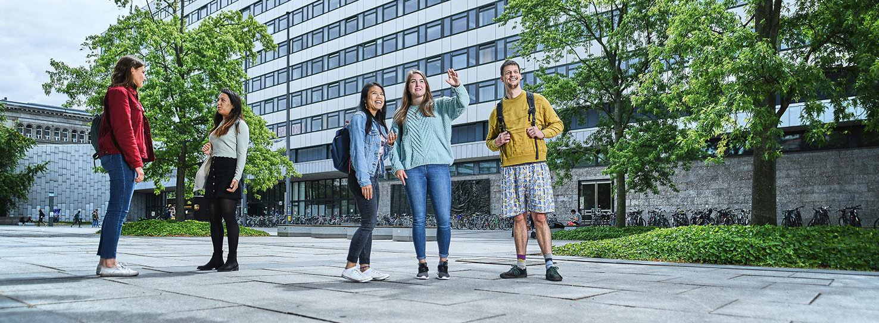
© Philipp Arnoldt
Designing a Sustainable Demand-Responsive Transport Service for Cottbus
Yiming Wang | Xi Yuan | XIaorui Wang | 25.06.2026
Notes:
Hello erveyone we are Group C and this is our process of design a sustainable DRT service for Cottbus

Slide 2
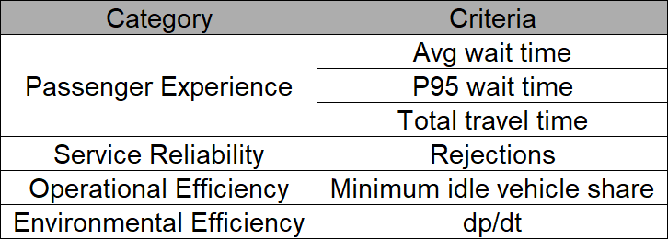
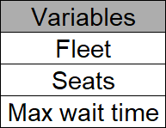
Criteria & Parameters
[1] Liyanage, S., Dia, H., & Duncan, G. (2025). AI-powered evaluation of on-demand public transport: A hybrid simulation approach. Smart Cities, 9(1), Article 4.
Notes:
First, we defined what we wanted to evaluate in the DRT system.
We grouped the evaluation criteria into four domains: passenger experience, service reliability, operational efficiency, and environmental efficiency. In total, we used six criteria.
For passenger experience, we looked at average waiting time, P95 waiting time, and total travel time. For service reliability, we used the number of rejected requests. For operational efficiency, we used the minimum idle vehicle share. For environmental efficiency, we used the ratio d_p over d_t, which means passenger-kilometres divided by vehicle-kilometres.
A higher d_p/d_t value means that each vehicle-kilometre carries more passenger-kilometres. So it can reflect pooling and transport efficiency. However, it is not a direct emission indicator. It is only used as an approximate indicator for environmental efficiency.
Before choosing the final nine scenarios, we ran several preliminary experiments. We found that three parameters had a clear influence on the results: fleet size, vehicle capacity, and maximum waiting time.
Fleet size affects vehicle supply and utilisation. Vehicle capacity affects pooling potential. Maximum waiting time affects both request acceptance and passenger waiting time.

Slide 3
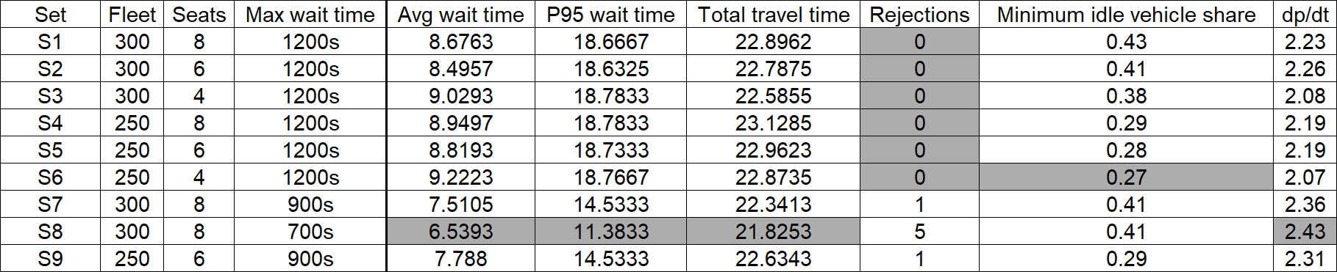
Test Set & Outcomes
Notes:
Based on these three parameters, we designed nine scenarios and compared their simulation results. The grey cells in the table show the best outcome for each criterion.
However, no single scenario performs best in all criteria. Therefore, choosing the final scenario is a multi-criteria decision problem. To evaluate the trade-offs between different objectives, we used the Analytic Hierarchy Process, or AHP.

Slide 4
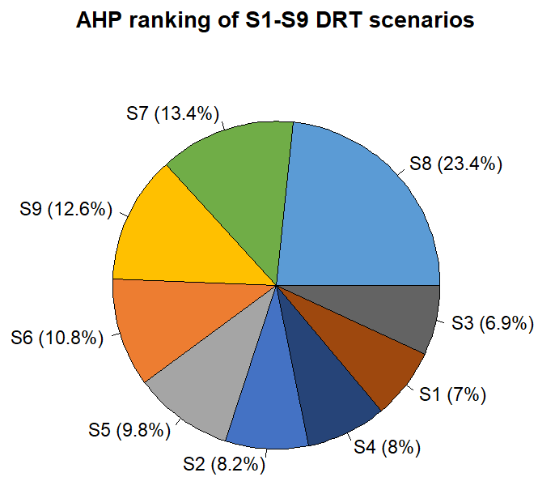
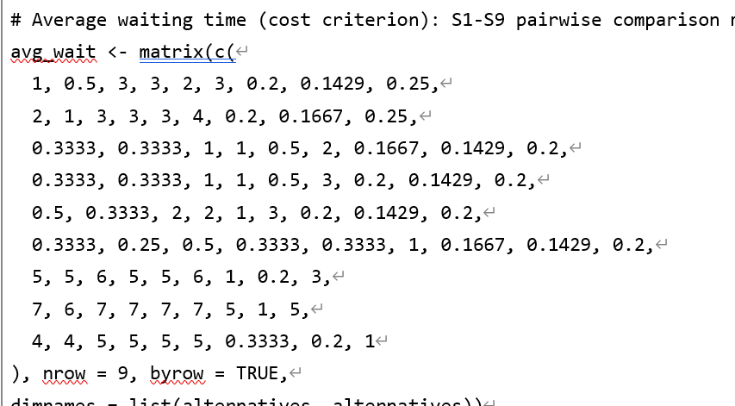
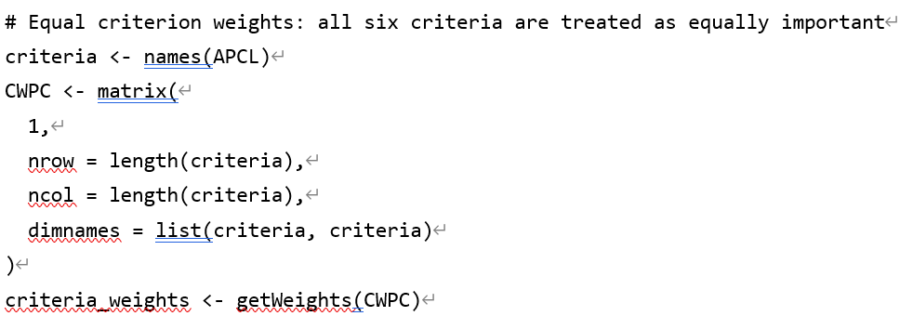
AHP Ranking and Final Selection
[2] Saaty, T. L. (1980). The analytic hierarchy process: Planning, priority setting, resource allocation. McGraw-Hill International Book Company.
Notes:
For each criterion, we compared the nine scenarios pairwise and created one alternative comparison matrix. Since we used six criteria, we created six matrices in total.
For example, for average waiting time, a shorter waiting time gets a higher preference value. The relative differences between scenarios were mapped to Saaty’s 1-to-9 scale. The matrix also follows the reciprocal rule. For example, if S8 is rated 7 times better than S1, then S1 is rated 1 over 7 compared with S8.
After that, we compared the six criteria with each other. Because we treated all criteria as equally important, the criteria comparison matrix was a 6-by-6 matrix filled with 1.
Then we used R to calculate the AHP scores. As shown in the pie chart, S8 receives the highest overall score. Therefore, the following cost and pricing analysis is based on S8.

Slide 5
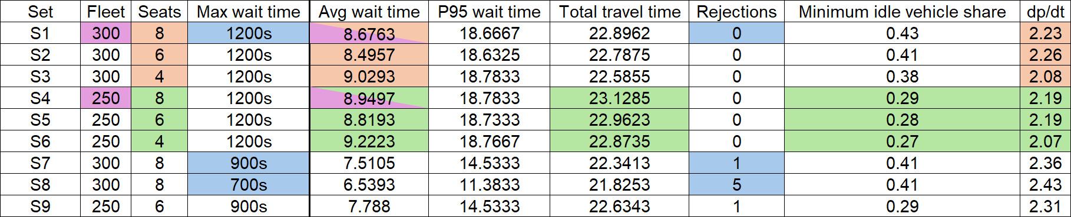
Findings
Notes:
We can also see some important trade-offs from the scenarios.
The most interesting finding is that improving passenger experience does not automatically mean improving the whole system. A stricter maximum waiting time substantially reduces average and extreme waiting times, but it also creates rejected requests. Meanwhile, reducing the fleet size improves vehicle utilization but worsens passenger waiting time. Therefore, the best DRT design depends on whether the city prioritizes service quality, reliability, or operating cost.

Slide 6
Cost-based fare estimation for S8
Annual Total Cost =
cost/hour × annual vehicle-hours + cost/km × annual vehicle-km + cost/vehicle × number of vehicles
[3]-[7]
Parameter | Assumption | Basis
c_h | 25 €/vehicle-hour | driver wage + employer contribution
c_km | 0.917 €/vehicle-km | ADAC Vito Tourer total car cost
c_v | 841 €/vehicle-month | depreciation + insurance
Overhead | × 1.10 | dispatching, customer service, administration
Estimated annual total cost ≈ 65.09 million €/year
Cost per ride ≈ 17.8 €/ride
[3] McCollom, B., & Polin, L. (1988). Cost analysis methodology for demand-responsive service.
Notes:
For the cost estimation, we use a simple three-variable cost model. So basically, we estimate the annual cost from three parts: vehicle-hours, vehicle-kilometres, and the number of vehicles.
For the hourly cost, we assume 25 euros per vehicle-hour. This covers the driver wage and the employer-side contribution. For the distance-based cost, we use 0.917 euros per vehicle-kilometre, based on the cost data of our selected vehicle model. For the fixed vehicle cost, we use 841 euros per vehicle per month, including depreciation and insurance.
We also add 10 percent on top of the direct cost for dispatching and back-office management costs.
With these assumptions, the estimated annual total cost for S8 is about 65.09 million euros. Dividing this by the annual number of served rides, the cost per ride is about 17.8 euros per ride.

Slide 7
Fare competitiveness
To fully cover the estimated annual operating cost, the DRT fare would need to be set at approximately: 18 € per ride
Mode / fare type | Fare level
Cottbus public transport single ticket | 2.70 €
Cottbus 24-hour ticket | 5.60 €
Average 3.6 km taxi trip | ≈ 11.80 €
Full cost-recovery DRT fare | 18 €
This fare is financially sustainable, but not competitive. Former bus users would very likely complain if they had to pay this fare.
[8] Cottbusverkehr. (n.d.). Moving Cottbus. Retrieved June 22, 2026, from https://www.cottbusverkehr.de/
[9] Taxi-Calculator.com. (n.d.). Cottbus taxi fare calculator. Retrieved June 22, 2026.
Notes:
Here we compare the full cost-recovery DRT fare with other transport options in Cottbus.
To fully cover the operating cost, the DRT fare would need to be around 18 euros per ride. This is much higher than a normal public transport single ticket, which costs 2.70 euros. It is also higher than a 24-hour ticket and even higher than the estimated taxi fare.
So, although 18 euros would make the system financially sustainable, it is not competitive. Former bus users would very probably complain if they had to pay this price.

Slide 8
How to reduce operational cost
Why is the fare high?
Driver cost accounts for about 67% of total operating cost. Passengers pay not only for their own ride, but also for the availability of the whole DRT fleet.
How to reduce cost?
Dynamic fleet operation: more vehicles in peak hours, fewer vehicles off-peak
Relax waiting-time target: slightly longer waits, fewer required vehicles
Mixed fleet: cheaper 4-seat or 6-seat vehicles where possible
Automated DRT: long-term option to remove driver cost
Notes:
In our cost estimation, driver cost accounts for about 67 percent of the total operating cost. This is the main problem.
To reduce the cost, we suggest- First, the city can use dynamic fleet operation, with more vehicles during peak hours and fewer vehicles off-peak. Second, the waiting-time target can be slightly relaxed, so fewer vehicles are required. Third, cheaper 4-seat or 6-seat vehicles can be used where demand is low. Finally, automated DRT could remove driver cost in the long term, although this is not a short-term solution.

Slide 9
Reference
[1] Liyanage, S., Dia, H., & Duncan, G. (2025). AI-powered evaluation of on-demand public transport: A hybrid simulation approach. Smart Cities, 9(1), Article 4.
[2] Saaty, T. L. (1980). The analytic hierarchy process: Planning, priority setting, resource allocation. McGraw-Hill International Book Company.
[3] McCollom, B., & Polin, L. (1988). Cost analysis methodology for demand-responsive service.
[4] Bundesagentur fuer Arbeit. (n.d.). Busfahrer/in. Entgeltatlas. Retrieved June 22, 2026, from https://web.arbeitsagentur.de/entgeltatlas/
[5] Germany Trade & Invest. (2026). Social insurance system. Retrieved June 22, 2026, from https://www.gtai.de/en/invest/investment-guide/social-insurance-system--660212
[6] ADAC. (n.d.). Autokostenuebersicht [PDF]. Retrieved June 22, 2026, from https://assets.adac.de/Autodatenbank/Autokosten/autokostenuebersicht.pdf
[7] DREAM_PACE. (2023). D2.1.1 analysis report on DRT digital and operational innovations in CE regions and engaged areas (Final version). Interreg Central Europe.
[8] Cottbusverkehr. (n.d.). Moving Cottbus. Retrieved June 22, 2026, from https://www.cottbusverkehr.de/
[9] Taxi-Calculator.com. (n.d.). Cottbus taxi fare calculator. Retrieved June 22, 2026.

