Slide 1
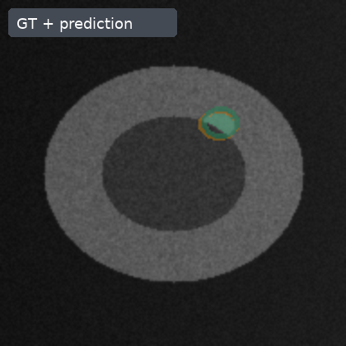
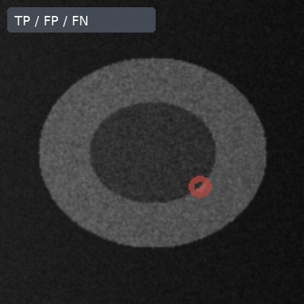
Overlay errors localize the small-lesion failure mode
GT / prediction
Error map
The miss is spatially small but changes lesion-level recall.
overlap
false positive
false negative
Synthetic public-safe image fixture; image treatment is integrated, clinical realism remains out of scope.

Slide 2
The evaluation path keeps image evidence and endpoints paired
Input image
GT / prediction
Endpoint summary
Failure review
same case
paired overlay
quantified error
case-level readout
Input, mask, prediction, and endpoint summaries are generated from the same synthetic case.

Slide 3
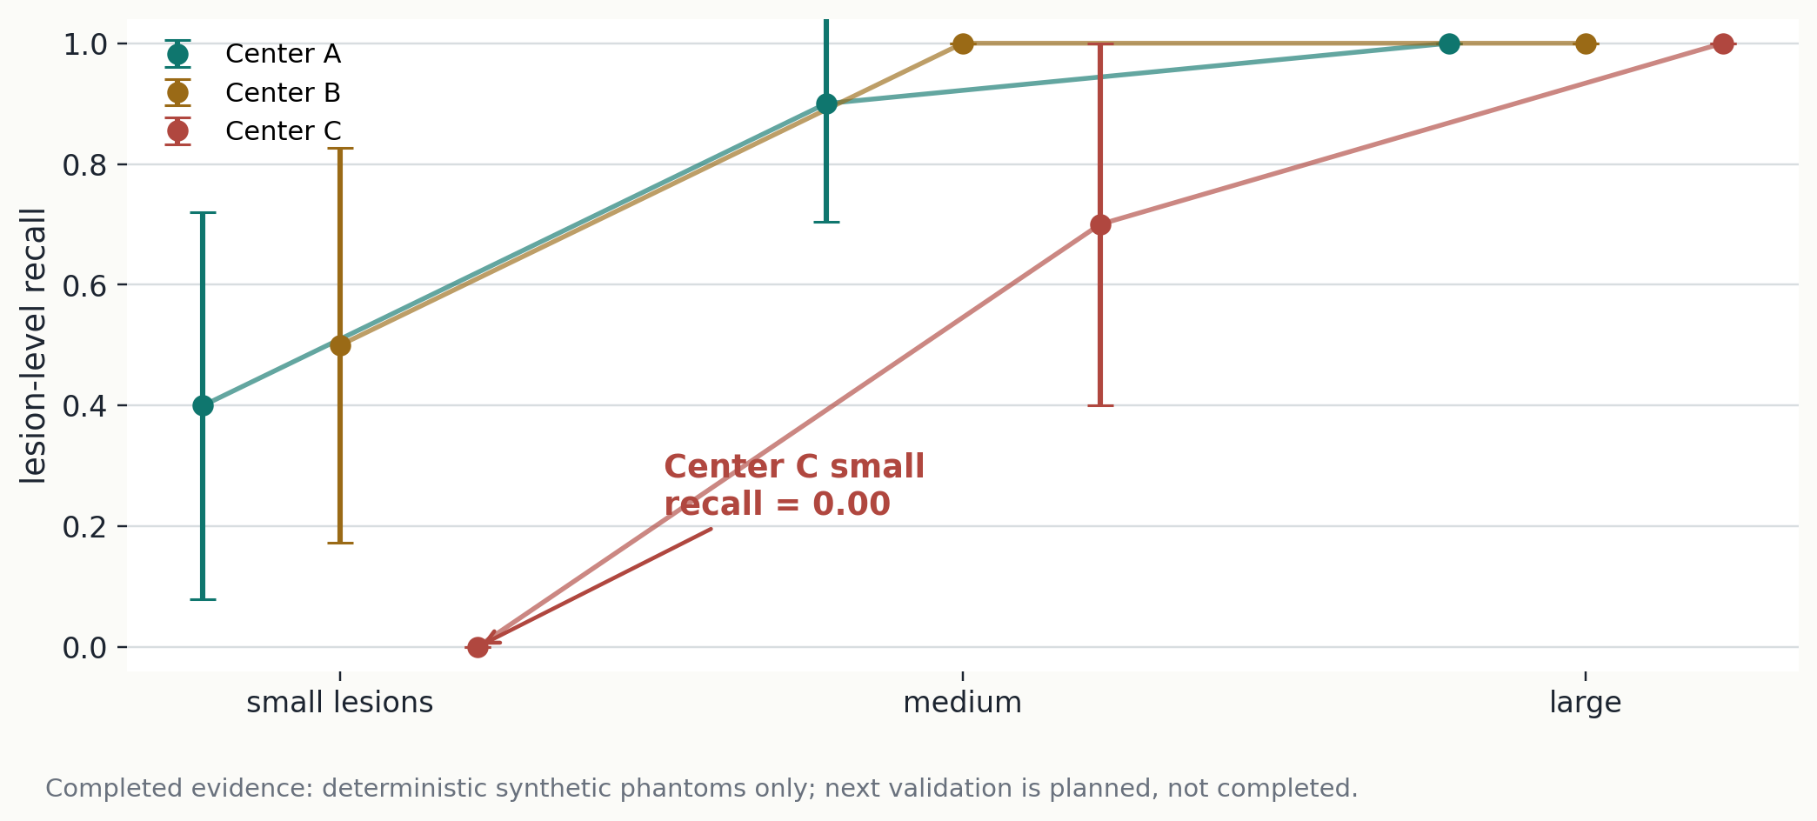
Lesion-size recall exposes the endpoint-level weakness
Recall drops most sharply for the smallest lesions in this deterministic fixture.
Deterministic fixture result; not clinical validation.

Slide 4
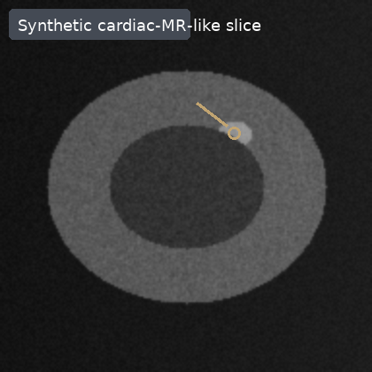
Same-case error maps show where the endpoint is lost
Input
GT / prediction
Error map
The miss is spatially small but changes lesion-level recall.
overlap
false positive
false negative
Synthetic public-safe image fixture; image treatment is integrated, clinical realism remains out of scope.

