Slide 1
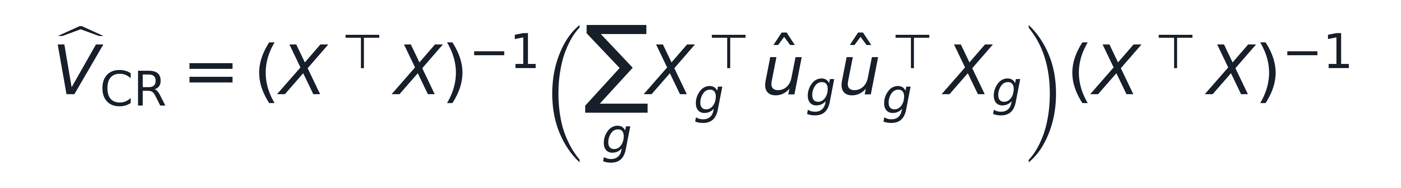
Cluster-robust variance centers uncertainty at the group level
Middle term aggregates score contributions by center.
Synthetic clustered-data fixture; design profile is deck-wide, geometry remains page-local.

Slide 2
Simulation varies clustering before interval evaluation
DGP knobs
Clustered samples
Interval procedures
Coverage / width
ICC, centers, imbalance
same estimand
naive vs CR
endpoint evidence
DGP knobs feed generated samples and interval procedures.

Slide 3
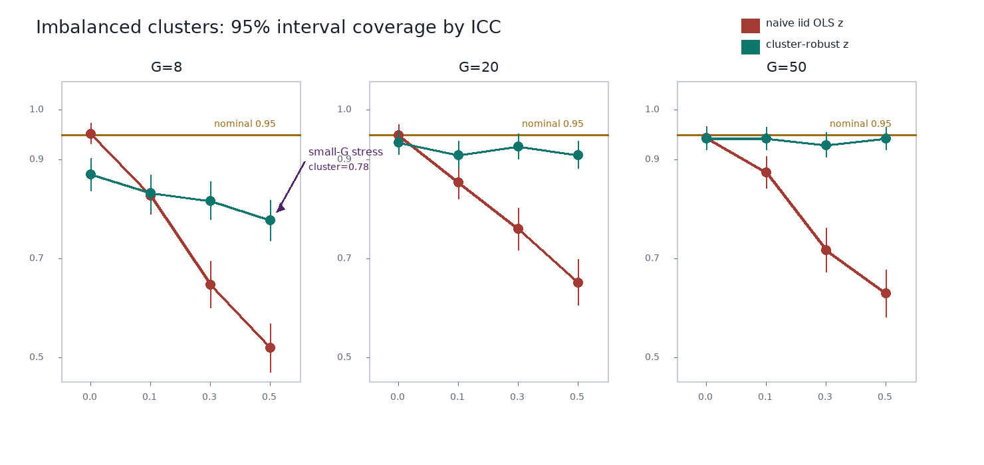
Cluster-robust intervals recover coverage, but small-G remains stressed
Coverage improves after center-level aggregation, with visible stress at low center counts.
Deterministic simulation; nominal 0.95 reference line shown in the plotted evidence.

Slide 4
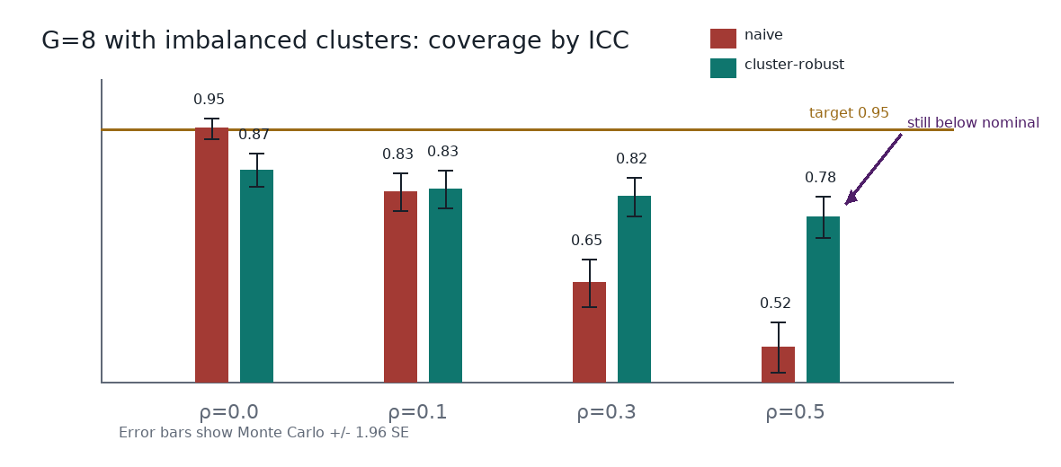
Small center counts remain anti-conservative
The failure region is the small-G corner; the next experiment should target finite-sample correction.
Negative result motivates CR2 or wild cluster bootstrap as the next discriminating experiment.

