Slide 1
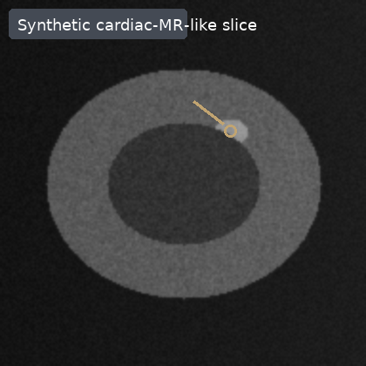
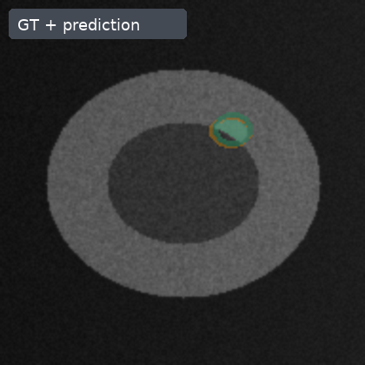
A small lesion is the unit of failure
01/05
Synthetic cardiac-MR-like segmentation task; not clinical validation
Evaluation unit: lesion detection + mask overlap
Dice summarizes mask overlap, but a missed small lesion is counted at the lesion level.
small lesion target
Endpoints: Dice overlap, lesion recall, false-positive burden
myocardial ring
Synthetic cardiac-MR-like phantoms; not clinical validation.
GT
Pred / TP
FP
FN

Slide 2
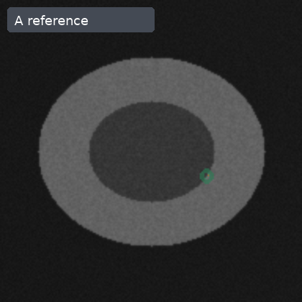
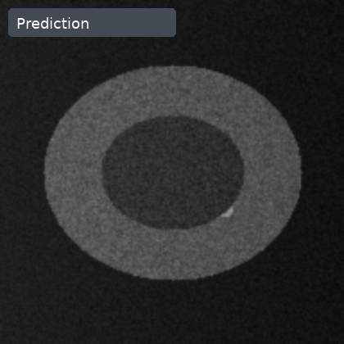
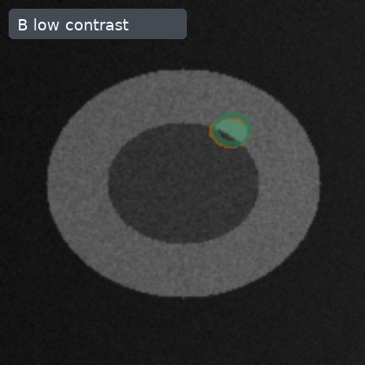
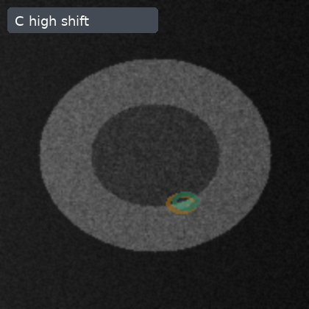
The stress test follows one image-to-endpoint path
02/05
Center appearance shift propagates through prediction before aggregation
Center A
reference contrast
case metrics Dice, recall, FP
center summary + lesion strata
Center B
low contrast + bias
image + GT
prediction
The same synthetic case carries image pixels, lesion mask, prediction and metrics before center-level averaging.
Center C
high shift
The stress test asks whether center-level average Dice hides lesion-level failures under appearance shift.
appearance shift
Aggregation is descriptive: no clinical validation claim is made from these phantoms.

Slide 3
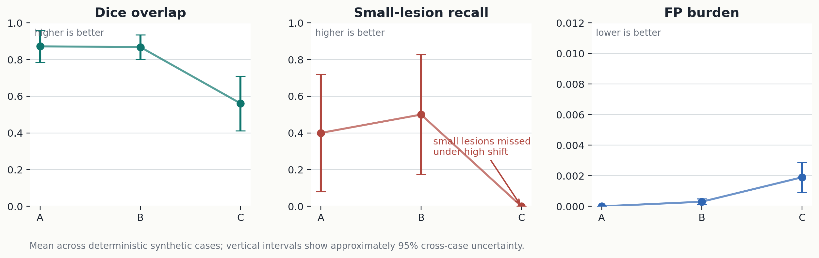
Average Dice can hide a lesion-level failure
03/05
Endpoint disagreement appears under the high-shift center
Center C average Dice = 0.56, but small-lesion recall drops to 0.00.
FP burden is lower-is-better; Dice and recall are higher-is-better.

Slide 4
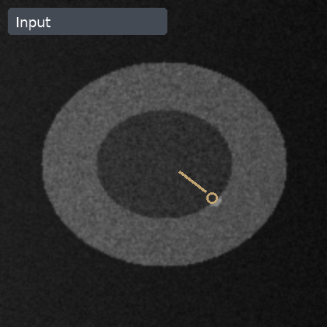
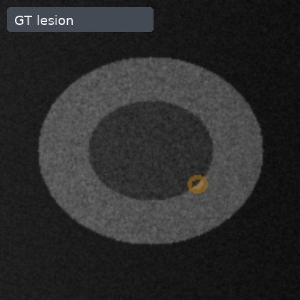
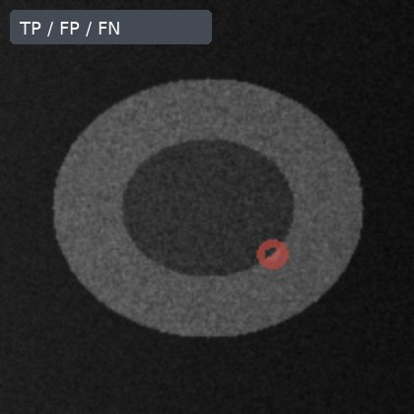
The failure is visible in the same-case overlay
04/05
A missed small lesion drives the negative endpoint
Input
GT lesion
Prediction
TP / FP / FN
GT
Pred / TP
FP
FN
Case C3-03 (Center C, small lesion): Dice 0.00; lesion recall 0; FN pixels 20.
All four panels are the same synthetic slice geometry.
The red FN region shows why an average overlap metric is not enough for this stress condition.

Slide 5
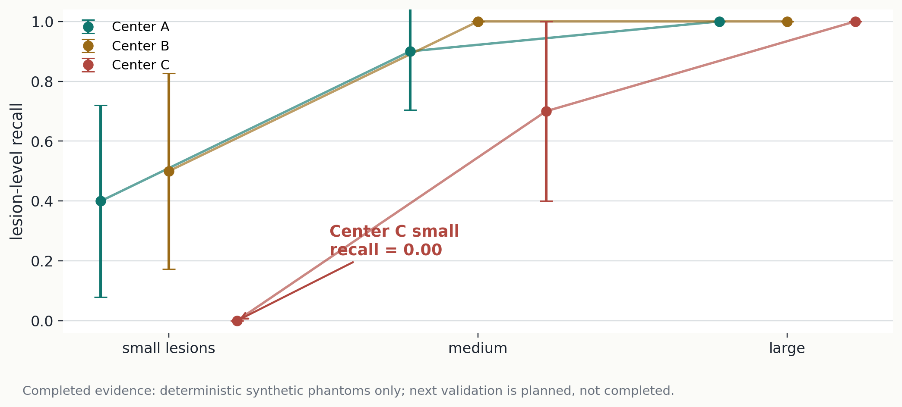
Validate the small-lesion shift explicitly next
05/05
Completed synthetic evidence motivates a planned held-out-center experiment
Completed evidence
Small lesions in the high-shift center are the supported failure regime in this deterministic phantom benchmark.
Planned validation
Hold out center C, stratify by lesion size, and sweep prediction threshold/calibration before comparing methods.
Synthetic cardiac-MR-like phantoms; not a patient validation endpoint.

