Slide 1

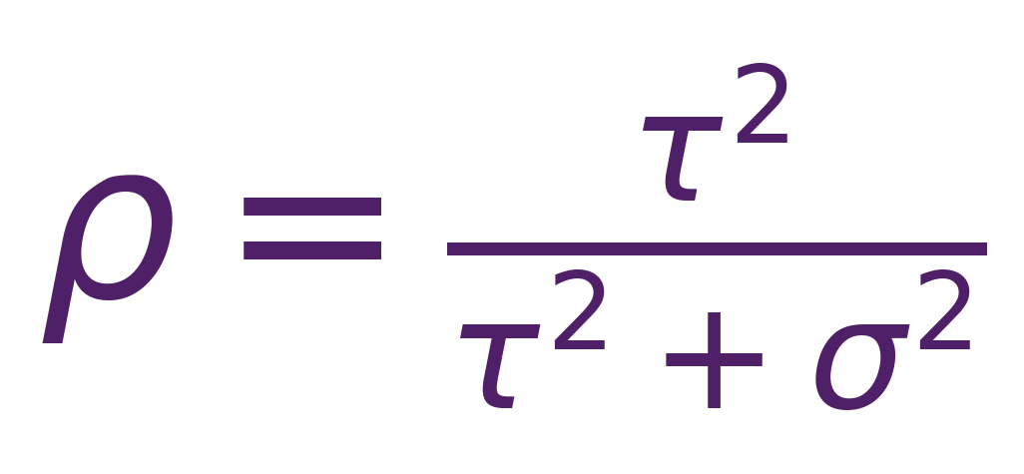
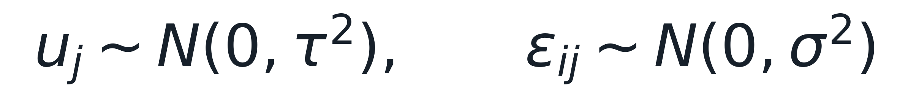
Center correlation breaks iid intervals
01/05
The point estimate targets β₁, but the uncertainty model changes.
Synthetic multi-center simulation; treatment effect β₁=0.25.
ρ is the intraclass correlation; center j is the inference unit.
β₁ is the treatment effect.
uⱼ: center-level shift shared within center j.
εᵢⱼ: individual residual noise.
Point estimates can remain centered while iid intervals lose coverage.
Grid: G=8/20/50 centers, ICC ρ=0/.1/.3/.5, balanced and imbalanced cluster sizes.

Slide 2
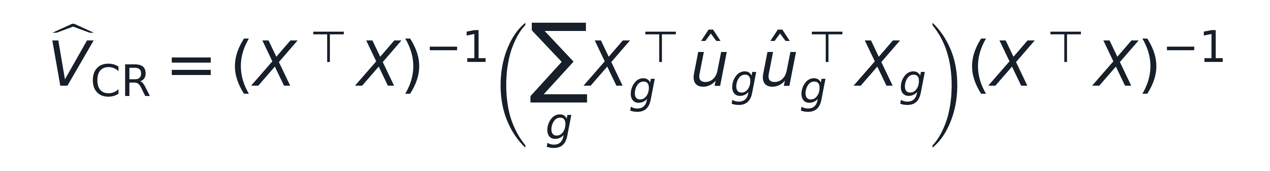

The sandwich variance aggregates by center
02/05
The middle term is a center-level score covariance, not a row-level residual pool.
Both intervals estimate β₁; only the variance object changes.
Cluster meat: score contributions are summed by center before forming covariance.
The simulation uses cluster-robust z intervals; CR2 and wild bootstrap remain planned comparisons.
Naive variance treats rows as independent.

Slide 3
A stress grid separates interval behavior
03/05
The same generated samples feed two intervals and the same coverage endpoint.
Synthetic experiment: vary center count, ICC, and cluster-size balance.
naive iid OLS z interval
DGP knobs G=8,20,50 centers ICC ρ=0,.1,.3,.5 balanced vs imbalanced
Generated samples 400 replicates per cell outcome, treatment, center
coverage, bias, interval width
cluster-robust z interval center scores aggregated
The design asks whether center aggregation repairs interval coverage across the stress grid.
Simulation study; endpoints are computed from the deterministic output for the same DGP grid.

Slide 4
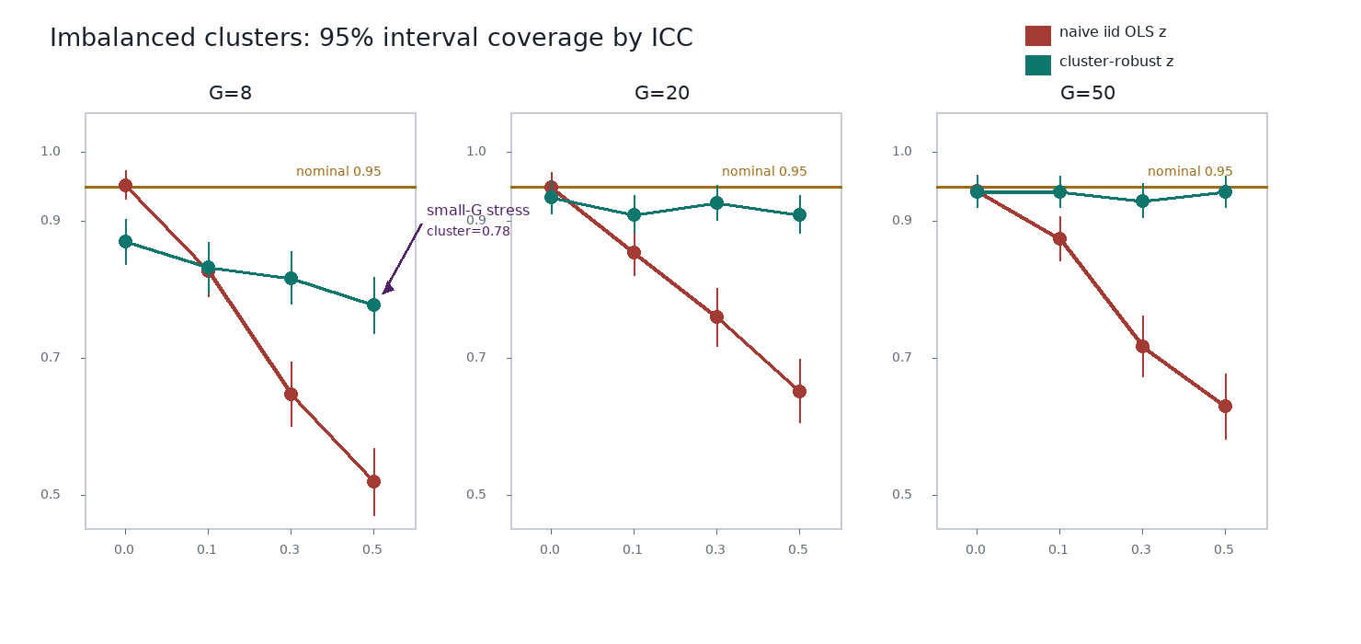
Cluster adjustment reduces, but does not erase, undercoverage
04/05
Coverage near 0.95 is the target; Monte Carlo error bars are part of the evidence.
Synthetic imbalanced-cluster simulation; vertical marks show Monte Carlo error bars.

Slide 5
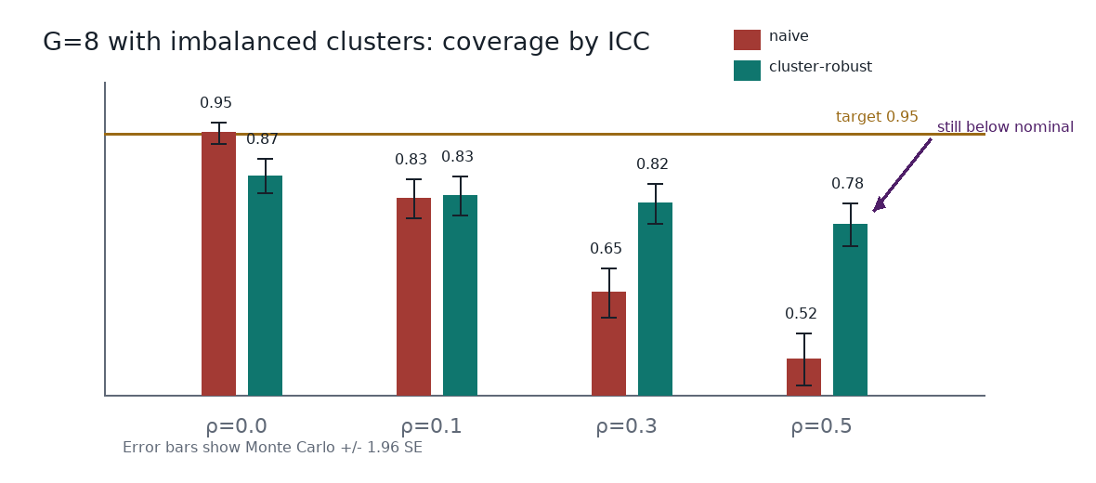
The remaining failure is finite-center undercoverage
05/05
The next experiment tests small-sample corrections under the same grid.
At G=8, ICC ρ=.5, imbalanced clusters, cluster-robust coverage is 0.78.
Few centers make the sandwich variance noisy; imbalance increases center leverage.
Planned comparison: CR2 small-sample correction and wild cluster bootstrap on the same grid.
Completed evidence is limited to the two intervals shown; bar intervals show Monte Carlo error bars.

