Slide 1
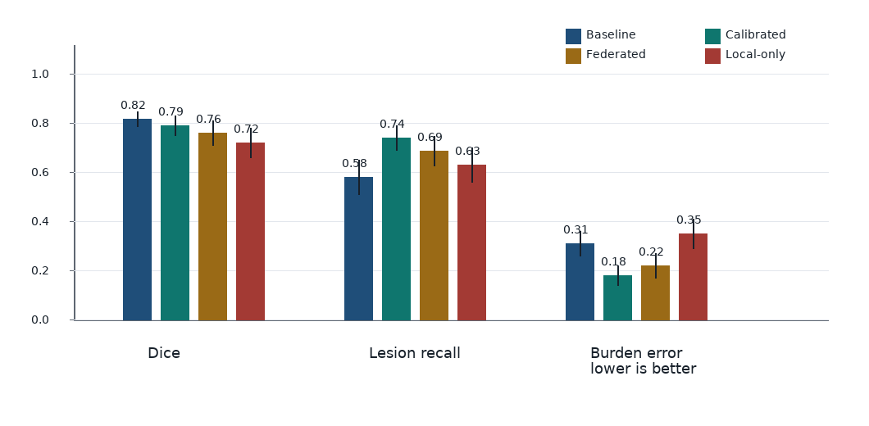
Endpoint Choice Changes the Method Ranking
01/04
The method story changes when the endpoint changes.
Evidence boundary: illustrative synthetic results - not completed validation
Interpretation In this synthetic example, Calibrated wins recall; burden error is lower-is-better and lowest for Calibrated. Baseline wins Dice only.
Meeting decision Freeze endpoint priority before ranking methods.
Reference retrieval: result/interval query selected inspected pages RRL-015, RRL-021, RRL-030, RRL-016, RRL-023; trace in EVIDENCE_MANIFEST; style not copied.

Slide 2
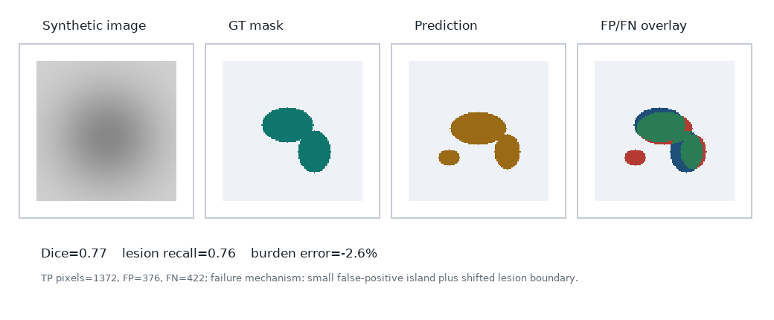
Average Dice Can Hide the Hard Case
02/04
A case page binds image, GT, prediction, error overlay, and metric.
Overlay legend
green = TP/overlap
red = FP
blue = FN
Scientific object: same synthetic case, aligned GT/prediction/error overlay, case metric next to visual.
Reference retrieval: failure-case query selected inspected pages RRL-022, RRL-024, RRL-018, RRL-013, RRL-025; trace in EVIDENCE_MANIFEST; style not copied.

Slide 3
Limited-Information Multi-Center Experiment
03/04
Raw data stay local; shared summaries are judged by endpoint-level evidence.
Center A local image + local label experimental unit: lesion-case
local estimator calibration score
Global estimator summary-sharing analysis
Center B local image + local label experimental unit: lesion-case
Transmitted likelihood / score / summary update (raw images stay local)
local estimator calibration score
Endpoint evaluation lesion recall + burden error worst-center gap < 5%
Local-only comparator no shared summaries
Center C local image + local label experimental unit: lesion-case
local estimator calibration score
Comparator path: local-only uses the same local scores without summary sharing; both branches enter the same endpoint gate.
Reference retrieval: method/design query selected inspected pages RRL-002, RRL-008, RRL-019, RRL-005, RRL-009; trace in EVIDENCE_MANIFEST; style not copied.

Slide 4
AI Phenotype Error Changes Inference
04/04
Segmentation output is a measured variable whose error can attenuate inference.
Target estimand
beta1: effect of true lesion burden T_i on downstream outcome Y_i
Observed AI phenotype M_i = T_i + U_i error varies by center
Validation subset observe both T_i and M_i estimate calibration error
Inference target Y_i = beta0 + beta1 T_i + eps_i naive M_i attenuates beta1
Toy calibration: E[T|M,center] = alpha_center + gamma_center M. Report beta1 after validation-calibrated correction, not a raw AI burden coefficient.
Evidence boundary This page is a generated-variable inference mechanism, not completed clinical validity evidence.
Reference retrieval: estimator/model query selected inspected pages RRL-044, RRL-027, RRL-020, RRL-028, RRL-007; trace in EVIDENCE_MANIFEST; style not copied.

