Slide 1
Investigating language production at the discourse level
Session 4
Vinicius Macuch Silva
Cognitive Modeling group

Slide 2
Stages of language production
Conceptualization > intended message
Utterance form(ul)ation
Lexicalization
Syntactic (compositional) structuring
Articulation > execution of motor movements

Slide 3
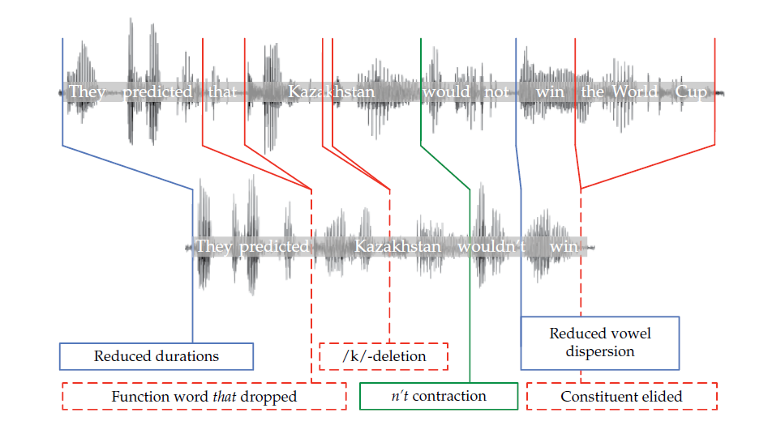
Signal reduction

Slide 4
Probabilistic reduction
Shorter linguistic forms and more reduced signals for contextually predictable message parts
Window into the architecture underlying language production system

Slide 5
What gets reduced?
Message components
Parts of the message the speaker wishes to convey
Linguistic forms
Instances of linguisic categories (not directly observable)
Linguistic signal (observable)
Acoustic signal or visual signal (gesture, sign, writing)

Slide 6
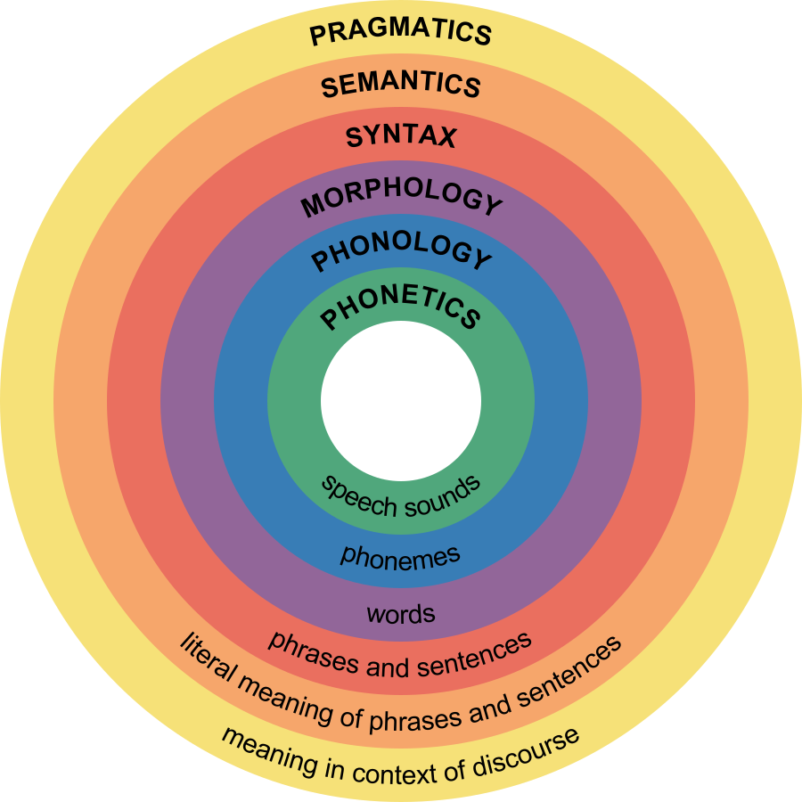

Slide 7
Reduction and omission of referring expressions
Near meaning-equivalent forms
Pronoun (“he”), name (“John”), noun phrase (“a colleague of mine”)
Referent accessibility in context (predictability)
Previous mention of a referent
Higher likelihood of future mention (reduced form)
Probability decreases with distance (lower preference for pronouns)

Slide 8
Reduction and omission of referring expressions
Effects of contextual predictability on realization of referring expressions
Less predictable preceding context > longer linguistic forms (Tily & Piantadosi, 2009)
Full vs. reduced lexical form > preference for shorter forms increases with contextual predictability (Mahowald et al. 2013)
Short form > supportive contexts (e.g. Susan loves the apes at the zoo, she even has a favorite ... vs. During a game of charades Susan was to embarassed to act like a ...)

Slide 9
Reduction beyond the level of the clause
Coherence relations
Coherence marker instead > more likely to be omitted in the presence of contextual cue to unexpected discourse relation (Asr & Demberg, 2015)
They did not panic during the first round of selling. (Instead), they sold into the strength, which kept the market orderly.
One vs. two sentences
Move the triangle to Central Park vs. Take the triangle. Now move it to Central Park.
Object consisted of less predictable words > Split message into two clauses (Gallo et al. 2008)

Slide 10
Open empirical questions
Inverse correlation btw predictability and linguistic signal
Relation btw production planning and realization of the linguistic signal
Reduction at different levels of linguistic encoding
Cues affecting probabilistic reduction
Local lexical cues
Integration of multiple cues to the same target

Slide 11
Theoretical accounts
Production ease > demands of incremental linguistic encoding
Communicative > communicative goals (audience design)
Representational > offline changes in representation over longer periods of time

Slide 12
Theoretical accounts
Production ease vs. communicative accounts > continuum of perspectives (competing pressures)
Achieve communicative goals while dealing with limited resources
Listener-specific audience design is possible but resource-demanding

Slide 13
Communicative accounts
Preferences in signal reduction and enhancement are affected by communicative goals
Bias for robust message transmission
Transmission of non-literal and social meaning
Cause a change in the interlocutor's state of mind
Understanding of production preferences > goals of language use

Slide 14
Trade offs between production ease and communicative goals
Production preferences > competition btw robust message transmission and production ease or effort
Bias for robust message transmission > signal quality
Bias for production ease > shorter and less articulated signals
Probabilistic reduction > contextual predictability increases a priori accuracy and speed of message transmission

Slide 15
Trade offs between production ease and communicative goals
Contextually less predictable message components > speaker provide better signals to aid comprehension
Better signal > higher likehood of achieving communicative goals
Reduction is expected in contexts where the message is predictable

Slide 16
Strong audience design hypothesis
Adapt productions so as to increase the probability of successful communication
Strong audience design
(a) Speakers integrate listener-specific information during encoding
(b) Immediate integration

Slide 17
Strong audience design hypothesis
(a) Listener-specific information > knowledge about interlocutor's perspective
Lexical encoding
Selection of referring expressions
Ways of referring to the same entity (interlocutor's perspective and knowledge state)

Slide 18
Strong audience design hypothesis
(b) Audience design > learning to best communicate in a given situation
Novel situation > infer which variant more likely to achieve their communicative goals
More reduced variants result in communicative failure > speakers adapt subsquent productions toward less reduced variants

Slide 19
Open questions in audience design research
Conditions under which speakers engage in audience design Natural communicative behavior
Rational or boundedly rational behavior
Utility of audience design > weighing of costs against expected benefits

Slide 20
Probabilistic reduction and the psycholinguistic agenda
Alternative means of expressing near meaning-equivalent messages
Sensitiveness to contextual predictability
Both production ease and communicative goals mediate reduction

