Slide 1
Investigating linguistic meaning using psycholinguistic tools
Session 2
Vinicius Macuch Silva
Cognitive Modeling group

Slide 2
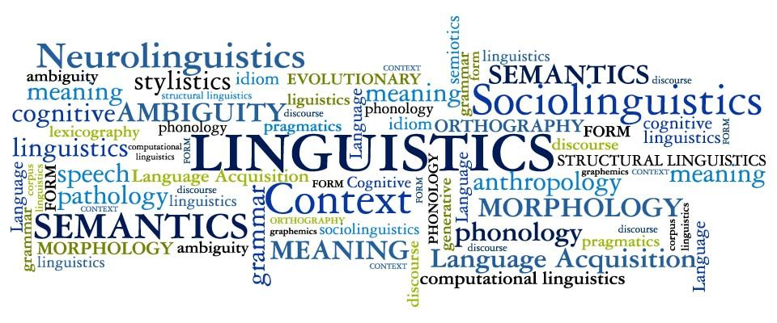

Investigating linguistic meaning using psycholinguistic tools
Psycholinguistics
Pragmatics

Slide 3
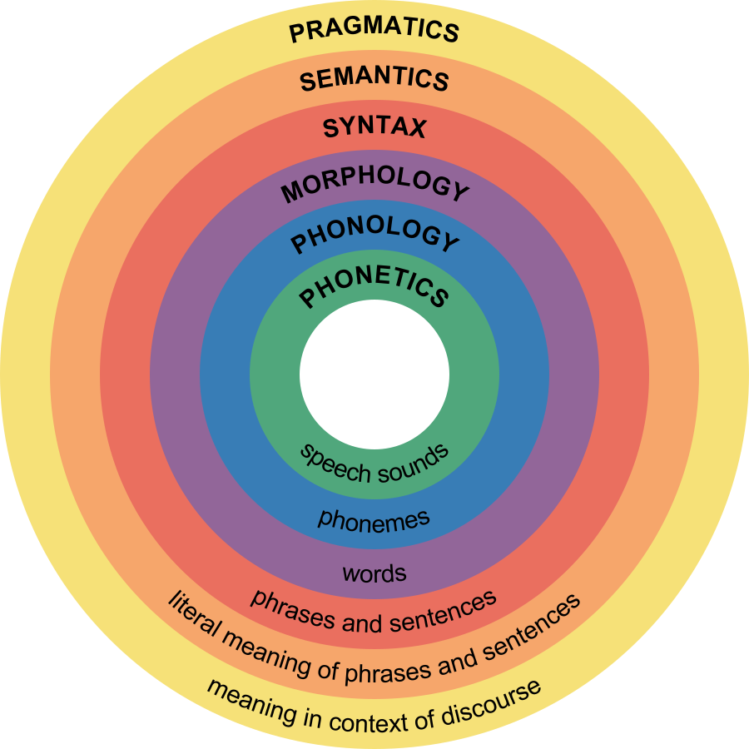
Pragmatics

Slide 4
Pragmatics
Speech Acts: An Essay in the Philosophy of Language
How To Do Things With Words
Logic and Conversation
Austin (1962)
Searle (1969)
Grice (1975)
Politeness: Some Universals in Language Usage
Relevance: Communication and Cognition
Pragmatics
Brown & Levinson (1978)
Levinson (1983)
Sperber & Wilson (1986)

Slide 5
How many layers of linguistic meaning?
“Discerning the meaning of an utterance requires more than just knowing the meaning of words and having a mastery of grammar. Understanding a speaker's meaning involves, among other things, inferring conclusions, acceding to indirect requests and referring to objects in (our out of) view. More importantly, understanding an utterance requires access to, or hypotheses about, the speaker's intention. In other words, understanding utterances involves undertanding the communicative (i.e. pragmatic) features of language.”
Noveck & Reboul (2008)

Slide 6
How many layers of linguistic meaning?
'Sentence meaning' <> 'Speaker meaning'
Semantic properties <> Intention attribution (cognitive effect)
Linguistic communication > attribution of mental states to interlocutors

Slide 7
Gricean principles of communication
Principle of cooperation
Interlocutors “make [their] conversational contribution such as is required, at the stage at which it occurs, by the accepted purpose or direction of the talk exchange in which [they] are engaged”
Maxims of conversation

Slide 8
Gricean principles of communication
'make your contribution as informative as is required and not more informative than is required’
Maxims of Quantity
‘do not give information that is false or that is not supported by evidence’
Maxims of Quality

Slide 9
Scalar implicatures
“I saw some of your children today” > I didn't see all of your children today
Generalized conversational implicature
Pragmatic inferences linked to common propositions
Pragmatically but not logically valid

Slide 10
Scalar implicatures
(Horn) Pre-existing linguistic scales
Expressions ranked by order of informativeness
<some, all>
Lower informativitity term > speaker implies that the proposition expressed by a higher informativity term is false

Slide 11
Scalar implicatures
(Levinson) Scalar implicatures are generated automatically whenever a weak term is used
(Chierchia) Implicatures always occurr except in a specific grammatical category (downward entailing)
Negations, question forms, antecedents of conditionals
(Sperber & Wilson) Semantic reading does not rely on a general and automatic mechanism. Context drives interpetation

Slide 12
Scalar implicatures
Post-Gricean environment > experimental work
Pragmatic enrichments > processing effort
(Bott & Noveck, 2004) Categorization task
Some cats are mammals
[Reaction time] False responses > true responses

Slide 13
Scalar implicatures
John heard that / the notebook for Geophysics / was very advanced. / Nobody understood it properly. / He heard that / if he wanted to pass the course / he should read / the class notes or the summary.
John was taking a university course / and working at the same time. / For the exams / he had to study / from short and comprehensive sources. / Depending on the course, / he decided to read / the class notes or the summary.

Slide 14
Scalar implicatures
Narrowed readings more effortful than semantic ones
Experiments > determine which Gricean-inspired theory can best make sense of the empirical results
In line with relevance theory // against default accounts

Slide 15
Definite reference
Referential language > semantically underspecified interpretation
Common ground (mutual knowledge)
Does common ground directly constraint linguistic interpretation?

Slide 16
Definite reference
Common ground is intrinsic to mutual understanding
(Herb Clark) Repeated reference as a measure of production
Interlocutors exchange descriptions and information to organize sets of picture into particular orders
Specificity of reference is modified by context
Lexical entrainment

Slide 17
Definite reference
(Herb Clark) Comprehension measures - Addressees have to pick out a referent based on asked questions
Question form presupposes what is part of common ground and enables addressee to pick out the salient reference
Addresse's reference resolution
Listener does not automatically take into consideration speaker's point of view

Slide 18
Keysar et al. (2000)

Slide 19
Definite reference
Strong common ground approach - People exploit linguistic cues and theory of mind constraints are accessed online
Referential language cannot in itself provide the listerner with relevant clues
Some amount of inference is needed to close the gap between sentence meaning and speaker meaning

Slide 20
Utterance interpretation
Code (lexical items)
Non-demonstrative inferences (in context)
Intentions (theory of mind)

Slide 21
Utterance interpretation
Scalars
Definite reference
Relative importance of code and inference
Extent to which theory of mind matters in sentence interpretation
Effortful inferential approach
<>
meaning resolution via language

Slide 22
What can experimental pragmatics offer?
Inform the field of linguistic pragmatics
Allow one to study features not traditionally associated with psycholinguistics
Gricean pragmatics can be extended to a wide variety of topics

