Slide 1
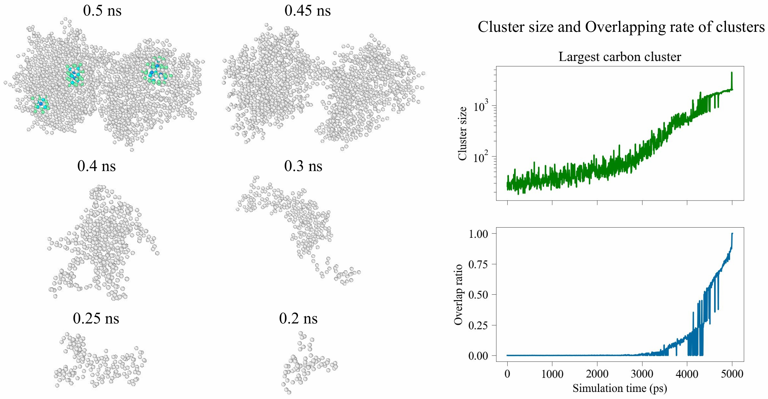
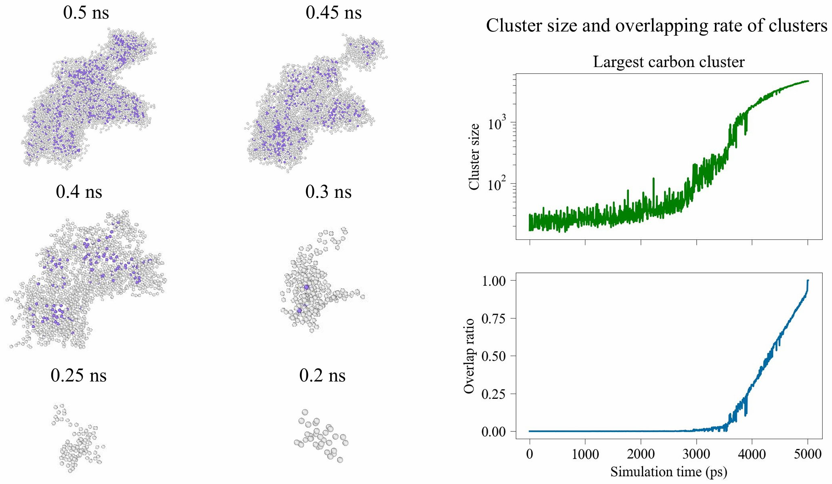
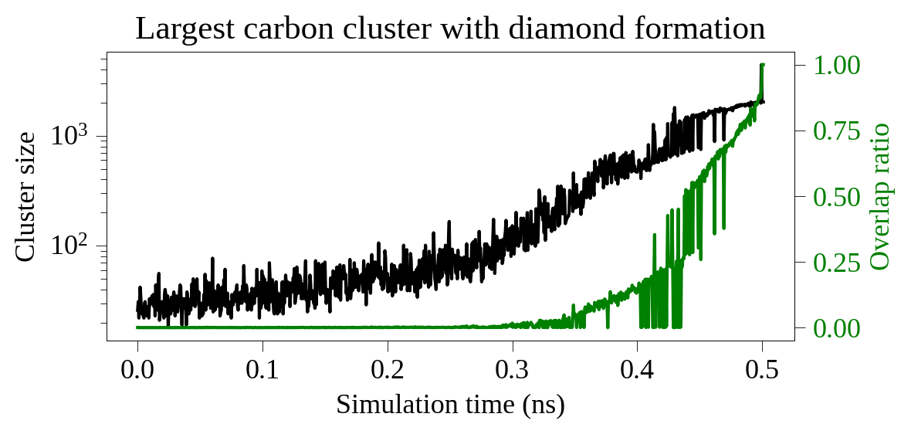
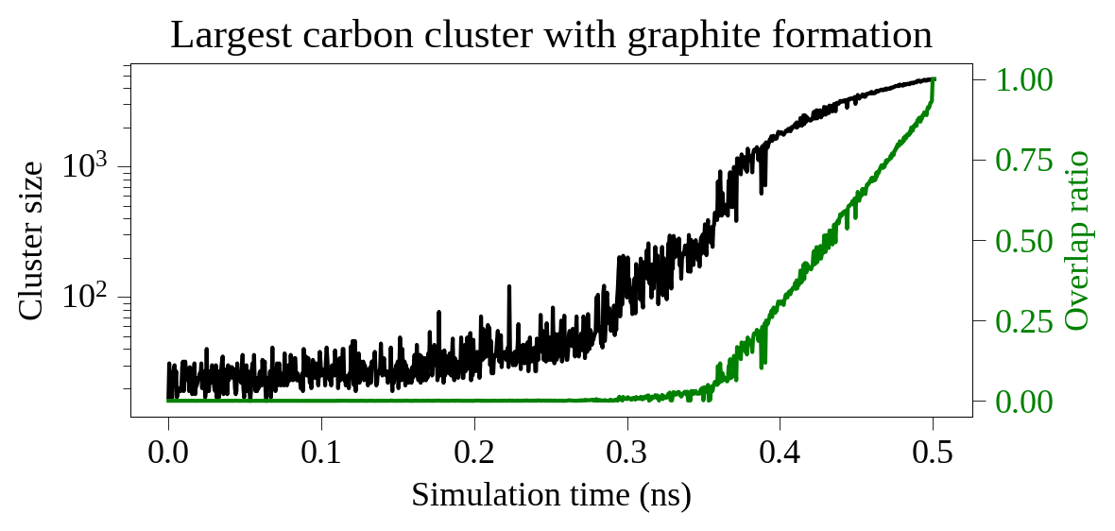
Nucleation of diamond cluster
0.2 ns
0.25 ns
0.3 ns
0.4 ns
0.45 ns
0.5 ns
Nucleation of graphite cluster
0.2 ns
0.25 ns
0.3 ns
0.4 ns
0.45 ns
0.5 ns

