Slide 1


A Dynamic Task Offloading Algorithm Based on Greedy Matching in Vehicle Ad Hoc Networks
CS741 – Next Generation Cloud Architecture Course Project
DEPARTMENT OF COMPUTER SCIENCE AND ENGINEERING
NATIONAL INSTITUTE OF TECHNOLOGY KARNATAKA SURATHKAL 2023 – 2024

Slide 2

Group Members
Irigi Yuva Kumar - 232CS013
Dhananjani Jayarukshi - 232CS014
Himanshu Thakkar - 232CS035

Slide 3
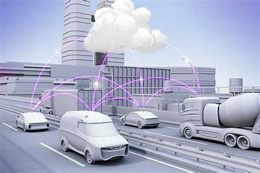
Content
Introduction
Background
Related Work
System Model
Problem Formulation
Proposed Algorithm
Simulation setup
Results and Analysis
Conclusion

Slide 4
Introduction
We implemented a dynamic task offloading algorithm for Vehicular Ad Hoc Networks (VANETs), based on greedy matching principles.
The algorithm can dynamically assign tasks to communication endpoints based on real-time network conditions, task characteristics, and resource availability.
This approach aims to optimize task assignment, minimize response times, and enhance service quality for cloud-based applications in vehicular environments.
The algorithm addresses unique challenges in VANETs, such as high mobility, limited bandwidth, varying channel conditions, and resource constraints.
We implemented another algorithm called KMM, for the performance comparison with the GMDC algorithm.
We have used simpy simulation framework for the simulation of the algorithms to check their performance.

Slide 5
Background
Mobile Ad Hoc Networks (MANETs):
A mobile ad hoc network (MANET) is a collection of mobile nodes that act as both routers and hosts in an ad hoc wireless network and that dynamically self-organize in a wireless network without using any pre-established infrastructure.
Vehicular Ad Hoc Networks (VANETs):
A specialized form of Mobile Ad Hoc Networks, facilitate communication between vehicles and roadside infrastructure, enabling intelligent transportation systems applications like traffic management and collision avoidance.
Task Offloading in VANETs:
Task offloading optimizes resource utilization and performance in VANETs by offloading computational tasks to nearby computing resources, reducing energy consumption and latency issues. Task offloading is two types,
Static Offloading: Involves in predefining task offloading policies based on static parameters such as vehicle density, location, or traffic patterns.
Dynamic Offloading: Optimizes task offloading decisions based on dynamic programming principles, considering factors such as task characteristics, network conditions, and resource availability.

Slide 6
Related Work
Greedy matching algorithms prioritize task assignment based on local optimization criteria, making them computationally efficient for dynamic VANET environments.
Machine learning-based approaches, like reinforcement learning or neural networks, learn task allocation policies from historical data or simulated environments, varying in complexity, adaptability, and performance.
We implemented a task allocation strategy for VANETs, combining dynamic task offloading and greedy matching algorithms.
The algorithm balances performance and computational overhead, prioritizing tasks based on proximity to resources and urgency.
Compared to existing static and dynamic techniques, the proposed greedy matching algorithm prioritizes tasks based on proximity to resources and urgency, improving system performance and user experience in VANETs.

Slide 7
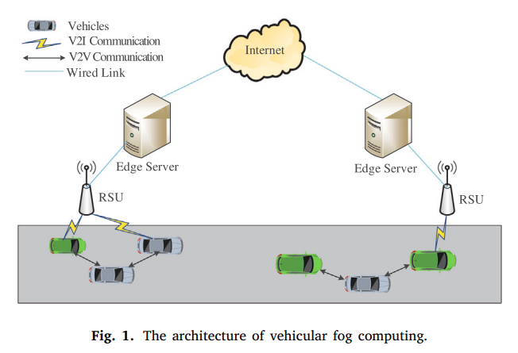
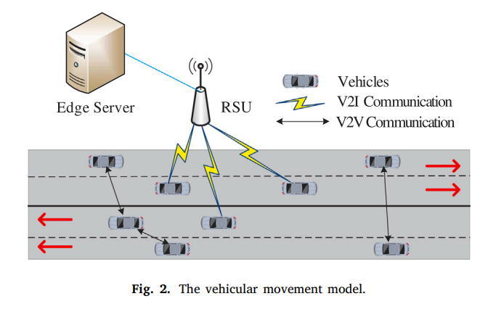
System Model
Our base paper presents a vehicle movement model (VMM) for urban traffic environments, using a four-lane dual carriageway with different vehicle movement directions. The model uses a random distribution of vehicles and manages the system using edge servers and RSU.
VFC communication models, including V2I, V2V, and V2X, are used to provide services. V2I focuses on data offloading through wireless links, while V2V maximizes secrecy rates.
V2V optimizes resource allocation for contact perception in vehicle-mounted cloud systems, while V2X addresses resource waste by joint allocation of spectrum and computing.
We need to divide the set of vehicles into left and right lanes. It calculates if a vehicle's position falls within the left or right portion of the road. If it does, it's in the left lane, otherwise it's in the right lane.

Slide 8
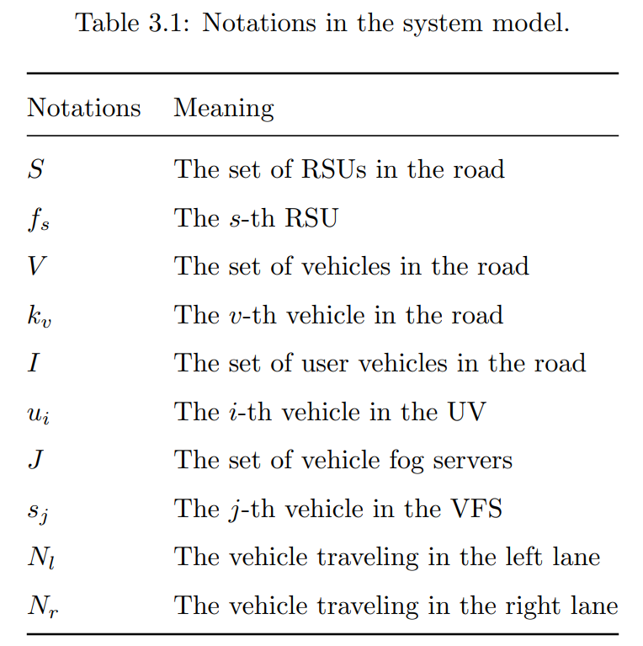
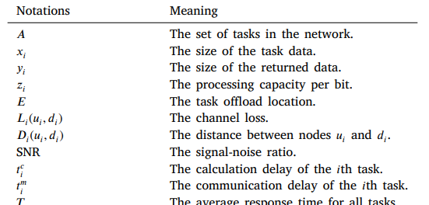
Problem Formulation
The dynamic task offloading algorithm for VANETs optimizes resource utilization and network efficiency by offloading computational tasks from multiple vehicles to nearby Fog Servers or Roadside Units.
The given tables summarize the notations in the system model.
For the implementation, we need to use set of formulas to get results.
Channel Loss
Transmission Rate (Uplink and Downlink)
Response Time
Euclidean Distances
Signal to Noise Ratio (SNR)
Computation Time
Communication Time
Transmission Delay (Uplink and Downlink)

Slide 9
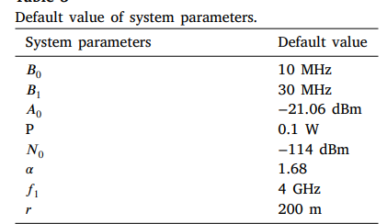
Default System Parameters

Slide 10

Proposed Algorithm
The proposed algorithm consists of GMDC and KMM components, aiming to optimize task offloading decisions in a vehicular ad-hoc network by efficiently assigning tasks to Vehicle Fog Servers or Roadside Units.
GMDC Algorithm:
Uses a greedy matching approach to assign tasks to available VFSs or RSUs.
It is for adapting the dynamics of traffic environment.
In GMDC, the user vehicle appears randomly.
It initializes parameters like communication range, transmission power, noise power, available bandwidth, and path loss exponent range.
Data preparation involves loading vehicle, VFS, and RSU data, and assigning tasks based on communication ranges and delay time.
The algorithm minimizes total response time by selecting the best match for each vehicle.

Slide 11
KMM Algorithm
The KMM algorithm is a sophisticated task assignment optimization method.
It involves initializing parameters and loading data, determining potential matches with VFSs and RSUs, optimizing the assignment to minimize total response time, and evaluating the algorithm's effectiveness through analysis of assignment results and total response time.
It uses a two-time selection mechanism to select the offload server and uses the Kuhn-Munkras (KM) algorithm for the final decision.

Slide 12
Simulation Setup
The SimPy simulation framework is utilized to model and simulate the behavior of vehicles in a vehicular ad-hoc network (VANET) environment.
SimPy is a Python-based discrete-event simulation library that allows users to model and simulate complex systems, including event-driven behavior, resource allocation, and process interactions.
It provides a high-level abstraction for defining and managing simulation processes, events, and resources.
The SimPy simulation framework starts with an initialization environment, which serves as the container for simulation processes.
Simulation processes are defined as Python generator functions that yield events representing state changes or actions within the system.
SimPy's scheduling mechanism schedules events, and event handlers execute them when they occur.
The simulation is executed using the env.run() method, and relevant data is collected for performance evaluation and system optimization.

Slide 13
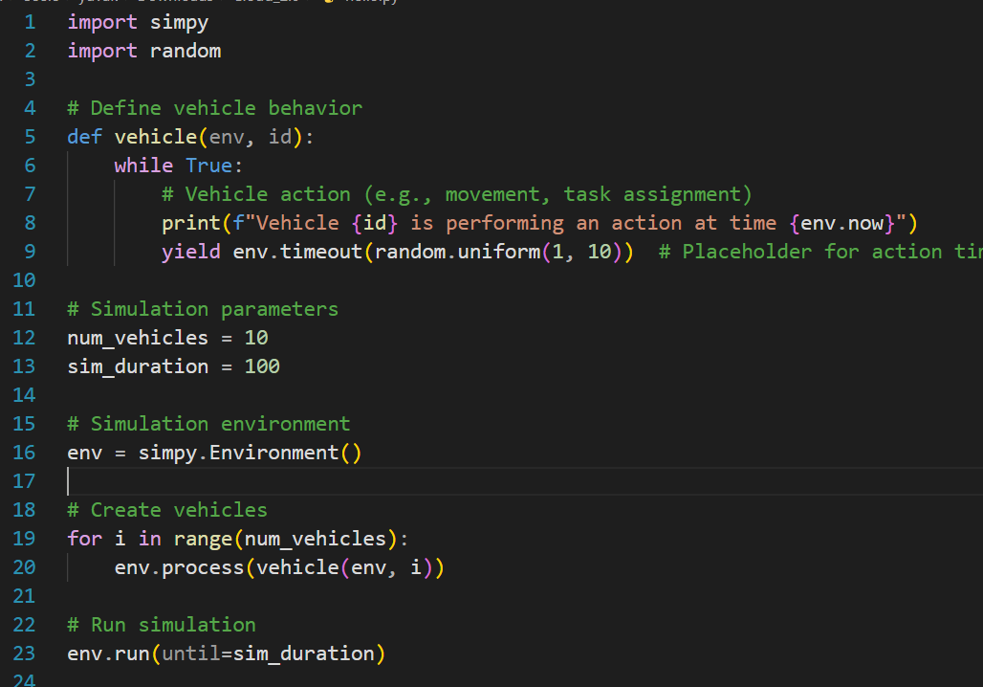
SimPy

Slide 14
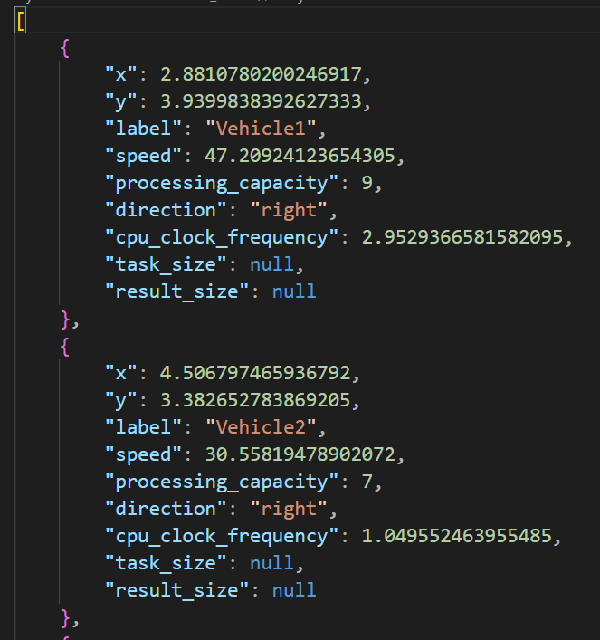
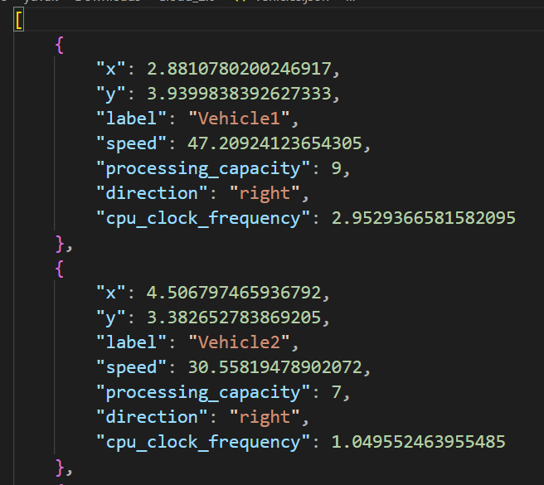
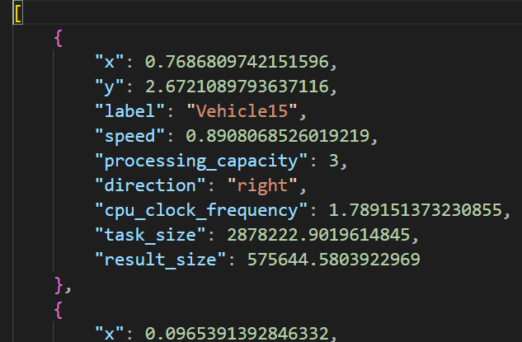
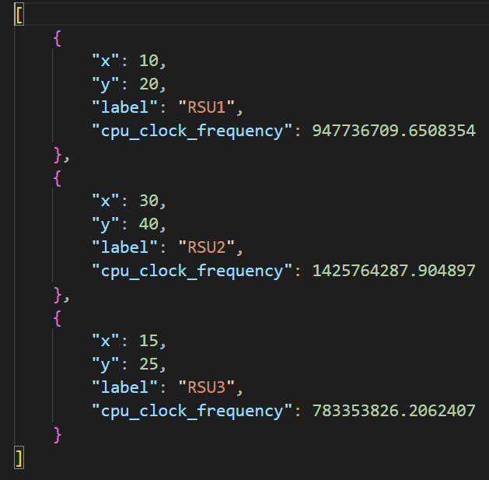
Result and Analysis
The simulation results and analysis involve generating data in the form of json files for all setups after executing the code file simulate.py.
vfs.json vehicles.json user_vehicles.json RSU.json

Slide 15
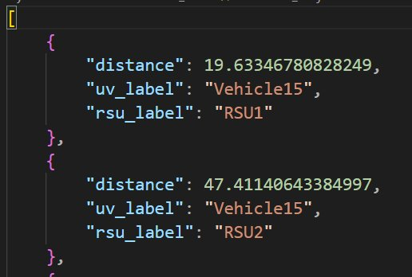
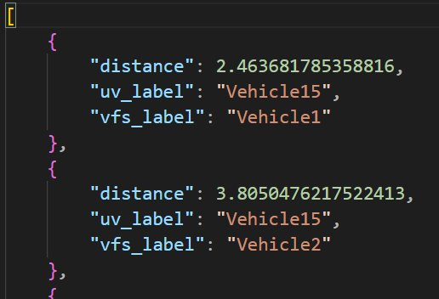
In the distances_rsu.json file, we have stored the calculated euclidean distances between each and every UV and RSU.
In the distances_vfs.json file, we have stored the calculated euclidean distances between each and every UV and VFS.
distances_rsu.json
distances_vfs.json

Slide 16
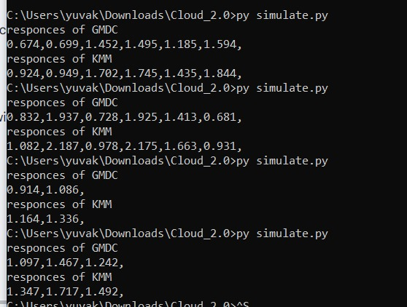
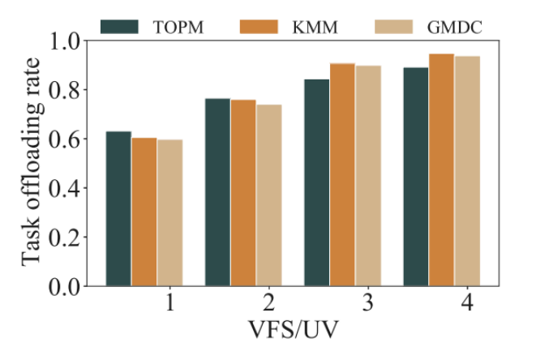
Response Time Distribution

Slide 17
KMM Matching Results and Minimum Time Cost
This output demonstrates the effectiveness of the KMM algorithm in efficiently matching vehicles with suitable offloading points, resulting in optimized task completion times.
The matching results means the location where each user vehicle offloads tasks to. It can be a VFS or a RSU. KMM algorithm uses a two-time selection algorithm to select the best offloading server.
The minimu time cost is taken from the KM algorithm when doing the matching of the vehicles for the second time.
‹#›

Slide 18
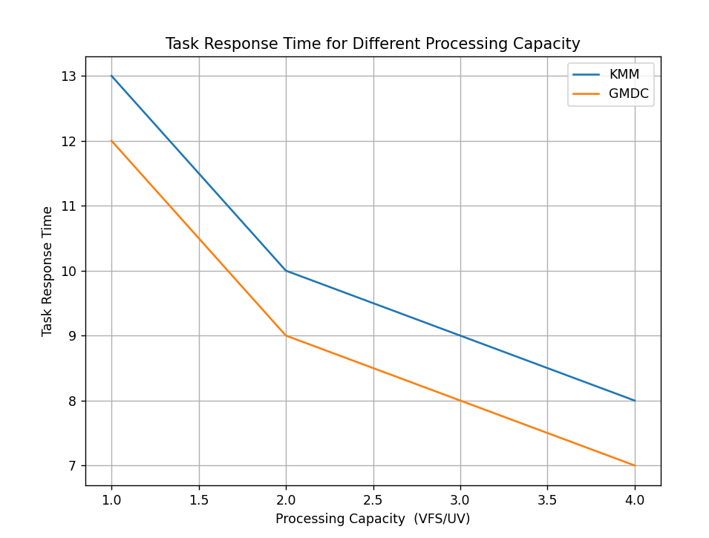
Comparison of GMDC and KMM Algorithms: Task Response Time Vs. Processing Capacity
This shows the task response time of KMM, and GMDC in the case of different UV processing capabilities.
As the processing power of UV decreases, more tasks are offloaded to RSU and VFS.
This increases the communication time, so the task response time of the two algorithms also increases.

Slide 19
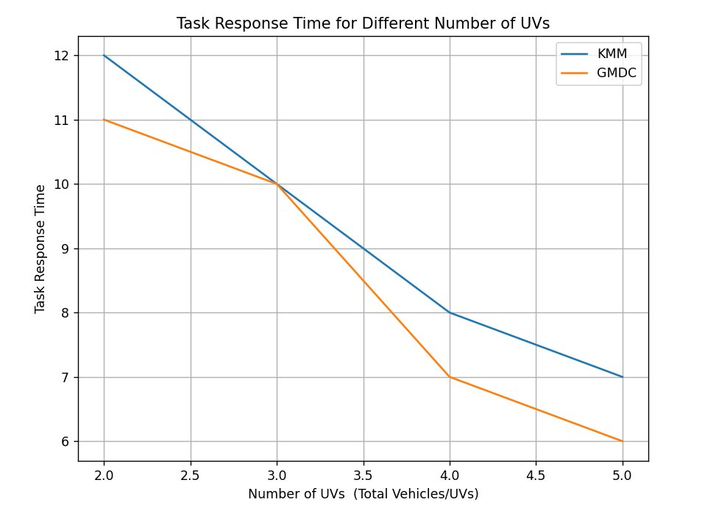
Comparison of GMDC and KMM Algorithms: Task Response Time Vs. Number of Tasks
This focuses on the response time parameters of GMDC, a dynamic algorithm that generates tasks randomly over time.
The number of UVs changes, but it doesn't significantly affect the offloading rate for different processing capacities.
For KMM, when UVs are large, VFS cannot handle tasks fully, so some are handed over to RSU.
As UVs decrease, most tasks are handed over to VFS, resulting in a smaller proportion of RSU than GMDC.
The response time of KMM is higher than that of GMDC, and the response time increases as UVs decrease.

Slide 20

Conclusion
Our base paper proposes a network model called VMM for vehicle movement, integrating vehicles with idle computing resources into a VFC.
It proposes two algorithms: Munkras-based matching algorithm KMM and dynamic algorithm GMDC based on greedy matching.
Both algorithms show close performance under ideal conditions. However, the article has shortcomings, such as not considering the cost of VFS and traffic environment complexity.
The dynamic task offloading algorithm based on greedy matching offers a promising avenue for optimizing resource utilization and task management in cloud-enabled vehicular environments.
Future research should explore advanced techniques for dynamic task prediction and real-world deployment.

Slide 21
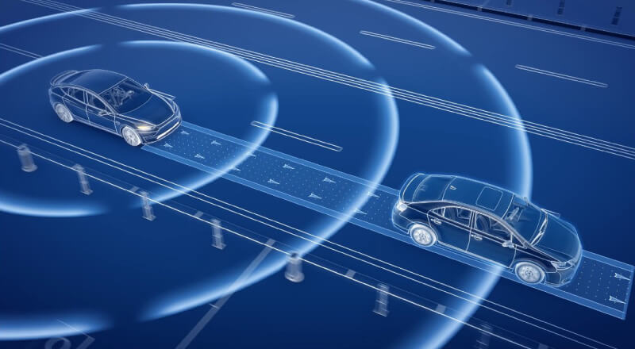
Thank You

