Slide 1
UI FRONTEND PROJECT

Slide 2
Made With
HTML
CSS
Java Script

Slide 3
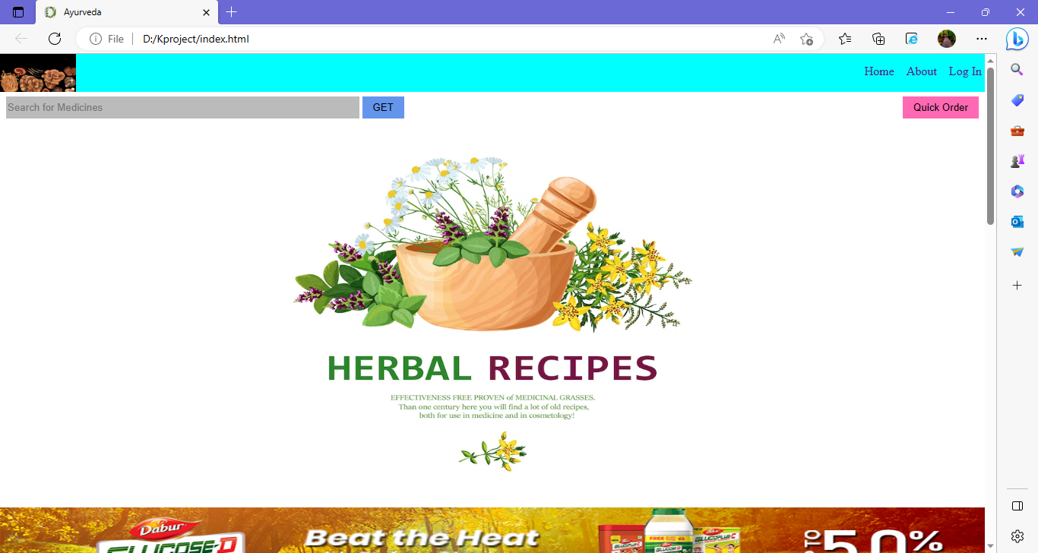

Slide 4
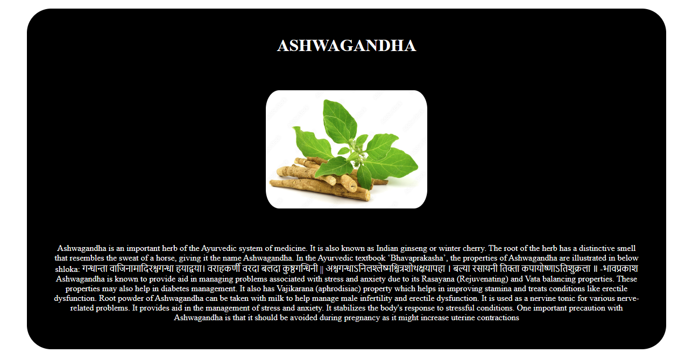
Know About Ayurvedic Ingredients

Slide 5
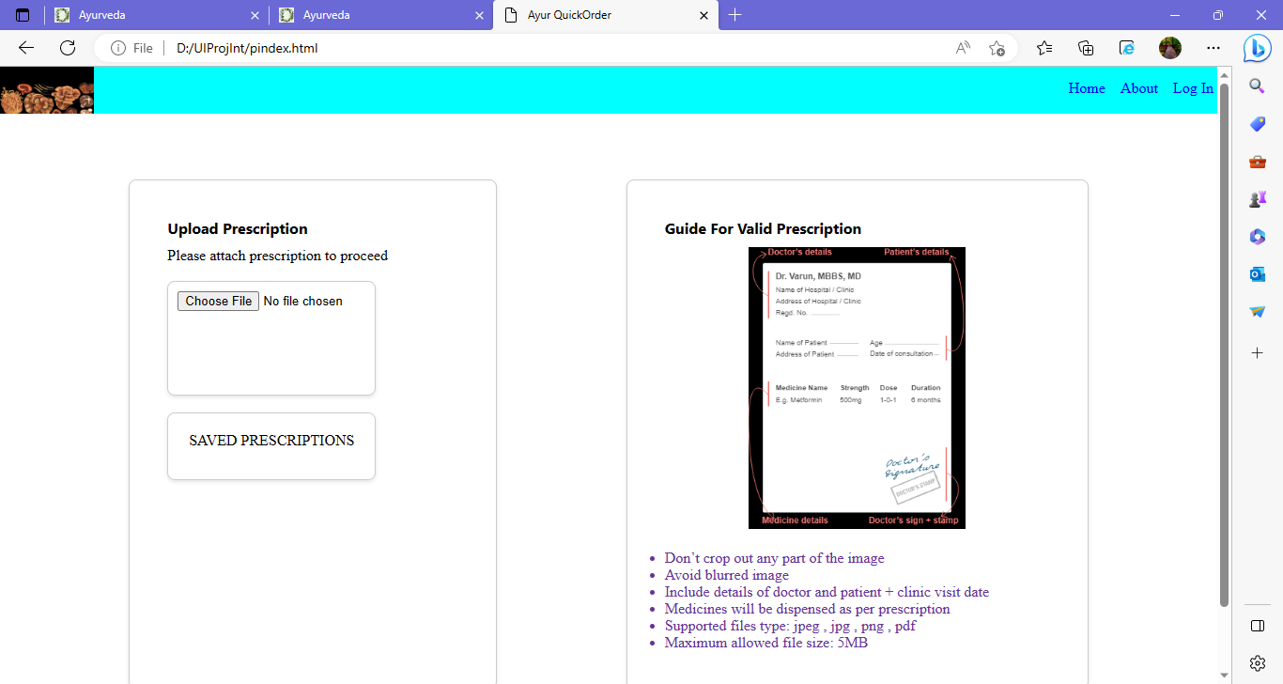
Quick Order

Slide 6
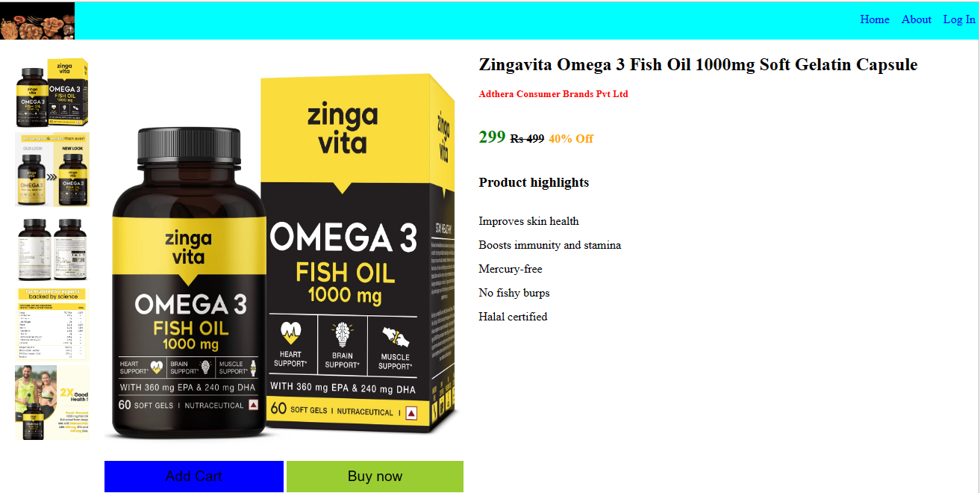

Slide 7
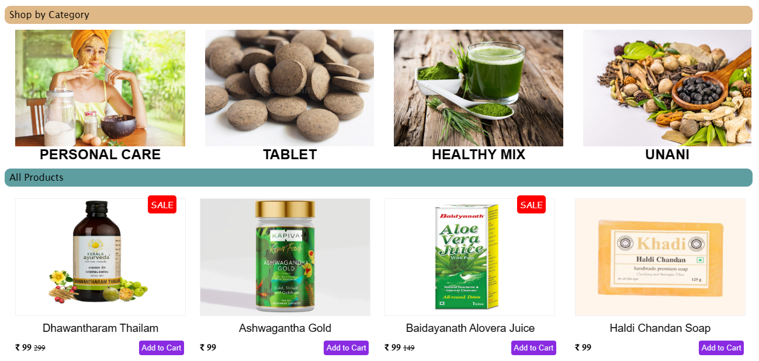

Slide 8


Slide 9
