Slide 1
Mom-o-Nomy
Hyperlocal Multi-vendor E-Commerce Platform
Done By
Yuva Harini Buvaneswari

Slide 2
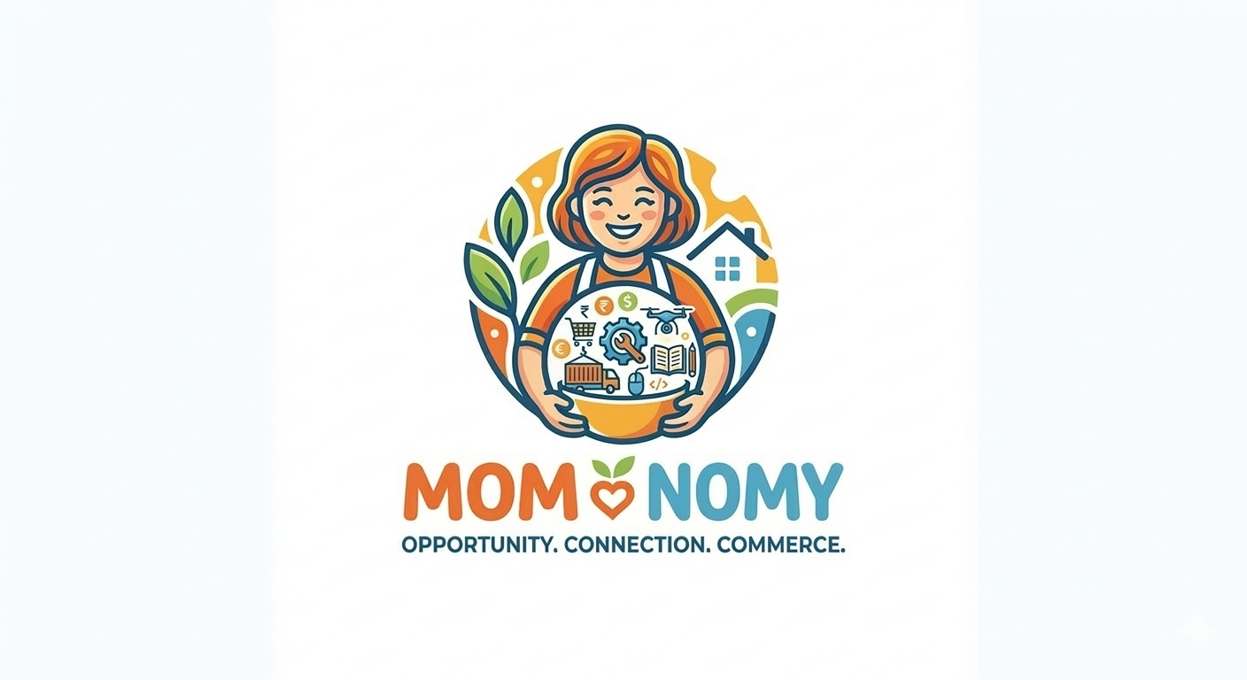
Project Name: Mom-o-Nomy (Empowering Single Mothers through a Hyperlocal Multi-vendor Marketplace)
Objective: To provide a dignified sustainable income for single mothers by monetizing their domestic skills.

Slide 3
Business Model Canvas: Mom-o-Nomy
Customer Segments
Value Propositions
Health-Conscious Consumers: Families looking for homemade food and essentials.
Corporate Clients: For bulk gifting, snacks, and catering services.
Gift Shoppers: People looking for unique, handmade crafts and accessories.
For Mothers: Financial independence, flexible working hours, and work-from-home dignity.
For Customers: 100% authentic, homemade, and chemical-free products.
Social Impact: Every purchase contributes to the education and welfare of a child.

Slide 4
Key Activities Key Resources
Skill Mapping: Identifying and categorizing the skills of mothers.
Quality Control: Ensuring hygiene and standard quality of products.
Branding & Marketing: Creating a professional identity for "Mom-o-Nomy".
Platform Maintenance: Managing the Full-Stack application.
Technology Stack: Full-Stack Web/Mobile Application.
The Community: A network of verified, skilled single mothers.
Brand Identity: Logo, eco-friendly packaging, and marketing collateral.

Slide 5
Key Partners
Channels
Local Wholesalers: To provide raw materials at discounted rates.
Logistics Partners: Local delivery agencies (Dunzo/Porter/Shadowfax).
NGOs & SHGs: To identify and onboard skilled single mothers.
Payment Gateways: For secure online transactions.
Mobile Application: Main platform for ordering.
WhatsApp Micro-stores: For quick local orders.
Pop-up Stalls: Local exhibitions in apartments and corporate hubs.

Slide 6
Customer Relationships
Revenue Streams
Emotional Branding: "Know Your Maker" – Every product carries the story of the mother who made it.
Trust & Transparency: Real-time feedback and direct earnings for mothers.
Community Support: Dedicated helpdesk for mothers.
Transaction Commission: 5-10% service fee per order.
Bulk/Wholesale Orders: Profit margin on large-scale corporate orders.
Subscription Model: Monthly recurring revenue for essential home-made kits (Masalas/Snacks).

Slide 7

Cost Structure
App Maintenance: Server costs, hosting, and technical updates.
Packaging & Logistics: Eco-friendly packaging and delivery costs.
Marketing & Onboarding: Costs for branding and training mothers.

Slide 8
Market Position: Hyperlocal Multi-vendor E-commerce platform.
The "Tech for Good" Angle: Using a Full-Stack solution to bridge the gap between talented single mothers and urban demand.
Sustainability: Focusing on eco-friendly packaging and community-led growth.
The Social Mission: "No single mother should have to choose between her child’s safety and her financial survival.“
"I chose this project because I have seen the pain of a single mother firsthand. My mother is a hero, and through Mom-o-Nomy, I want to make sure every single mother feels like one too."

Slide 9
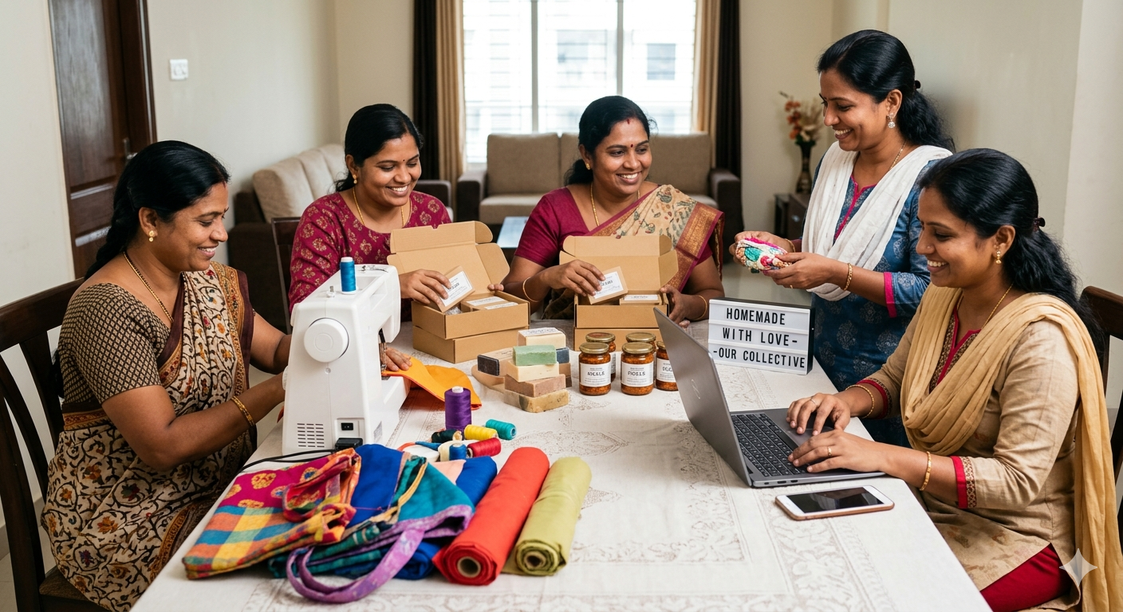
Mom-o-Nomy: Because every mother deserves to be a queen in her child's eyes without worrying about the next meal."

