Slide 1


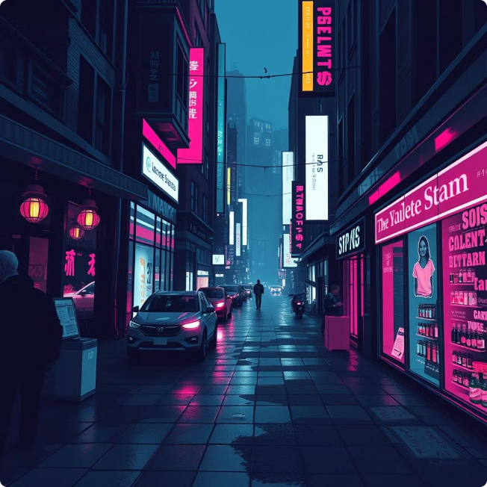
Image Captioning with the Flickr8k Dataset
Image captioning is a fascinating field in computer vision and natural language processing, where the goal is to generate meaningful and descriptive text captions for images. The Flickr8k dataset is a widely recognized benchmark for image captioning research. This dataset, comprising 8,000 images paired with five different captions each, provides a rich resource for training and evaluating image captioning models. This project aims to explore the development of a robust image captioning model capable of generating accurate and descriptive captions for new, unseen images.
by Yuva Karthikeswar Dadisetty
AI / ML Intern

Slide 2
Problem Statement
Objective:
Develop a robust image captioning model that can generate accurate and descriptive captions for images utilizing the Flickr8k dataset. This dataset comprises 8,000 images, each accompanied by five different captions detailing various entities and events within the image. The aim is to build a system capable of producing meaningful and contextually relevant captions for new, unseen images.
Dataset Overview:
The Flickr8k dataset serves as a benchmark for sentence-based image description and retrieval. It includes:
8,000 Images: Each image is paired with five distinct captions.
Image Sources: Images are sourced from six different Flickr groups, depicting a diverse range of scenes and scenarios.
Content Focus: The images intentionally exclude well-known people or landmarks to emphasize general scene descriptions.
Requirements:
Data Pre-processing:
Load and pre-process images and captions from the dataset.
Tokenize and prepare captions for model training.

Slide 3
Problem Statement Continuation
Model Development:
Construct and train an image captioning model employing techniques such as Convolutional Neural Networks (CNNs) for image feature extraction and Recurrent Neural Networks (RNNs) or Long Short-Term Memory (LSTM) networks for caption generation.
Evaluate the model's performance using metrics such as BLEU score, METEOR, and CIDEr.
Evaluation:
Assess the model's capability to generate descriptive and coherent captions on a separate validation set.
Fine-tune the model based on performance metrics and validation results.
Deployment:
Develop a user interface allowing users to upload images and receive generated captions.
Ensure the model can handle various types of images and provide relevant descriptions.
Resources:
https://www.kaggle.com/datasets/adityajn105/flickr8k
Inspiration:
This project aims to enhance the field of image captioning by leveraging the established Flickr8k dataset and improving the quality and relevance of generated captions. The outcome could advance image understanding and human-computer interaction.
Acknowledgements:
The dataset and benchmark are made available through the contributions of the research community and dataset creators. For additional details on the dataset and its usage, please refer to the Flickr8k dataset page.

Slide 4
Dataset Overview
Dataset Source
Image Content
Caption Variety
The Flickr8k dataset is sourced from six different Flickr groups, providing a diverse range of scenes and scenarios. This ensures a comprehensive representation of various image categories and contexts, making it suitable for training models that can generalize to different types of images.
The images in the Flickr8k dataset are intentionally chosen to exclude well-known people or landmarks. This focus on general scene descriptions allows for the development of models that can effectively capture the essential elements of an image without relying on recognizing specific individuals or locations.
Each image in the dataset is paired with five distinct captions. This variety of descriptions provides a richer understanding of the image content and allows the model to learn to generate captions that are both accurate and diverse.

Slide 5
Project Overview
Downloading dataset from kaggle
Importing Necessary Libraries
Loading VGG16 Model
Extract Image Feature
Load Captions Data
Pre-process Text Data
Train Test Split
Model Creation
Train the Model
Generate Captions for the Image
Visualize the Results
Test with the Real Data

Slide 6
Data Preprocessing
1
Image Loading
2
Caption Tokenization
The first step in data preprocessing involves loading the images from the dataset. These images are typically stored in a standardized format such as JPEG or PNG. The images are then resized and normalized to ensure consistency in their dimensions and pixel values for model training.
The captions associated with each image are tokenized, which means they are broken down into individual words or sub-word units. This process is essential for preparing the captions for model training. Tokenization allows the model to learn the statistical relationships between words and their associated image features.
3
Caption Padding
4
Vocabulary Creation
Caption padding is often employed to create sequences of uniform length. This involves adding special padding tokens to shorter captions to ensure that all captions have the same length. Padding helps the model handle captions of varying lengths during training and prediction.
A vocabulary is created from the set of unique tokens extracted from the captions. This vocabulary is used to map words to their corresponding indices, which allows for efficient representation and processing of the captions during training and prediction.

Slide 7
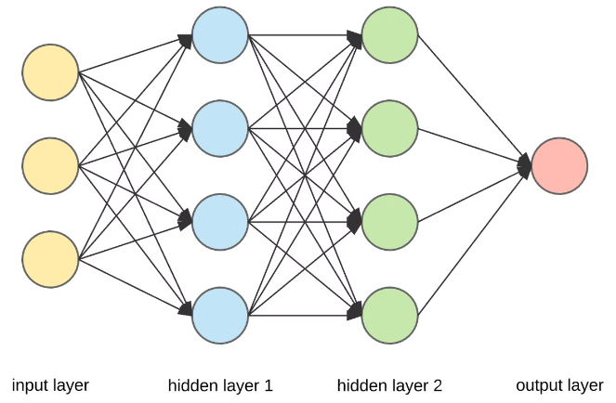
Model Development: Image Feature Extraction
Convolutional Neural Networks (CNNs)
CNNs are a powerful class of neural networks commonly used for image recognition and feature extraction. They excel at extracting hierarchical features from images, starting with low-level features like edges and shapes and progressing to higher-level features such as objects and scenes.
Transfer Learning
Transfer learning is a technique that leverages pre-trained CNN models, such as ResNet or VGG, trained on massive image datasets like ImageNet. By using these pre-trained models as a starting point, we can extract meaningful image features that can be used for image captioning without requiring extensive training on the Flickr8k dataset from scratch.
Feature Vector Generation
Once the CNN has processed an image, it generates a feature vector. This vector represents a compressed representation of the image's key features, which are then fed into the caption generation component of the model.

Slide 8
Model Development: Caption Generation
1
Recurrent Neural Networks (RNNs)
RNNs are a type of neural network that are specifically designed to handle sequential data. They have internal memory that allows them to process information in a step-by-step manner, making them suitable for generating captions, which are essentially sequences of words.
2
Long Short-Term Memory (LSTM) Networks
LSTMs are a special type of RNN that are particularly well-suited for handling long-term dependencies in sequential data. They have a sophisticated memory mechanism that allows them to learn and retain information over extended periods, which is crucial for generating coherent and grammatically correct captions.
3
Decoder Network
The caption generation process often involves a decoder network. The decoder network takes the image features from the CNN and the initial start-of-sentence token as input. It then uses the RNN or LSTM to generate the subsequent words of the caption one by one.
4
Word Prediction
The model predicts the next word in the caption based on the previous words and the image features. This process continues until a special end-of-sentence token is predicted, indicating the completion of the caption.

Slide 9
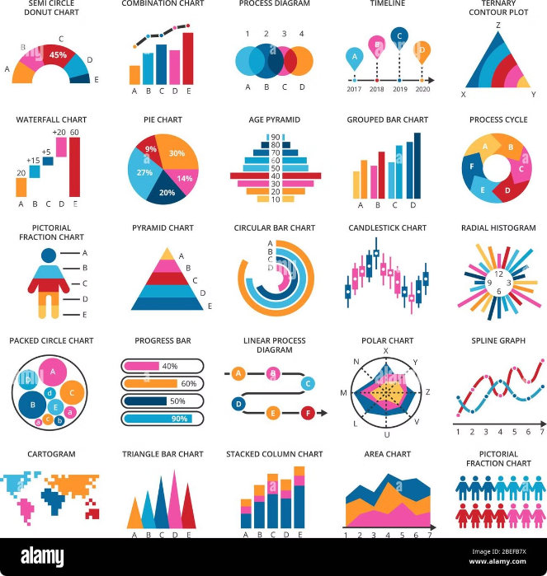
Model Evaluation
Metric
Description
BLEU (Bilingual Evaluation Understudy)
A metric that measures the similarity between the generated caption and a set of reference captions. It assesses the n-gram overlap between the generated caption and the reference captions.
METEOR (Metric for Evaluation of Translation with Explicit Ordering)
A metric that combines unigram precision and recall with word order similarity. It is designed to be more robust to sentence structure variations compared to BLEU.
CIDEr (Consensus-based Image Description Evaluation)
A metric that evaluates the caption's overall coherence and consistency with the image content. It considers the semantic similarity between the generated caption and a set of reference captions.

Slide 10

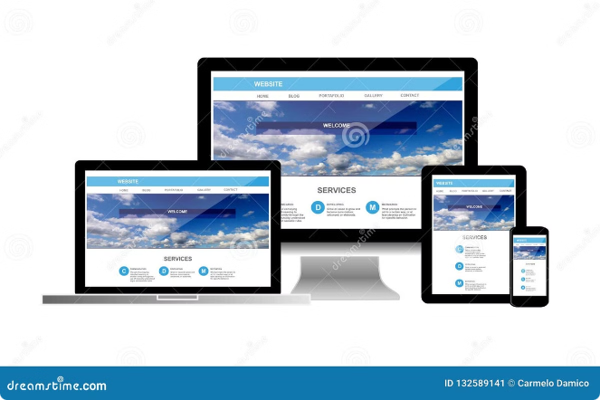


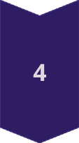
Deployment
User Interface
A user-friendly interface allows users to upload images and receive generated captions. The interface should be intuitive and easy to use, providing a seamless experience for users.
Image Handling
The deployed model should be able to handle various types of images, including different image formats, resolutions, and content. It should be robust enough to handle images with diverse scenes and objects.
Caption Generation
The model should generate captions that are relevant to the image content, providing accurate and descriptive descriptions of the objects, events, and scenes depicted in the image.
Output Presentation
The generated captions should be presented in a clear and readable format, allowing users to easily understand the description of the image. The interface should also provide options for users to save or share the generated captions.

Slide 11






Model Fine-Tuning
Hyperparameter Optimization
Performance Monitoring
Error Analysis
Dataset Augmentation
Analyzing the errors made by the model can provide valuable insights into its strengths and weaknesses. By understanding the types of errors the model is making, we can develop strategies to address those errors and improve its overall performance.
The performance of the image captioning model can be further improved by fine-tuning the model's hyperparameters. Hyperparameters are parameters that are not learned during training but are set beforehand.
Regularly monitoring the model's performance on a validation set allows for identifying areas where improvements can be made. This involves tracking metrics such as BLEU, METEOR, and CIDEr and analyzing the generated captions to identify any patterns or biases.
Enlarging the training dataset by adding more images and captions can further enhance the model's generalization ability. This can be achieved by collecting new images or by using data augmentation techniques to create variations of existing images.

Slide 12
Impact and Future Directions
1
Image Understanding
2
Human-Computer Interaction
Image captioning models contribute to a deeper understanding of image content. They can be used to extract meaningful information from images, enabling applications such as image search, retrieval, and analysis.
These models can improve human-computer interaction by providing more accessible and informative ways to interact with images. For example, they can be used to generate descriptions for visually impaired individuals or to provide context for image-based communication.
3
Multilingual Captioning
4
Advanced Captioning Models
Future research can explore multilingual captioning, where the model can generate captions in multiple languages. This would broaden the accessibility and applicability of image captioning models for diverse users and contexts.
Developing more sophisticated captioning models that can generate more creative, engaging, and informative captions is an ongoing area of research. This includes incorporating techniques such as attention mechanisms and generative adversarial networks (GANs).

Slide 13

Conclusion
The Flickr8k dataset provides a valuable platform for developing and evaluating image captioning models. By leveraging this dataset and employing techniques such as CNNs and RNNs, we can create models that can generate accurate and descriptive captions for images. This project showcases the potential of image captioning in enhancing image understanding and human-computer interaction. Further research in this field can explore new approaches to caption generation, improve model performance, and extend the capabilities of image captioning models to diverse applications.

Slide 14
Thank You

