Slide 1
CSE-PROJECT

Slide 2
Welcome to our
Presentation

Slide 3
Presentation on
Round Robin Schedule using C Language

Slide 4
What is Round Robin Scheduling ?
The name of this algorithm comes from the round-robin principle, where each person gets an equal share of something in turns. It is the oldest, simplest scheduling algorithm, which is mostly used for multitasking.
In Round-robin scheduling, each ready task runs turn by turn only in a cyclic queue for a limited time slice. This algorithm also offers starvation free execution of processes.

Slide 5
Introduction:
The name of this algorithm comes from the round robin principle,where each person gets an equal share of something in turns
Round Robin is one of the oldest,fairest and easiest algorithms and widely used scheduling methods in traditional OS.
Round Robin is a pre-emptive algorithm.
The biggest advantage of the round-robin scheduling method is that of you know the total number of processes on the run queue,then you can assume the worst-case response time for the same process.
This method spends more time on context switching.
Worst-cae latency is a term used for the maximum time taken for the execution of all the tasks.

Slide 6
Flow chart for Round Robin Schedule
1)Initialize an array of processes ,along with their arrival time and burst time .
2)Initialize variables for Time Quantum and remaining time for each process.
3)Sort the process array based on arrival time.
4) Set the current time to 0.
5)Repeat the following steps until all process have completed :
a)For each process in the array,check if its arrival time is less than or equal to the current time.
b)If a process has arrived,and its remaining time is greater than 0,decreament its remaining time by the time quantum.
c)If a process’s remaining time is less than or equal to 0,mark it as completed.
d)Increment the current time by the time quantum.
6)Calculate and print the average waiting time and average turn around time for all processes.

Slide 7
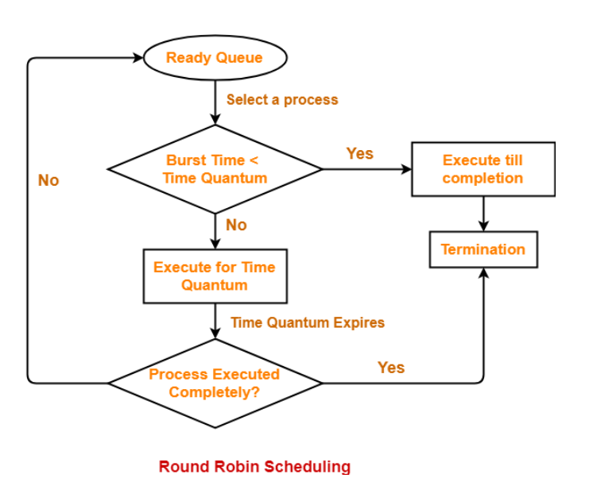
Execution Flow

Slide 8
Steps to solve Round Robin CPU Schedule
Step 1: Organize all processes according to their arrival time in the ready queue. The queue structure of the ready queue is based on the FIFO structure to execute all CPU processes.
Step 2: Now, we push the first process from the ready queue to execute its task for a fixed time, allocated by each process that arrives in the queue.
Step-3: If the process cannot complete their task within defined time interval or slots because it is stopped by another process that pushes from the ready queue to execute their task due to arrival time of the next process is reached.

Slide 9
Step-4: Therefore, CPU saved the previous state of the process, which helps to resume from the point where it is interrupted.(If the first time of the process is left, push the process end of the ready queue).
Step-5: Similarly, the scheduler selects another process from the ready queue to execute its task. When a process finishes its task within time slots the process will not go for further execution because the process’s burst time is finished.
Step-6 : Similarly, we repeat all the steps to execute the process until the work has finished.

Slide 10
Code of this project

Slide 11
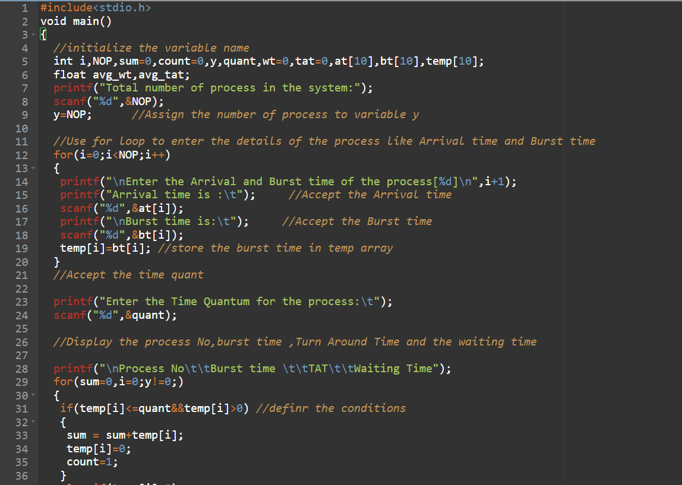

Slide 12
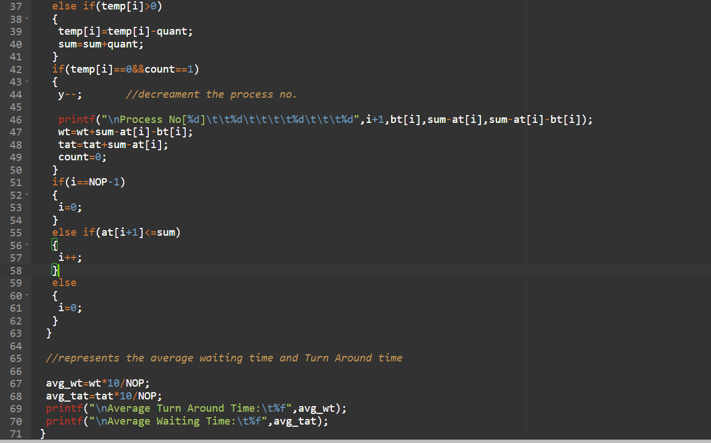

Slide 13
INPUT AND OUTPUT

Slide 14
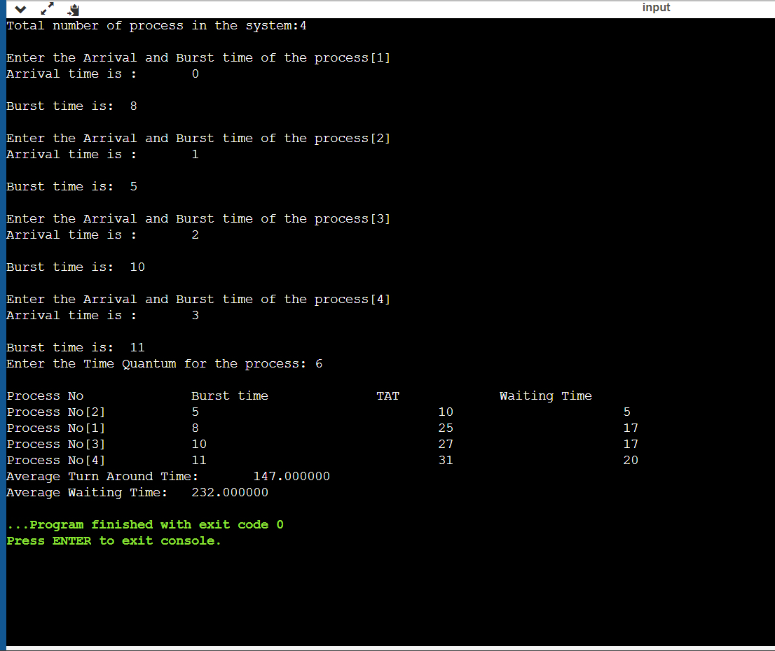

Slide 15
You can also check for output :-

Slide 16

Thanking You

Slide 17
Prepared by :- 1) Abhigna Regd.No AP22110010752 2) Yuva Sri Sai Regd.No AP22110010750 3) Karishma Regd.No AP22110010753 ☺ ☺ ☺

