Slide 1
DATA ENGINEERING CAPSTONE · SNOWFLAKE
Global Retail E-Commerce
Data Warehouse & Analytics
An end-to-end Star Schema data warehouse — Full & Incremental ETL, SCD Type 2 history tracking, PII masking, and SQL-validated data-quality controls — built entirely on Snowflake with Python analytics.
SPRINT-BASED CAPSTONE · SQL + SNOWPARK PYTHON + STREAMLIT
TEAM 7 · DA PROJECT
Malaram Manjith Naidu
Boggavarapu Yuva Satya Kunaal
Pasupulati Sai Meghana
Vaishnavi V
Jovitha Rajendran

Slide 2
BUSINESS SCENARIO
Project Objective
A global retail e-commerce company needs a centralized Data Warehouse to reliably measure revenue, customer value, and product performance — instead of querying fragmented, inconsistent operational tables.
Design the Warehouse
Engineer the Pipeline
Govern the Data
Deliver Insight
Model a Star Schema — conformed dimensions plus a single fact table capturing every order line.
Build Full and Incremental ETL in SQL, with SCD Type 2 history tracking on the customer dimension.
Mask sensitive PII, validate every row against known data-quality issues, and log every rejection.
Query and analyze in Python, then ship a live, interactive dashboard for revenue, segments, and geography.
RETAIL_CAPSTONE · SNOWFLAKE · TEAM 7
02

Slide 3
SYSTEM DESIGN
Architecture Overview
RAW → STAGING → DW → ANALYTICS — every row is typed, cleaned, and reconciled before it reaches a chart.
RAW
STAGING
DW
ANALYTICS
5 source tables
VARCHAR, as-is
Cleaned + validated
rejects logged
Star Schema
SCD2 + masking
SQL + Python
live dashboard
RETAIL_CAPSTONE · SNOWFLAKE · TEAM 7
03

Slide 4
SOURCE DATA
Source Data Overview
1.4M
ENTITY
SOURCE FILE
ROWS
Customers
customers_merged.csv
244,000
TOTAL MERGED ROWS
1.2M
Products
products_merged.csv
15,000
Orders
orders_merged.csv
205,000
CLEAN RECORDS — 86%
200K
Order Items
order_items_merged.csv
798,000
Payments
payments_merged.csv
138,000
INTENTIONALLY IMPERFECT — 14%
Every source file blends valid and deliberately flawed rows, reflecting realistic operational data.
RETAIL_CAPSTONE · SNOWFLAKE · TEAM 7
04

Slide 5
DATA PROFILING
Data Quality Challenges
Each dataset includes six deliberately injected issue types, identified during profiling and handled during ETL.
Missing Values
Negative Numbers
Future Dates
Blank or NULL fields
Invalid amounts
Unrealistic timestamps
city, email, name
quantity, unit_price
order_date, updated_at
Duplicate Keys
Orphaned References
Type Mismatches
Repeated identifiers
Broken foreign keys
Text in numeric fields
customer_code, order_id
__ORPHAN__ sentinel
"FREE", "NOT_A_NUMBER"
RETAIL_CAPSTONE · SNOWFLAKE · TEAM 7
05

Slide 6
SQL · STAGING LAYER
Staging Layer — Flag, Don't Just Filter
Every row runs through a single CASE expression that assigns a specific rejection reason, or lets it through clean — nothing is silently dropped.
04_full_load_staging.sql
CREATE OR REPLACE TEMPORARY TABLE _customers_flagged AS
SELECT *,
ROW_NUMBER() OVER (PARTITION BY customer_code ORDER BY updated_at) AS rn,
CASE
WHEN customer_code IS NULL THEN 'missing_customer_code'
WHEN city IS NULL OR TRIM(city) = '' THEN 'missing_city'
WHEN email IS NULL OR TRIM(email) = '' THEN 'missing_email'
WHEN phone IS NOT NULL AND NOT REGEXP_LIKE(phone,'.*[0-9].*')
THEN 'phone_type_mismatch'
WHEN TRY_TO_TIMESTAMP(updated_at) > CURRENT_TIMESTAMP()
THEN 'future_updated_at'
ELSE NULL
END AS reject_reason
FROM RAW.CUSTOMERS_RAW;
RETAIL_CAPSTONE · SNOWFLAKE · TEAM 7
06

Slide 7
STAGING LAYER
Data Cleaning Strategy
A repeatable four-step rule set is applied consistently to every one of the five source tables.
01
02
03
04
Flag
Deduplicate
Split
Reconcile
A CASE expression checks every applicable issue type and records a specific reason, e.g. "negative_quantity".
ROW_NUMBER() partitions by business key; only the first issue-free occurrence survives as clean.
Issue-free, first-occurrence rows insert to *_CLEAN. Everything else inserts to *_ERRORS with its reason.
STAGING counts are validated against the dataset's own ground-truth profiling summary.
RETAIL_CAPSTONE · SNOWFLAKE · TEAM 7
07

Slide 8
DIMENSIONAL MODELLING
Star Schema Design — Summary
DIM_CUSTOMER
SCD Type 2 — surrogate key, full history preserved on city/email/phone change
DIM_PRODUCT
Product attributes, category, unit price — Type 1, simple overwrite
DIM_DATE
Calendar hierarchy — day, month, quarter, year, weekday flag
DIM_LOCATION
Unique city / state combinations observed across orders
FACT_SALES
Grain: one row per order item — quantity, unit_price, line_amount, order_status
RETAIL_CAPSTONE · SNOWFLAKE · TEAM 7
08

Slide 9
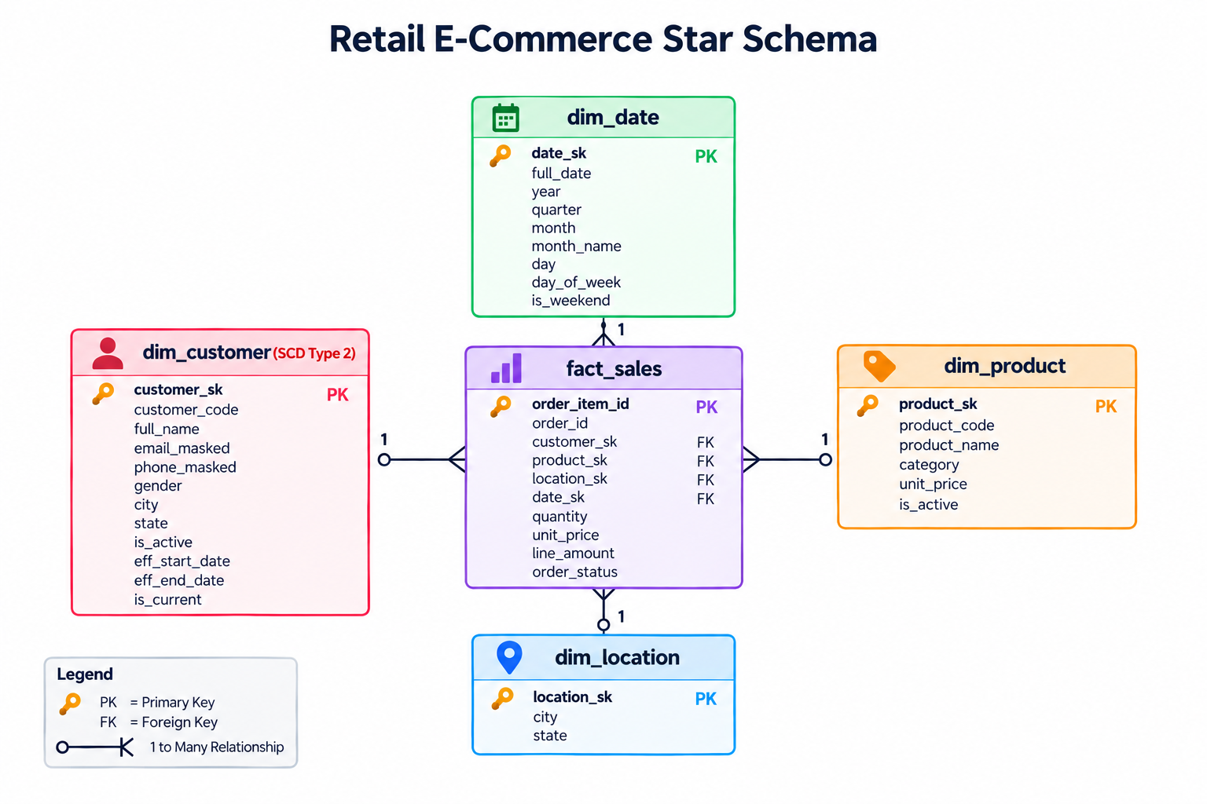
DIMENSIONAL MODELLING
Star Schema Diagram
RETAIL_CAPSTONE · SNOWFLAKE · TEAM 7
09

Slide 10
SQL · DATA DEFINITION
Fact Table Design — Grain
05_dw_ddl.sql
GRAIN
CREATE OR REPLACE TABLE FACT_SALES (
order_item_id STRING,
order_id STRING,
customer_sk NUMBER,
product_sk NUMBER,
location_sk NUMBER,
date_sk NUMBER,
quantity NUMBER,
unit_price NUMBER(18,2),
line_amount NUMBER(18,2),
order_status STRING
);
One row per order line item — the lowest granularity available in the source data.
ADDITIVE MEASURES
quantity — units sold
unit_price — per-unit price at sale
line_amount — fully additive revenue
FOREIGN KEYS
customer_sk · product_sk · location_sk · date_sk
referencing every conformed dimension
RETAIL_CAPSTONE · SNOWFLAKE · TEAM 7
10

Slide 11
SQL · ETL FRAMEWORK
ETL — Full Load
STAGING is joined against every populated dimension to build FACT_SALES from scratch — the baseline used for initial warehouse population.
06_dw_dml.sql
INSERT INTO DW.FACT_SALES
SELECT
oi.order_item_id, oi.order_id,
dc.customer_sk, dp.product_sk, dl.location_sk,
TO_NUMBER(TO_CHAR(o.order_date, 'YYYYMMDD')),
oi.quantity, oi.unit_price, oi.line_amount, o.status
FROM STAGING.ORDER_ITEMS_CLEAN oi
JOIN STAGING.ORDERS_CLEAN o ON oi.order_id = o.order_id
JOIN DW.DIM_CUSTOMER dc ON o.customer_code = dc.customer_code
AND dc.is_current = TRUE
JOIN DW.DIM_PRODUCT dp ON oi.product_code = dp.product_code
LEFT JOIN DW.DIM_LOCATION dl ON o.order_city = dl.city
AND o.order_state = dl.state;
RETAIL_CAPSTONE · SNOWFLAKE · TEAM 7
11

Slide 12
HISTORICAL TRACKING
SCD Type 2 Implementation
When a tracked attribute changes — city, email, or phone — the existing row is expired, never overwritten, and a fresh current row is inserted.
BEFORE — expired row
AFTER — new current row
customer_code
C0009857
customer_code
C0009857
city
Mumbai
city
Delhi
is_current
FALSE
is_current
TRUE
eff_end_date
2026-09-12
eff_end_date
NULL
Both rows for C0009857 remain queryable — historical revenue attribution stays accurate to the customer's location at time of purchase.
RETAIL_CAPSTONE · SNOWFLAKE · TEAM 7
12

Slide 13
SQL · SCD TYPE 2
SCD Type 2 — SQL Implementation
Two statements: expire the changed row, then insert whichever rows are new or were just expired.
07_scd2_customer.sql
-- Step A: expire the OLD version if city/email/phone changed
UPDATE DW.DIM_CUSTOMER dc
SET eff_end_date = CURRENT_TIMESTAMP(), is_current = FALSE
FROM STAGING.CUSTOMERS_CLEAN sc
WHERE dc.customer_code = sc.customer_code
AND dc.is_current = TRUE
AND (dc.city <> sc.city OR dc.email_masked <> ... );
-- Step B: insert the NEW version as current
INSERT INTO DW.DIM_CUSTOMER (..., eff_start_date, eff_end_date, is_current)
SELECT sc.*, CURRENT_TIMESTAMP(), NULL, TRUE
FROM STAGING.CUSTOMERS_CLEAN sc
LEFT JOIN DW.DIM_CUSTOMER dc
ON sc.customer_code = dc.customer_code AND dc.is_current = TRUE
WHERE dc.customer_code IS NULL; -- new, or just expired above
RETAIL_CAPSTONE · SNOWFLAKE · TEAM 7
13

Slide 14
SQL · INCREMENTAL ETL
ETL — Incremental Load
A LOAD_WATERMARKS table records the last successfully processed timestamp; only newer rows are extracted.
08_incremental_load.sql
CREATE OR REPLACE TABLE LOAD_WATERMARKS (
table_name STRING, last_loaded_at TIMESTAMP
);
-- Only pull rows newer than the last successful run
INSERT INTO STAGING.ORDERS_CLEAN
SELECT order_id, customer_code, TRY_TO_TIMESTAMP(order_date),
status, order_city, order_state
FROM RAW.ORDERS_RAW
WHERE customer_code <> '__ORPHAN__'
AND TRY_TO_TIMESTAMP(order_date) >
(SELECT last_loaded_at FROM LOAD_WATERMARKS WHERE table_name='ORDERS');
-- Advance the watermark after a successful run
UPDATE LOAD_WATERMARKS SET last_loaded_at = CURRENT_TIMESTAMP()
WHERE table_name = 'ORDERS';
RETAIL_CAPSTONE · SNOWFLAKE · TEAM 7
14

Slide 15
DATA GOVERNANCE
Masking & Error Logging
Sensitive Field Masking
Structured Error Logging
Applied at DW load time to every row in DIM_CUSTOMER.
Every rejected row is preserved — never dropped — with its exact reason.
priya.sharma@example.com
p***a@example.com
CUSTOMERS_ERRORS
phone_type_mismatch
ORDERS_ERRORS
+91 98765 43210
***********3210
orphan_customer
ORDER_ITEMS_ERRORS
email_masked and phone_masked replace raw values — unmasked data never leaves STAGING.
negative_quantity
PAYMENTS_ERRORS
duplicate_payment_id
RETAIL_CAPSTONE · SNOWFLAKE · TEAM 7
15

Slide 16
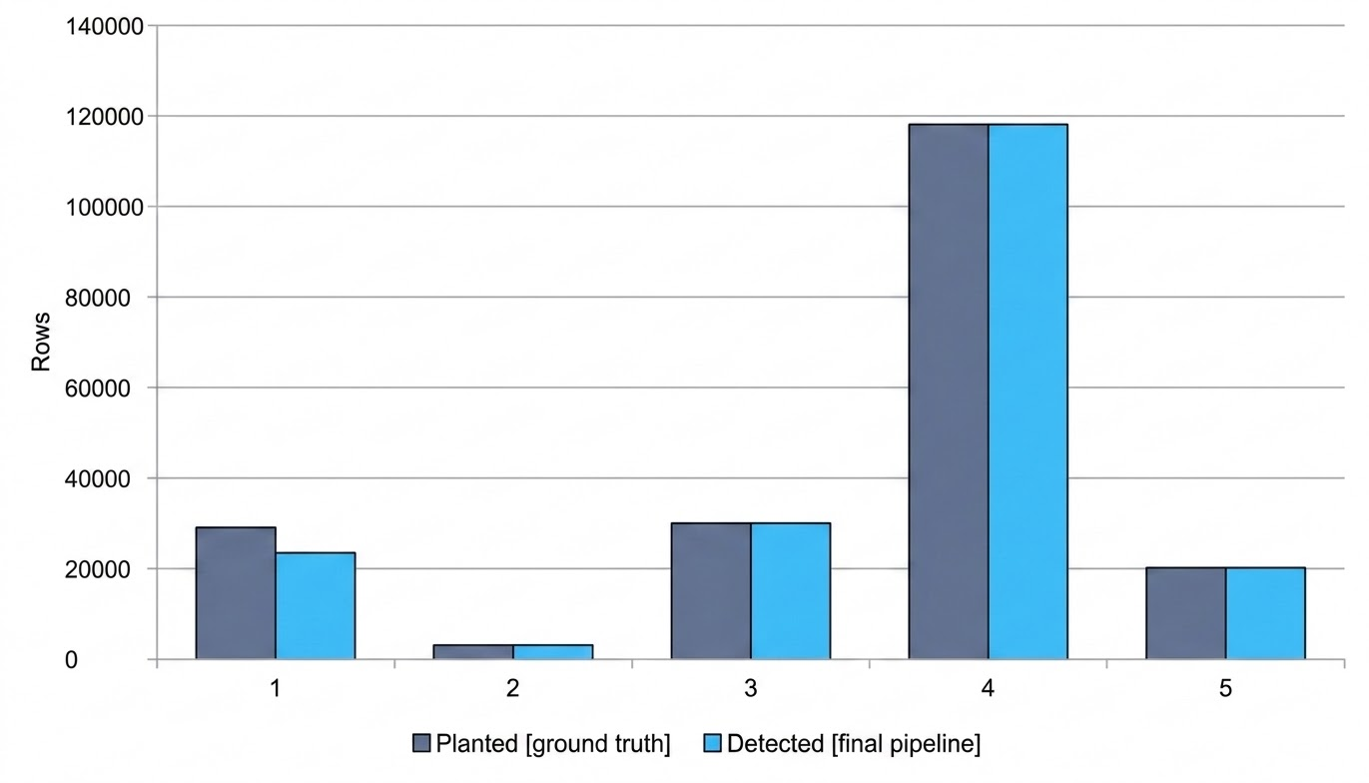
QUALITY ASSURANCE
Validation Results
Detection counts were checked against profiling_summary.json — the generator's own record of exactly how many bad rows were planted per table.
3 / 5
TABLES AT EXACT MATCH
80.8%
CUSTOMER DETECTION RATE
The remaining customer gap is explained by time-decay: dates injected as "future" at dataset-generation time have since elapsed — not a logic error.
RETAIL_CAPSTONE · SNOWFLAKE · TEAM 7
16

Slide 17
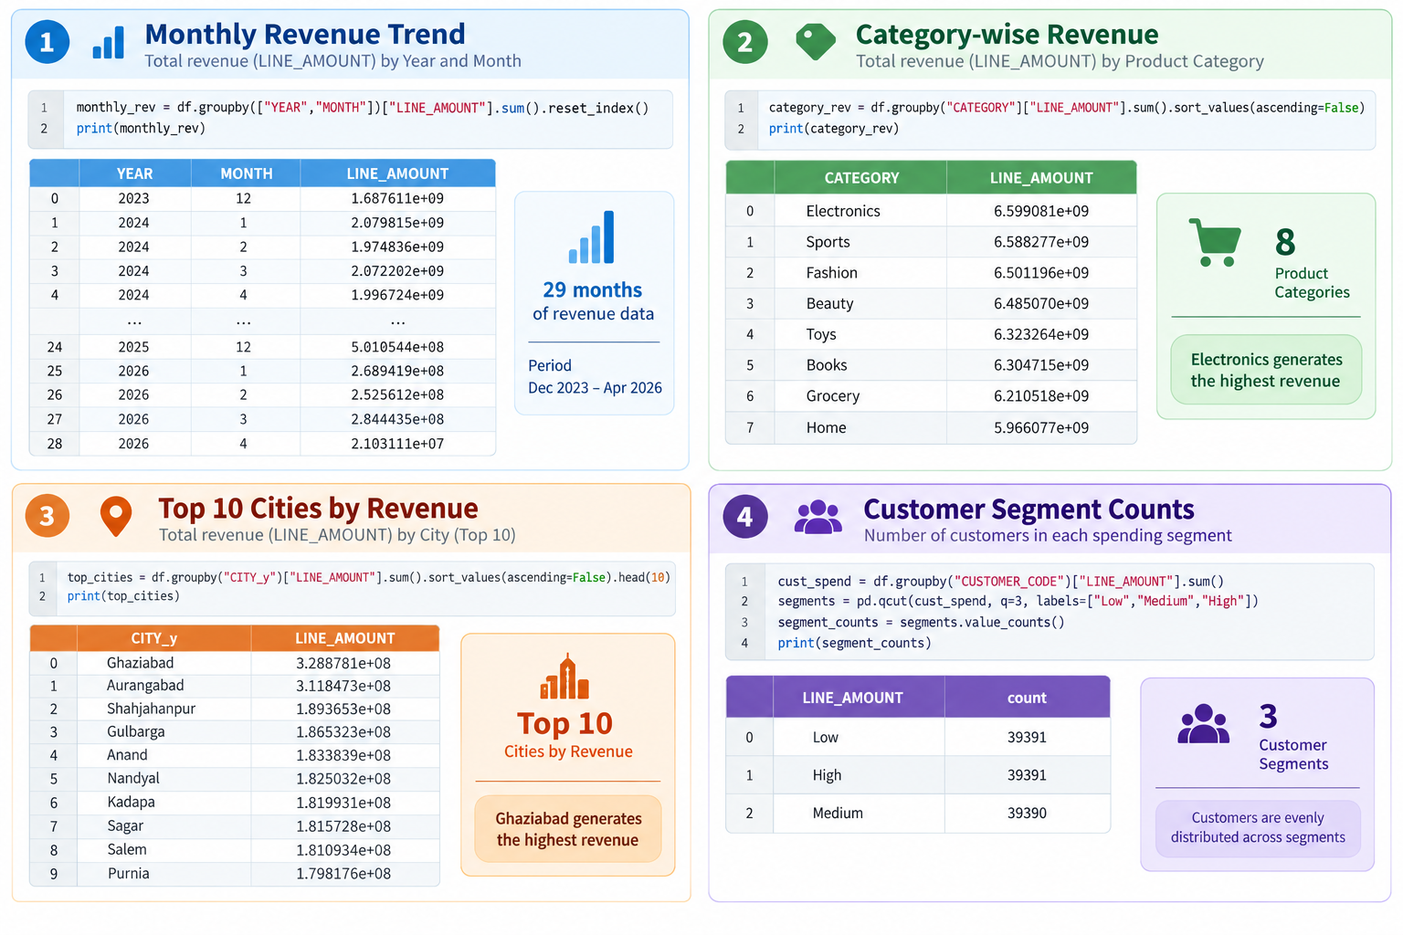
PYTHON · DATA ANALYSIS
Python Data Analysis
RETAIL_CAPSTONE · SNOWFLAKE · TEAM 7
17

Slide 18
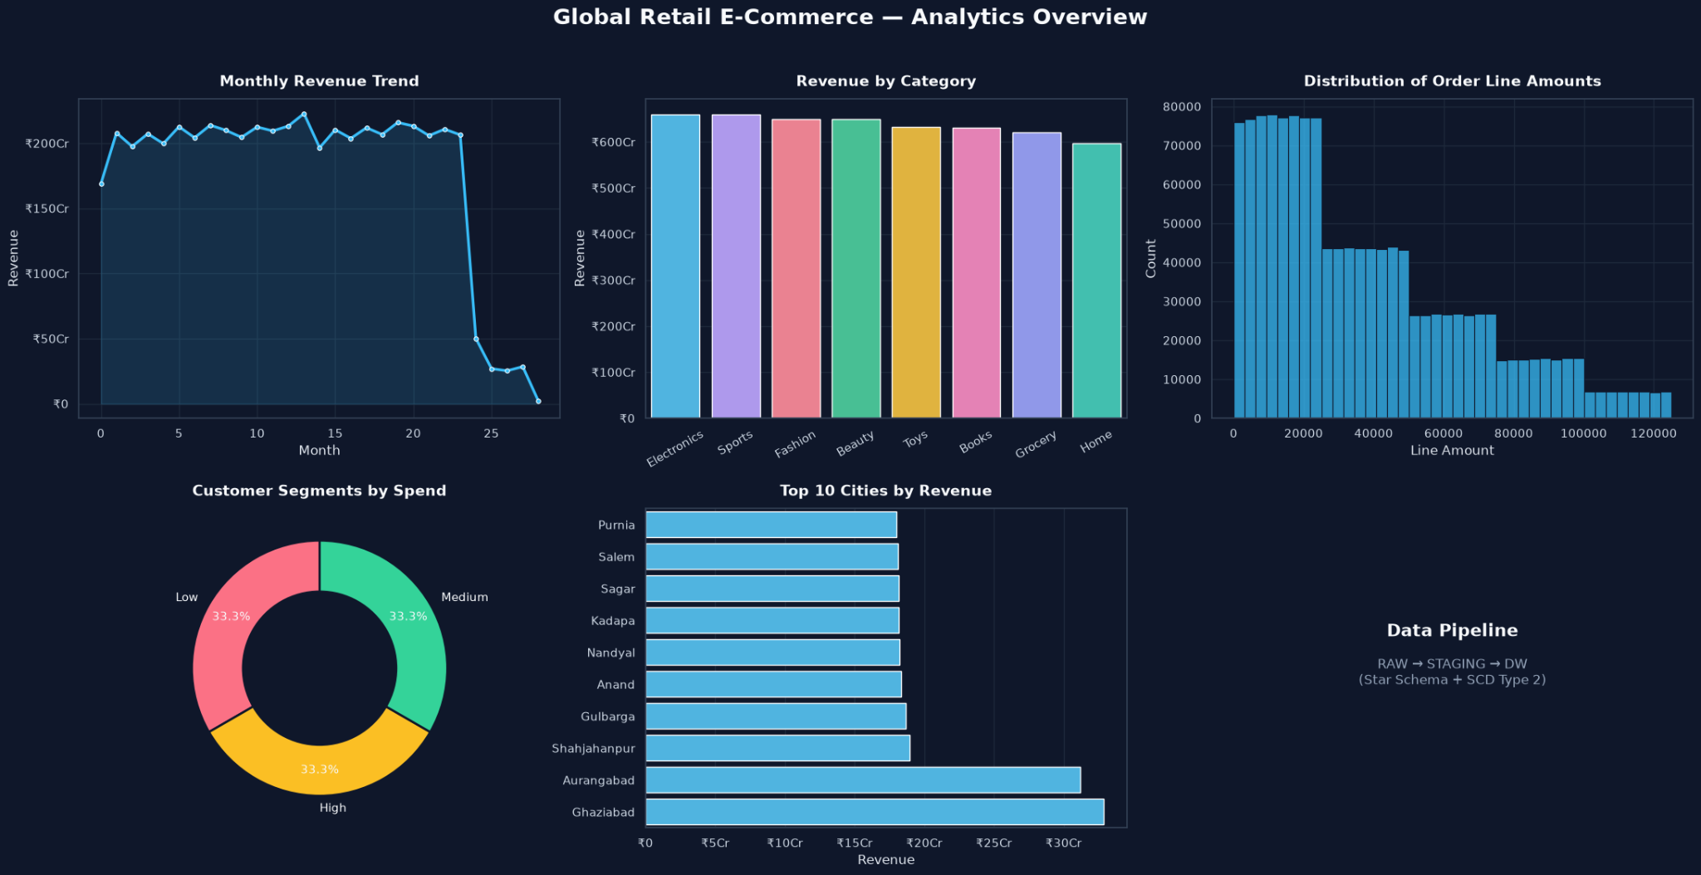
PYTHON · DATA VISUALIZATION
Python Data Visualization Charts
RETAIL_CAPSTONE · SNOWFLAKE · TEAM 7
18

Slide 19
PYTHON · SNOWPARK
Python Analytics — Data Extraction
Snowpark pulls DW tables directly into pandas inside a Streamlit-in-Snowflake app — no external database driver or credentials required.
streamlit_app.py
from snowflake.snowpark.context import get_active_session
import pandas as pd, altair as alt
session = get_active_session()
@st.cache_data(ttl=600)
def load_data():
fact_sales = session.table("DW.FACT_SALES").to_pandas()
dim_customer = session.table("DW.DIM_CUSTOMER") \
.filter('"IS_CURRENT" = TRUE').to_pandas()
dim_product = session.table("DW.DIM_PRODUCT").to_pandas()
dim_date = session.table("DW.DIM_DATE").to_pandas()
return fact_sales, dim_customer, dim_product, dim_date
RETAIL_CAPSTONE · SNOWFLAKE · TEAM 7
19

Slide 20
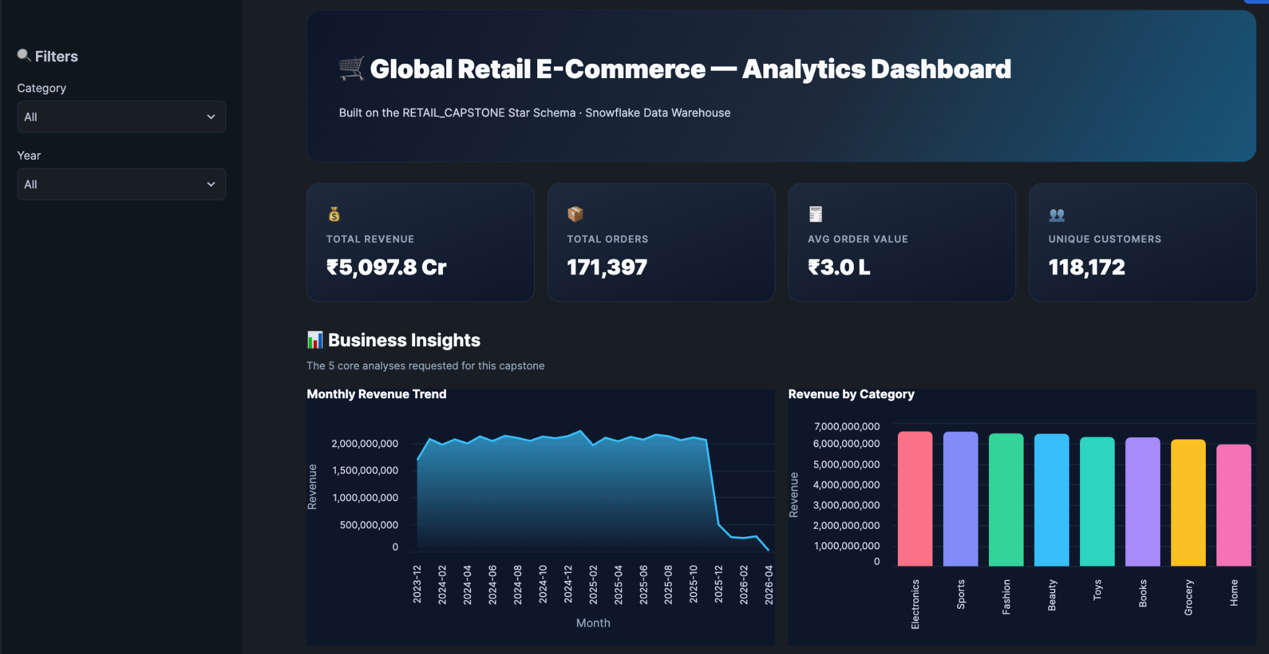
ANALYTICS LAYER
Live Dashboard — Overview
A Streamlit-in-Snowflake app — filters update every KPI and chart in real time, no separate BI tool required.
RETAIL_CAPSTONE · SNOWFLAKE · TEAM 7
20

Slide 21
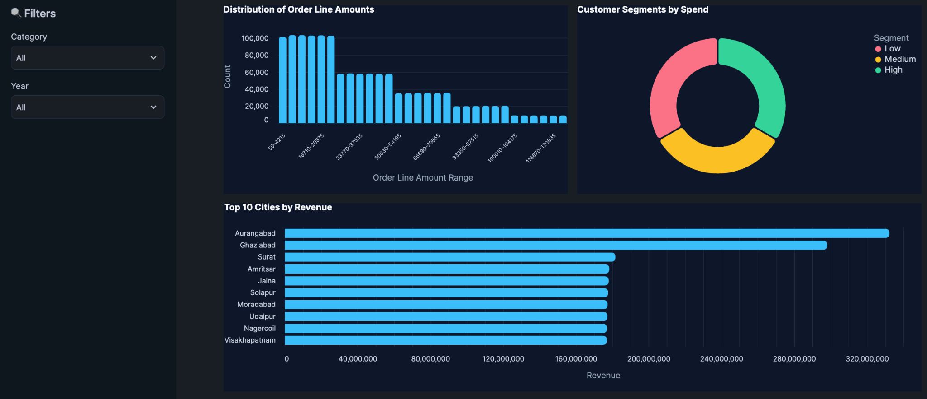
ANALYTICS LAYER
Dashboard — All Five Chart Types
Line, bar, histogram, donut, and horizontal bar — each with live hover tooltips, rendered natively via Altair.
RETAIL_CAPSTONE · SNOWFLAKE · TEAM 7
21

Slide 22
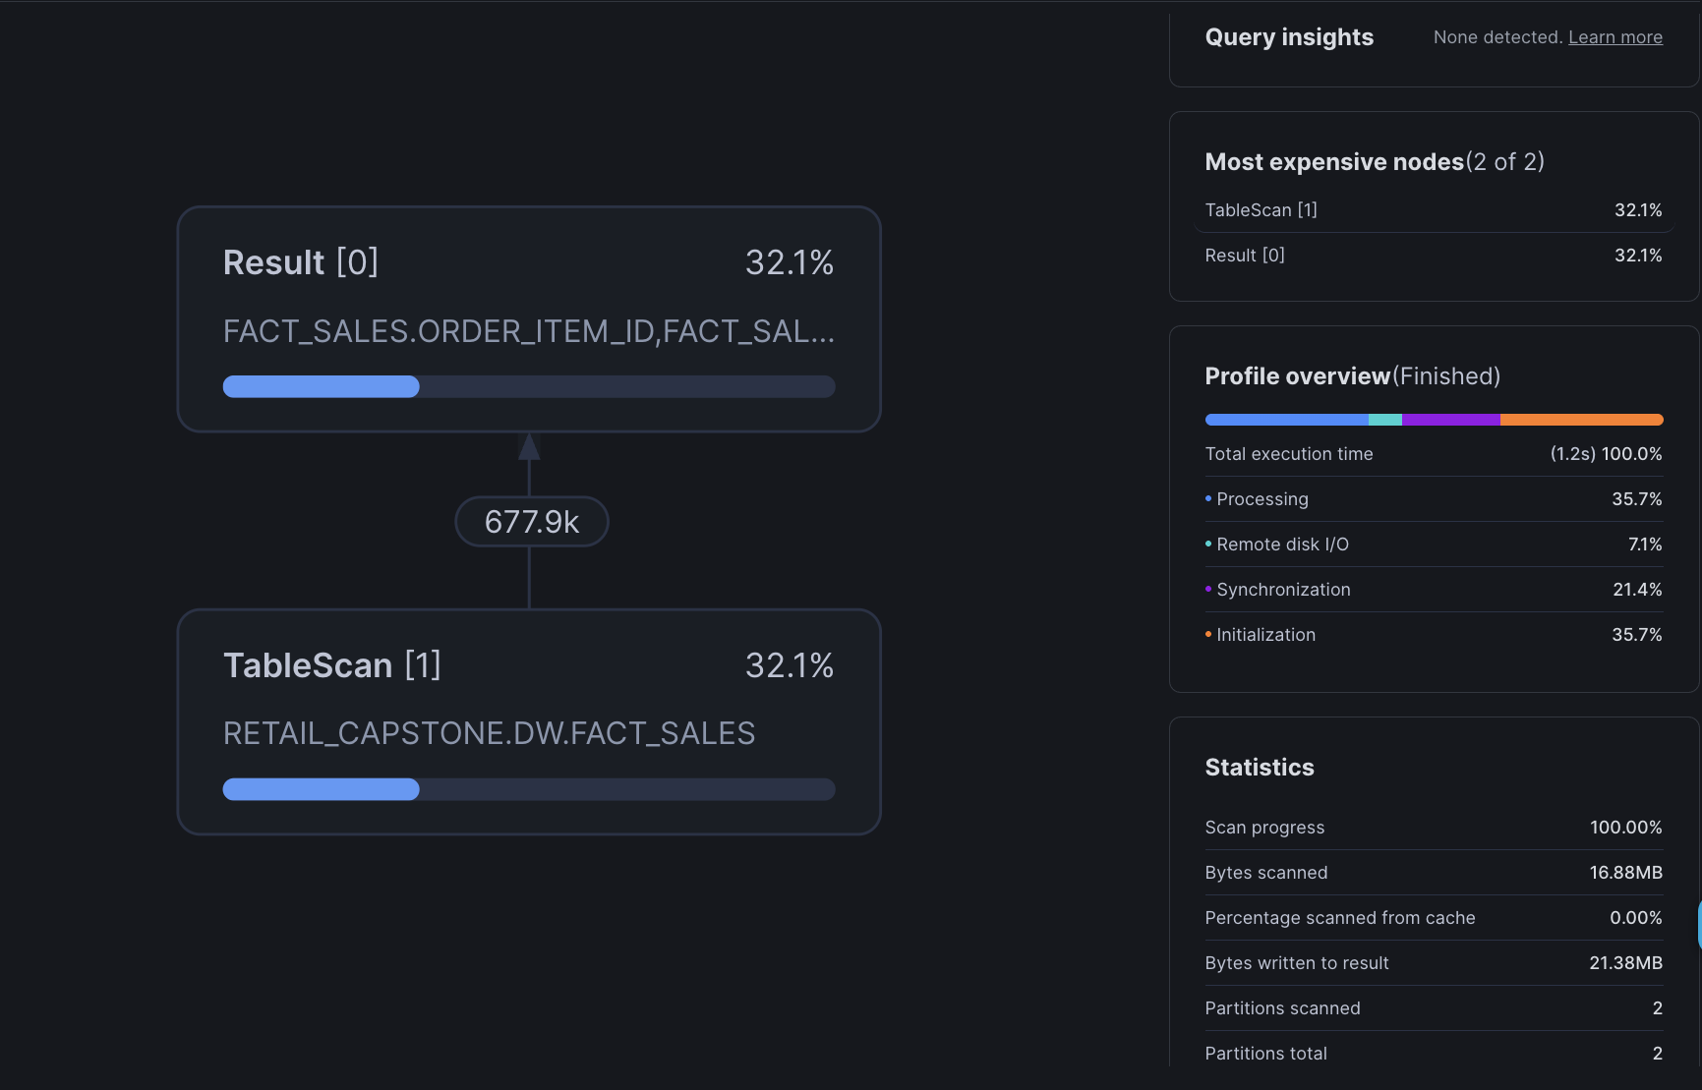
PERFORMANCE
Query Optimization
ALTER TABLE DW.FACT_SALES
CLUSTER BY (date_sk);
Most analytical queries filter or group by date — clustering lets Snowflake's micro-partition pruning skip irrelevant blocks instead of scanning the full table.
1.2s
16.88 MB
EXECUTION TIME
BYTES SCANNED
2
0
PARTITIONS SCANNED
INSIGHTS FLAGGED
RETAIL_CAPSTONE · SNOWFLAKE · TEAM 7
22

Slide 23
USE CASES
Real-World Use Cases
Retail & e-commerce firms reuse this Star Schema to unify sales, customer, and product data for revenue reporting
Marketing teams use SCD Type 2 customer history for segmentation, loyalty programs, and churn analysis
Finance & compliance teams rely on PII masking and error logs to meet GDPR / DPDP data-privacy regulations
Business analysts use the Streamlit-in-Snowflake dashboard as self-serve BI, replacing manual Excel reporting
Data engineering teams reuse the full + incremental ETL pattern to onboard new source systems
Performance teams apply the same clustering & query-profiling approach to control warehouse costs at scale
The same pattern used here — star schema, SCD2, masking, watermark ETL — is exactly what production retail data platforms run today.
RETAIL_CAPSTONE · SNOWFLAKE · TEAM 7
23

Slide 24
ADVANTAGES
Why This Approach Wins
Single source of truth — eliminates conflicting numbers from fragmented spreadsheets and siloed systems
Trustworthy by design — every cleaning rule is validated against ground truth, not just assumed correct
Full historical accuracy — SCD2 means no customer trend or attribution is ever lost to an overwrite
Built-in governance — PII masking and per-row error logs make the pipeline audit-ready from day one
Faster decisions — live, filterable dashboards replace static reports with real-time answers
Cloud-scale & cost-efficient — clustering and query profiling cut scan time and compute spend as data grows
Together, these advantages turn a one-time capstone pipeline into a template for real production data platforms.
RETAIL_CAPSTONE · SNOWFLAKE · TEAM 7
24

Slide 25
CONCLUSION
A Production-Realistic Warehouse, Fully Validated
Star Schema with 4 dimensions + FACT_SALES, SCD Type 2 on DIM_CUSTOMER
Full and Incremental ETL, both demonstrated with live watermark tracking
PII masking and structured, per-row error logging across every source table
Data-quality detection validated against ground truth, not just assumed correct
5 required chart types delivered as an interactive Streamlit-in-Snowflake dashboard
Query optimization applied and measured via native Snowflake Query Profile
This pipeline generalizes directly to production: swap the CSV source for Snowpipe, and the STAGING → DW contract stays unchanged.
RETAIL_CAPSTONE · SNOWFLAKE · TEAM 7
25

Slide 26
Thank You
Global Retail E-Commerce — Data Warehouse & Analytics
TEAM 7 · DA PROJECT · BUILT ON SNOWFLAKE

