Slide 1
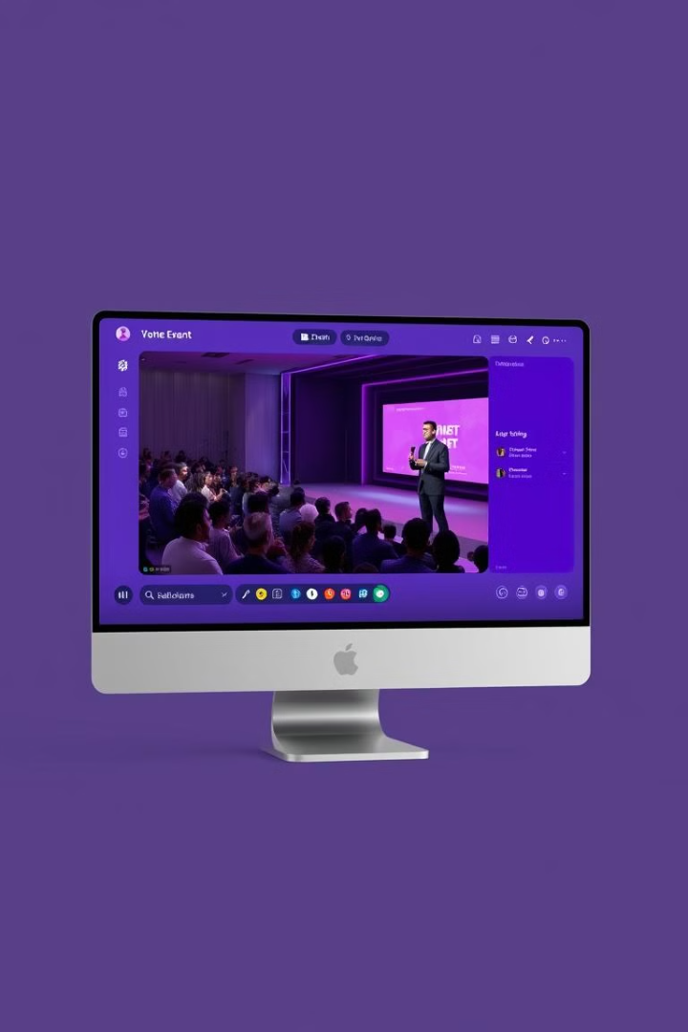
Virtual Event Platform
Welcome to our Virtual Event Platform, designed to streamline and enhance your online events.
CBIT
Team Members
AI&DS – i-1
Boggavarapu Yuva Satya Kunaal | 1601 22 771 031
Sasi Vakul Rithwik | 1601 22 771 059
Vallaboina Shiva Prasad | 1601 22 771 063

Slide 2


Abstract
Our virtual event platform offers a robust and user-friendly solution for hosting engaging online events.
1
Multi-User Roles
2
Administrator Control
The platform supports diverse user roles, empowering administrators, organizers, and attendees.
Administrators oversee the platform, managing users and ensuring seamless operation.
3
Organizer Features
4
Attendee Engagement
Organizers create events, invite participants, and provide event details, including Google Meet links.
Attendees engage with events through interactive features and communication tools.

Slide 3
Introduction
Our platform revolutionizes the way you host virtual events, providing a seamless and engaging experience for all participants.
Event Creation
Live Streaming and Interaction
Organizers easily create events with customizable settings and branding options.
Host live sessions with interactive features such as Q&A, polls, and chat.
1
2
3
4
Participant Management
Post-Event Analytics
Efficiently manage participants, assign roles, and control access to event content.
Gain insights into event performance with detailed analytics and reports.

Slide 4
User Roles and Functionalities
Our platform caters to various user needs, offering tailored functionalities for each role.
Administrators
Organizers
Attendees
Oversee the platform, manage user accounts, and ensure smooth operations.
Plan and execute events, manage participants, and provide event details.
Participate in events, access content, and interact with other attendees.
Create and manage user roles
Create events with customizable settings
Register for events and access event information
Monitor platform activity and security
Invite participants and manage access
Engage with live sessions and ask questions
Configure settings and system updates
Host live sessions and manage interactions
Network with other attendees and participate in discussions

Slide 5

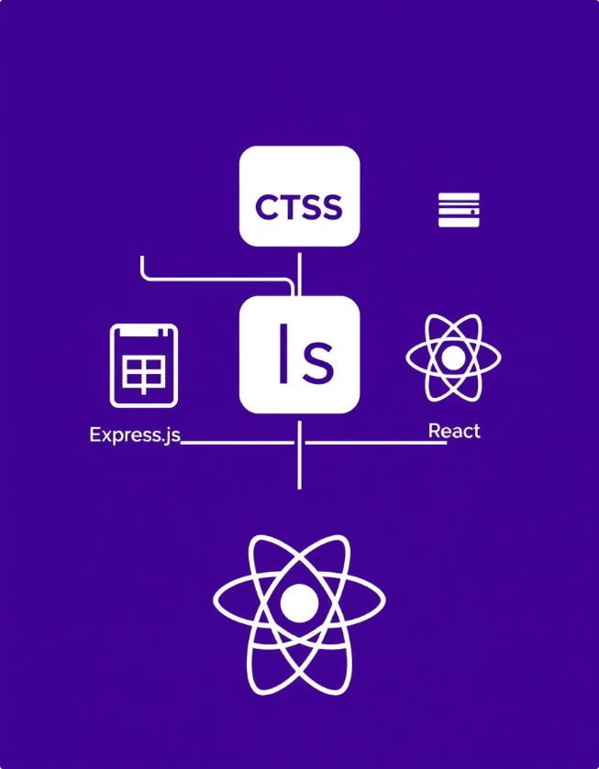
Technologies Used
Our platform leverages a combination of modern technologies to deliver a robust and scalable solution.
Technology
Description
HTML, CSS, JavaScript
Front-end development for user interface and interactive elements
Express.js
Node.js web application framework for backend logic and API development
MongoDB
NoSQL database for storing user data, event details, and other platform information
React
JavaScript library for building dynamic and responsive user interfaces

Slide 6
Progress
Virtual Event Platform
-- Completed with Figma design :
-- Will start with Frontend using React Framework
25%
0% 25% 50% 75% 100%
Didn’t start Demo using Figma Frontend Backend Complete

Slide 7
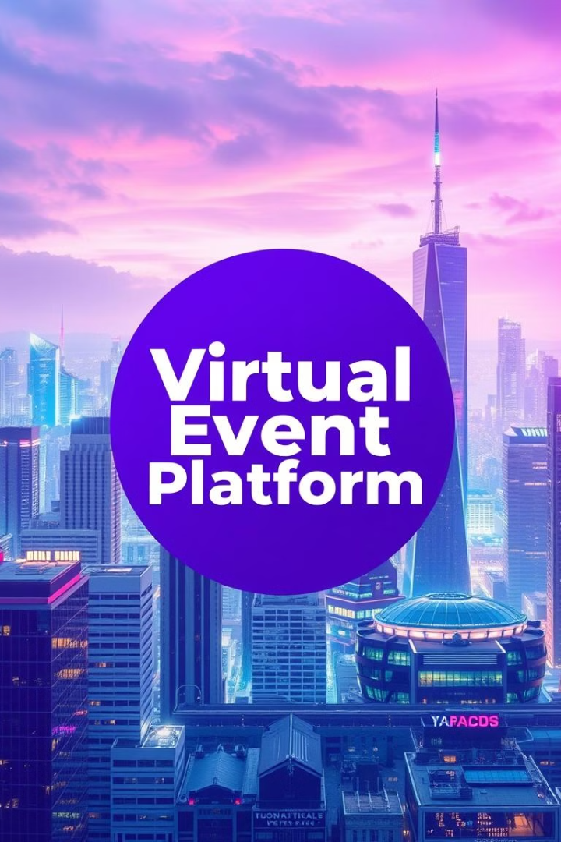



Conclusion
Our Virtual Event Platform empowers you to host engaging and successful online events, connecting people and ideas in the digital realm.
Streamlined Event Management
Simplify event planning, execution, and attendee engagement.
Enhanced User Experience
Provide a user-friendly and intuitive platform for all participants.
Scalable and Secure
Host large-scale events with reliable performance and robust security measures.

