Slide 1

DEPARTMENT OF ARTIFICIAL INTELLIGENCE AND DATA SCIENCE
CHAITANYA BHARATHI INSTITUTE OF TECHNOLOGY
A Presentation on Internship Certification
Data Science for Everyone
By
Boggavarapu Yuva Satya Kunaal (160122771031)
AI&DS – I1
VII SEM

Slide 2
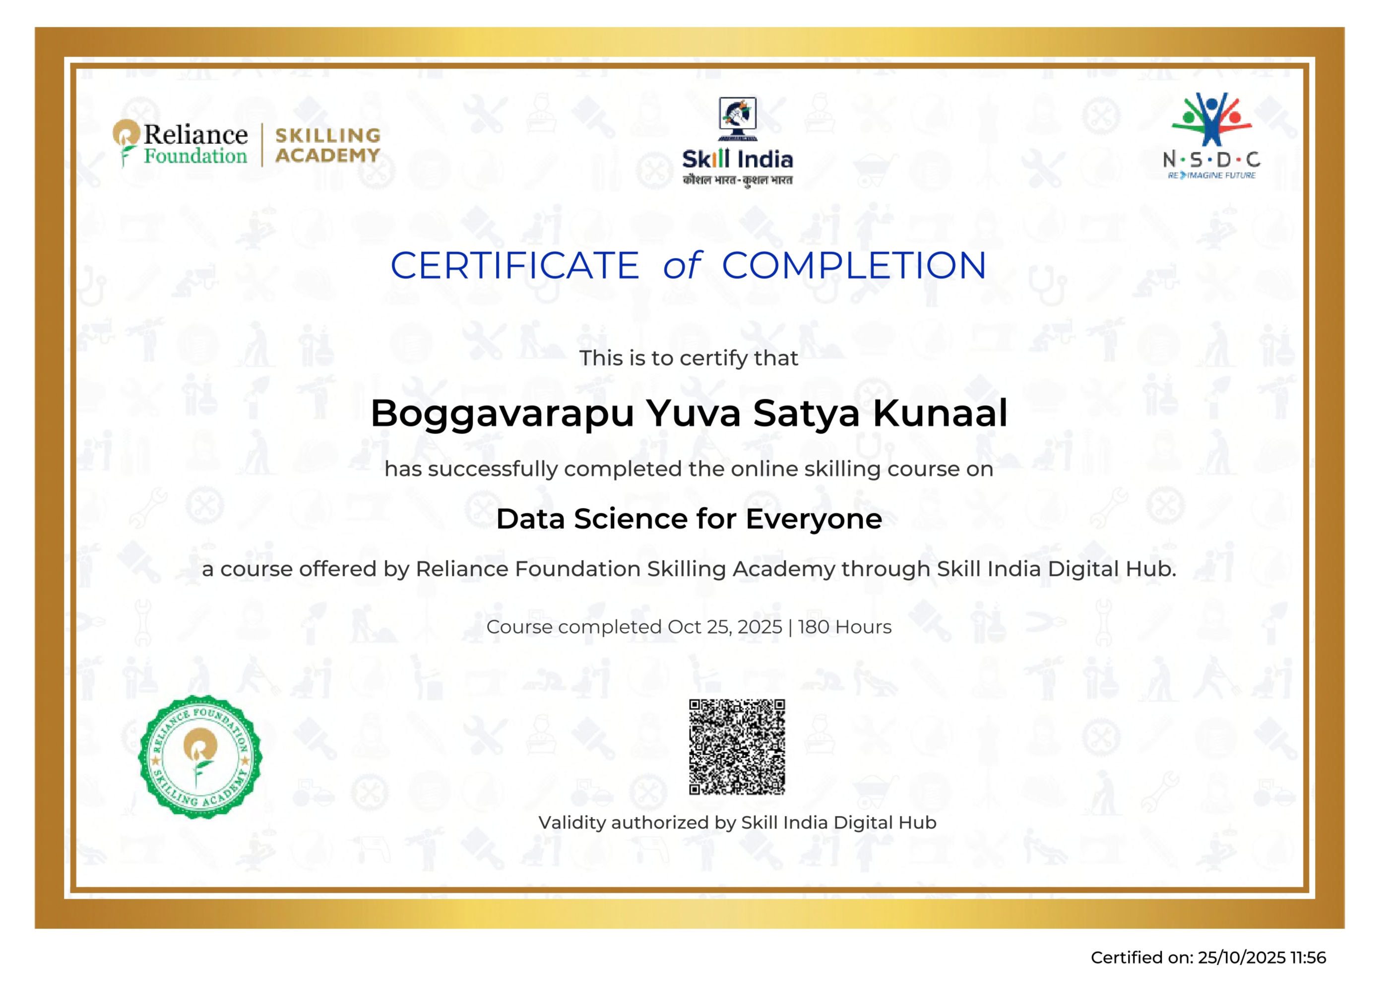
Certificate of Completion

Slide 3





About the organizations
Under the Ministry of Skill Development & Entrepreneurship (MSDE), National Skill Development Corporation (NSDC), is dedicated to empowering India's youth through comprehensive skill development.
Reliance Foundation Skilling Academy gives youth a competitive edge by equipping them with skills that are most relevant today
Skill India Digital Hub is an online training platform designed and developed to skill, reskill and upskill Indian individuals for jobs and entrepreneurial opportunities.

Slide 4
Course Layout
Week | Description
1 | Module 1: Data Science Fundamentals and Exploration • Course orientation & Introduction to Data Science concepts . • Mastered Python data analysis libraries: Pandas, NumPy, and Matplotlib. • Conducted Exploratory Data Analysis (EDA) on the Netflix dataset.
2 | Module 2: Advanced Preprocessing & Certification • Engineered 17 key features and handled missing data (Directors, Country). • Built data transformation pipelines and mastered feature selection.
3 | Module 3: Capstone Project: Model Development • Implemented Random Forest Classifier for popularity prediction. • Conducted extensive hyperparameter tuning to achieve 90.6% accuracy. • Evaluated model using ROC-AUC, F1-score, and Confusion Matrix. • Successfully completed the course and cleared the certification exam.

Slide 5
Course Outcomes
Week | Description
4 | Capstone Project Execution : Dashboard Development • Developed FastAPI backend for real-time prediction endpoints. • Created responsive frontend using HTML/CSS and Chart.js for analytics. • Integrated the trained ML model with the web interface.
5 | Project Closure & Documentation • Finalized system integration and optimized performance. • Prepared comprehensive project documentation and technical specifications. • Completed final project deliverables and demonstration materials.
Data Preprocessing & Feature Engineering for real-world datasets using Pandas and NumPy.
Machine Learning Implementation using Random Forest Classifier achieving 90.6% accuracy.
Web Application. Development of predictive models using FastAPI backend and REST APIs.
Interactive Data Visualization and dashboard creating using chart.js for business intelligence.
Feature Importance Analysis to identify key popularity drives like Genres and Content Type.
Successfully passed the proctored certification exam.

Slide 6
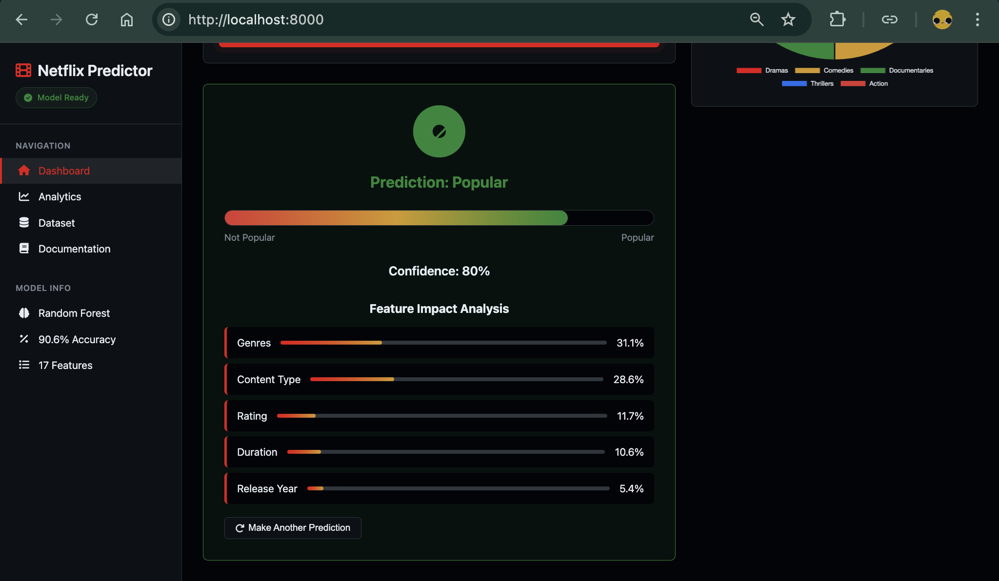
Capstone Project: Netflix Popularity Predictor
A comprehensive business intelligence tool that predicts content popularity on Netflix, built by integrating a Machine Learning model with a responsive web dashboard for real-time analytics.
Key Integration:-
ML: Scikit-learn, Random Forest Classifier (90.6% Accuracy).
Web-Framework: FastAPI (Python) for backend REST services.
Visualization: Chart.js for dynamic feature impact analysis and analytics.

Slide 7
Project Architecture & Implementation
Technology Stack:
ML Model: Scikit-learn (Random Forest Classifier).
Backend: FastAPI framework with REST API endpoints.
Frontend: HTML5, CSS3, JavaScript, and Chart.js for visualization.
Data Processing: Pandas and NumPy for data manipulation.
Workflow:
User inputs content details (Genre, Duration, Rating) via the Web Dashboard.
FastAPI server receives the request and preprocesses the input data.
Random Forest model analyzes features and predicts popularity.
System returns the prediction result with a confidence score.
Dashboard visualizes the result and displays Feature Impact Analysis.

Slide 8
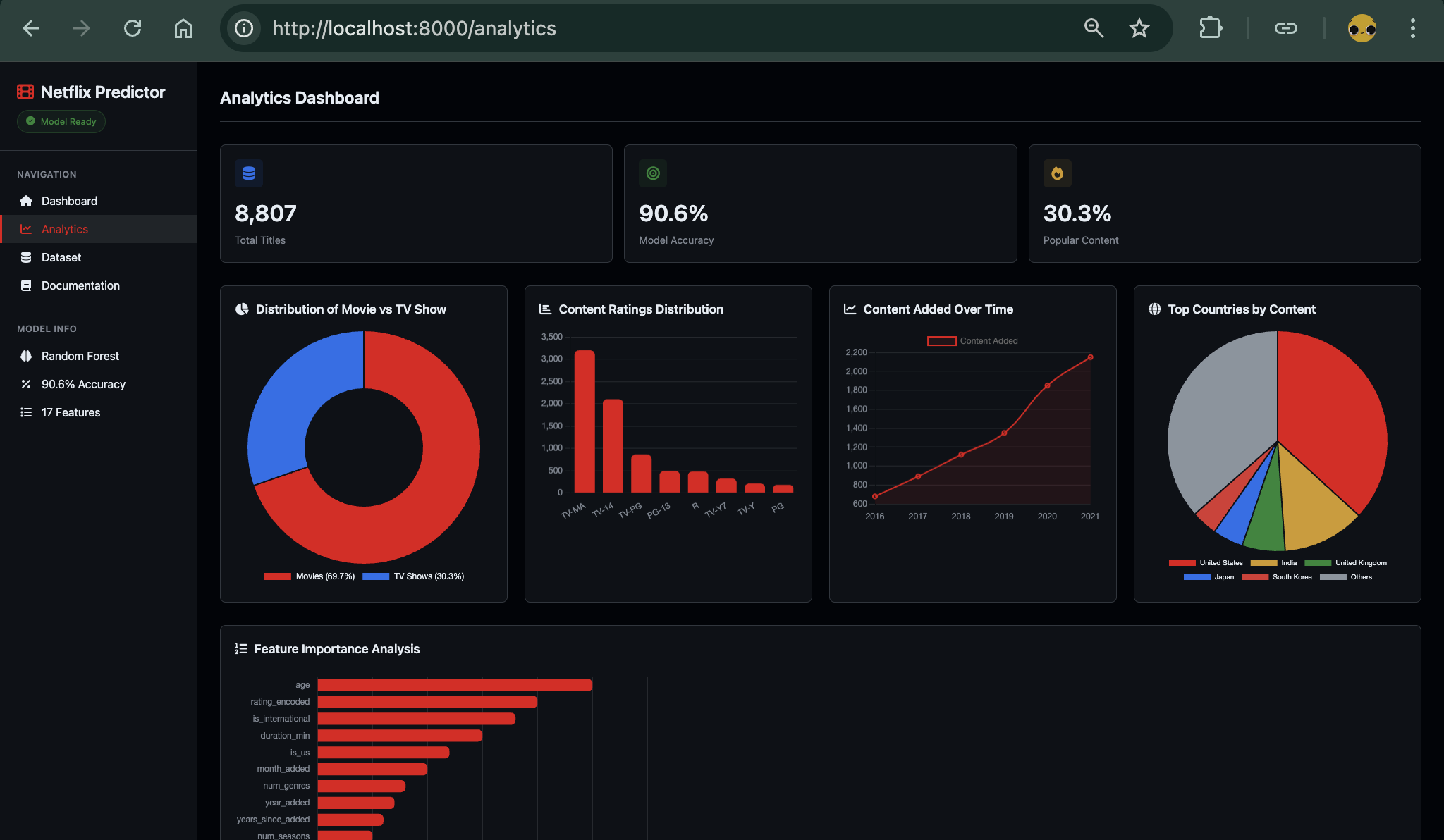
Analytics & Visualization: Interactive Dashboard
Real-time Predictions: Instant popularity forecasting with confidence scores and probability metrics.
Feature Impact Analysis: Dynamic visualization showing key drivers like Genres (31.1%) and Content Type (28.6%).
Content Distribution: Comparative charts analyzing the proportion of Movies vs. TV Shows in the catalog.
Temporal Trends: Interactive line graphs tracking content addition patterns and growth over years.
Dataset Exploration: Detailed interface for examining underlying content statistics and metadata.

Slide 9
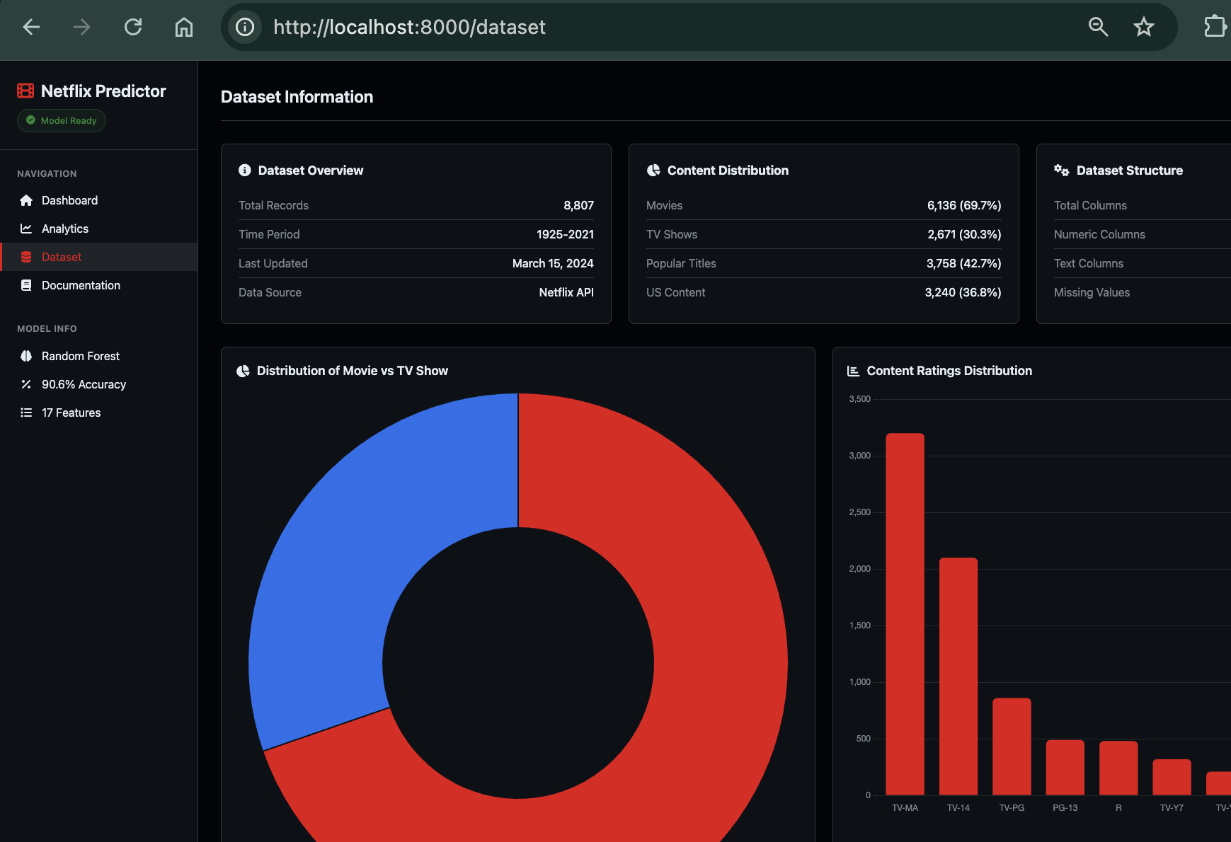
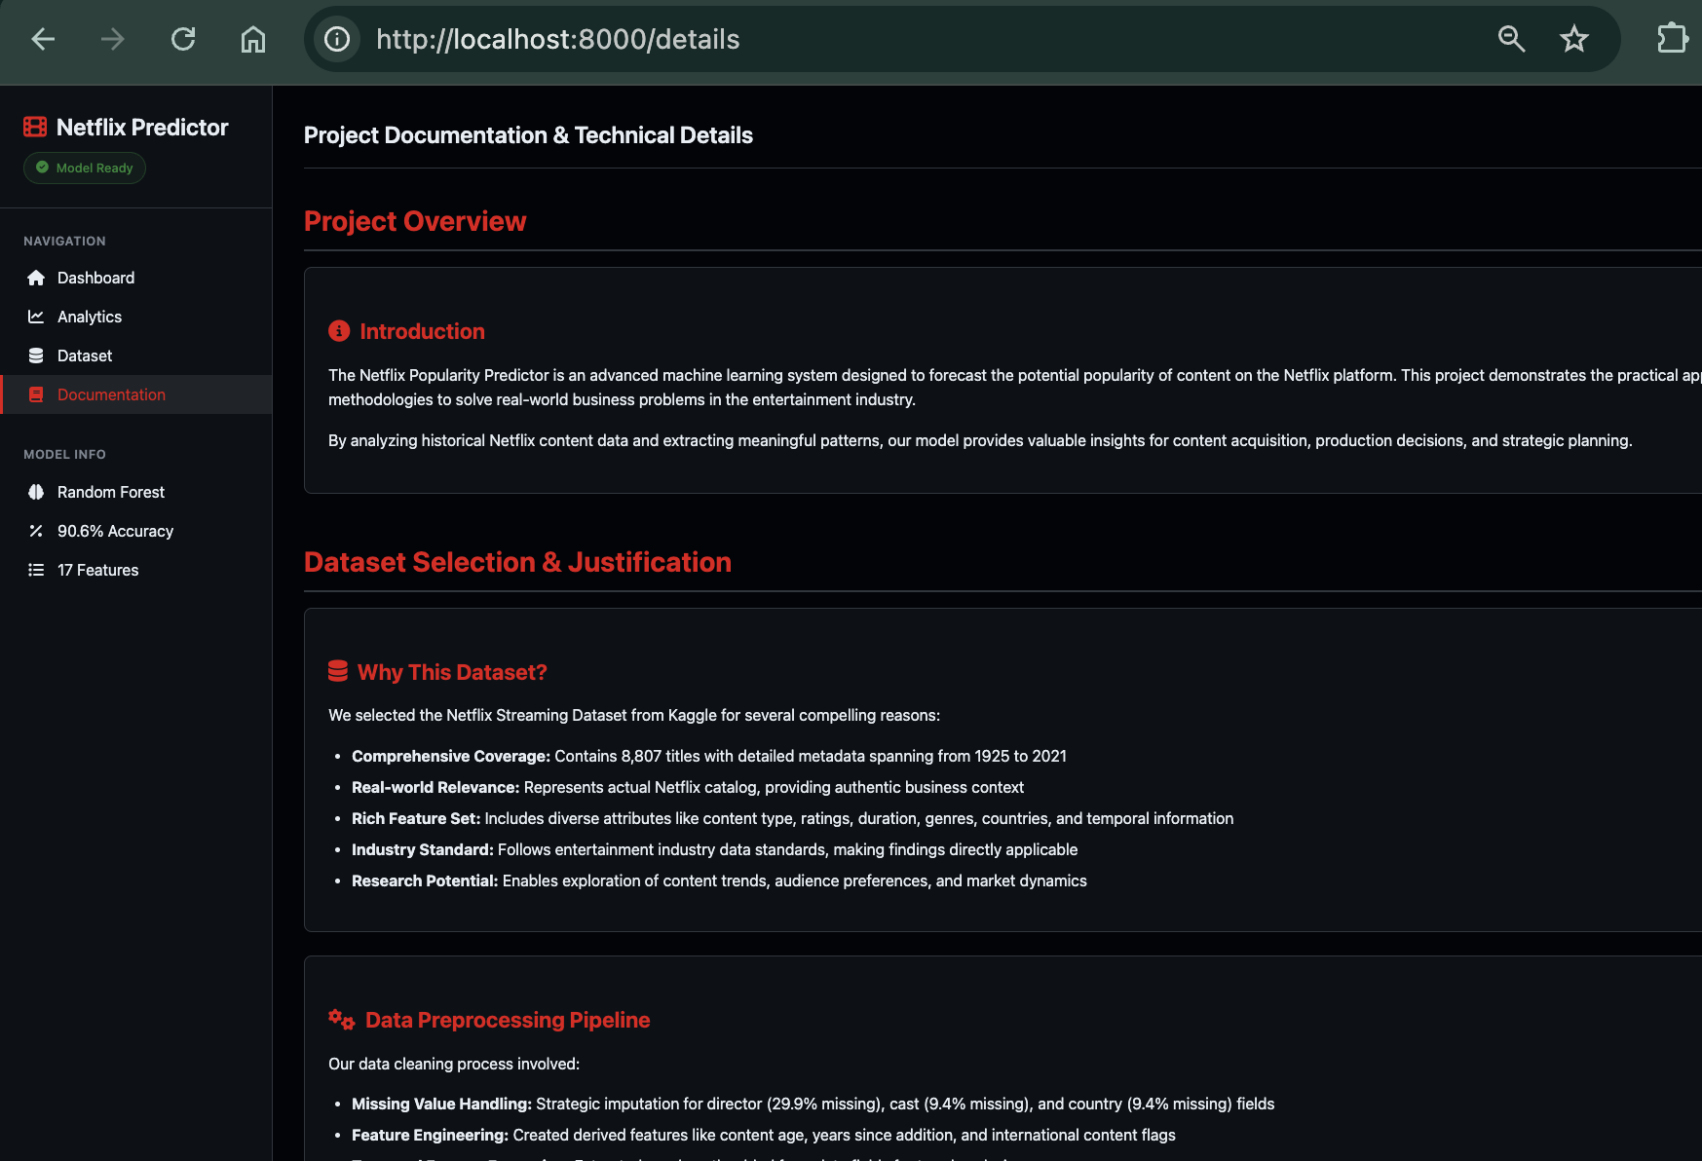
Predictor
Dataset
Results
Website Details
Analytics

Slide 10
Conclusion
Bridging Theory & Practice: Successfully bridged theoretical data science concepts with real-world business applications through end-to-end implementation.
Model Success: Delivered a robust Random Forest prediction model achieving 90.6% accuracy, validating the effectiveness of the chosen algorithms.
Business Intelligence: Transformed raw historical data into actionable insights, identifying Genres (31.1%) and Content Type as the primary drivers of popularity.
Accessibility: Proved that complex machine learning models can be made accessible to non-technical stakeholders through intuitive web dashboards.
Future Scope: The system framework is scalable for enterprise analytics and can be adapted for other streaming platforms or real-time content strategies.

Slide 11
THANK YOU

