Slide 1
Bloch-McConnell equation
simulation and fit tool tutorial
Internal git revison number 506d505
Moritz Zaiss

Slide 2
Overview
The principle structure of the simulation
Main functions
The parameters structs Sim and Space
Examples

Slide 3
Sequence
…
Sim.Trec
Tsat=n*tp+n-1*td
Readout
Zi
Trec
Gaussian
Sinc
Blocl
SL
adiaSL
B1, tp td, DC
Bssfp
GRE
Linestomeasure
TR, flipangle,
Parameters
‘Z-magnetization‘
time

Slide 4
functions
NUMERIC_SIM(Sim);
ANALYTIC_SIM(Sim);
Both function generate the numeric or analytic solution of the BM equations, respectively. They need the parameters structure Sim described in the following.

Slide 5
Parameter struct ‘Sim‘ contains the following fields:
solver parameters |  | Saturation parameters
analytic | bool, if analytic solution shall be calculated | FREQ | Double, Scanner frequency in Hz
numeric | bool, if numeric solution shall be calculated | B1 | Double, Mean pulse power [µT]
offset | Double, offset range or single offset where Z-values shall be calculated | Trec | Double, Recover time bevore saturation [s]
all_offsets | Int, 1=Zspec, 0 = only +-offset, 2= onres | spoilf | Double, spoilfactor = 0 for full spoiling
MT | Bool, % 1 = with MT pool (pool C), 0 = no MT pool | Zi | Double, Initial magnetization
n_cest_pool | Int, number of CEST/NOE pools (CEST pools: B,D,E,F,G...) | shape | String, Pulse shapes, ‘SPINLOCK’, ‘seq_gauss’, ‘block’, ‘block_trap’, ‘gauss’, ‘sech, sinc_1’, ‘sinc_2’, ‘sinc_3’, ‘sinc_4’
Rex_sol | String, type of approximation for Rex - options: 'Hyper', 'Lorentz' , 'minilorentz' | pulsed | Bool, flag if pulsed of cw
MT_sol_type | String, Analytic MT solution type - options: 'Rex_MT' | n | Int, Number of pulses
xZspec xxZspec | Double array, offset list double array, fine offset list | tp | Double pulse duration [s]
modelfield | String, Solution to be displayed | DC | Duty cycle, 0.5=50%=tp/(tp+td) this determines td.

Slide 6
Parameter struct ‘Sim’ contains the following fields:
Pool parameters |  | Readout parameters
tissue | Tissue type as defined in getSim(Sim) | TR | Double, repetition time in [s]
CESTagent | CEST pool system type as defined in getSim(Sim) | TE | Double, echo time in [s]
pH | Double, pH value for getSim | flipangle | Double, flip angle in degrees
temperature | Double, temperature value for getSim | linestomeasure | Int, how many k-space lines are measured
R1i, R2i | Relaxation parameters of pool i | Readout_type | String, ‘bssfp’, ‘gre’
fi kiA kAi dwi | Double>0, Relative concentration of pool i Double>0, Exchange rate of pool i Double>0, Back exchange rate of pool i = kiA*fi Double Chemical shift relative to water of pool i
MT_lineshape | String, Lineshape of MT pool, options: ‘SuperLorentzian‘, ‘Gaussian‘, ‘Lorentzian‘

Slide 7
3_BATCH_simulation_param_space
Just run the whole file or individual section one after another
You should get the result of the following slides
A loop creates a whole space of solutions the NUMERIC_SPACE or ANALYTIC_SPACE
NUMERIC_SPACE.(field){ii} = NUMERIC_SIM(Sim);
ANALYTIC_SPACE.(field){ii} = ANALYTIC_SIM(Sim);
Outcomes (Z-spectra, Asymmetry and R1p are plotted via PLOT_SPACE(Sim,Space,NUMERIC_SPACE,ANALYTIC_SPACE);

Slide 8
The struct ‘Space‘ allows to define the simulated parameter space
The standard parameters get loaded and then one parameter gets changed as defined in ‘Space’.
Thus
Space.n = [1 2 3 5 10];
Space.tp = [0.05 0.1];
Space.B1 = [0.8 1.6 3.2];
Creates 3 Plots:
Z-spectra with standard params (also tp and B1) but varying n
Z-spectra with standard params (also n and B1) but varying tp
Z-spectra with standard params (also tp and n) but varying B1

Slide 9
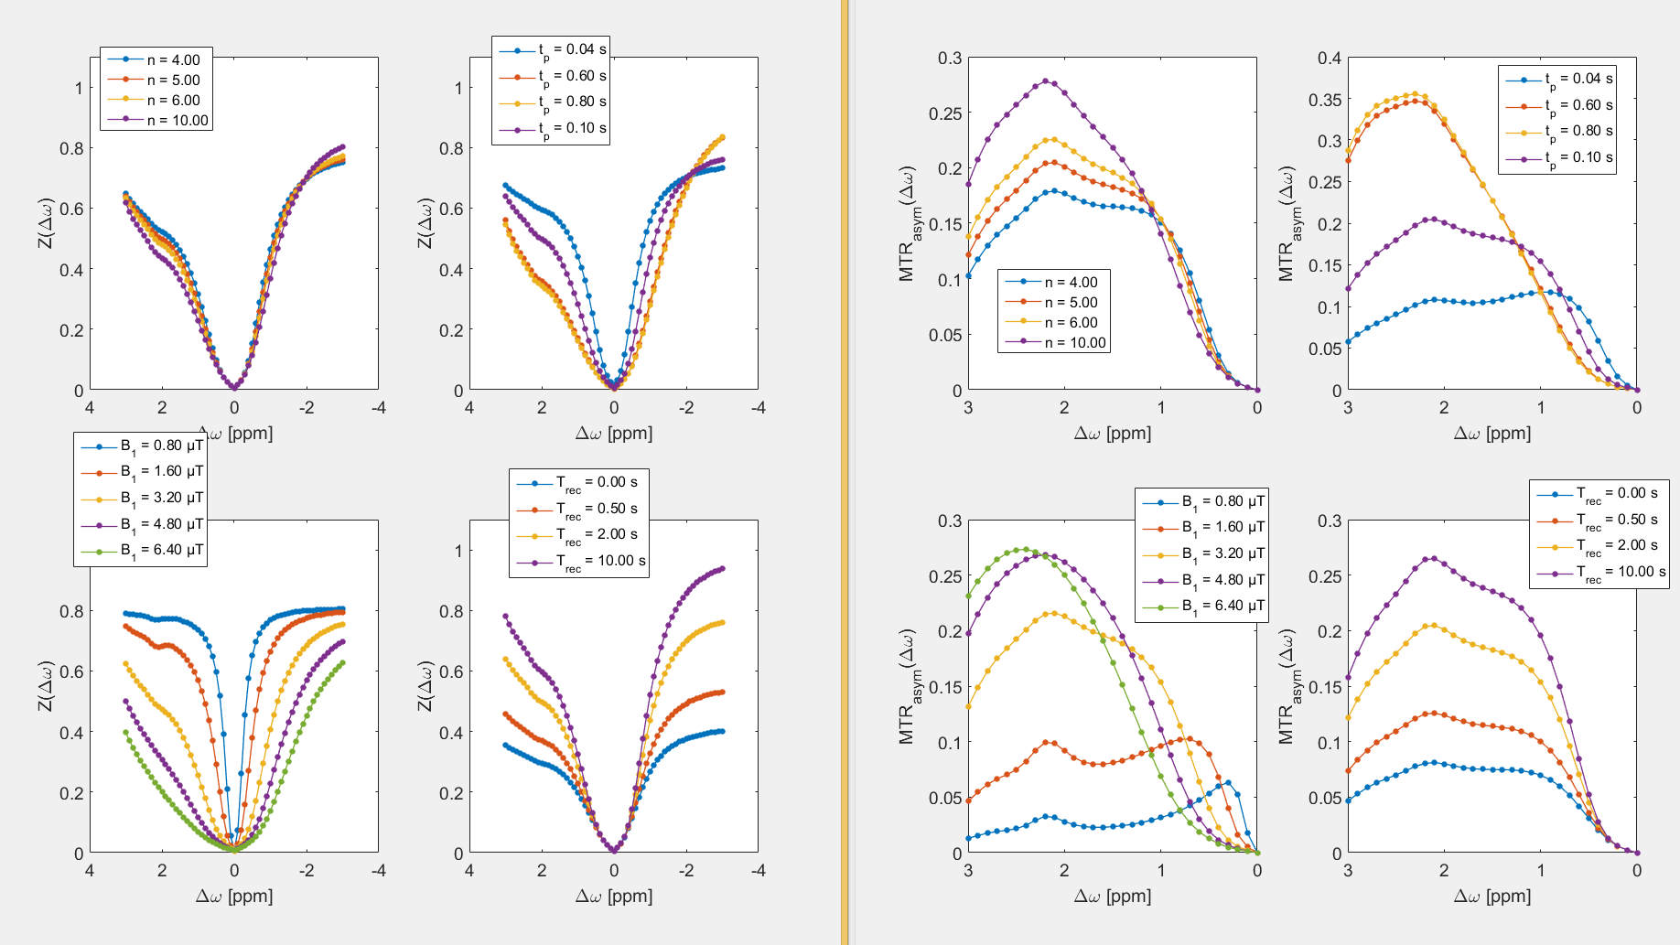

Slide 10
BATCH_simulation
Try to change Sim.B1 which is the standard B1 and run again
Try to change Space.B1 which is the B1 varying
Change SIM.linestomeasure to increase the number of measured k-space lines after saturation.
Alter tissue or CEST parameters by changing the call of getSim
E.g.: Sim.tissue = ‘WM';
Sim.CESTagent = 'glucose';
Run again! And get the following

Slide 11
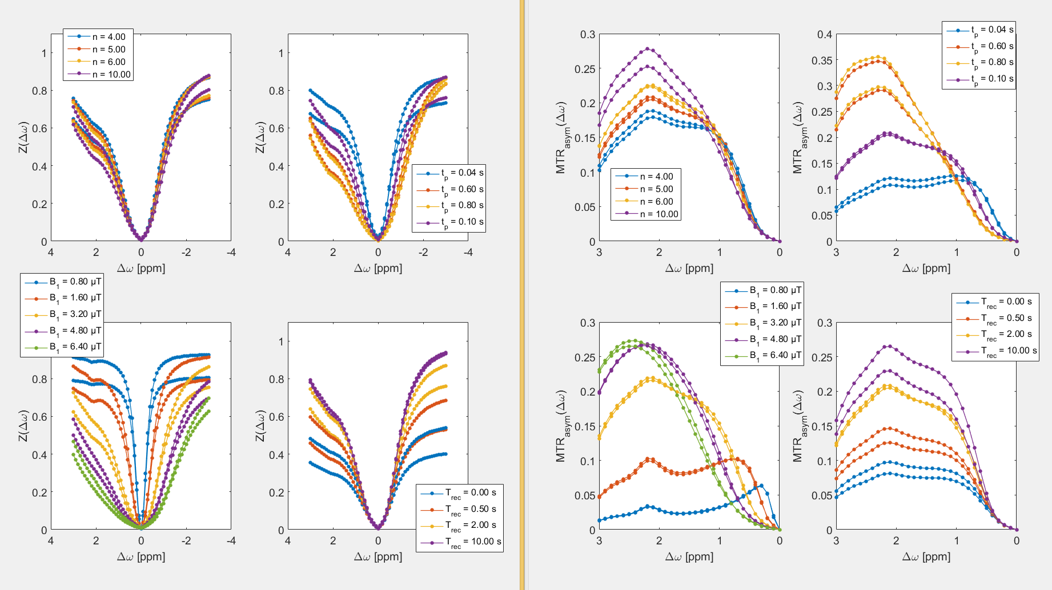
You see that with the same CEST agent (glucose) the signal in GM differs slightly from that in WM

Slide 12
BATCH_simulation
To see all the hydroxyls of glucose just increase FREQ to mimic a 100 T scanner and increase the sampling of xZspec
Sim.FREQ= 100*gamma_;
%Pool B Sim.dwB=2;
Sim.R2B=66.66;
Sim.fB=0.0045; % 100mM
Sim.kBA=5000;
% Pool D
Sim.dwD=2.2;
Sim.R2D=66.66;
Sim.fD=0.0009;
Sim.kDA=500;
% Pool E
Sim.dwE=2.8;
Sim.R2E=66.66;
Sim.fE=0.0009;
Sim.kEA=1000
% Pool F
Sim.dwF=0.6;
Sim.R2F=66.66;
Sim.fF=0.0009; % 0.0045/5 for 100mM and 5 exchanging protons
Sim.kFA=5000;
% Pool G
Sim.dwG=1.2;
Sim.R2G=66.66;
Sim.fG=0.0009;
Sim.kGA=5000;

Slide 13
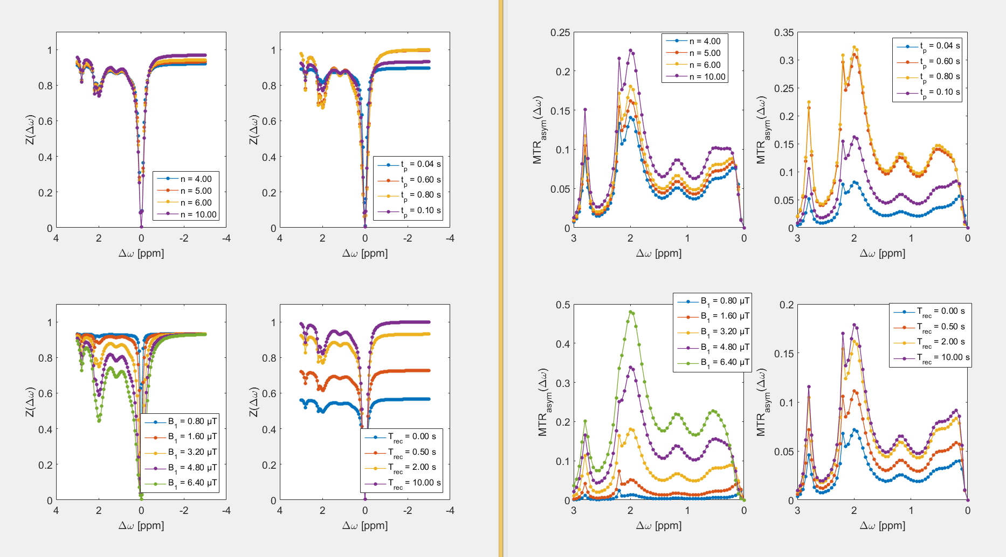

Slide 14
BATCH_simulation_readout WIP
By increasing the linestomeasure you can test different readouts e.g. bssfp and gre
If you run the BATCH_simulation_readout you should see the following

Slide 15
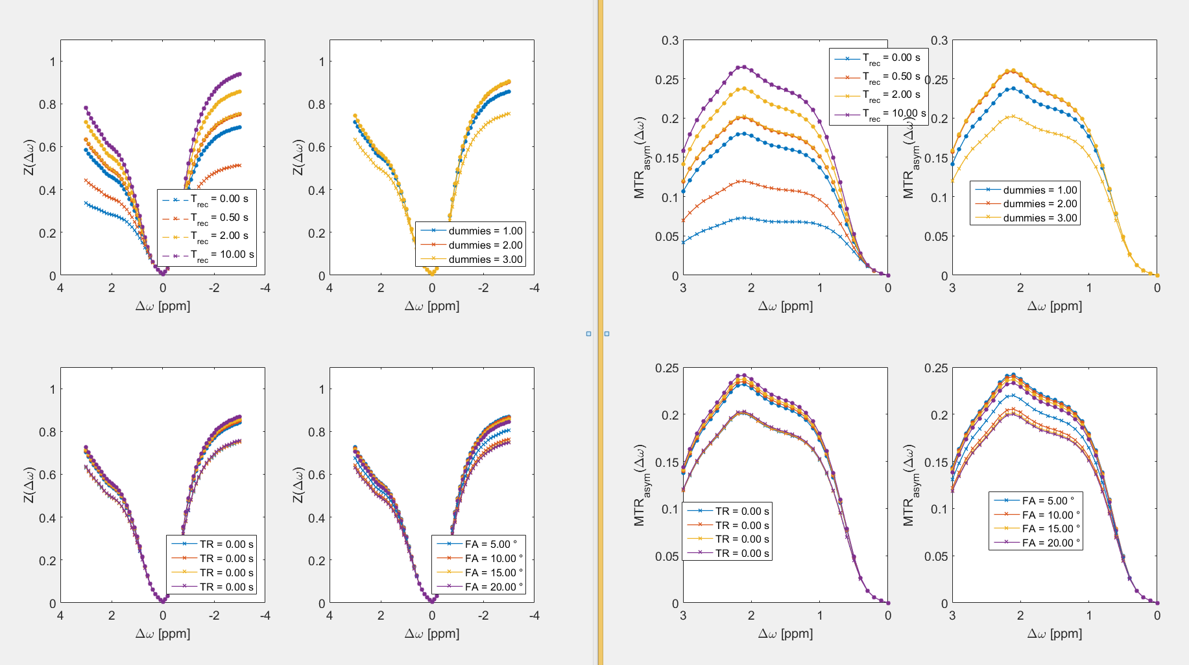
bssfp (circles) versus gre (crosses)

