Slide 1
1
Intro2cs
Tirgul 5

Slide 2
What we will cover today?
2
File IO
Dictionaries
XML
Importing files
List comprehension
Function with unknown number of arguments

Slide 3
How Can We Store Data
3
Till now, when we wanted to keep any piece of data we assigned to it variables of different types – integers, strings, lists, tuples etc.
Is there any limitation to the size of the data that can be assigned to a variable?
Notes:
אם יש הפסקת חשמל - כל המידע שעבדתי עליו אבוד, אבל כל הקבצים ששמרתי יהיו לי זמינים בהפעלת המערכת הבאה.
קבצים שומרים על התוכן שלהם גם כשהמחשב כבוי
יצרתי קובץ תמונה, אפשר לשמור אותו ואז הוא יהיה זמין לצפייה על ידי תוכנית אחרת.

Slide 4
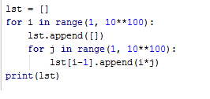
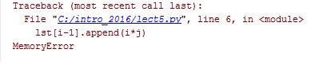
How Large is the Data We Use?
4
What will happen here?

Slide 5
Memory Limitation
5
The containers we know (list\tuple etc.) are limited in the amount of information they can hold (~536M items on a 32bit system[ref])
Notes:
אם יש הפסקת חשמל - כל המידע שעבדתי עליו אבוד, אבל כל הקבצים ששמרתי יהיו לי זמינים בהפעלת המערכת הבאה.
קבצים שומרים על התוכן שלהם גם כשהמחשב כבוי
יצרתי קובץ תמונה, אפשר לשמור אותו ואז הוא יהיה זמין לצפייה על ידי תוכנית אחרת.

Slide 6
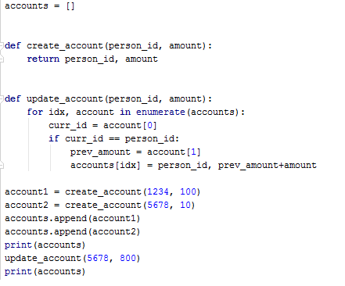

How Long is the Data Kept?
6
Notes:
אם יש הפסקת חשמל - כל המידע שעבדתי עליו אבוד, אבל כל הקבצים ששמרתי יהיו לי זמינים בהפעלת המערכת הבאה.
קבצים שומרים על התוכן שלהם גם כשהמחשב כבוי
יצרתי קובץ תמונה, אפשר לשמור אותו ואז הוא יהיה זמין לצפייה על ידי תוכנית אחרת.

Slide 7
How Long is the Data Kept?
7
But what happens to the accounts data when the program finishes to run, for any reason?
That data is lost, since it is kept only while the program is running

Slide 8
Solution – we can use files!
8
A file is an ordered sequence of bytes.
Can store large amount of data
Files information is maintained across system shut downs\reboots, and could be accessed by different programs.
Upon reading a file, a suitable program interprets the content of a file (playing music, displaying images and text).
Notes:
תוכן של קבצים הוא תמיד ביטים, אנחנו יכולים לפרש אותו בזמן הקריאה איך שאנחנו רוצים

Slide 9
Handling Files in Python
9
To create files, write to files and read from files Python defines a custom file handling API (Application Programming Interface).
Notes:
תוכן של קבצים הוא תמיד ביטים, אנחנו יכולים לפרש אותו בזמן הקריאה איך שאנחנו רוצים

Slide 10
Creating a file object
10
f = open(filename)
open is python built-in function which returns a file object, with which we can work with files.
filename is a string which indicates the file location within the file system (absolute or relative to the folder from which the program is running).
For example:
C:/intro/ex5/some_txt_file.txt

Slide 11
File ‘open’ing mode
11
f = open(filename,[mode])
When opening a file we should declare our intentional use of this file.
Protects us against undesired consequences.
Two basic types of modes :
Read (default)
Write
Notes:
The multiple modes “defend” us so we would not do what we don’t mean to (e.g unwanted changes)
We have to declare in advance what are our intentions toward the open file (do we wish to manipulate it? read only?)

Slide 12
File ‘open’ing mode (2)
12
The multiple modes “defend” us so we would not do what we don’t mean to (e.g unwanted changes in the file)
We have to declare in advance what are our intentions toward the open file (do we wish to manipulate it? read only?)

Slide 13
open in read mode (default)
13
f = open(filename,'r')
If filename does not exist :
Traceback (most recent call last):
File "<pyshell#0>", line 1, in <module>
f = open('filename')
FileNotFoundError: [Errno 2] No such file or directory: 'filename'

Slide 14
open in write mode
14
f = open(filename,'w')
If filename does not exist:
python will create such.
If filename does exist:
python will override (delete) the existing version and replace it with a new (the current) file. – Beware!

Slide 15
open in append mode
15
f = open(filename,'a')
If filename does not exist:
python will create such.
If filename does exist:
python will add any written data to the end of the file.

Slide 16

write to file
16
n = f.write(s)
Write the string s to the file f.
n = number of written characters.
f = open("file.txt")
n = f.write('Happy New Year')

Slide 17
write to file (2)
17
f = open("file.txt", 'a')
n = f.write('Happy New Year')
write adds content to the end of the file but does not insert line breaks. E.g :
f.write('Don')
f.write('key')
f content :
Happy New YearDonkey

Slide 18
write multiple lines – use Join
f = open("file.txt", 'a')
L = [‘Happy’,’new’,’year’]
n = f.write('\n'.join(L))
f content :
Happy
new
year
Join - Concatenate strings using the first string

Slide 19
write multiple terms to file
19
f.writelines(seq)
Write the strings contained in seq to the file
one by one.
For example:
my_strings = ['Don', ‘key']
f.writelines(my_strings)
f content :
Donkey
writelines expects a list of strings,
while write expects a single string.

Slide 20
closeing a file
20
f.close()
After completing the usage of the file, it should be closed using the close method.
Free the file resource for usage of other processes.
Some environments will not allow read-only and write modes opening simultaneously

Slide 21
the open with statement
21
Things don’t always go as smoothly as we plan, and sometimes causes programs to crash.
E.g. trying a 0 division.
If the program crashes, we don’t get a chance to close (and free the resource of) the open file.
To verify the appropriate handling of files, even in case of program crash we can make use of the with statement.
Notes:
https://docs.python.org/3/reference/compound_stmts.html#with

Slide 22
the with statement
22
with open(file_path, 'w') as our_open_file:
# we can work here with the open
# file and be sure it is properly
# closed in every scenario
The with statement guarantees that even if the program crashed inside the with block, it will still be properly closed.
Notes:
https://docs.python.org/3/reference/compound_stmts.html#with

Slide 23
You can’t write to a closed file
23
f.close()
f.writelines(['hi','bi','pi'])
Traceback (most recent call last):
File "<pyshell#20>", line 1, in <module>
f.writelines(['hi','bi','pi'])
ValueError: I/O operation on closed file.

Slide 24
reading from file
24
f.read(n)
Read at most n characters from f (default = all file)
f.readline()
Read one line.
f.readlines()
Read all lines in the file - returns a list of strings ( list of the file’s lines).
https://docs.python.org/3/tutorial/inputoutput.html
Notes:
https://docs.python.org/2/tutorial/inputoutput.html

Slide 25
reading a 'w' mode file
25
f = open(filename,'w')
f.read()
Traceback (most recent call last):
File "<pyshell#1>", line 1, in <module>
f.read()
io.UnsupportedOperation: not readable
Use ‘r+’ mode for reading and writing

Slide 26
Iterating over a file
26
When we read a file, Python defines a pointer (an iterator) which advances with every consecutive reading.
f.readline() # 1st time
>> Hi :)
f.readline()# 2nd time
>> Bi :(
f content
Hi :)
Bi :(
Mitz
Paz
Notes:
https://docs.python.org/2/tutorial/inputoutput.html

Slide 27
Iterating over a file - tell
27
The tell() method returns the current position within the file.
f.readline() # 1st time
>> Hi :)
f.tell()
>> 5
f content
Hi :)
Bi :(
Mitz
Paz
Notes:
https://docs.python.org/2/tutorial/inputoutput.html

Slide 28
Access (e.g. print) all the lines in a file
28
f = open(filename)
for line in f:
print(line)
When do the iteration stop?
When reaching end-of-file (EOF)
We may think on a file as a sequence - thus we stop when there’s no more items in f - when we reach EOF
Notes:
https://docs.python.org/3/tutorial/inputoutput.html

Slide 29
Programs with multiple files
29

Slide 30
Importing files
Suppose foo.py has code we want to use in bar.py
In bar.py we can write:
import foo
foo.func1()
preferred alternatives. No problems with name collision
import foo as my_foo
my_foo.func1()
from foo import func1,func2
func1()
from foo import *
func1()
Here’s more info on handling cyclic imports. https://docs.python.org/3/faq/programming.html#how-can-i-have-modules-that-mutually-import-each-other

Slide 31
Importing runs the code
We want to be able to run foo.py, but also want to use its code in bar.py
import foo
foo.func1()
…more_stuff…
bar.py
def func1():
dostuff…
print(“hello”)
foo.py
If we run this, also prints.
Run this. Okay.
__name__ will have the value “__main__” only if the current module is first to execute
import foo
foo.func1()
…more_stuff…
def func1():
dostuff…
if __name__ == “__main__”:
print(“hello”)
bar.py
foo.py
Run this. Okay.
Run this. Okay.

Slide 32
The Dictionary Data Structure
A dictionary is a another type of dataset
It contains keys and values.
Each key has its own value
Keys
Values
1
2
3
“Hello”
“a”
“b”
“c”
“world”

Slide 33
The Dictionary Data Structure
Similar to lists - Dictionaries are mutable
The main difference between dictionaries and list is how to retrieve values
In list we had indexes (L[0])
In dicts we use keys (d[‘key’])

Slide 34
The dictionary data structure
Keys are unique within a dictionary while values may not be.
Keys must be of an immutable data type such as strings, numbers, or tuples.
Values can be any Python data type, mutable or immutable

Slide 35
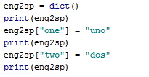

Creating a dictionary
empty dictionary
a value
a key

Slide 36

Creating a dictionary
* Creating a dictionary with terms:
In general, the order of items in a dictionary is unpredictable
Dictionaries are indexed by keys, not integers

Slide 37


Dictionary Indexing
* If the index is not a key in the dictionary, Python raises an exception

Slide 38


The in operator
Note that the in operator works differently for dictionaries than for other sequences
For offset indexed sequences (strings, lists, tuples), x in y checks to see whether x is an item in the sequence
For dictionaries, x in y checks to see whether x is a key in the dictionary

Slide 39


Keys and Values
The keys method returns a sequence of the keys in a dictionary

Slide 40


Keys and Values
The values method returns a list of the values

Slide 41

Keys and Values
The items method returns a list of tuple pairs of the key-value pairs in a dictionary

Slide 42


Keys are unique - values not necessarily
Chang the value of d[1]
Add another key with value ‘b’

Slide 43
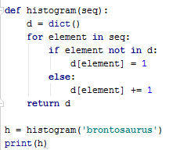
Example: histrogram

Slide 44
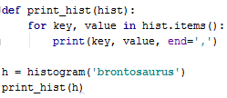
Key-Value Pairs
Change the print_hist function:

Slide 45
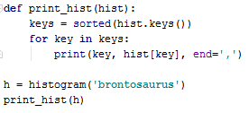
Sorting the Keys
Change the print_hist function:

Slide 46
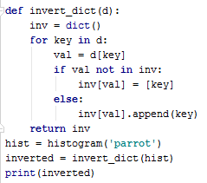
Using lists as values

Slide 47
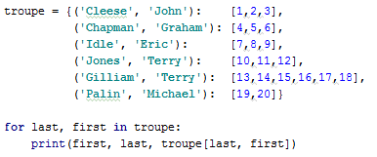
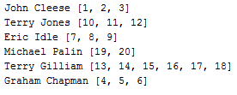
Using tuples as keys

Slide 48
XML (Extensible Markup Language)
XML developed by World Wide Consortium’s (W3C’s) XML Working Group (1996)
XML portable, widely supported, open technology for describing data
XML quickly becoming standard for data exchange between applications
Notes:
48

Slide 49
XML Documents
XML marks up data using tags, which are names enclosed in angle brackets
<tag> elements </tag>
Elements: individual units of markup (i.e., everything included between a start tag and its corresponding end tag)
Nested elements form hierarchies
Root element contains all other document elements
View XML documents
Any text editor
Internet Explorer, Notepad, Visual Studio, etc.

Slide 50
XML Documents
XML documents end with .xml extension
View XML documents
Any text editor
Internet Explorer, Notepad, Visual Studio, etc.

Slide 51
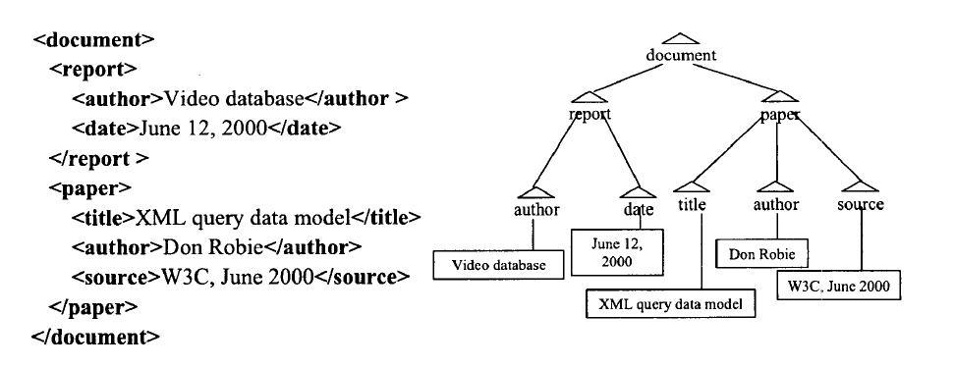
XML Tree Structure

Slide 52
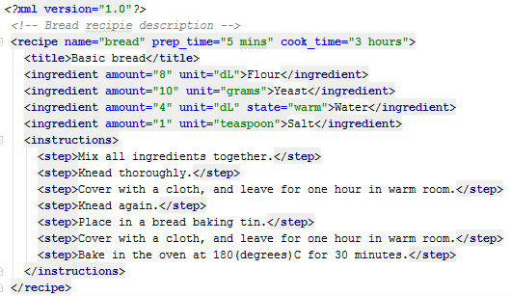
XML: Example

Slide 53
XML: Well-formed XML
All XML elements must have a closing tag
XML tags are case sensitive
All XML elements must be properly nested
All XML documents must have a root tag
Attribute values must always be quoted

Slide 54
ElementTree
Access the contents of an XML file in a "pythonic" way.
Use iteration to access nested structure
Use dictionaries to access attributes
Each element/node is an "Element"
Google "ElementTree python" for docs

Slide 55
XML: Back to example

Slide 56
Basic ElementTree Usage
import xml.etree.ElementTree as ET # Parse the XML file and get the recipe element document = ET.parse("recipe.xml") root = document.getroot() # What is the root? print (root.tag) # Get the (single) title element contained in the recipe element element = root.find('title') print (element.tag, element.attrib, element.text) # All elements contained in the recipe element for element in root: print (element.tag, element.attrib, element.text) # Finds all ingredients contained in the recipe element for element in root.findall('ingredient'): print (element.tag, element.attrib, element.text)
# Continued…
Notes:
56

Slide 57
Basic ElementTree Usage
# Finds all steps contained in the root element # There are none! for element in root.findall('step'): print ("!",element.tag, element.attrib, element.text) # Gets the instructions elementment instructions = root.find('instructions') # Finds all steps contained in the instructions element for element in instructions.findall('step'): print (element.tag, element.attrib, element.text) # Finds all steps contained at any depth in the recipe element for element in root.getiterator('step'): print (element.tag, element.attrib, element.text)
Notes:
57

Slide 58
Basic ElementTree Usage
import xml.etree.ElementTree as ET # Parse the XML file and get the recipe element document = ET.parse("recipe.xml") root = document.getroot() element = root.find('title') for element in root.findall('ingredient'): print (element.attrib['amount'], element.attrib['unit‘]) print ("Instructions:“) element = root.find('instructions') for i,step in enumerate(element.findall('step')): print (i+1, step.text)
Notes:
58

Slide 59
Basic ElementTree Usage
import xml.etree.ElementTree as ET # Parse the XML file and get the recipe element document = ET.parse("recipe.xml") root = document.getroot() ingredients = [] for element in root.findall('ingredient'): ingredients.append([element.text, element.attrib['amount'],
element.attrib['unit']]) if element.attrib.get('state'): ingredients.append(element.attrib['state'])
Notes:
59

Slide 60
School Solution of EX5
Keep up with the GUI demonstration!
Idea: Comparing stores by prices

Slide 61
List Comprehensions – motivation
Say you would like to get a list of squares, from some list/tuple/iterable. You would have probably written:
But this seems like a lot of code for such a simple operation.
In these cases you should remember your zen!
Simple is better, but how can we simplify this?
def get_squares(seq):
lst = []
for x in seq:
lst.append(x**2)
return lst

Slide 62
List Comprehensions - 1
Is a way to create a list from another iterable/sequence, where each element in the created list:
Satisfies a certain condition.
Is a function of a member in the original sequence/iterabel.
It allows for the creation of lists in an understandable syntax.
You just write your expression inside the ‘[]’!

Slide 63
List Comprehensions - 2
Returning to our previous example:
Could be simplified to:
Much easier right?
def get_squares(seq):
lst = []
for x in seq:
lst.append(x**2)
return lst
def get_squares(seq):
return [x**2 for x in seq]

Slide 64
Conditioning
You can add conditions inside an expression, allowing for the creation of a sublist in a more “pythonic” way.
What do you think these examples do?
[i for i in seq if i in range(min,max)]
[i**2 for i in range(num) if is_prime(i)]
[chr for chr in string if chr.islower()]
[str(round(pi, i)) for i in range(1, 6)]
vec = [[1,2,3], [4,5,6], [7,8,9]] [num for elem in vec for num in elem]
Notes:
1. All numbers in seq within the range
2. Power of all numbers in seq, if the number is prime
3. All lower charecters in a string
4. Rounding of pi to i numbers after the dot
5. All the numbers in the vector flattend, [1,2,…,9]

Slide 65
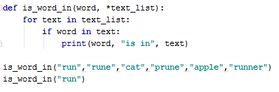

Fucntion Extras
You can define functions that accept as many arguments as the user wishes to provide.
Arguments are placed in a tuple.
65

Slide 66
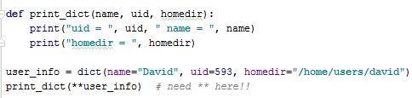

Passing dictionaries to functions

