Slide 1

Introduction to Machine Learning
Dr. Matan Gavish Spring 2020
Lecture 1.1: Machines? Learning?
Updated March 23, 2020

Slide 2
Why are we here?

Slide 3
Machine Learning is everywhere
2

Slide 4
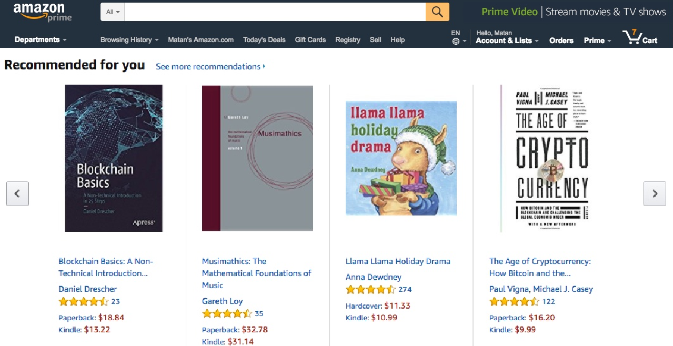
Personalized Recommendations
Source: amazon.com

Slide 5
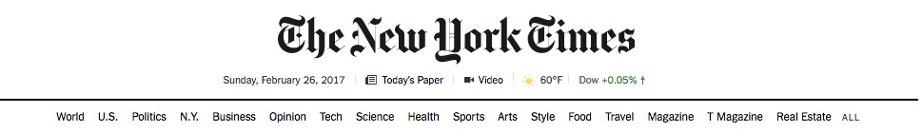
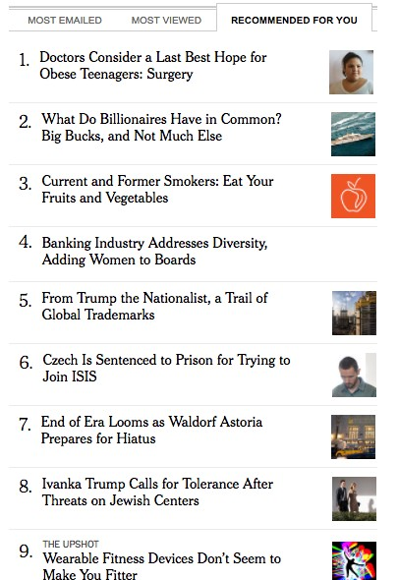
Personalized Recommendations
Source: nytimes.com

Slide 6
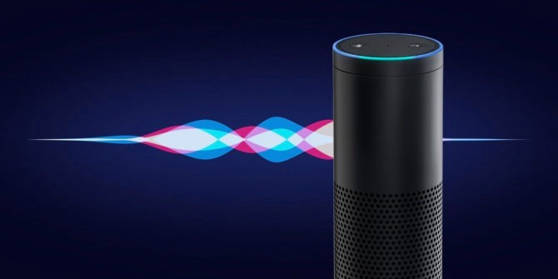
Personal Assistants
Source: makeuseof.com

Slide 7
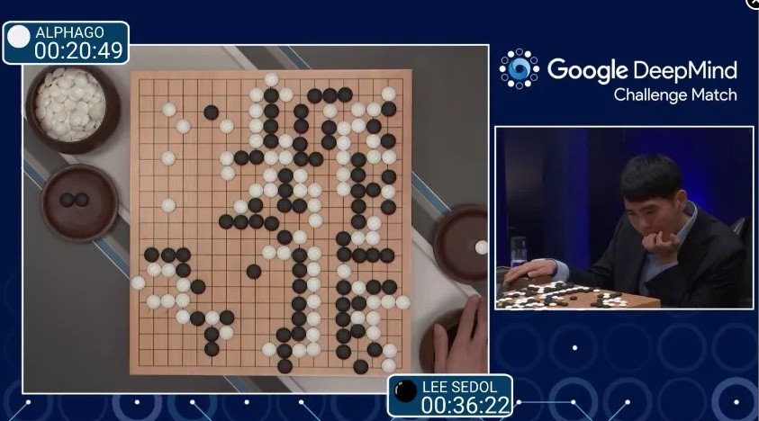
Alpha Go
Source: DeepMind / cnet

Slide 8
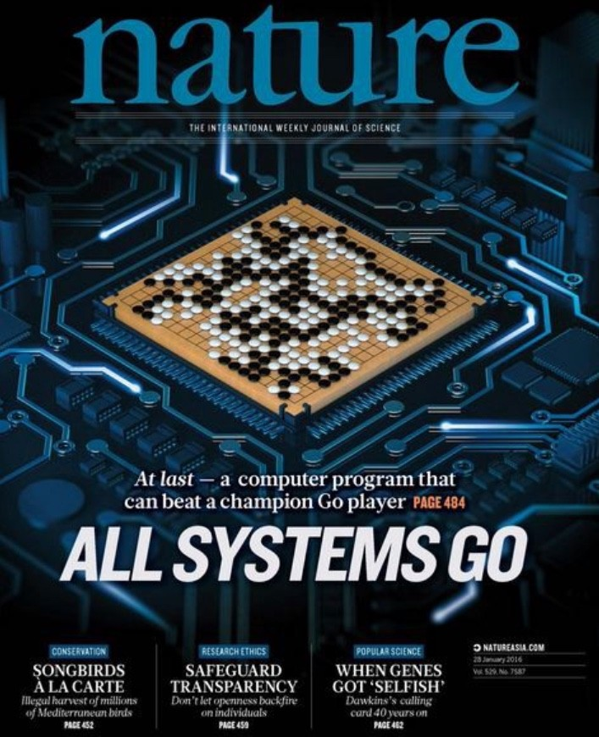
Alpha Go
Source: Nature.com

Slide 9
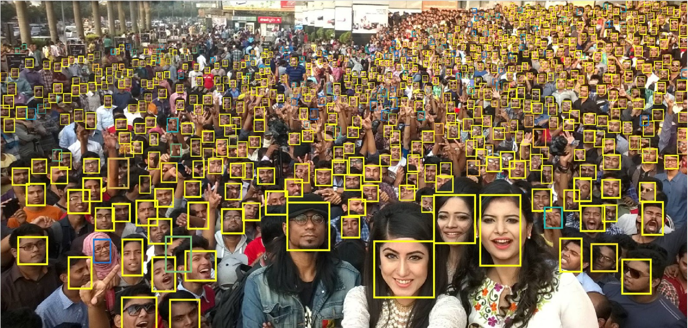
Face Detection / Recognition
Source: Hu, Ramanan, Finding Tiny Faces, arxiv:1612.04402

Slide 10
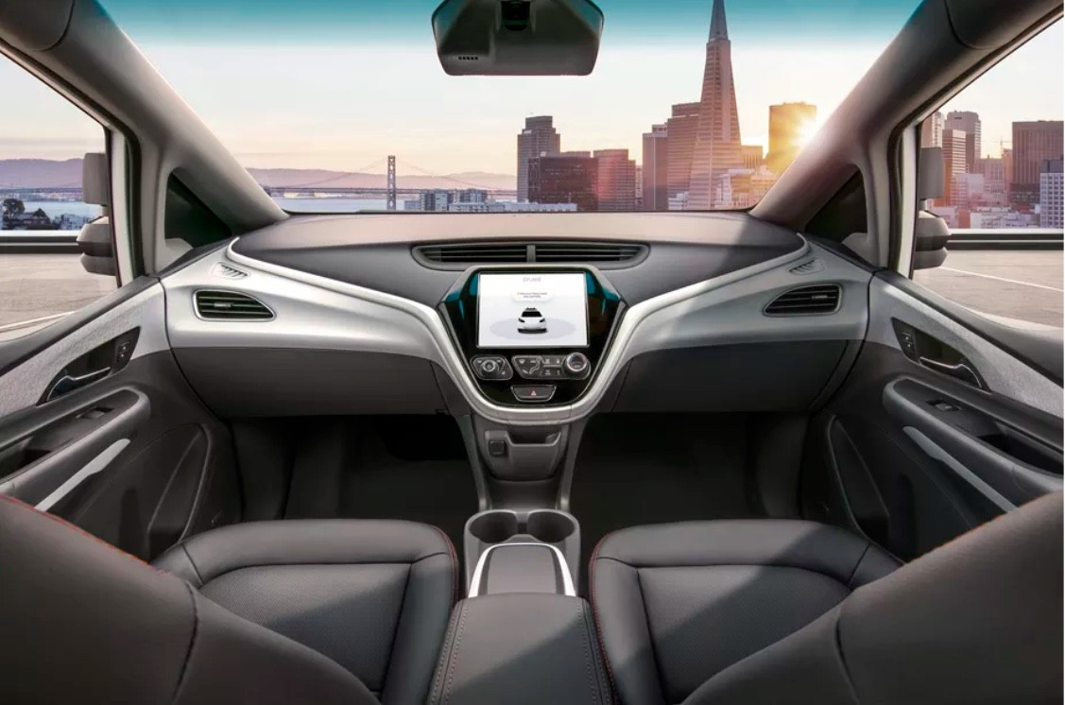
Autonomous driving
Source: GM / theverge.com

Slide 11
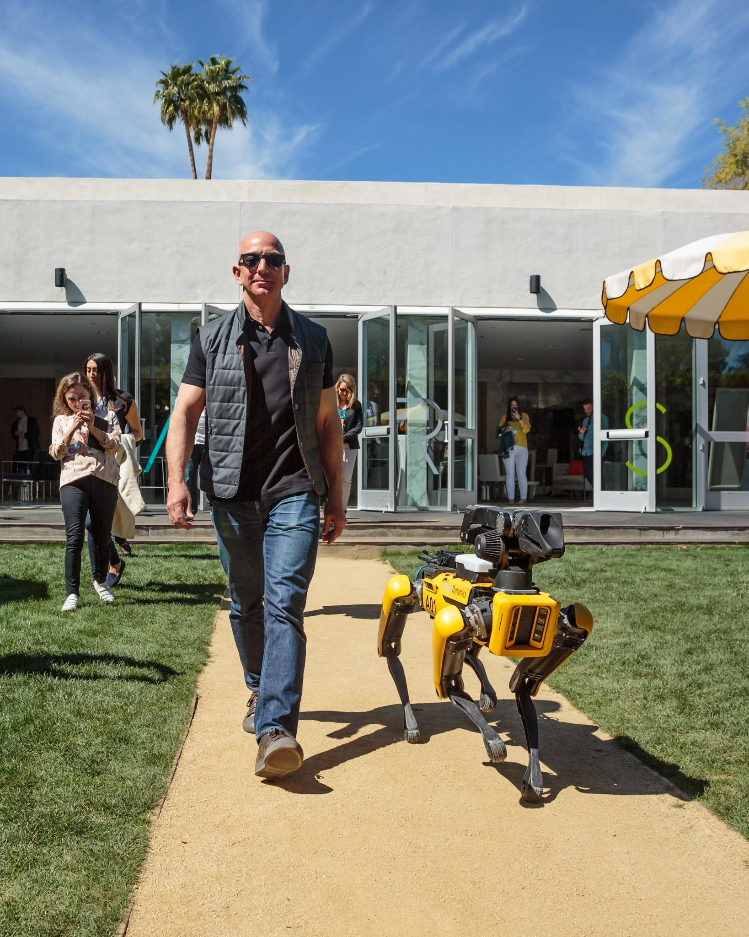
Autonomous robots
Source: twitter/jeffBezos

Slide 12
When do we need ML?
Ⓧ Some tasks are too complicated for “classical” if/then programming
Ⓧ Need to respond automatically to rapidly changing conditions
Ⓧ Want to improve continuously as more data comes in
11

Slide 13

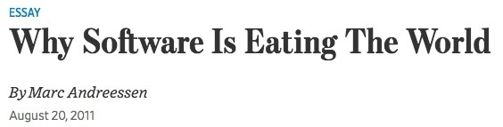
Source: WSJ

Slide 14
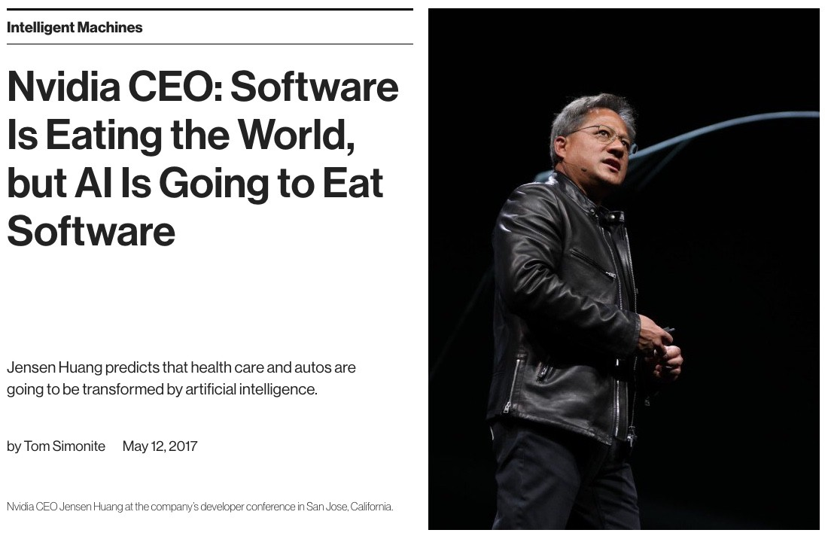
Source: MIT Technology Review

Slide 15
Who cares? Basically everyone.
Ⓧ Machine translation
Ⓧ Face recognition
Ⓧ Machine vision
Ⓧ Medical imaging
Ⓧ Autonomous driving
Ⓧ Speech recognition
Ⓧ Online advertising
Ⓧ Search engines
Ⓧ Spam detection
Ⓧ E-commerce
Ⓧ Healthcare

Slide 16
Who cares? Basically everyone.
Ⓧ Text and handwriting recognition
Ⓧ Cybersecurity
Ⓧ Algo trading
Ⓧ Personal assistants
Ⓧ Online publishing
Ⓧ Fraud detection
Ⓧ Personalized recommendations
Ⓧ …

Slide 17
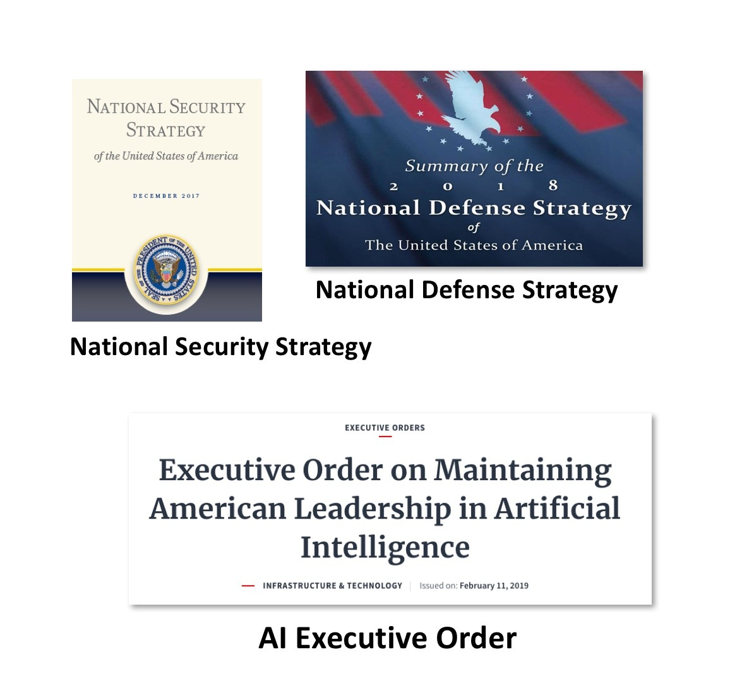
U.S. Federal Budget Priorities
Source: Slides shown at Science of Deep Learning conference, NAS, Washington DC, 3/2019

Slide 18
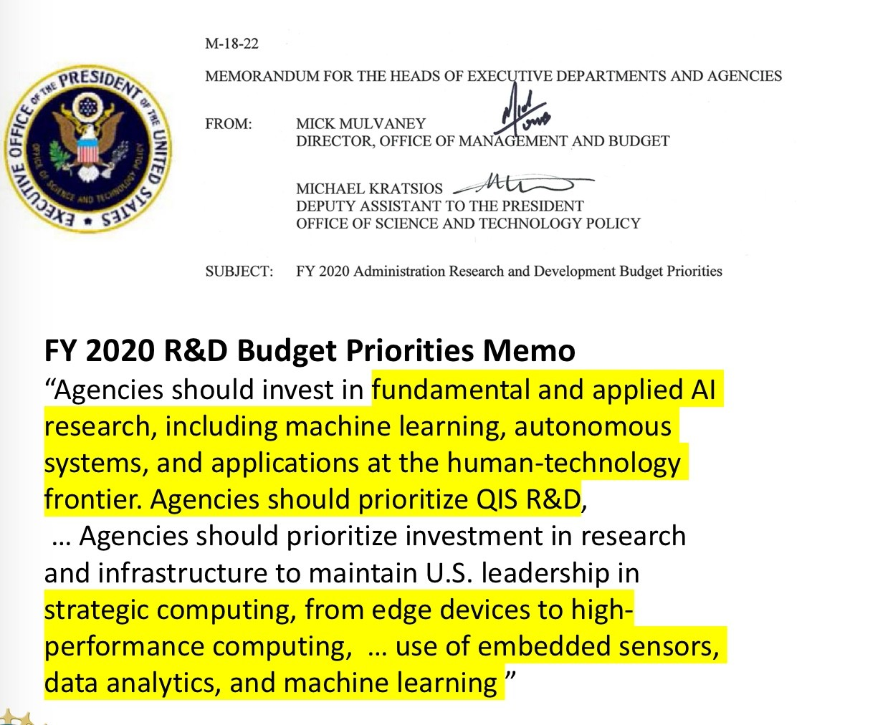
U.S. Federal Budget Priorities
Source: Slides shown at Science of Deep Learning conference, NAS, Washington DC, 3/2019

Slide 19
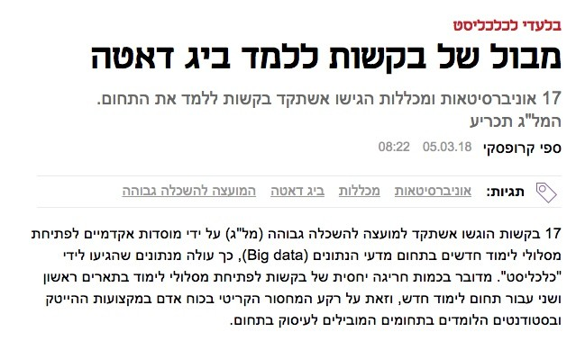
Source: calcalist.co.il

Slide 20
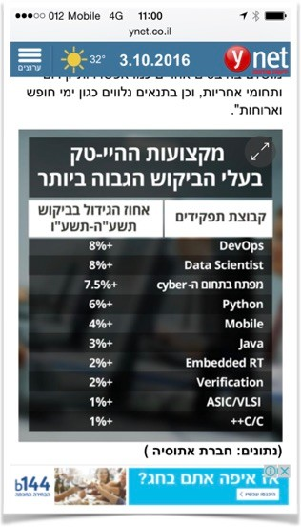
Source: ynet

Slide 21
The world is changing rapidly
ML skills are becoming as essential as coding skills for
Ⓧ Software developers
Ⓧ Algorithm developers
Ⓧ Scientists
24

Slide 22
What is learning?

Slide 23
What is learning
Fundamental questions:
Ⓧ How do we learn?
Ⓧ What is learnable?
Ⓧ How do we know if we learned?
26

Slide 24
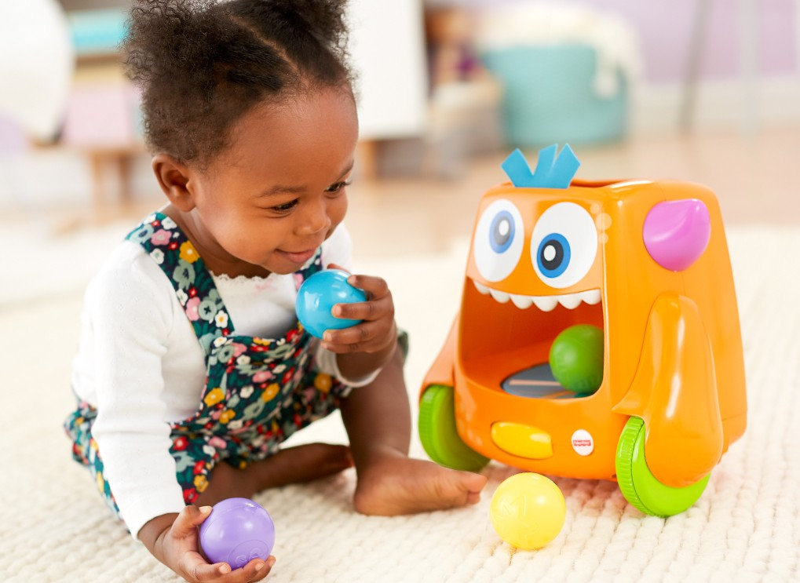
Learning
Source: fisher-price.com

Slide 25
Learning - an ambitious deknition
Have you watched a child learn? Children –
Ⓧ Make sense of the world around them
Ⓧ Find useful, efficient representation of information
Ⓧ Separate useful and non-useful information
Ⓧ Learn to separate foreground from background
Ⓧ Learn to separate phonemes from audio stream
Ⓧ Organize information into knowledge
Ⓧ Discover concepts
Ⓧ …and everything with no prior knowledge!

Slide 26
Learning - in this course
Ⓧ Trying to learn a rule from examples
Ⓧ A rule is simply a function f : X → Y
Ⓧ The set X is called the domain set
Ⓧ The set Y is called the response (or label) set
Ⓧ Given training instances of the form (x, y) ∈ X × Y …
Ⓧ … generalize from the training instances and learn a function f such that y = f(x) on training instances
Ⓧ Produce a prediction rule ^{ˆ}f
Ⓧ Now predict f(x) on unseen objects x ∈ X by ^{ˆ}f(x)
Ⓧ Measure performance by comparing truth f(x) and prediction ^{ˆ}f(x)
Ⓧ This is known as supervised learning
(You should find this definition disappointing.)

Slide 27
Map of Machine Learning

Slide 28
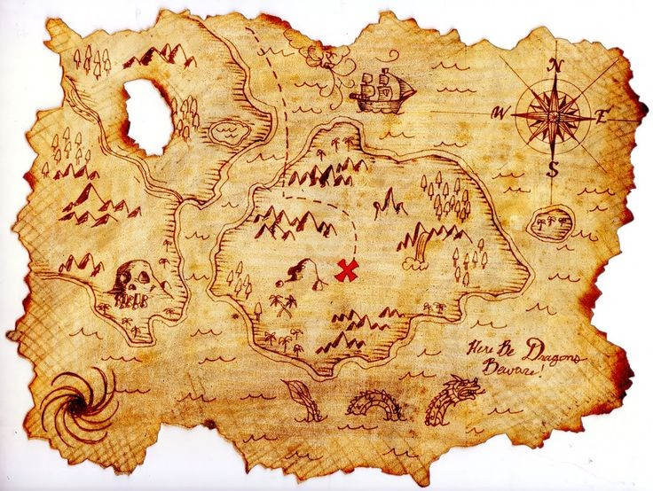
Finding your way around ML
Source: byronbayphotographer.com

Slide 29
Examples of Sample domain X
Ⓧ Feature vectors
Ⓧ Images
Ⓧ Video / audio
Ⓧ Freetext and text collections
Ⓧ Strings
Ⓧ Matrices
Ⓧ Trees / Graphs
Ⓧ Time series
Ⓧ Geo data
Ⓧ Compound (e.g. image + freetext)

Slide 30
Examples of Label set Y
Ⓧ Classification: Y = {±1}
Ⓧ Multiclass classification: Y = {1, . . . , k}
Ⓧ Regression: Y = R
Ⓧ Ranking
Ⓧ Matching
Ⓧ Link prediction
Ⓧ …

Slide 31
Examples
Ⓧ Credit card fraud detection
X : Features of transactions
Y = {ok, fraud}
Ⓧ Spam filter
X : emails
Y: {ok, spam}
Ⓧ Image object classification
X : images
Y: object classes (house, horse, car, …)
|Y| fairly small

Slide 32
Examples - cont.
Ⓧ Product recommendation
X : Features of users
Y: possible products
|Y| small or large, depending on application
Ⓧ Real estate price prediction
X : house features
Y: sale price (in shekels)
Ⓧ Speech recognition
X : short audio recordings
Y: possible words (depending on context)

Slide 33
No free lunch
Ⓧ Assume our training data is {(x , f(x ))}
m
i i
i=1
Ⓧ Assume f could be any function. So training data does not tell us
Ⓧ
Ⓧ
anything about f(x) for new x. (Why?)
In other words, without any prior knowledge on f, it’s impossible to learn it
The mathematical formulation of this fact (needs additional assumptions) is known as the No Free Lunch Theorem.

Slide 34
Hypothesis classes
Ⓧ Because of No Free Lunch,
Ⓧ Must assume some prior knowledge about f
Ⓧ For example, assume that f belongs to some known class of functions H
Ⓧ The learning algorithm only outputs h ∈ H
Ⓧ H is called a Hypothesis Class or a Model

Slide 35
Flavors: Batch vs online
Ⓧ Batch learning:
1. Choose hypothesis class H
m
2. Get “training” set {(x , y )} .
i i
i=1
3. Train model and obtain h ∈ H
k
ˆy } where ˆy_{j} = h(˜x_{j})
4. Get “new data” {˜x } . Predict {
k
j
j=1
j
j=1
Ⓧ Online learning:
Choose hypothesis class H and initial h₀
2. for i = 1, 2, . . .
  Get one sample x_{i}
  estimate ˆy_{i} := h_{i−1}(x_{i} ),
  get feedback - true value y_{i}
  update hypothesis based on x_{i}, y_{i} to obtain h_{i}

Slide 36

Flavors: Supervised vs unsupervised
Ⓧ In some learning problems, training data is only x ∈ X with no label
Ⓧ This is unsupervised learning
Ⓧ Example task: cluster the samples into groups (clusters)
Ⓧ Example task: anomaly detection - detect samples x that are anomalous or different from the rest

Slide 37
Our focus
Ⓧ Most of this course will focus on …
Ⓧ Batch learning
Ⓧ Sample domain of feature vectors (X = R )
d
Ⓧ Supervised learning: regression (Y = R) and classification (Y = {±1})
40

Slide 38
This course

Slide 39
What does it mean to be an ML expert?
Ⓧ Understand theory, algorithms, principles, computational considerations
Ⓧ Be familiar with many data types
Ⓧ Know how to approach and explore a new, unfamiliar dataset
Ⓧ Be familiar with ways to standardize unstructured data
Ⓧ Be familiar with many ML tasks
Ⓧ Be familiar with many ML methods/models
Ⓧ Know by personal experience which method usually works on which data
Ⓧ Know how to evaluate your solution - will it work well on new data?

Slide 40
Different thinking required
Ⓧ Combine formal mathematical thinking with more loose reasoning
Ⓧ Think like a physicist or engineer
Ⓧ Use approximations
Ⓧ Use simulations
Ⓧ Use theory with respect and caution

Slide 41
Course team
Ⓧ Teacher: Dr. Matan Gavish
Ⓧ Section leaders: Elad Granot, Gad Mintz, Asaf Yehoodai, Gilad Green
Ⓧ Tsar: Elisha Kipnis
Ⓧ Tsarina: Hadar Mulian
Ⓧ TAs: Tal Reiss, Omer Amichay, Daniel Afrimi, Harel Rotem, Michael Kabanov, Ela Fallik, Hadas Schacham, Or Honovitch, Yitzchak Vaknin, Alon Fridman, Gal Patel

Slide 42
Course mechanics
Ⓧ course email: iml.huji@gmail.com
Ⓧ Moodle
Ⓧ Syllabus and requirements
Ⓧ Textbooks
Ⓧ Homework - theory
Ⓧ Homework - coding in Python
Ⓧ Hackathon
Ⓧ Midterm
Ⓧ Final exam

Slide 43
Why this course is fun
Ⓧ All the math you learned - finally working together! (Calculus, probability, linear algebra, algorithms)
Ⓧ Calculus and probability in high dimensions
Ⓧ Combination of theoretical and practical knowledge
Ⓧ New ways to think:
theory <> practice
working with messy real-world data
statistics and data science “approximate” thinking
voodoo / thumb-rules / black magic
numerical / computational considerations

Slide 44
Resources available to you
Ⓧ Lecture slides
Ⓧ Lecture videos
Ⓧ Lecture handouts
Ⓧ Tutorial handouts
Ⓧ Lab meetings
Ⓧ Office hours
Ⓧ Moodle (questions and discussion)
Ⓧ Mid-term quiz

Slide 45
Good Luck. Let’s Start.

