Slide 1
Zomato

Slide 2
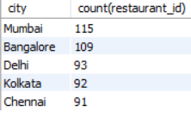
City and resturants
select city,count(restaurant_id) from zomatorestaurantsgroup by cityorder by count(restaurant_id) desc;

Slide 3
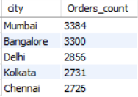
Cities and orders
select city,count(order_id) as Orders_count from zomatorestaurants join zomataorders on zomataorders.restaurant_id=zomatorestaurants.restaurant_idgroup by cityorder by count(order_id) desc;

Slide 4
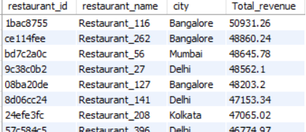
Revenue by each resturant
select zomatorestaurants.restaurant_id,restaurant_name,city,round(sum(total_cost),2) as Total_revenue from zomataorders join zomatorestaurants on zomataorders.restaurant_id=zomatorestaurants.restaurant_idgroup by restaurant_id,restaurant_name,cityorder by sum(total_cost) desc

Slide 5
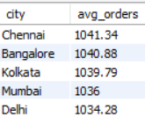
Average Order amount in each city
SELECT zomatorestaurants.city, round(avg(zomataorders.total_cost),2) as avg_orders from zomataorders join zomatorestaurantson zomataorders.restaurant_id=zomatorestaurants.restaurant_id group by zomatorestaurants.cityorder by round(avg(zomataorders.total_cost),2) desc

Slide 6
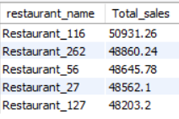
Top 5 restaurants based on sales
select zomatorestaurants.restaurant_name, round(sum(zomataorders.total_cost),2) as Total_sales from zomataorders join zomatorestaurants on zomataorders.restaurant_id = zomatorestaurants.restaurant_id group by zomatorestaurants.restaurant_nameorder by Total_sales desc limit 5;

