Slide 1
Ai powered autonomous assistive robot with arm support
- A final year project presentation

Slide 2
Abstract
The AI-Powered Autonomous Assistive Robot with Arm Support is designed for real-time object detection, autonomous navigation, and pick-and-place operations using Artificial Intelligence and computer vision. The system uses Raspberry Pi 3 Model B+, OpenCV, TensorFlow Lite, ESP32, and a 4-DOF robotic arm for intelligent robotic control and mobility. It provides a low-cost and efficient solution for assistive robotics, warehouse automation, and smart material handling applications.

Slide 3
Objective
To develop an AI-powered robotic system for real-time object detection and classification using computer vision.
To integrate a 4-DOF robotic arm for accurate autonomous pick-and-place operations.
To enable autonomous navigation using a 4WD smart chassis with obstacle detection.
To design a low-cost, energy-efficient, and intelligent assistive robotic platform.

Slide 4
Problem Statement
Logistics operations depend on manual forklift handling of tricon containers, which causes safety risks, delays, and high labor cost, so design and develop an AI powered autonomous assistive robot with robotic arm to enable safe, efficient, and automated container handling.

Slide 5
Block Diagram

Slide 6
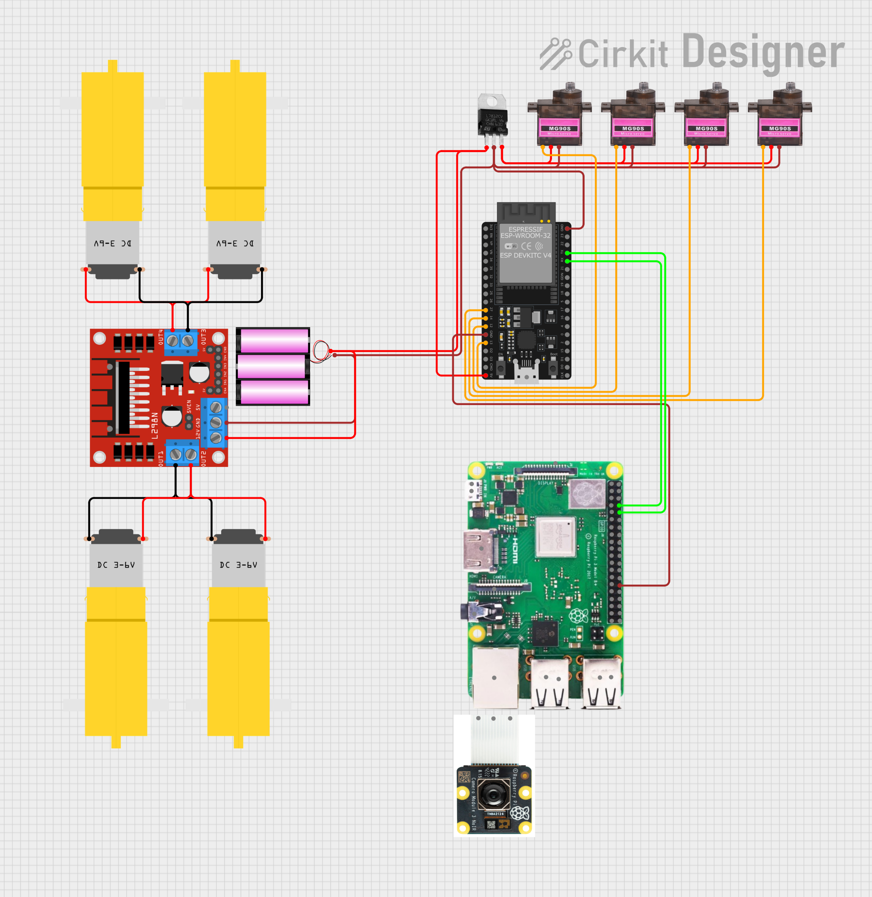
Circuit Diagram

Slide 7
Components used
Raspberry Pi 3 Model B+
Zebronics USB Web Camera
ESP32 WROOM(38 pins)
4DOF Robotic Arm(3D-Printed)
MGS90 Servo Motor (4x)
4WD Car Chassis Kit with BO motors(4x)
L298N Motor Driver
12V Lithium-ion Battery + 3SBMS

Slide 8
Programming Language:
Python
Embedded C
IDE / Development Tools:
Thonny IDE
Arduino IDE
Libraries and Frameworks:
OpenCV
TensorFlow Lite

Slide 9


Kinematics concepts
What is a 4-DOF arm?
Base, Shoulder, Elbow, Wrist
A 4-DOF arm has 4 independent joints. Each joint adds one degree of freedom — one axis of rotation. Together they determine where the end-effector (gripper/tool) can reach in 3D space.
Step 1 — Forward Kinematics (FK)
FK is the easy direction: given known joint angles θ₁…θ₄, compute the end-effector position. Each joint's transformation is a rotation matrix. Multiplied together, they give the final pose.
x,y,z = FK(θ₁, θ₂, θ₃, θ₄) T = T₁(θ₁) × T₂(θ₂) × T₃(θ₃) × T₄(θ₄)

Slide 10

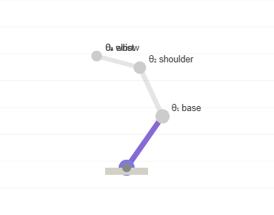
Step 2 — The IK Problem
Inverse Kinematics flips the question: given a target position (x, y, z), find the joint angles θ₁…θ₄ that place the end-effector there. This is the hard direction — often multiple solutions or none.
θ₁, θ₂, θ₃, θ₄ = IK(x_target, y_target, z_target) Non-linear, may have 0, 1, or many solutions
Step 3 — Decouple: Base rotation θ₁
In a 4-DOF arm the base joint rotates around the vertical (Z) axis. This decouples from the rest — we solve θ₁ first using just the target's X and Y coordinates.
θ₁ = atan2(y_target, x_target) This rotates the whole arm to face the target.

Slide 11
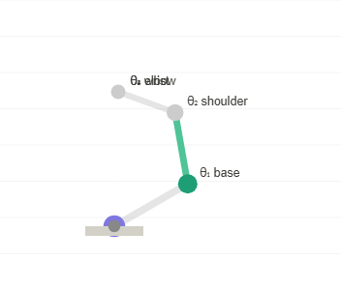
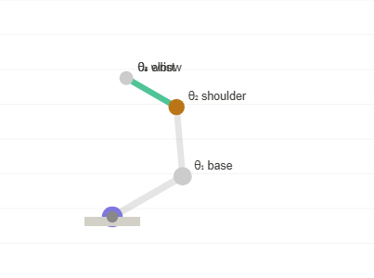
Step 4 — Planar problem: reach in 2D
θ₂,θ₃
Once the base is rotated, the shoulder + elbow form a 2-link planar chain in a vertical plane. The target becomes a 2D point (r, z) where r is horizontal distance and z is height.
r = √(x² + y²) (horizontal reach) z = z_target - base_height Now solve a 2-link IK in the (r, z) plane
Step 5 — Law of cosines for θ₂ & θ₃
Geometry
The 2-link chain forms a triangle. The distance D from shoulder to target, and the two link lengths L₂ and L₃, let us solve for the elbow angle θ₃ directly via the law of cosines.
D² = r² + z² cos(θ₃) = (D² - L₂² - L₃²) / (2·L₂·L₃) θ₃ = acos(...) ← elbow angle θ₂ = atan2(z, r) - atan2(L₃·sin(θ₃), L₂+L₃·cos(θ₃))

Slide 12
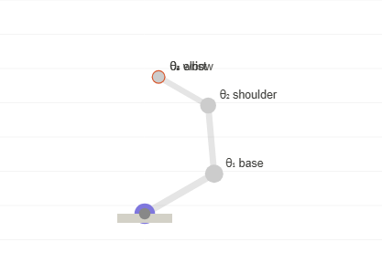
Step 6 — Wrist angle θ₄
The 4th DOF controls the wrist orientation. If a specific end-effector angle φ is required, θ₄ compensates for whatever θ₂ and θ₃ contribute. If orientation is free, θ₄ can optimize for clearance.
θ₄ = φ_target - θ₂ - θ₃ φ_target = desired end-effector angle (0 = horizontal, π/2 = pointing down)
Step 7 — Elbow up / down ambiguity
Multiple solutions
The law of cosines gives two solutions for θ₃ (± sign). This is the classic 'elbow-up' vs 'elbow-down' configuration. Both reach the same point. Pick based on obstacle avoidance or joint limits.
θ₃ = +acos(...) ← elbow down θ₃ = -acos(...) ← elbow up Both are valid IK solutions!

Slide 13

Summary — Full IK pipeline
The 4 steps together: (1) rotate base to face target, (2) project to 2D plane, (3) use law of cosines for shoulder & elbow, (4) adjust wrist for final orientation. Analytical — fast, exact, no iterations needed.
θ₁ = atan2(y, x) r = √(x²+y²), z = z-h θ₃ = ±acos((r²+z²-L₂²-L₃²)/(2L₂L₃)) θ₂ = atan2(z,r) - atan2(L₃·sin θ₃, L₂+L₃·cos θ₃) θ₄ = φ - θ₂ - θ₃

Slide 14
Limitations
Base rotation : 0 to 180
Shoulder or lower arm : 0 to 80
Elbow or upper arm : 10 to 100
Gripper : 40 to 170

Slide 15
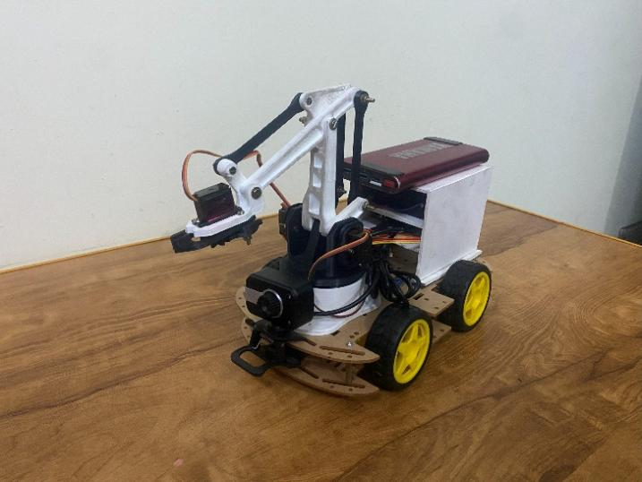
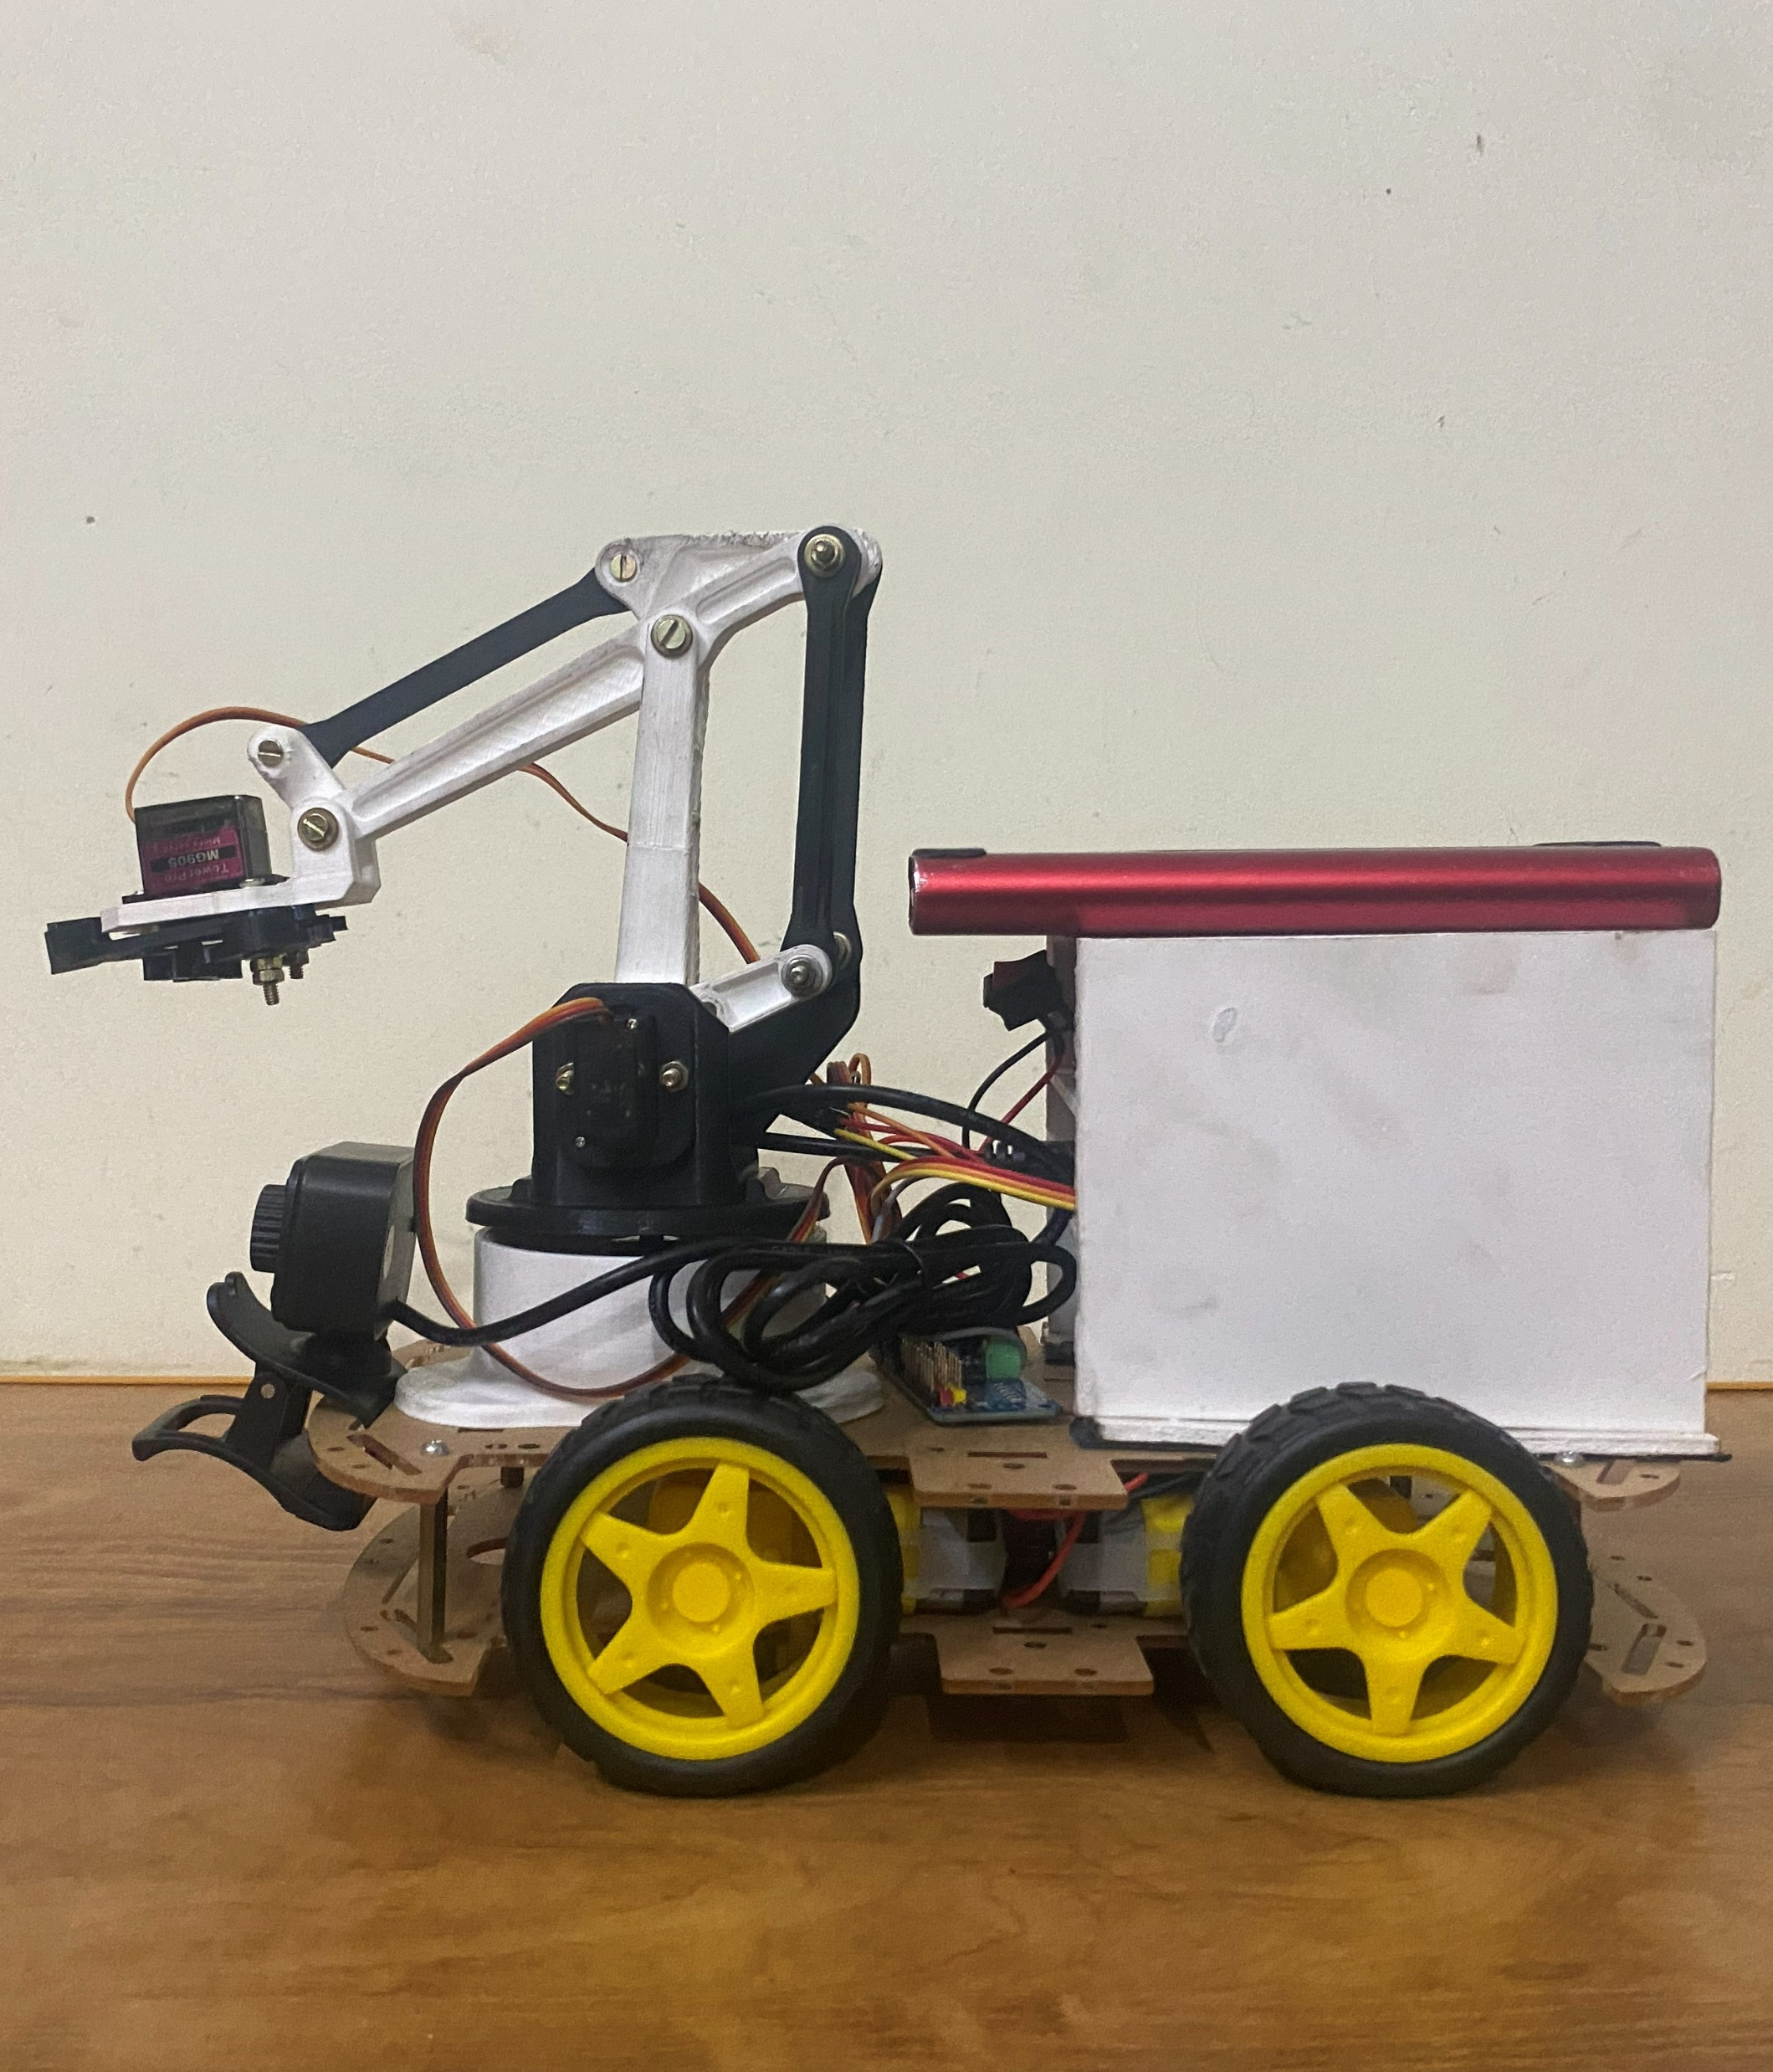
Prototype

Slide 16
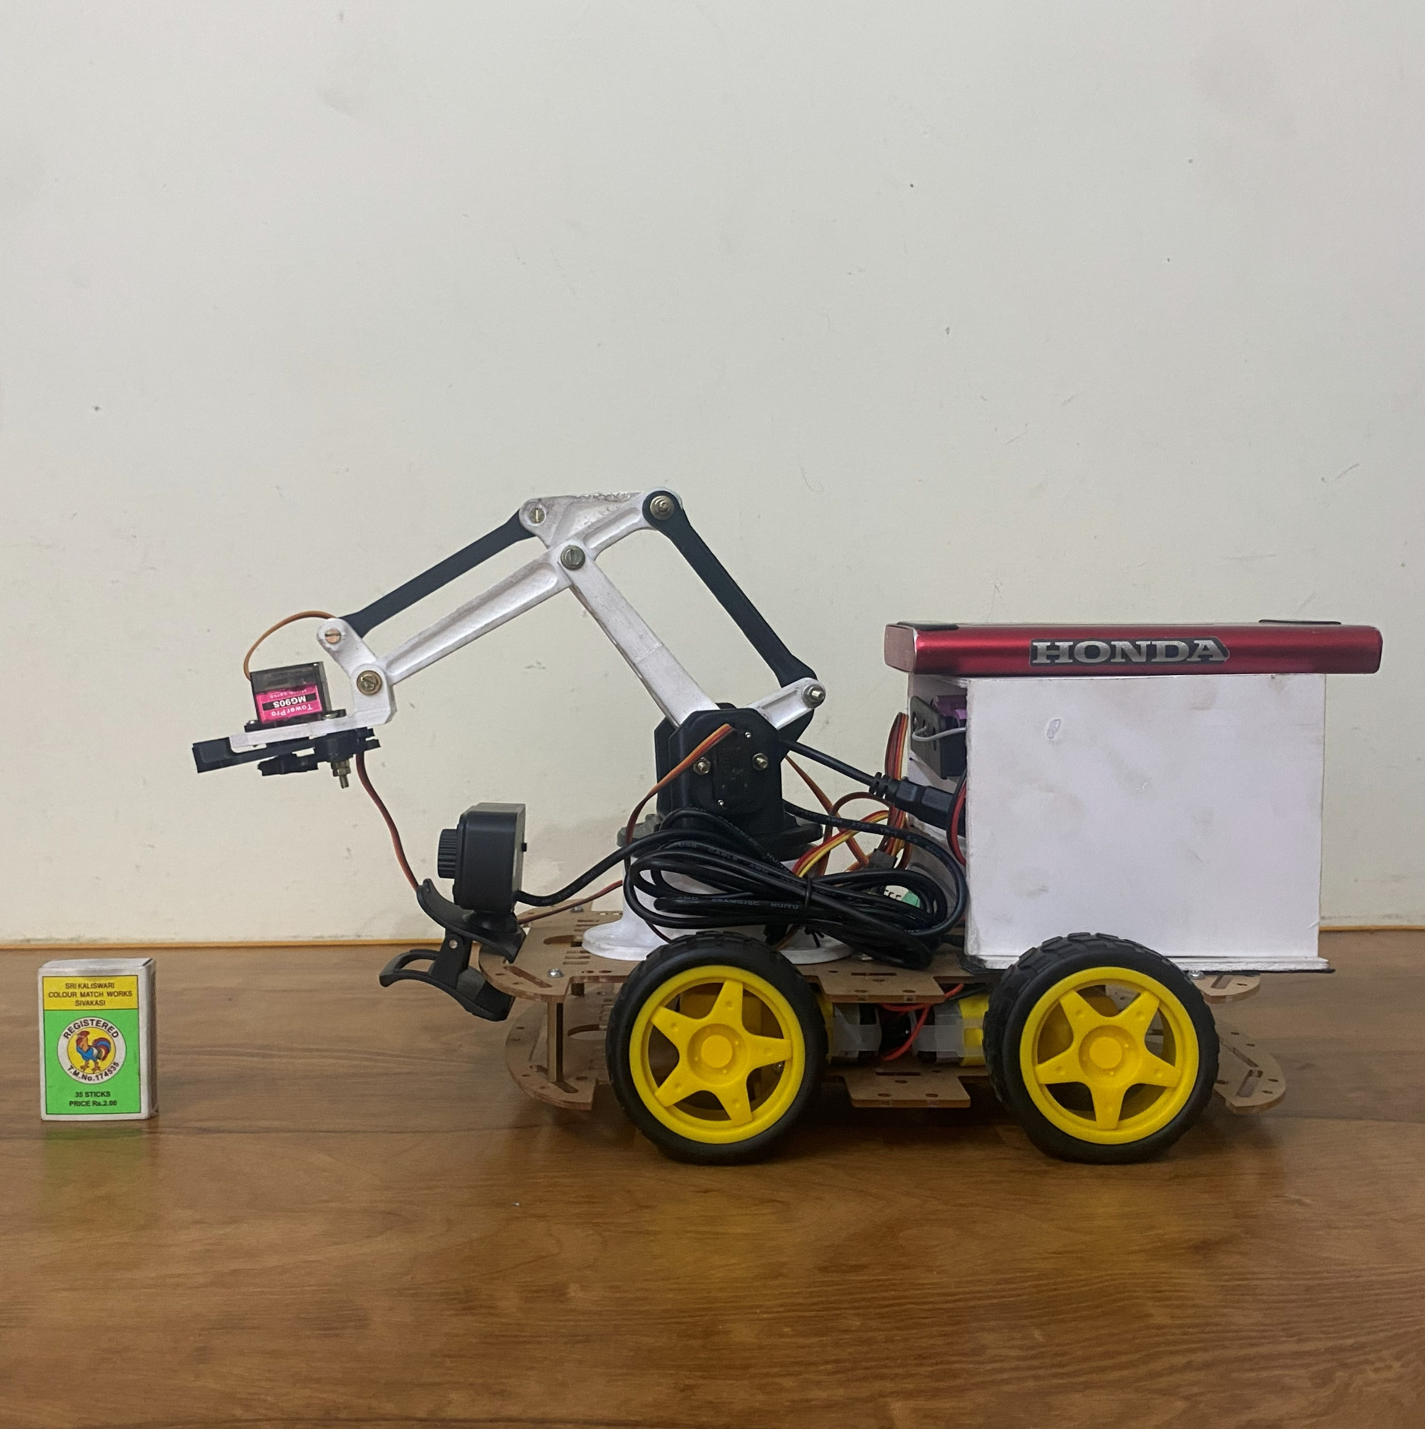
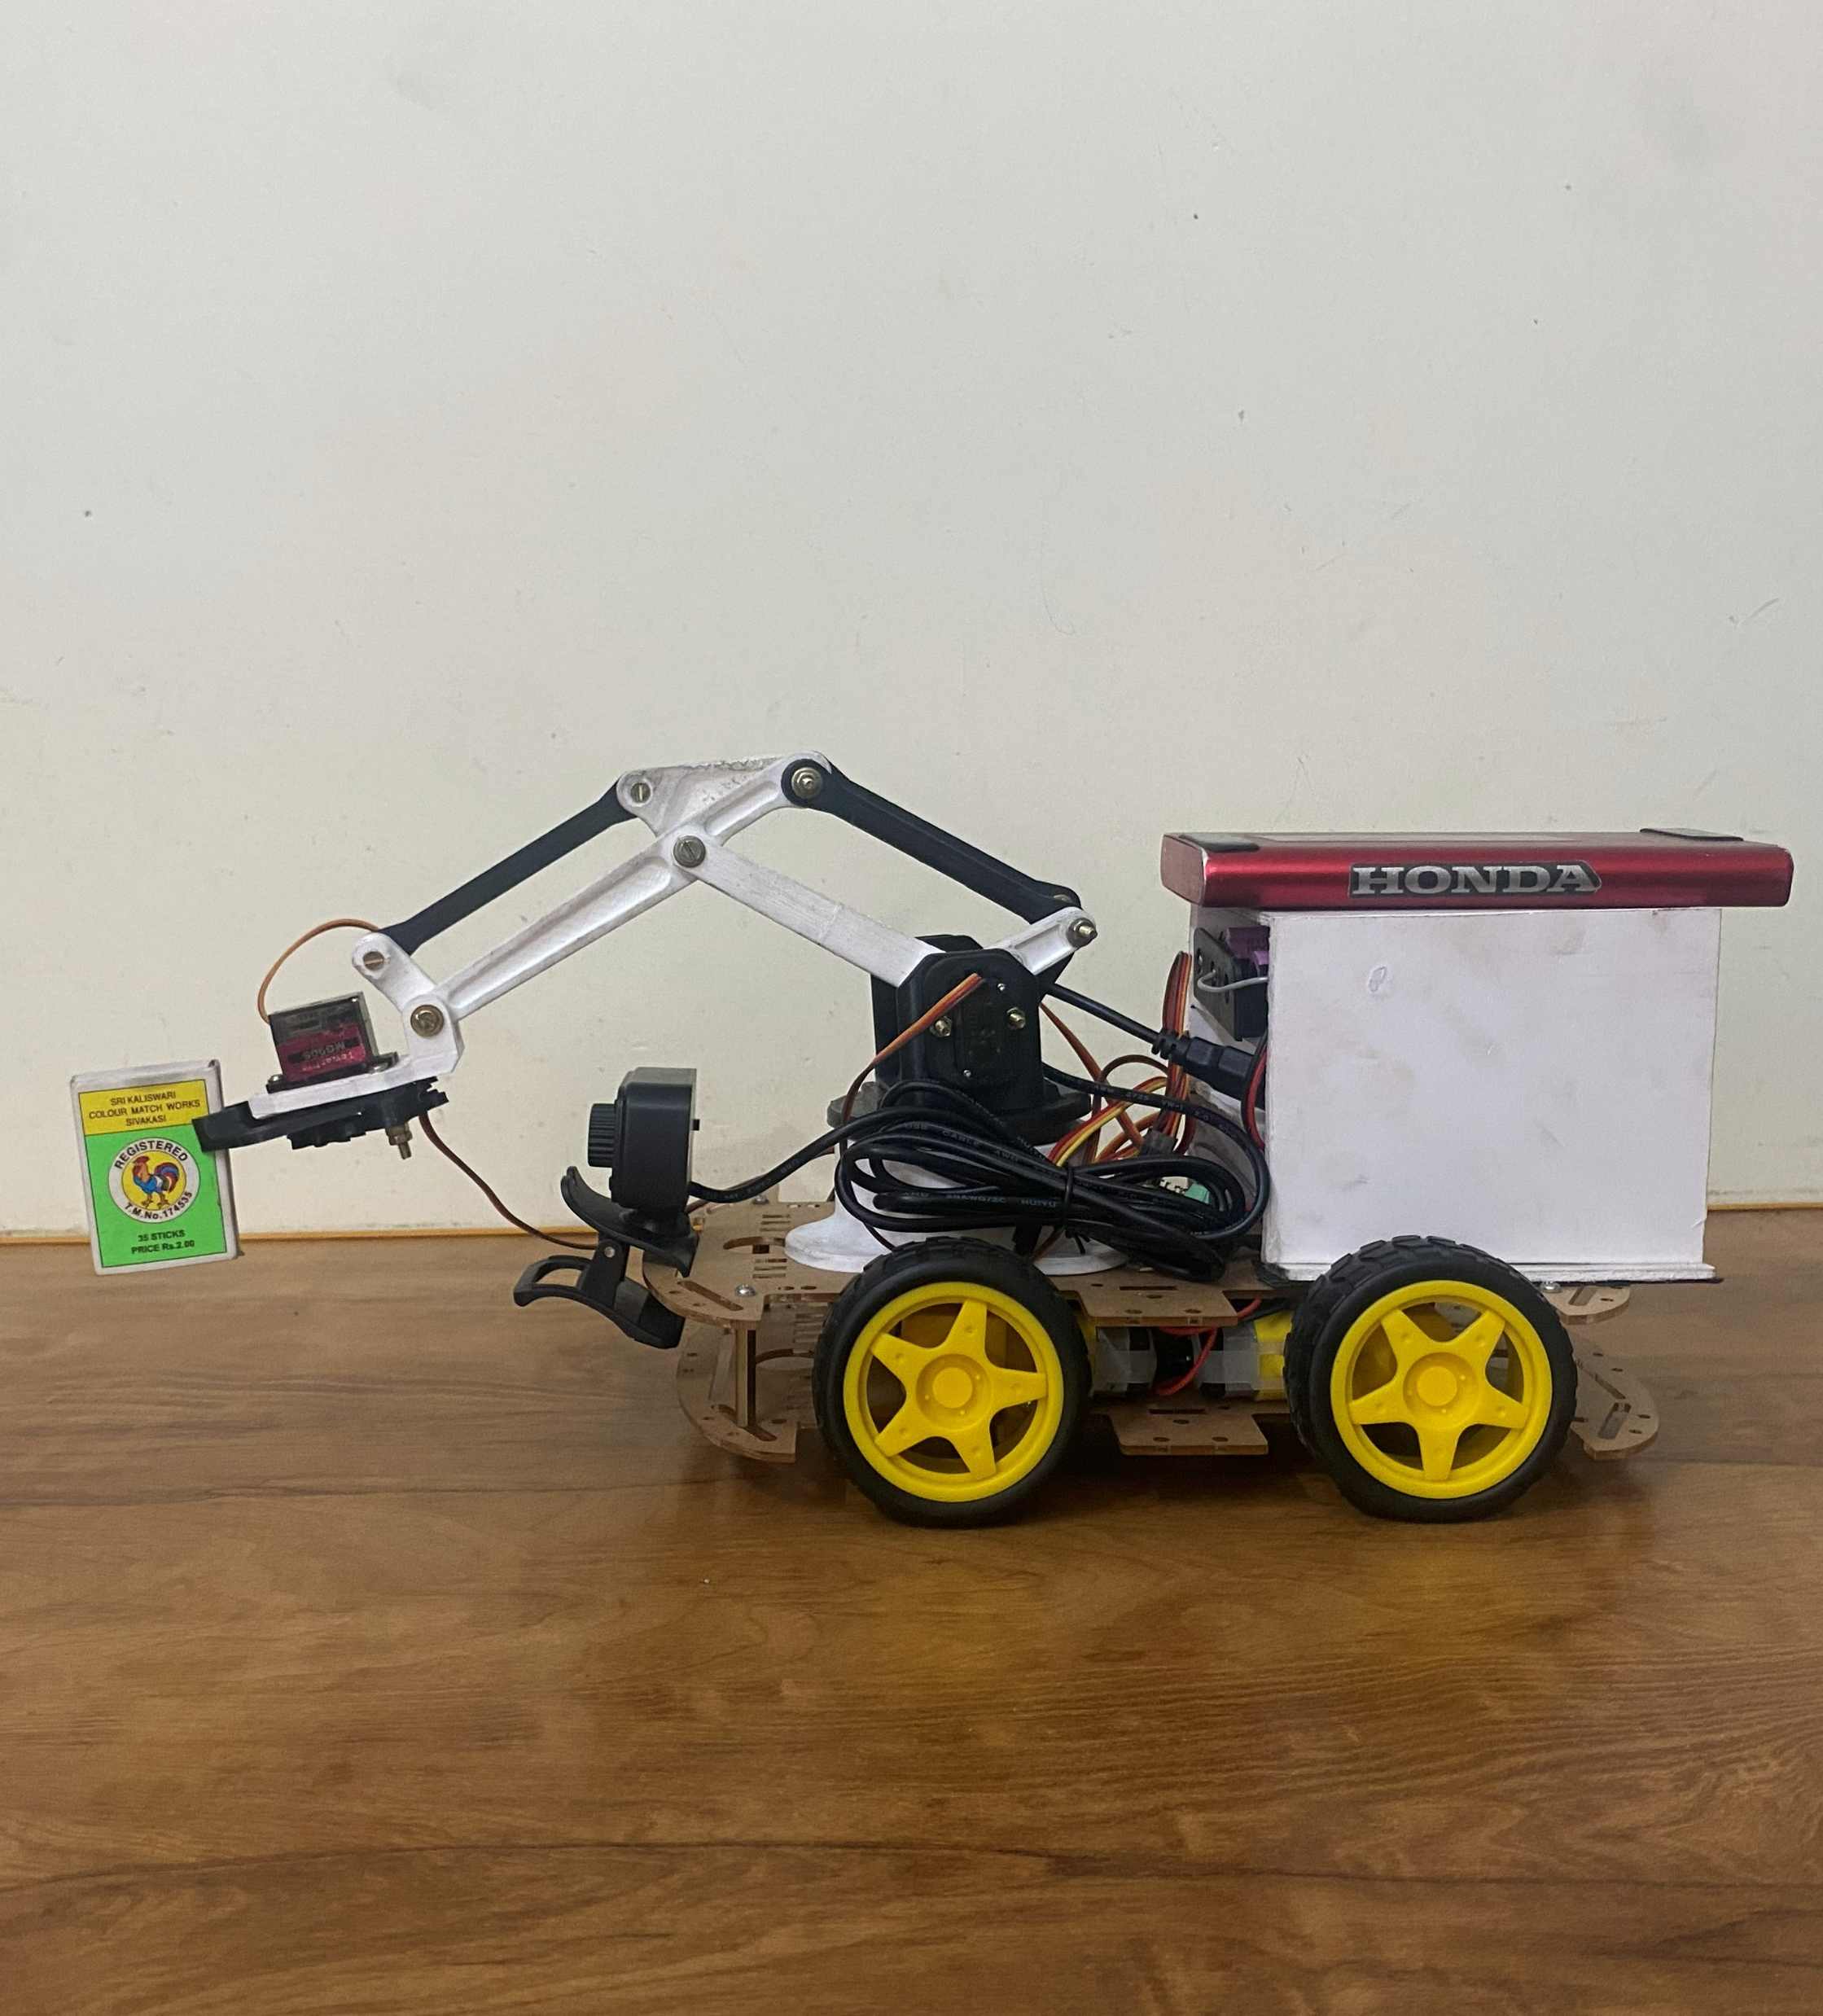
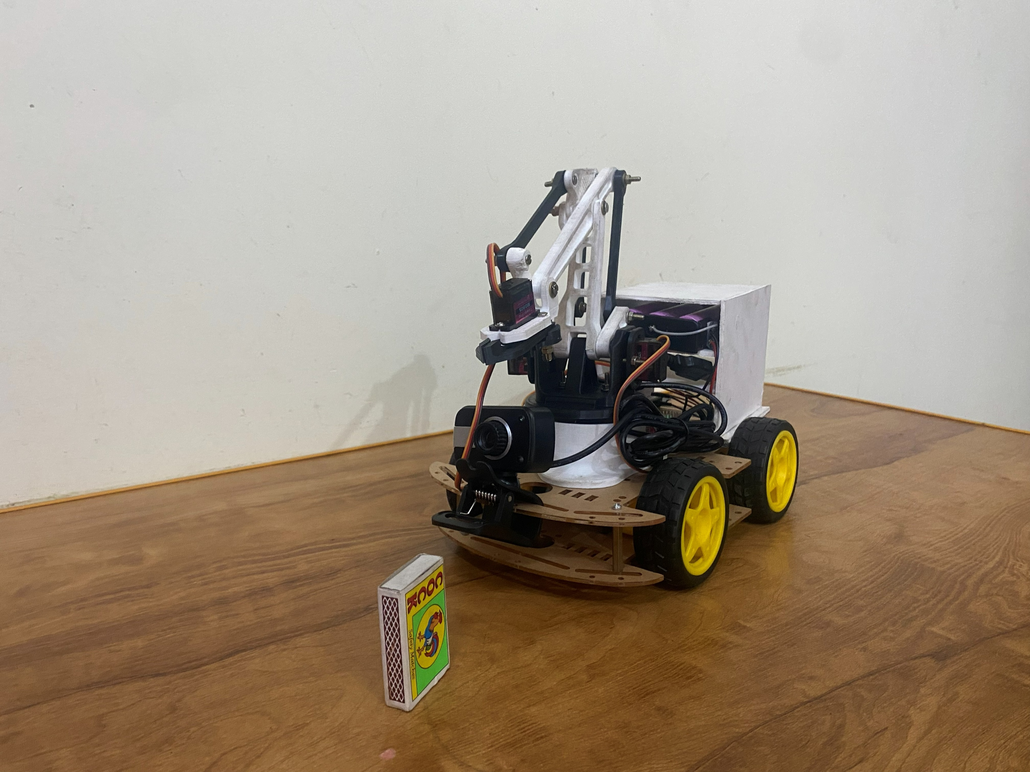
Working

Slide 17
THANK YOU

