Slide 1
Data-Driven Insights: Sales & Social Media Performance
Uncovering Key Trends and Predictive Power
BY ,
V YUVAN KRISHNAN

Slide 2
Project Overview
This presentation summarizes the analysis of two distinct datasets:
Facebook Live Sellers Dataset (Thailand): Examining engagement metrics and their impact on different content types.
Sales Prediction Dataset: Predicting product sales based on advertising expenditures across various platforms.
Goal: To extract actionable insights and build predictive models to inform business strategies.

Slide 3
Facebook Live Sellers: Understanding the Data
Dataset contains information about Facebook pages of 10 Thai fashion and cosmetics retail sellers.
Key variables analyzed: status_type (e.g., photo, video, status, link), num_reactions, num_comments, num_shares, num_likes, num_loves, num_wows, num_hahas, num_sads, num_angrys.
Focus on understanding user engagement across different post types.

Slide 4
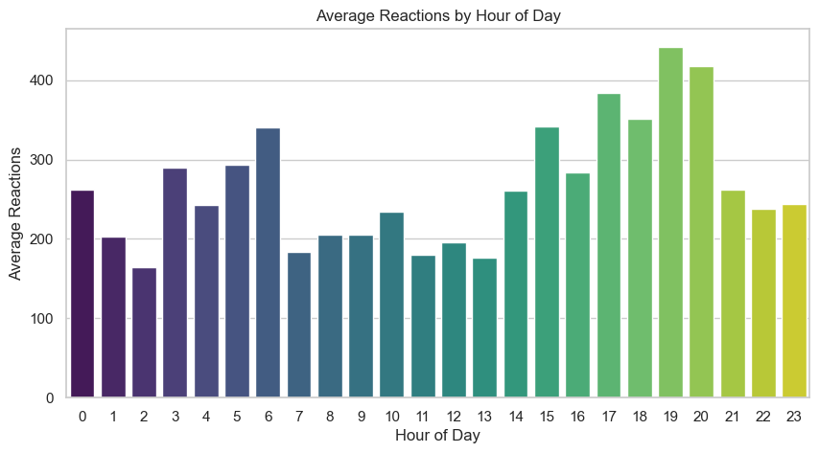

Slide 5
Facebook Live Sellers: Engagement Insights
Observations:
Typically, 'Photo' posts receive the highest number of reactions, comments, and shares, indicating their effectiveness in engaging the audience.
Video' posts also show significant engagement, particularly in terms of reactions and comments.
Status' updates and 'Link' shares generally have lower engagement.
Correlation Analysis:
Strong positive correlations exist between num_reactions, num_likes, num_loves, and num_wows, suggesting these reactions often occur together.
num_comments and num_shares also correlate positively with overall reactions.

Slide 6
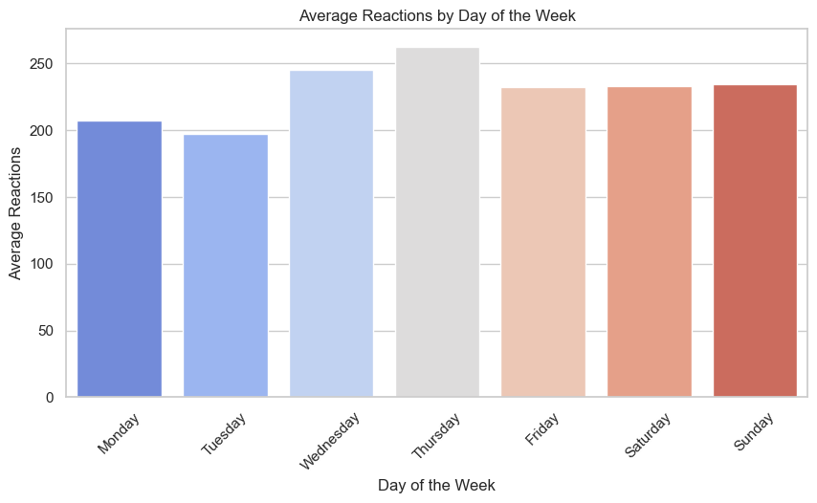
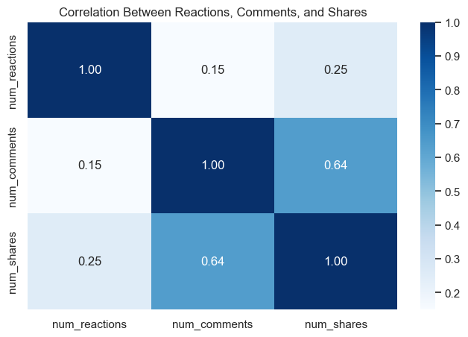

Slide 7
Sales Prediction: The Advertising Landscape
Dataset details advertising expenditures on TV, Radio, and Newspaper platforms.
The target variable is Sales.
Understanding the relationship between ad spend and sales is crucial for optimizing marketing budgets.

Slide 8
Sales Prediction: Unveiling Relationships
Observations:
TV advertising generally shows a strong positive correlation with sales.
Radio advertising also contributes positively to sales.
Newspaper advertising appears to have a weaker or less consistent relationship with sales compared to TV and Radio.
Pre-processing Steps: (Mention if you handled missing values, outliers, or transformed features).

Slide 9
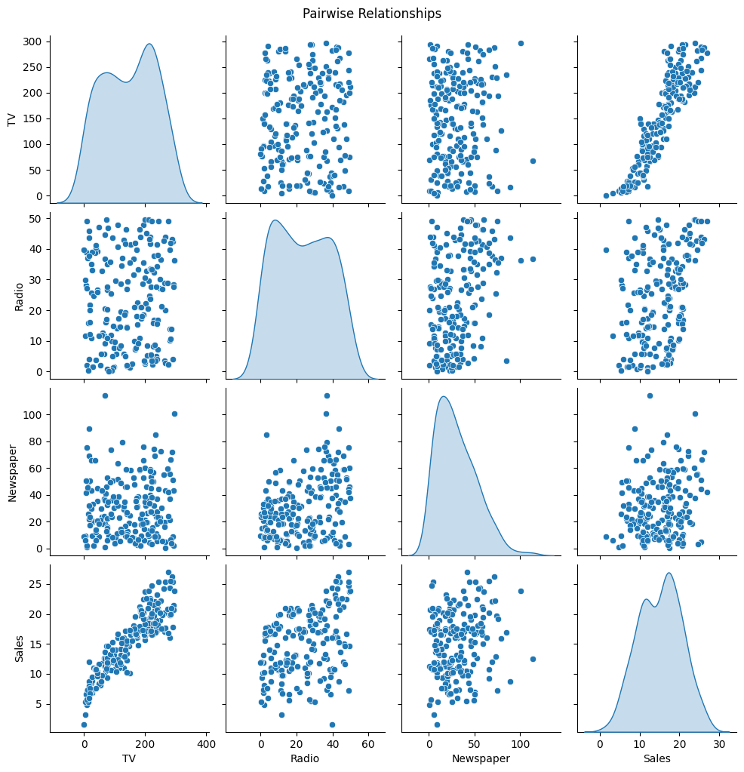

Slide 10
Sales Prediction: Model Performance
Model Used: Linear Regression
R² Score: 0.9059941054821599
This indicates that approximately 90.6% of the variance in sales can be explained by the advertising expenditures. This is a very strong model.
RMSE: 1.7043724789743673
The Root Mean Squared Error of approximately 1.7 suggests that, on average, our model's predictions deviate from the actual sales by about 1.7 units. This is a relatively low error, indicating good predictive accuracy.

Slide 11
Key Takeaways & Recommendations
Facebook Live Sellers:
Prioritize 'Photo' and 'Video' content for maximum engagement on Facebook Live.
Analyze specific audience reactions (likes, loves, wows) to tailor content more effectively.
Consider the optimal timing for posts to maximize reach and engagement.
Sales Prediction:
TV and Radio advertising are highly effective drivers of sales. Continue to invest strategically in these channels.
Re-evaluate the effectiveness of Newspaper advertising. Consider shifting budget to more impactful channels or refining newspaper ad strategies.
The predictive model can be used to forecast sales based on planned advertising budgets, enabling better resource allocation.

Slide 12
Conclusion & Future Work
Conclusion: Data analysis provides valuable insights for optimizing both social media presence and advertising strategies.
Future Work:
Facebook: Explore the impact of post text, time of day, and audience demographics on engagement.
Sales: Incorporate other potential influencing factors (e.g., competitor activity, seasonality, economic indicators) into the sales prediction model for even greater accuracy.
Consider advanced modeling techniques for both datasets (e.g., time series analysis for sales, sentiment analysis for Facebook comments).

