Slide 1
MINI PROJECT PRESENTATION / DEEP LEARNING
DeepVision
Pedestrian–Vehicle Interaction
Risk Prediction
An LSTM-based approach for proactive road safety analytics
JAAD DATASET • LSTM • STREAMLIT
Project: deepvision-pedestrian-risk-prediction
01

Slide 2
Problem statement & objectives
Moving from reactive incident response to early identification of risky pedestrian–vehicle interactions.
THE PROBLEM
OUR APPROACH
Pedestrian safety depends on changing motion and behaviour. A single frame may miss how an interaction is developing over time.
Use a sequence of pedestrian motion, behaviour and road-context features to estimate whether a high-risk crossing is likely in the future.
PROJECT OBJECTIVES
• Represent pedestrian–vehicle context through structured features derived from JAAD annotations.
• Learn temporal patterns from 15 consecutive frames using an LSTM network.
• Classify interactions into Low Risk and High Risk using a probability threshold.
• Provide an interactive dashboard for prediction, analysis, performance review and incident reporting.
02

Slide 3
Dataset & preparation
JAAD video annotations are converted into a structured, track-based time-series dataset.
SOURCE VIDEOS
ANNOTATION RECORDS
MODEL-READY RECORDS
MODEL INPUTS
337
391,038
350,124
15 features
ANNOTATION PROCESSING
VIDEO-LEVEL DATA SPLIT
1. Read pedestrian-track XML and traffic-context XML.
2. Match videos with both annotation sources.
3. Extract bounding boxes, frame IDs, pedestrian attributes and road signals.
4. Remove invalid bounding boxes and duplicate pedestrian-frame rows.
5. Exclude 40,914 terminal records without a 15-frame future label.
Training: 235 videos | 238,297 model records
Validation: 51 videos | 52,502 model records
Testing: 51 videos | 59,325 model records
The split is performed by video ID (70% / 15% / 15%), so frames from one video are not distributed across multiple partitions.
After sequence generation: Train 214,899 | Validation 46,748 | Test 52,736 sequences.
Note: 350,124 is the model-ready labelled dataset size; 391,038 is the cleaned annotation-record count before future-label trimming.
03

Slide 4
How the dataset defines High Risk and Low Risk
The class labels are created from JAAD pedestrian crossing annotations, not from manually assigned crash severity.
OBSERVED WINDOW
FUTURE TARGET
15 consecutive frames
(t−14 to t)
Crossing annotation at t + 15
HIGH RISK | risk_label = 1
LOW RISK | risk_label = 0
The pedestrian's JAAD annotation is “crossing” 15 frames after the observed sequence ends.
The model learns to recognise earlier motion, behaviour and scene-context patterns associated with this future crossing state.
The pedestrian's JAAD annotation at t + 15 is “not-crossing”.
The observed sequence is labelled negative for the future-crossing prediction task.
IMPORTANT INTERPRETATION
In this project, “High Risk” is an operational name for a future-crossing positive label. It is not a ground-truth collision, near-miss, vehicle-distance or time-to-collision label.
21

Slide 5
From annotation to prediction: a worked example
The dataset label and the dashboard decision are two separate stages in the pipeline.
1 DATASET INPUT
2 FUTURE LABEL
3 APP DECISION
Observe one pedestrian track over 15 consecutive frames.
Extract motion, bounding-box, behaviour and road-context features.
Look up the same pedestrian track 15 frames later.
If annotation = “crossing” → label 1.
If annotation = “not-crossing” → label 0.
LSTM outputs a probability.
≥ 0.55 → High Risk
< 0.55 → Low Risk
Shape: 15 timesteps × 15 features
Target is future crossing state
Demo example: 78.37% → High Risk
The model does not receive the future annotation at inference time; that annotation is used only to create training/test labels. The dashboard classifies from the observed 15-frame feature sequence.
22

Slide 6
Feature engineering
15 numeric inputs represent pedestrian motion, bounding-box geometry, behaviour and traffic context.
MOTION & GEOMETRY (7)
PEDESTRIAN STATE (4)
ROAD CONTEXT (4)
dx, dy – frame-to-frame centre displacement
speed – √(dx² + dy²)
acceleration – change in speed
bbox_area – bounding-box width × height
bbox_bottom – lower y-coordinate
relative_bbox_height – pedestrian box height relative to the video maximum
is_looking – 1 when annotation says looking
is_walking – 1 when action is walking
is_standing – 1 when action is standing
is_occluded – 1 for partial or full occlusion
Categorical annotations are converted into binary indicators before model input.
has_ped_crossing – crossing present
has_ped_sign – pedestrian sign present
has_stop_sign – stop sign present
has_traffic_light – traffic light annotation available
These features describe annotated scene context; they are not live sensor detections.
Scaling: StandardScaler is fitted on training data only; the same scaler transforms validation, test and application inputs.
The model uses these 15 selected features in this exact order for every timestep.
04

Slide 7
Temporal input & future-risk label
The model observes 15 historical frames and labels the current sequence using the crossing annotation 15 frames ahead.
A. INPUT WINDOW (15 CONSECUTIVE FRAMES)
LSTM CLASSIFIER
1
2
3
4
5
6
7
8
9
10
11
12
13
14
15
Learns patterns across the ordered frames
Each frame contributes the same 15 engineered features.
B. LABEL CONSTRUCTION IN THE NOTEBOOK
Current sequence
frames t−14 … t
Future annotation
at frame t + 15
risk_label
0 or 1
risk_label = 1 when the pedestrian's future annotation is “crossing” 15 frames later; otherwise it is 0. This is a future crossing label, not a measured collision probability.
Tensor shape: (number of sequences, 15 timesteps, 15 features). Test set: 52,736 sequences.
05

Slide 8
End-to-end system architecture
The notebook creates and trains the model; the Streamlit app loads saved artifacts to score prepared feature sequences.
JAAD INPUT
DATA PREPARATION
FEATURE PIPELINE
SEQUENCE BUILDER
LSTM TRAINING
Videos + XML annotations
Clean tracks + join context
15 features + scaling
15 frames × 15 features
Binary risk classifier
STREAMLIT INFERENCE APP
SAVED INFERENCE ARTIFACTS
Input → validate → scale → predict → classify
.keras model | feature scaler | feature config | threshold
APP INPUT OPTIONS
1. DEMO
2. CSV
3. MANUAL
Synthetic model-aware sequences for UI demonstration.
Upload exactly 15 × 15 numeric feature values.
Enter/edit a 15 × 15 feature matrix in the app.
The uploaded app does not include live camera detection or pedestrian tracking; it accepts already prepared feature sequences.
06

Slide 9
LSTM model architecture & working
The final regularized network contains two LSTM layers followed by a dense binary-classification head.
INPUT
LSTM 1
DROPOUT
LSTM 2
DROPOUT
DENSE
DROPOUT
OUTPUT
15 × 15
32 units
return sequences
0.35
16 units
0.35
16 • ReLU
0.30
1 • Sigmoid
WHAT THE LSTM LEARNS
REGULARIZATION & MODEL SIZE
• Processes the 15 frames in time order.
• The input, forget and output gates regulate information flow through the cell state.
• The first LSTM returns a representation for every timestep.
• The second LSTM compresses the sequence into a final temporal representation.
• Sigmoid converts the final score to a value between 0 and 1.
• L2 regularization (0.001) on LSTM and dense kernels/recurrent weights.
• Dropout reduces co-adaptation between units.
• Adam optimizer, learning rate 0.0005; gradient clip norm 1.0.
• Binary cross-entropy loss.
• Total trainable parameters: 9,569.
Output interpretation: sigmoid score is treated as the model's estimated likelihood of the future-crossing label; the decision threshold converts it into Low Risk or High Risk.
07

Slide 10
Training strategy & operating threshold
Training controls overfitting; the final reported test results use a 0.55 decision threshold.
TRAINING CONFIGURATION
WHY THE THRESHOLD MATTERS
• Maximum epochs: 30 | Batch size: 256
• Optimizer: Adam (learning rate 0.0005)
• Loss: Binary cross-entropy
• Early stopping: validation AUC, patience 5; restore best weights
• Learning-rate reduction: monitor validation loss, factor 0.5, patience 2
• L2 regularization + dropout; no class_weight argument in the final regularized-model fit.
If probability ≥ threshold → High Risk
If probability < threshold → Low Risk
Lower threshold: catches more high-risk cases but raises false alarms.
Higher threshold: fewer false alarms but can miss more high-risk cases.
FINAL TEST THRESHOLD
HIGH-RISK RECALL
FALSE NEGATIVE RATE
FALSE POSITIVE RATE
0.55
85.12%
14.88%
8.35%
08

Slide 11
Why the application uses a 0.55 decision threshold
A probability score is converted into a class using one consistent operating point.
OPERATING THRESHOLD
DEMO PROBABILITY
DECISION MARGIN
0.55
78.37%
+23.37 pp
55% probability
Above the threshold
0.7837 − 0.55
Probability scale
0.00 | Low Risk region
0.55 threshold → High Risk region
THRESHOLD TRADE-OFF
A lower threshold generally increases sensitivity to positive cases but may create more false alarms. A higher threshold generally reduces false alarms but can miss more positive cases. The 0.55 setting is used consistently for the app and the reported LSTM test metrics in this presentation.
23

Slide 12
Comparison with baseline models
All models are evaluated on the same 52,736 test sequences; each model uses its recorded operating threshold.
Model | Threshold | Accuracy | Precision | Recall | F1 | ROC-AUC | PR-AUC
LSTM | 0.55 | 90.24% | 73.70% | 85.12% | 79.00% | 96.02% | 82.67%
Logistic Regression | 0.80 | 89.97% | 70.69% | 91.38% | 79.72% | 95.79% | 80.60%
Random Forest | 0.55 | 79.23% | 92.29% | 4.00% | 7.67% | 94.41% | 74.20%
XGBoost | 0.35 | 80.83% | 78.11% | 15.37% | 25.69% | 94.71% | 75.49%
LSTM RESULT
IMPORTANT INTERPRETATION
LSTM achieves 85.12% recall, 79.00% F1, 96.02% ROC-AUC and 82.67% PR-AUC at its 0.55 operating threshold.
Random Forest's 92.29% precision is paired with only 4.00% recall: it misses most high-risk cases at threshold 0.55.
Precision, recall, F1 and accuracy depend on the listed threshold. ROC-AUC and PR-AUC evaluate ranking across thresholds. These are the notebook's recorded results; thresholds are not identical across models.
09

Slide 13
Final LSTM test performance
Final reported evaluation: 52,736 test sequences, threshold = 0.55.
Accuracy
Precision
Recall
CONFUSION MATRIX
90.24%
73.70%
85.12%
37,913
3,453
F1 score
ROC-AUC
PR-AUC
79.00%
96.02%
82.67%
1,692
9,678
HOW TO READ THE RESULT
Rows = actual class
Columns = predicted class
• 37,913 true negatives: correctly identified Low Risk sequences.
• 9,678 true positives: correctly identified High Risk sequences.
• 1,692 false negatives: High Risk cases missed by the model.
• 3,453 false positives: Low Risk cases flagged as High Risk.
For a safety-oriented use case, recall is important because false negatives represent missed high-risk interactions.
10

Slide 14
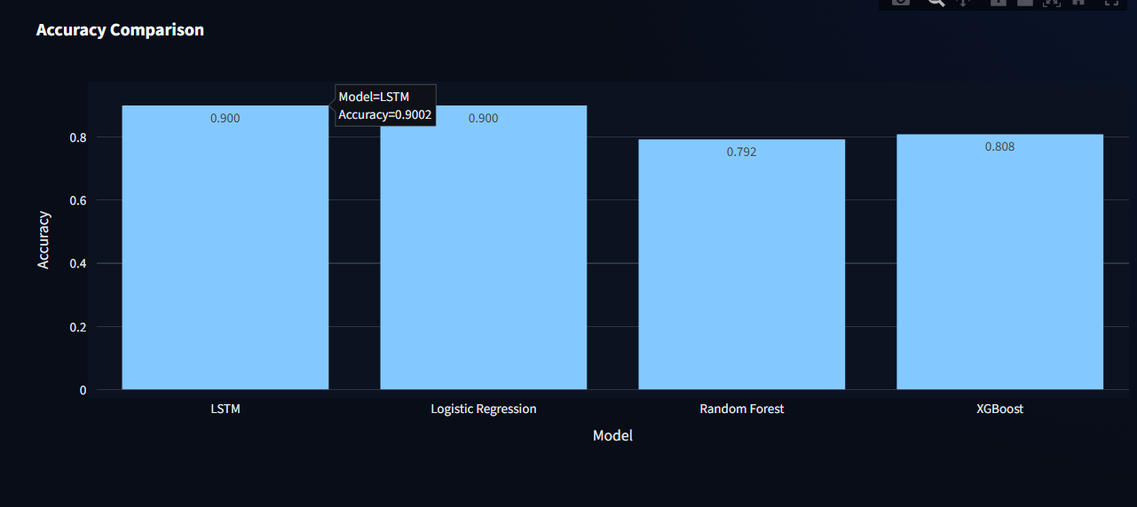
Model comparison: accuracy
Dashboard visualization comparing the four evaluated classifiers on the held-out test set.
Held-out test accuracy by model
LSTM is evaluated at the project operating threshold of 0.55; baseline thresholds are as recorded in the notebook.
100
90.24%
89.97%
79.23%
80.83%
80
60
40
20
0
LSTM
Logistic Regression
Random Forest
XGBoost
Accuracy alone does not show how well a model detects the positive class. Recall, F1-score and AUC are considered alongside it.
WHAT IT SHOWS
LSTM records 90.24% accuracy, closely followed by Logistic Regression at 89.97%; XGBoost reaches 80.83% and Random Forest 79.23%.
Accuracy is only one measure: the models use different operating thresholds, so compare recall, F1 and AUC as well.
14

Slide 15
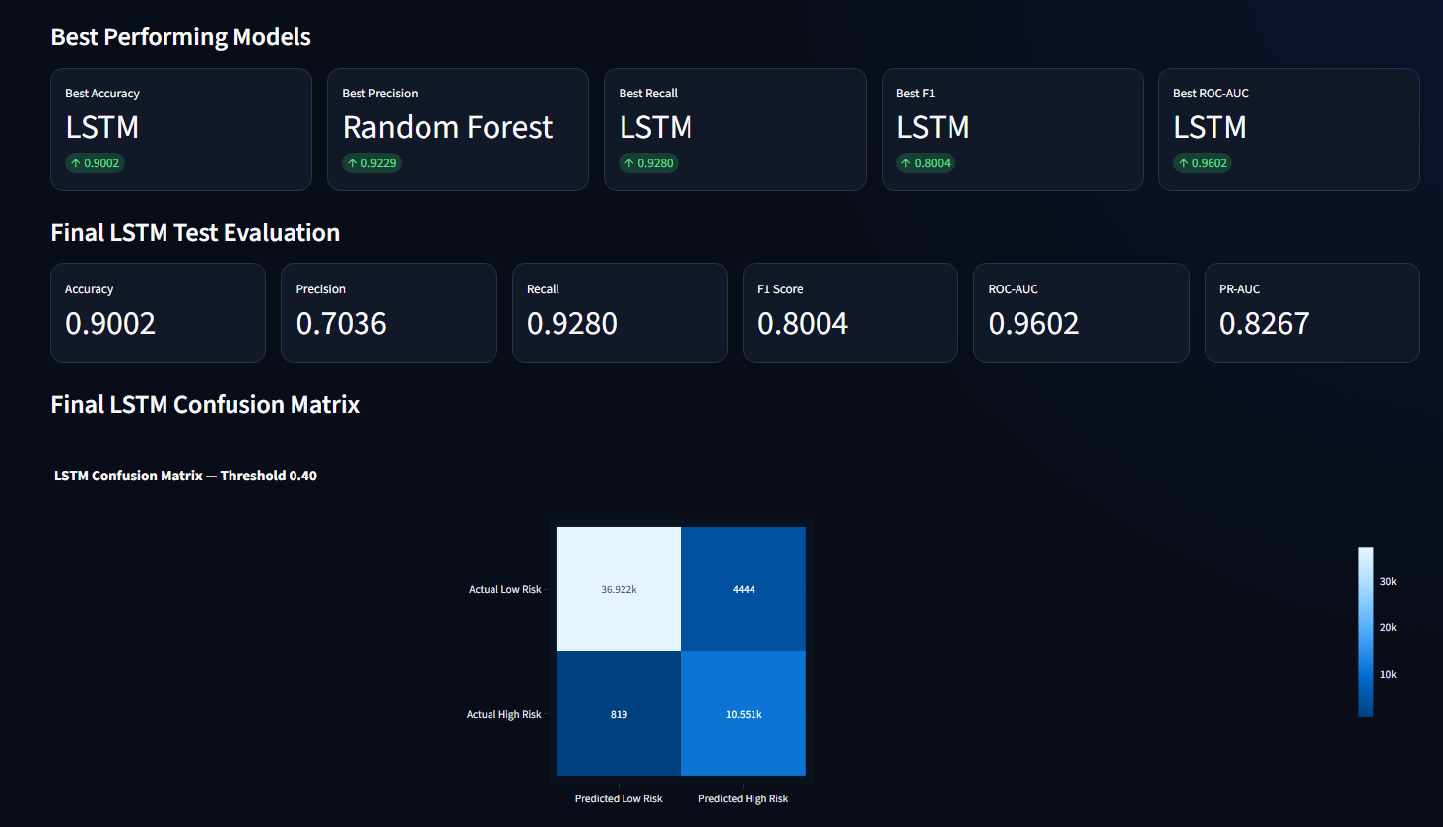
Best models & final LSTM evaluation
The dashboard brings model-level metric leaders together with the final LSTM test results.
Final LSTM test evaluation | Operating threshold: 0.55
ACCURACY
PRECISION
RECALL
90.24%
73.70%
85.12%
F1 SCORE
ROC-AUC
PR-AUC
79.00%
96.02%
82.67%
Confusion matrix
Rows = actual class • Columns = predicted class
37,913
3,453
WHAT THE TEST RESULTS MEAN
True Negative
False Positive
• The model correctly identifies 9,678 future-crossing sequences.
• It misses 1,692 positive sequences (false negatives).
• It flags 3,453 non-crossing sequences as positive (false positives).
• ROC-AUC measures ranking quality across thresholds; it is not changed by choosing 0.55.
1,692
9,678
False Negative
True Positive
KEY INTERPRETATION
LSTM leads in accuracy, recall, F1 and ROC-AUC; Random Forest has the highest precision, but its recall is very low.
Final LSTM test metrics: 90.24% accuracy • 73.70% precision • 85.12% recall • 79.00% F1 • 96.02% ROC-AUC • 82.67% PR-AUC.
15

Slide 16
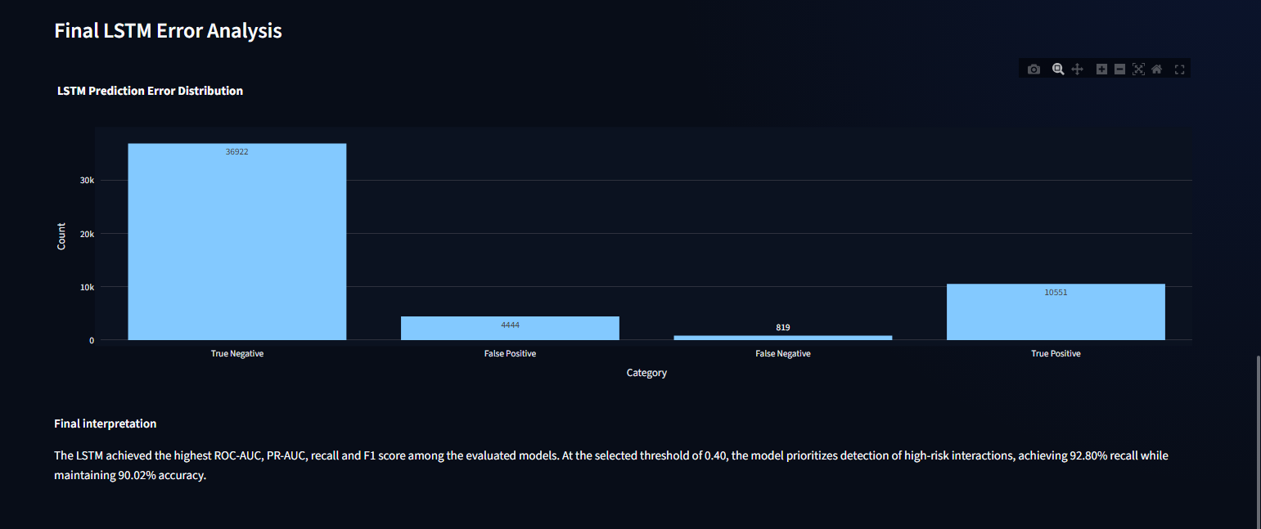
Final LSTM error analysis
Breakdown of correct predictions and the two types of classification error at threshold 0.55.
Final LSTM error analysis
Test-set outcomes at the 0.55 operating threshold (52,736 sequences).
37,913
9,678
3,453
1,692
True Negative
False Positive
False Negative
True Positive
False-negative rate: 14.88% | False-positive rate: 8.35% | A false negative is a future-crossing case not flagged by the model.
ERROR BREAKDOWN
37,913 true negatives and 9,678 true positives were correctly classified; 3,453 false positives and 1,692 false negatives remain.
False negatives are high-risk interactions missed by the model; the 1,692 cases correspond to a 14.88% false-negative rate.
16

Slide 17
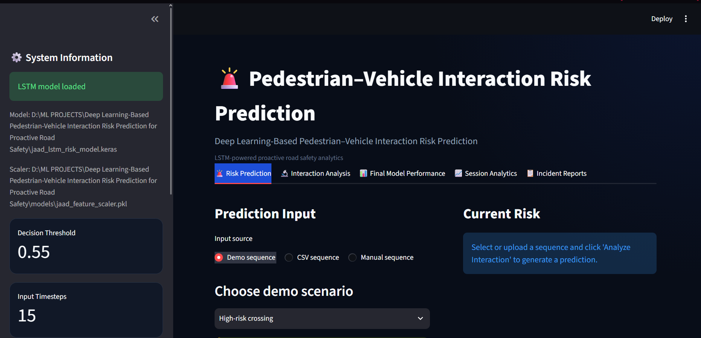
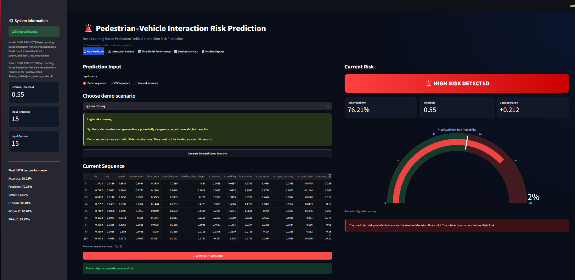
Application output & visualizations
Streamlit dashboard implemented for interactive prediction and model inspection.
MODEL STATUS & INPUT SCREEN
RISK PREDICTION RESULT
Shows model/scaler loading, decision settings, input-source selection and scenario preparation.
Displays risk classification, probability, threshold, decision margin, gauge and sequence table.
The dashboard and final test evaluation are presented with the same 0.55 operating threshold.
11

Slide 18
Streamlit application modules
The interface separates prediction, sequence inspection, model evaluation and reporting.
01 RISK PREDICTION
Choose Demo / CSV / Manual input → validate 15 × 15 values → scale → predict → show risk class and probability.
02 INTERACTION ANALYSIS
Inspect the current sequence through feature trends and per-timestep behaviour/context visualizations.
03 FINAL MODEL PERFORMANCE
Review stored model-comparison metrics, threshold settings, ROC/PR-AUC and performance summaries.
04 SESSION ANALYTICS
Review predictions generated in the current app session, risk distribution and probability trends; export session CSV.
05 INCIDENT REPORTS
View high-risk predictions with scenario/source and probability details; export incident records as CSV.
Scope boundary: the current dashboard operates on prepared feature sequences; it does not extract pedestrians from live video or calculate real-world collision distance/time-to-collision.
12

Slide 19
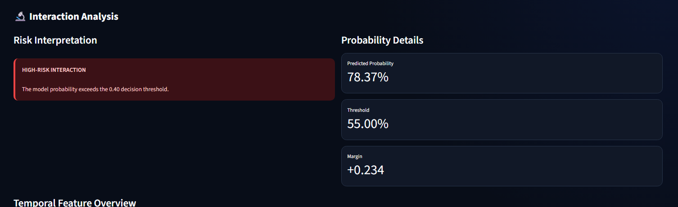
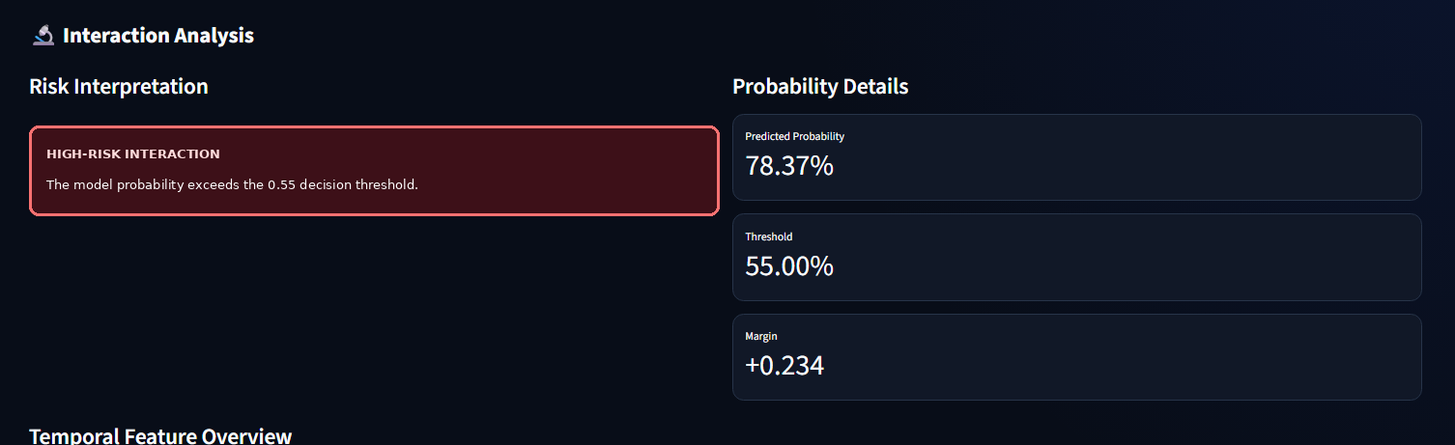
Interaction analysis: individual sequence
The dashboard explains a prediction by showing its probability, decision threshold and temporal context.
HOW TO READ IT
The example sequence receives a 78.37% predicted risk probability. The configured decision threshold is 55%; 78.37% exceeds it, so the sequence is classified as High Risk.
The dashboard compares the predicted probability with the 0.55 threshold and displays the resulting High-Risk classification.
17

Slide 20
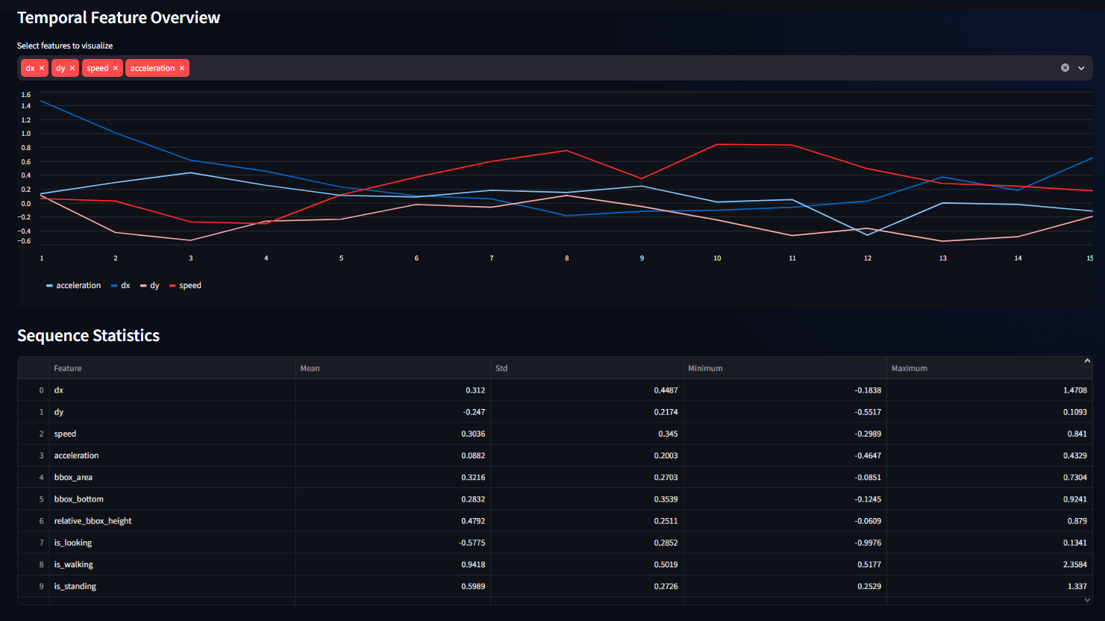
Temporal feature overview
Selected motion features are plotted across the 15 input timesteps, with summary statistics below.
WHAT IT DEMONSTRATES
The line chart lets the user inspect how dx, dy, speed and acceleration change across the observed sequence; the table summarizes feature distributions.
These plots support sequence-level interpretation; they are not a feature-importance ranking or a causal explanation.
18

Slide 21
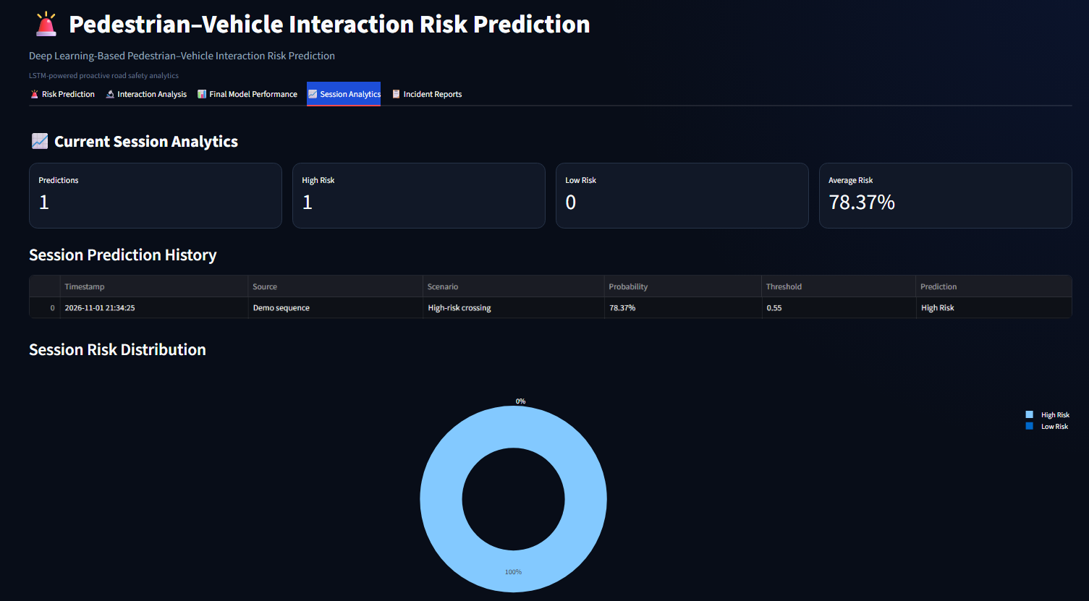
Session analytics
A live session summary tracks predictions generated during the current application run.
EXAMPLE SESSION
This captured session contains one prediction: one High-Risk result, zero Low-Risk results and an average predicted risk of 78.37%.
The table records timestamp, input source, scenario, probability, threshold and prediction; this is a demo-session snapshot, not a dataset-level metric.
19

Slide 22
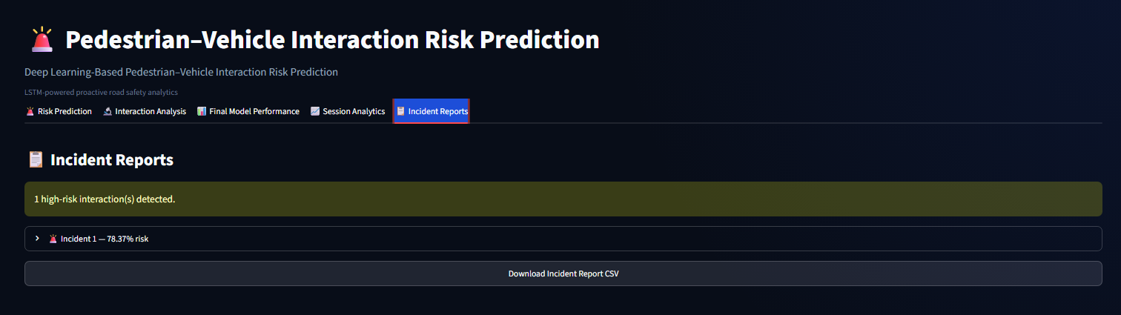
Incident reports
High-risk predictions are surfaced for review and can be exported as a CSV report.
EXAMPLE OUTPUT
The screenshot shows one high-risk interaction at 78.37% probability and provides a downloadable incident-report CSV.
This is a model-flagged interaction from the selected demo scenario; it should not be described as a confirmed real-world crash.
20

Slide 23
Conclusion & future scope
A temporal deep-learning prototype for proactive pedestrian–vehicle risk assessment.
WHAT WE ACHIEVED
FUTURE ENHANCEMENTS
• Built a JAAD-based temporal dataset
• Engineered 15 motion, behaviour and context features
• Trained and compared four classifiers
• Developed an interactive Streamlit dashboard
• Achieved 85.12% high-risk recall at the 0.55 operating threshold on the final test evaluation
• Integrate live pedestrian detection and tracking
• Connect video streams to feature extraction
• Add vehicle distance / time-to-collision cues
• Validate on additional road-scene datasets
• Evaluate real-time latency and field performance
DEEPVISION
Thank you
Questions?
13

