Slide 1

HYDRA
Cracking SSH Authentication with Hydra
YUVAPRIYA S
2022503552

Slide 2
PROBLEM STATEMENT
Use Hydra to launch a brute‑force attack against an SSH server. Discuss how attackers exploit weak SSH passwords and the importance of using SSH keys, disabling password authentication, and implementing fail2ban to secure SSH access.

Slide 3

PROCEDURE
1. Install Hydra
To begin, you need to install Hydra, a popular password-cracking tool.
Step 1.1: Update the package lists for upgrades.
sudo apt update
Step 1.2: Install Hydra.
sudo apt install hydra

Slide 4

Install OpenSSH Server
If you don't already have an SSH server installed, you need to install OpenSSH Server.
Step 2.1: Install OpenSSH server.
sudo apt install openssh-server
Step 2.2: Start the SSH server.
sudo systemctl start ssh
Step 2.3: Verify that the SSH server is running
sudo systemctl status ssh

Slide 5

Create a Test User
Next, you will create a test user for the SSH attack.
Step 3.1: Create a new user named testuser.
sudo adduser testuser
Step 3.2: Set a password for the user.
sudo passwd testuser

Slide 6

Create a Password List
For Brute-Force Attack, create a simple password list to use with Hydra for the brute-force attack.
Step 4.1: Create a text file with a list of common passwords (e.g., password123, qwerty, 123456).
nano ~/passwords.txt
Step 4.2: Add a few common passwords into this file, one per line:
123456
password
Step 4.3: Save and close the file.

Slide 7
Launch Hydra to Perform Brute-Force Attack
Use Hydra to try multiple passwords from the list against the SSH service.
Step 5.1: Run Hydra with the test user and the password list to crack the SSH login.
hydra -l testuser -P ~/passwords.txt -t 4 -vV ssh://127.0.0.1
Explanation:
-l testuser: Specifies the username (testuser) to target.
-P ~/passwords.txt: Specifies the path to the password list (~/passwords.txt).
-t 4: Specifies the number of parallel tasks.
-vV: Enables verbose output to show each attempted password.
Step 5.2: Hydra will begin testing each password from the list and display which passwords were attempted.

Slide 8

Review the results
Once the attack completes, Hydra will report the successfully cracked password.
Example Output:
[22][ssh] host: 127.0.0.1 login: testuser password: weakpas
Step 6.1: Hydra will display the valid password it found after testing all the options.

Slide 9
Secure the SSH Server
To mitigate such attacks, consider securing your SSH server with the following steps:
Step 7.1: Use SSH keys instead of passwords.
Disable password authentication by modifying the /etc/ssh/sshd_config file.
Set PasswordAuthentication no.
Restart the SSH service:
sudo systemctl restart ssh
Step 7.2: Implement fail2ban to block IP addresses that attempt too many invalid login attempts.
sudo apt install fail2ban
This will help prevent brute-force attacks from continuing by temporarily banning IPs that make repeated invalid login attempts.

Slide 10
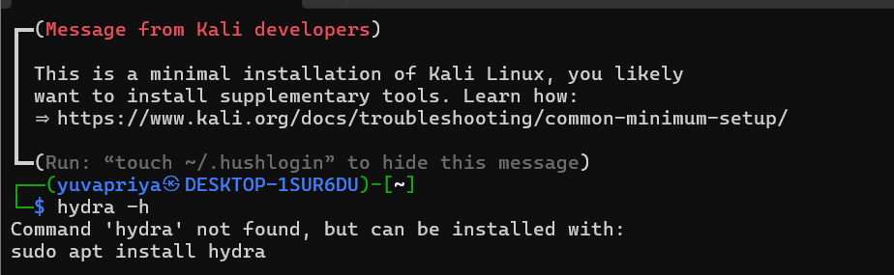

Slide 11
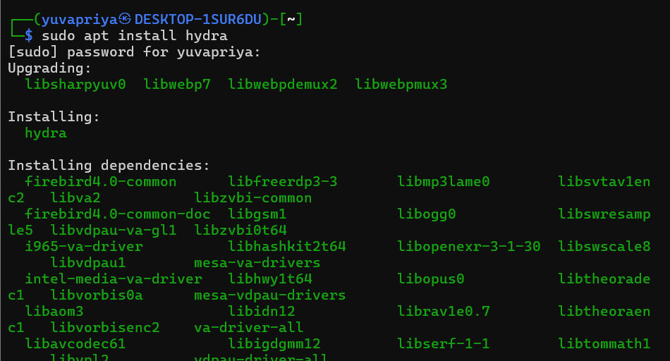

Slide 12
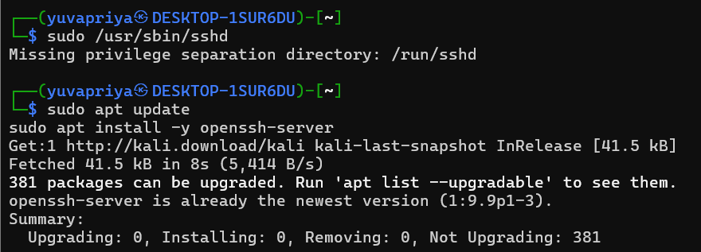

Slide 13
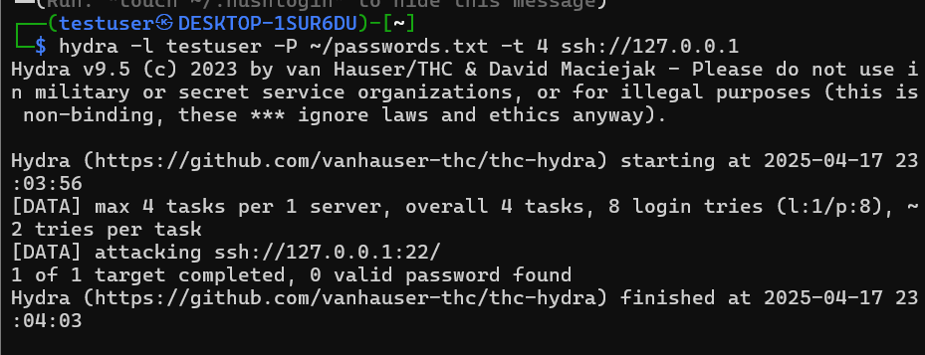

Slide 14
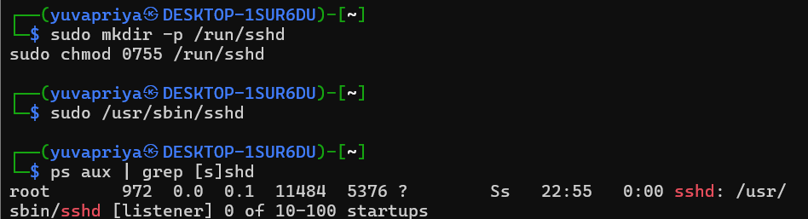
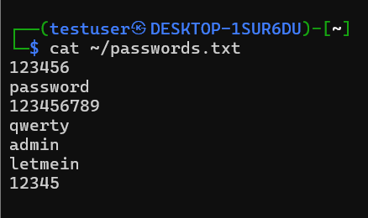

Slide 15
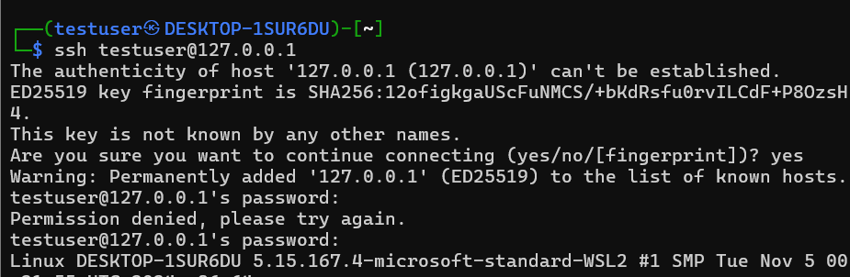
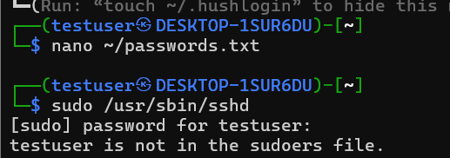

Slide 16
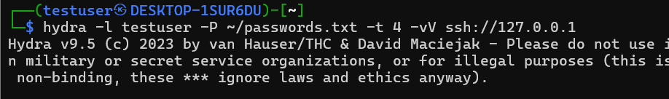
Demo link
https://drive.google.com/file/d/1lS5kEDpnIb85DnVy3YTKAUmrcXAgnloe/view?usp=sharing

Slide 17
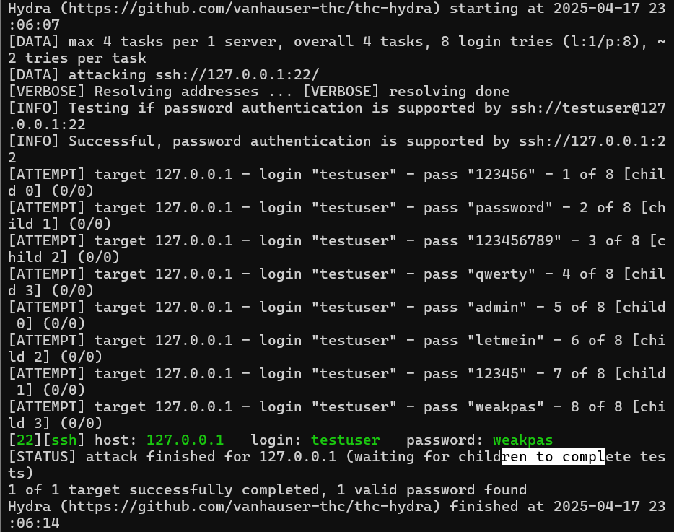

Slide 18
THANK YOU
YUVAPRIYA S​
2022503552

