Slide 1


SMART INDIA HACKATHON 2026
TITLE PAGE
Problem Statement ID - SIH26112
Problem Statement Title - Design and Develop a Modular Autonomous Mobile Robot (AMR) Platform for Smart Warehouse Automation
Theme - Robotics and Drones
PS Category - Hardware
Team ID - 158819
Team Name (Registered on portal) – Team_7

Slide 2
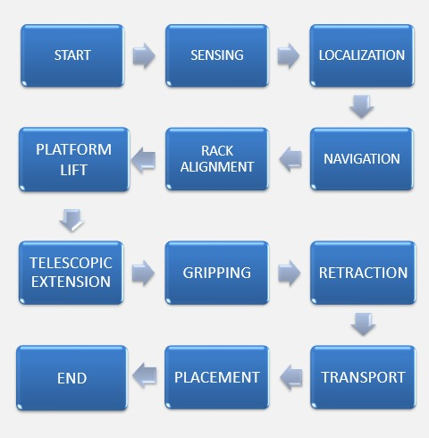
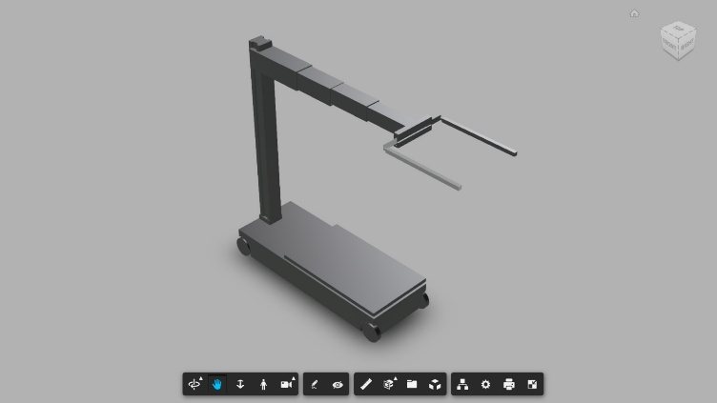
IDEA TITLE
Autonomous Multi-Level Rack Retrieval Robot for Adaptive Warehouse Automation
Team_7
Proposed Solution (Describe your Idea/Solution/Prototype)
The Problem: Key Innovation:
Conventional AMRs primarily transport items at floor level.
Multi-level racks require a mechanism to access elevated storage locations.
Fixed AS/RS solutions are typically tied to dedicated rack and aisle infrastructure.
Different rack heights require flexible vertical positioning during retrieval. Existing warehouses need solutions that can integrate without major rack modification.
Mobile + lift + telescopic reach in one robot
Automated rack-level access across different heights
Adaptive gripping for varied item/box sizes
Minimal rack modification for deployment
Modular mechanical architecture for scalable development
•
•
•
How It Works:
Our Solution:
Autonomous robot for rack item retrieval
Rising platform reaches the required rack level
Telescopic arm extends into the rack
Adjustable gripper accommodates different box sizes
Designed for existing warehouse racks

Slide 3

Team_7
TECHNICAL APPROACH
A. Hardware
B. Software
AMR chassis | Adjustable rubber-padded gripper
Motor drivers | LiDAR / depth sensing
Battery system | IMU & wheel encoders
Camera | Proximity / safety sensors
Telescopic arm | Raspberry Pi 5 controller
ROS 2 | Rviz2
SLAM | Autodesk Fusion
Gazebo | MoveIt 2
Nav2 | Codesys
C. System Workflow
1
2
3
4
SENSING
RACK ALIGNMENT
TELESCOPIC EXTENSION
RETRACTION
LOCALIZATION
PLATFORM LIFT
GRIPPING
TRANSPORT & PLACEMENT
NAVIGATION
@SIH Idea submission- Template
3

Slide 4
FEASIBILITY AND VIABILITY
Team_7
ASPECT | FEASIBILITY | KEY RISK | MITIGATION
Navigation & localization | ROS 2 + LiDAR navigation is well established | Dynamic obstacles, localization error | Sensor fusion + obstacle detection
Rack alignment | Depth / proximity sensing supports alignment | Lateral offset at the rack | Closed-loop fine alignment before lift
Lifting mechanism | Actuated linear lifting is readily implementable | Load variation, mechanical deflection | Payload limits + structural analysis + position feedback
Telescopic arm & gripper | Controlled linear reach with adjustable grip | Cantilever load, varied item sizes | Payload limits + support / locking + grip range limits
Stability & payload | Low-mounted battery supports stability | CG shift during arm extension | Wide base + low CG + extension limits
Safety | Sensors can support safe operation | Collision with people or racks | Obstacle sensing + speed limits + emergency stop
Manufacturing & maintenance | Modular design with standard components | Wear in moving parts, alignment drift | Modular parts + periodic calibration
• Analysis
of the feasibility of t
he idea
• Potential
challenges and risk
s
• Strategie
s for overcoming th
ese challenges
Assembly file - https://a360.co/3Vkj5lU
For full details of the design with the topology details visit GitHub - https://github.com/Yuvaraaj-007/SiH-26112/tree/main

Slide 5
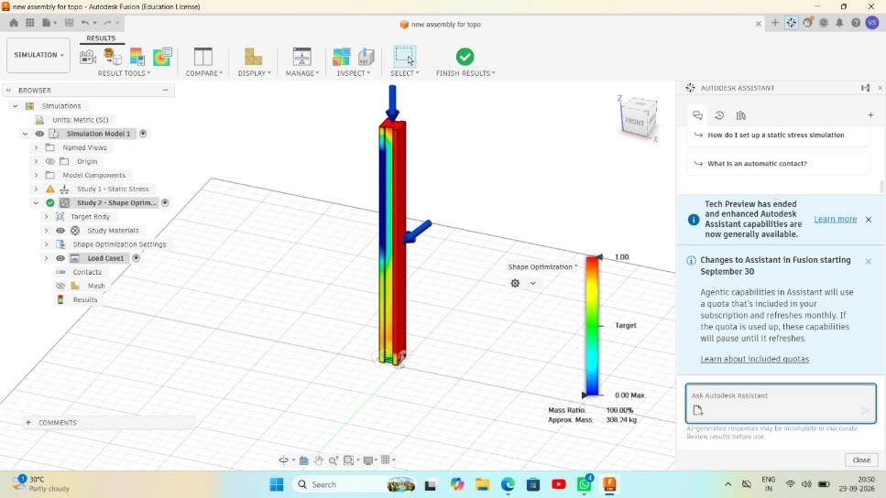
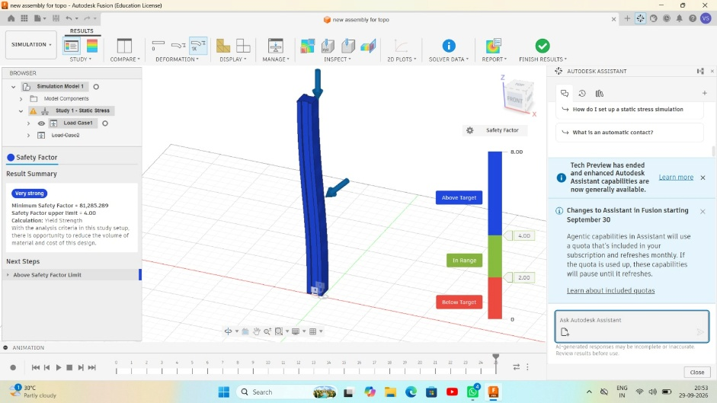
IMPACT AND BENEFITS
Team_7
Warehouse Operations: Automated multi-level retrieval; less repetitive manual handling
Productivity: Continuous material movement; consistent retrieval workflow
Safety: Less manual heavy handling; controlled robotic retrieval
Infrastructure: Built for existing racks; minimal rack modification
Scalability: Modular mechanical design; adapts to warehouse layouts
Economic Potential: Potentially less manual handling; reusable multi-task platform
For assembly animation click here
For stress analysis video click here
For optimization of design click here

Slide 6
RESEARCH AND REFERENCES
Team_7
ROS 2 — Robotics Middleware Macenski et al., "Robot Operating System 2: Design, Architecture, and Uses in the Wild," Science Robotics, 2022. https://doi.org/10.1126/scirobotics.abm6074
Autonomous Mobile Robot Navigation Loganathan & Ahmad, "A Systematic Review on Recent Advances in Autonomous Mobile Robot Navigation," Engineering Science and Technology, 2023.. https://www.sciencedirect.com/science/article/pii/S2215098623000204?via%3Dihub
Smart Mobile Warehouse Robot "Mechatronic System Design of a Smart Mobile Warehouse Robot for Automated Storage/Retrieval Systems," IEEE ASYU, 2020. https://doi.org/10.1109/ASYU50717.2020.9259882
Warehouse Storage & Retrieval Roodbergen & Vis, "A Survey of Literature on Automated Storage and Retrieval Systems," European Journal of Operational Research, 2009. https://www.sciencedirect.com/science/article/pii/S0377221708001598
Mobile Robot Navigation Macenski et al., "The Marathon 2: A Navigation System," IROS, 2020. https://doi.org/10.1109/IROS45743.2020.9341207

