Slide 1


TIC-TAC-TOE GAME
SUPERVISOR Mr.A.Malarmannan,M.E.,, AP/CSE.
PRESENTED BY
2303811710421188 – YUVARAJ P

Slide 2

PRESENTATION OVERVIEW
Objective
Project Introduction
Problem Statement
Methodologies (Programming concepts relevant to problem statement)
Architecture of the proposed system
List of Modules
Merits
Results and Discussion
Queries

Slide 3
OBJECTIVE
Provides an engaging two-player or player-versus-computer gameplay experience.
Implements a randomized computer AI for challenging single-player mode.
Offers an interactive graphical user interface (GUI) for ease of use.Tracks scores and ensures smooth game flow.

Slide 4
PROJECT INTRODUCTION
Tic Tac Toe is a classic logic-based game played on a 3x3 grid.
This project involves:Designing a Java-based application using Swing and AWT.
Implementing game logic, event handling, and randomized moves for AI.
Maintaining a scoreboard for player performance tracking.

Slide 5
PROBLEM STATEMENT
Challenges in similar applications:
Lack of engaging and interactive GUIs in basic games.Predictable computer moves reducing replayability.
Absence of score-tracking mechanisms.
Proposed Solution:
A GUI-based Tic Tac Toe game with intuitive design, randomized AI logic, and a dynamic scoreboard.

Slide 6
Methodologies (Programming concepts relevant to problem statement)
AWT and Swing:
Used to create the graphical interface (buttons, panels, labels).
Event Handling:
Captures user actions like button clicks to update game state.
Randomization:
Ensures the computer makes random moves in the player-vs-computer mode.
File Handling (Optional):
For saving scores or game states (if implemented).
Exception Handling:
Manages unexpected inputs or invalid game states.

Slide 7
FLOW DIAGRAM
Player Input Module
Game Board Module
Start
Game Logic Module
Reset or Replay?
Scoreboard Module
AI Logic Module

Slide 8
MODULE DESCRIPTION
Player Input Module:
Captures names and preferences (symbol and mode).
Game Board Module:
Displays the 3x3 grid with interactive buttons.
Game Logic Module:
Checks for wins, ties, or valid moves.
Computer AI Module:
Implements random move logic for the computer.
Scoreboard Module:
Tracks and updates player scores dynamically.

Slide 9
MERITS
Engaging Gameplay:
Provides a challenging experience in single-player mode.
Interactive GUI:
Intuitive design for ease of use.
Randomized AI:
Adds unpredictability to the game.
Score Tracking:
Keeps a record of player performance across rounds.
Reusable Architecture:
Can be extended with new features like larger grids or difficulty levels.

Slide 10
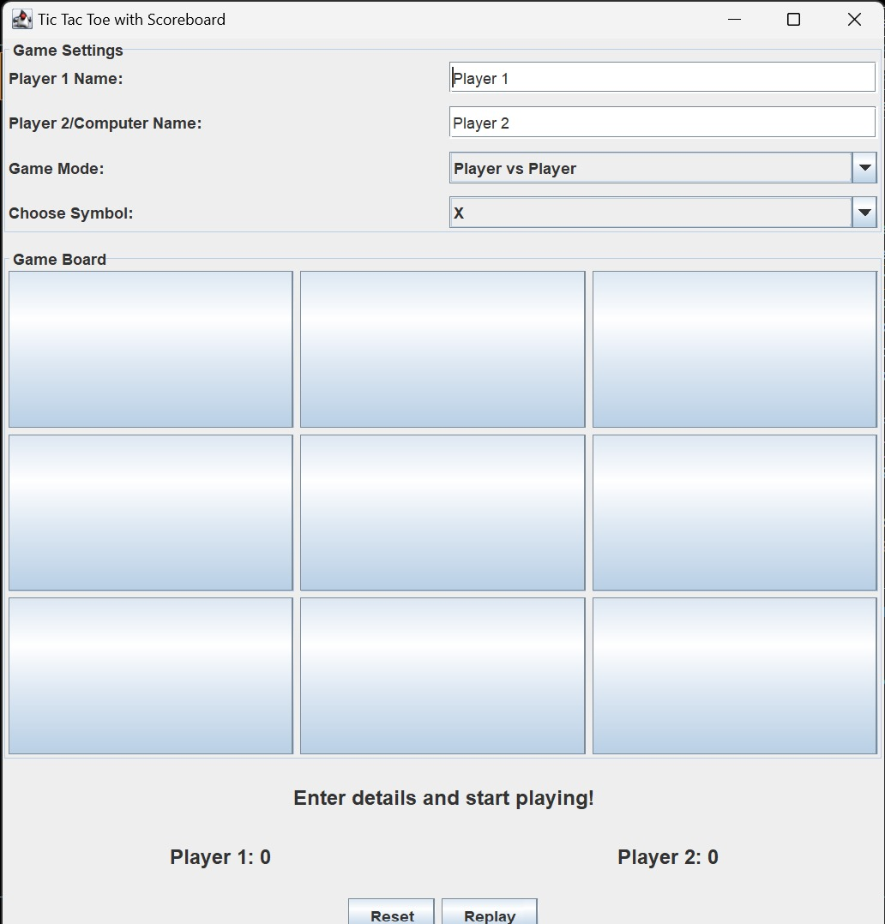
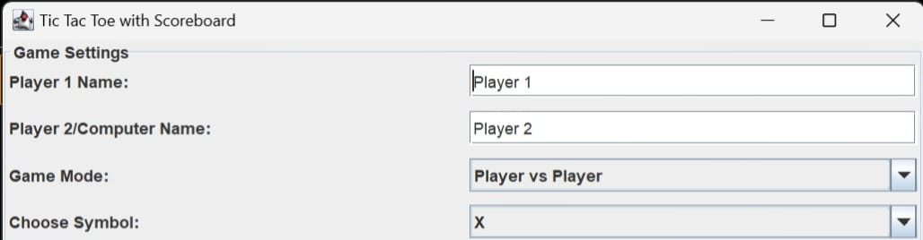
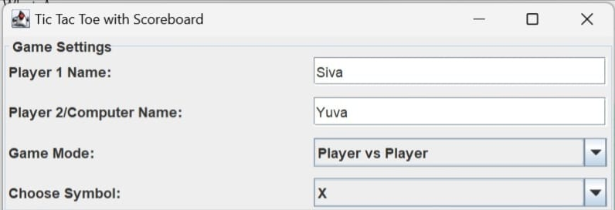
RESULT AND DISCUSSION

Slide 11
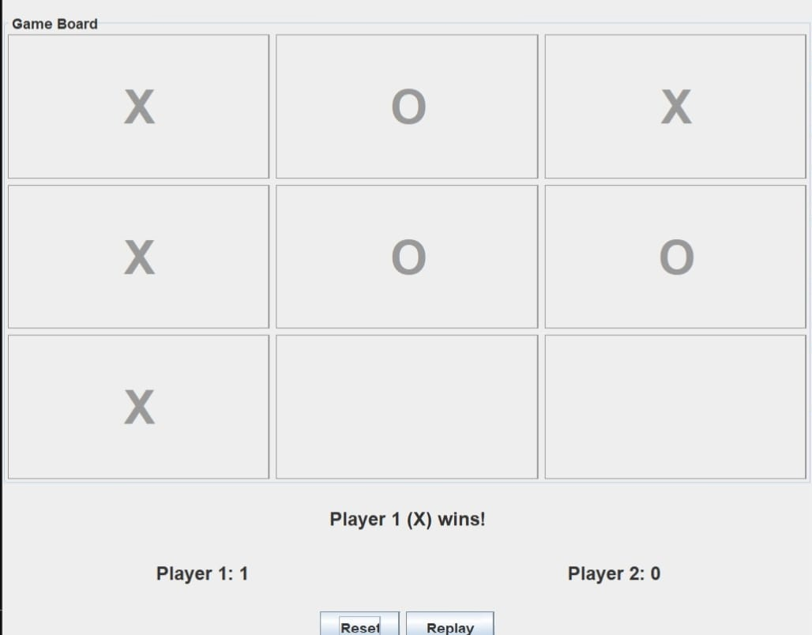
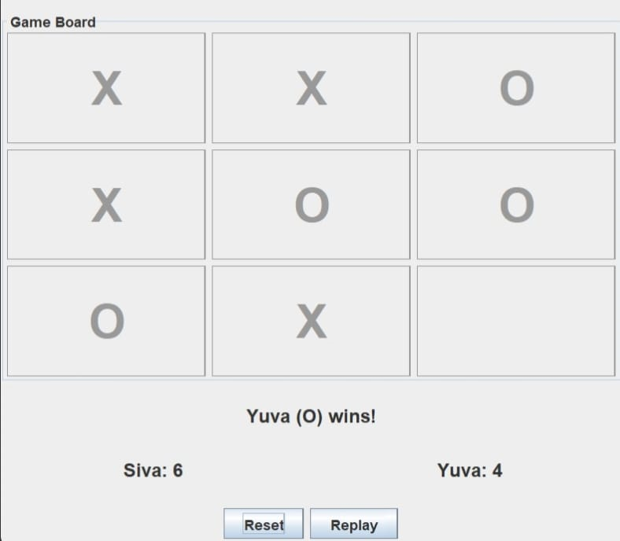
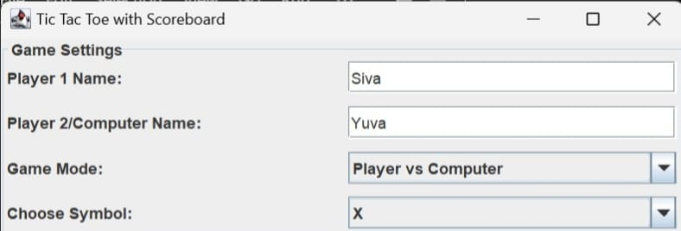
RESULT AND DISCUSSION

Slide 12
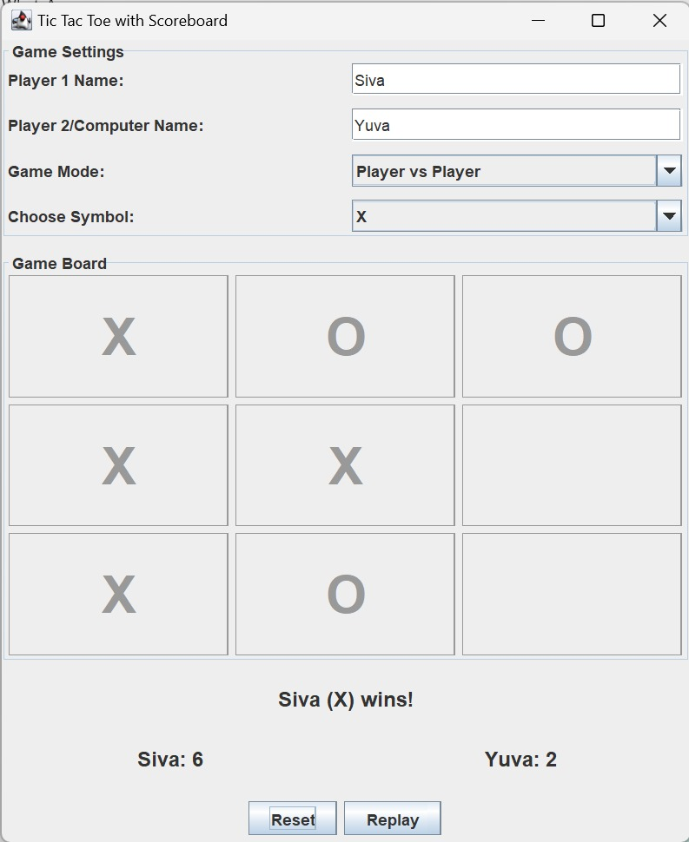
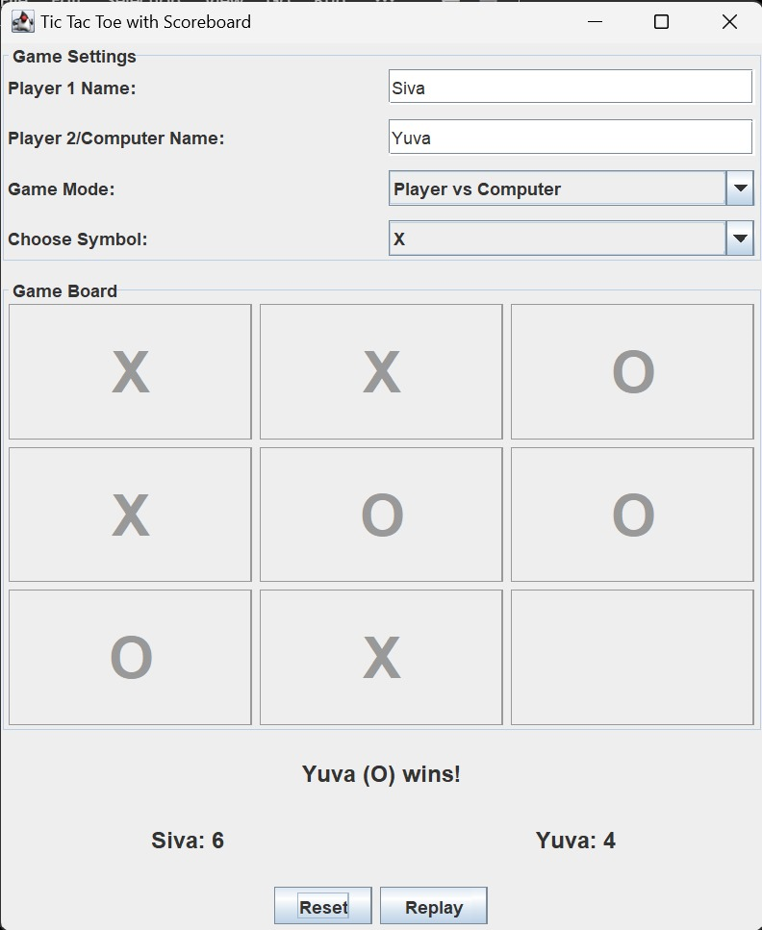
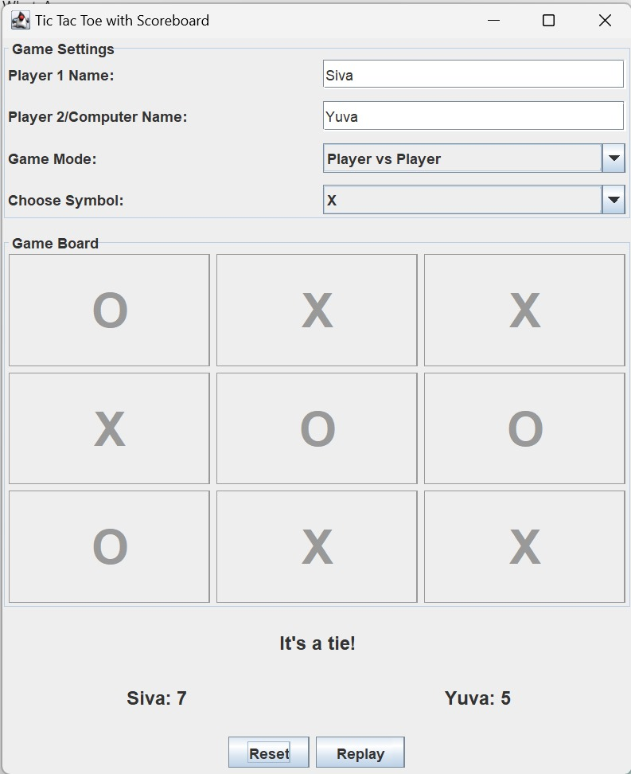
RESULT AND DISCUSSION

Slide 13
THANK YOU

