Slide 1
Employee Data Analysis using Excel
STUDENT NAME:D.YUVARAJ
REGISTER NO:312211497 (asunm1429312211497)
DEPARTMENT:B.COM GENERAL
COLLEGE:ALPHA ARTS AND SCIENCE

Slide 2
PROJECT TITLE
Employee Performance Analysis using Excel

Slide 3


AGENDA
Problem Statement
Project Overview
End Users
Our Solution and Proposition
Dataset Description
Modelling Approach
Results and Discussion
Conclusion
3/21/2024 Annual Review

Slide 4

PROBLEM STATEMENT
Scope: The analysis will focus on various aspects of employee data, including but not limited to:
Demographics: Analyzing age, gender, education level, and other demographic factors to understand the composition of the workforce.
Performance Metrics: Evaluating employee performance through metrics such as annual reviews, productivity rates, and goal achievements.
Retention and Turnover: Identifying patterns and factors contributing to employee turnover and retention. This includes analyzing tenure, reasons for leaving, and identifying at-risk employees.
Employee Satisfaction: Assessing employee satisfaction through survey data, feedback, and engagement scores to identify areas for improvement.
Compensation and Benefits: Examining the impact of compensation, benefits, and work-life balance on employee satisfaction and retention.
Attendance and Absenteeism: Analyzing attendance records to identify trends and correlations with performance and retention.

Slide 5

PROJECT OVERVIEW
The Employee Data Analysis project aims to leverage data-driven insights to enhance workforce management within the organization. By systematically analyzing employee-related data, this project seeks to uncover trends, identify areas for improvement, and inform strategic HR decisions that will drive employee satisfaction, retention, and overall productivity. The analysis will focus on key areas such as demographics, performance, retention, compensation, and employee engagement.

Slide 6


WHO ARE THE END USERS?

Slide 7

OUR SOLUTION AND ITS VALUE PROPOSITION
CONDITIONAL FORMATING –MISSING
FILTER-REMOVE
FORMULA-PERFORMANCE
PIVOT-SUMMARY
GRAPH-DATA VISUALIZATION

Slide 8
Dataset Description
EMPLOYEE= KAGGLE
26-FEATURES
9-FEATURES
EMP ID-NUM
NAME-TEXT
EMP TYPE
PERFORMANCE LEVEL
GENDER-MALE FEMALE
EMPLOYEE RATING-NUM

Slide 9

THE "WOW" IN OUR SOLUTION
PERFORMANCE LEVEL=IFS(Z8>=5,”VERYHIGH”
“,Z8>=4,”HIGH”,Z8>=3<“MED”,TRUE,”LOW”)
3/21/2024 Annual Review
9

Slide 10
MODELLING
DATA COLLECTION
FILE DOWNLOAD FROM KAGGLE
FEATURES COLLECTION
DATA CLEANING
MISSSING VALUE IDENTIFY
MISSING VALUE FILTER OUT
PERFORMANCE LEVEL
PIVOT TABLE
SUMMARY
VISULAIZATION
GRAPHY

Slide 11
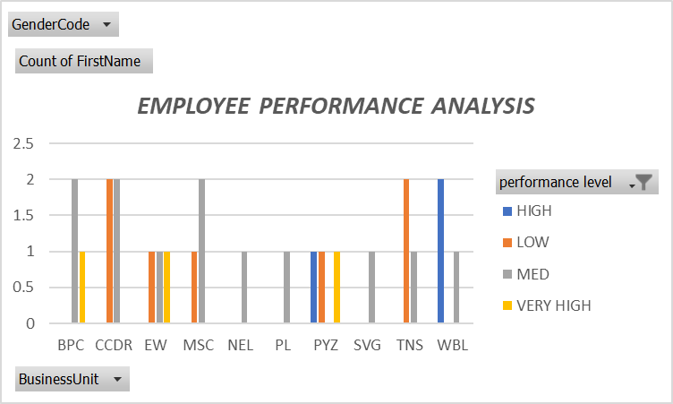
RESULTS
11

Slide 12
conclusion
The Employee Data Analysis project has provided valuable insights into the organization’s workforce, highlighting key areas for improvement and opportunities for strategic enhancement. By analyzing various aspects such as demographics, performance, retention, satisfaction, and compensation, the project has offered a comprehensive understanding of the factors influencing employee behavior and organizational outcomes.

