Slide 1
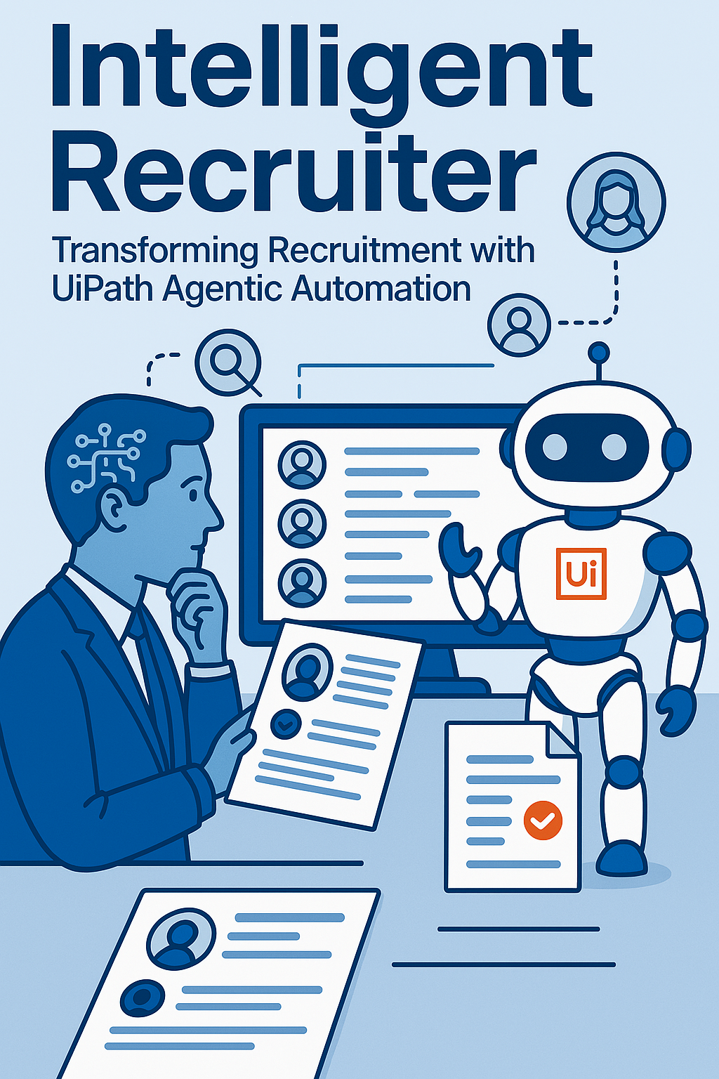
Intelligent Recruiter - Transforming Recruitment with UiPath Agentic Automation.
UiPath AgentHack. Build the AI agents of tomorrow.

Slide 2

DaBot(Ramboll) Intelligent Recruiter
Yuvaraja Kannan
Automation Lead @Ramboll
Yuvaraja.kannan@gmail.com

Slide 3
Problem statement and proposed solution
Problem
Solution
Challenges in Resume Screening
Manual screening is time-intensive and prone to errors
Basic ATS lacks contextual understanding of skills and experience
No adaptive learning or proactive shortlisting of candidates
Difficulty in eliminating irrelevant resumes
Risk of overlooking qualified candidates
Scale of the Challenge
Large-scale industries receive over 0.5 million resumes approximately each year
Recruiters spend at least 2 minutes per resume after initial filtering
Approximate screening time: 14,000 hours per year for 0.5 million resume
An agentic intelligent recruiter using UiPath, which automates the end-to-end process — from loading job descriptions and downloading resumes to intelligent candidate shortlisting and recruiter notification. It leverages a UiPath AI Agent to provide context-aware match scoring, skill gap analysis, and explainable recommendations for each candidate
Agentic Intelligence: Goes beyond keyword matching by using intelligent prompts to understand context, relevance, and fit.
Explainable AI: Provides justifications and recommendations, making the scoring transparent and trustworthy.
Fully Integrated Workflow: Seamlessly combines automation and intelligence—from reading CVs to updating the recruitment system.
Scalable & Adaptive: Can handle thousands of applications, and improves over time with feedback loops.

Slide 4
Benefits and technologies used
Details
Benefits, impact and outcomes
End-user​ | Recruiters and Hiring managers
User department​ | Talent Acquisitions and Humar resources
Industries​ | Industry-agnostic
UiPath products used​ | UiPath Studio and UiPath agents
Other - integrations / APIs / technologies used​ | HTML and CSS
⏱️Time Saved
Reduces manual screening effort by 60–80%
Speeds up shortlisting from hours to minutes per job (Saves 2-3 mins per resume). 14k hours for 0.5 million resumes approximately.
🤖 Steps Automated
Launches recruiting system and reads JDs
Downloads and reads CVs
Matches CVs with JDs using agentic AI
Shortlists candidates and sends recruiter summaries
💡User Pain Reduced
Eliminates tedious manual reading of resumes
Removes bias-prone keyword matching
Gives clear, explainable match scores and reasoning
📈 Achieved Outcomes
Higher quality shortlists with contextual relevance
Scalable screening for high-volume hiring
Frees up recruiters to focus on strategic and human tasks (like interviews and candidate experience)

Slide 5
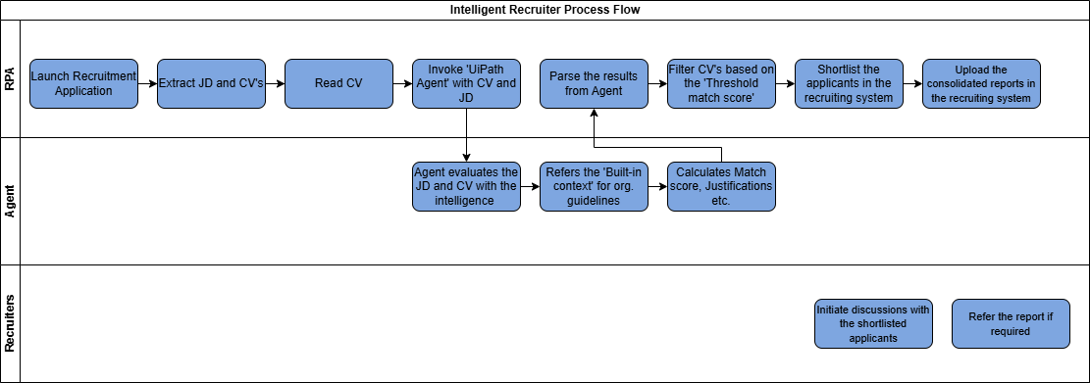
Solution Architecture
This solution combines the power of UiPath RPA and UiPath Agentic AI to automate and enhance resume screening.

Slide 6
UiPath Agent Architecture
This agent is designed to evaluate how well a candidate's resume matches a given job description. Here's a high-level architecture breakdown.
Input Layer
Processing Layer
Context Layer
Scoring Layer
Justification Layer
Output Layer
Job Description (string)
Candidate Resume (string)
Natural Language Processing (NLP) to analyze both inputs
Skill Matching Algorithm
Experience Evaluation
Education Assessment
Additional Qualifications Analysis
Context to understand company-specific jargon or values Experience Evaluation
Industry specific terminologies to help agent better evaluate resumes based on domain knowledge.
Match Score Calculation (0-100)
Score Breakdown (skills, experience, education, additional qualifications)
Matched Skills Identification
Missing Skills Identification
Experience Alignment Analysis
Education Alignment Analysis
Strengths and Gaps Identification
Generates insights and recommendations for hiring managers
Overall Match Score
Score Breakdown
Detailed Justification
Recommendations

Slide 7
What’s next ?
After successfully implementing the ‘Intelligent Recruiter’ Solution using UiPath Agents, further the solution can be extended to cover the hiring life cycle.
Intelligent Recruiter Solution
UiPath RPA Schedule interviews to shortlisted candidates
UiPath Agents analysis interview Transcripts
UiPath Agents provides interview feedback
UiPath RPA Release Offer letters

Slide 8
By combining the speed of RPA with the intelligence of AI, Intelligent Recruiter enables faster, fairer, and more accurate hiring decisions. Let the UiPath AI and automation do the heavy lifting- so your team can focus on what matters most: People

