Slide 1
Natural Language processing Usecases
01/04/2024
www.race.reva.edu.in

Slide 2
Introduction
“I am telling you, the world’s first trillionaires are going to come from somebody who masters AI and all its derivatives, and applies it in ways we never thought of.” ~Mark Cuban.

Slide 3



SPEAKER
Yuvaraju
Senior Manager Data Science
Professional​
• 16+ years in IT Industry, IITM Alumni
• Talks about #AI,#NLP, #ChatGPT #Computer Vision
• Trained 1000+ Corporates

Slide 4
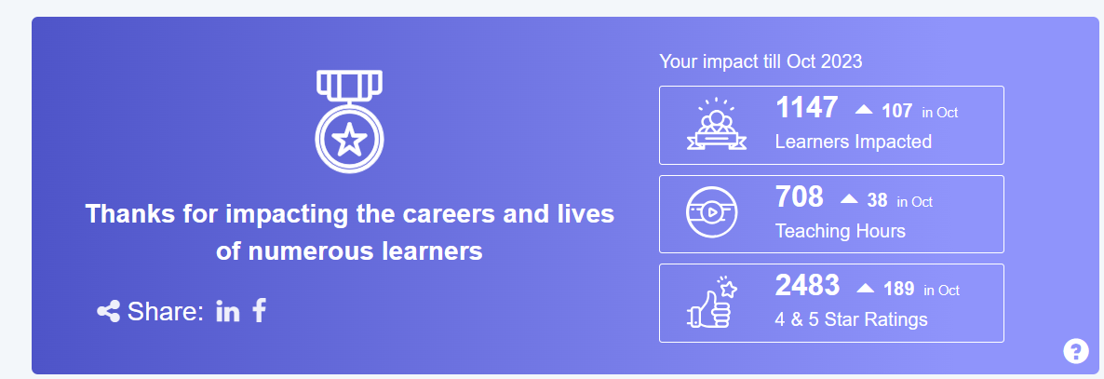

My AI Journey
Industry Experience: Banking,Automotive,Telecom, Oil and Gas,Manufacturing and Aerospace
Industry Projects:
Banks Cheque clearing using computer vision+NLP techniques
International Trade Automation using Named Entity Recognition Techniques
Multi Country Automation of Security Services operations using AI
Fraud Detection using LSTM and RNN techniques
Sales Forecasting
After Market Recommendation
NOx reduction using predictive analytics for power plant
Churn Prediction of the customer using Multihead Attention Transformers
Fair AI

Slide 5
Question
What is the purpose of vectorization in Natural Language Processing (NLP)?
To translate text from one language to another.
B) To convert text into numerical format for machine learning algorithms.
C) To visually represent text data in graphical form.
D) To compress large text documents into smaller files.
Correct Answer: B) To convert text into numerical format for machine learning algorithms.

Slide 6
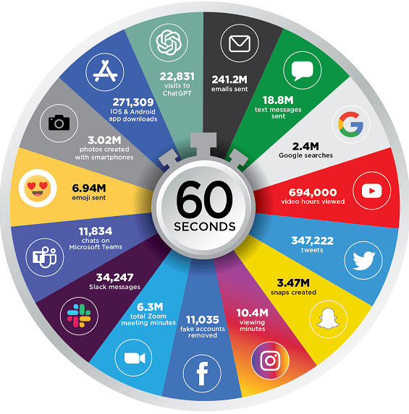
Every Minute of Internet in 2023
Social platforms are the top source of unstructured natural language data due to the massive volume of user-generated text.
Manual analysis of this data is impossible due to its sheer volume.
NLP-based intelligent systems are crucial to extract meaningful insights from social media data.
Source: ediscoverytoday

Slide 7
NLP Use cases
01
05
Text Classification
Machine Translation
02
06
Named Entity Recognition
Recommendation systems
03
Topic Modelling
04
Text Summarization

Slide 8

Text Classification

Slide 9
Text Classification
Text Classification
Binary
Multi class
Multi label
Spam/Non Spam
Positive/Negative/Neutral
News Article classification:
AI and Agriculture
Sports and politics

Slide 10
Applications
Twitter classification Actionable tweets/ Non-Actionable tweets
| Just bought a new phone from XYZ brand, and it's a disaster! The battery drains so quickly. @XYZSupport, any solutions for this? #DisappointedCustomer |
| Had a great weekend with my new XYZ coffee machine! ☕️ #HappyCustomer |
| Loving the new xyz skincare products! My skin feels amazing. #SelfCare |

Slide 11
Applications
Content classification and organization
Organising email to Personal, Social and promotions
Personal
Social
Promotions

Slide 12
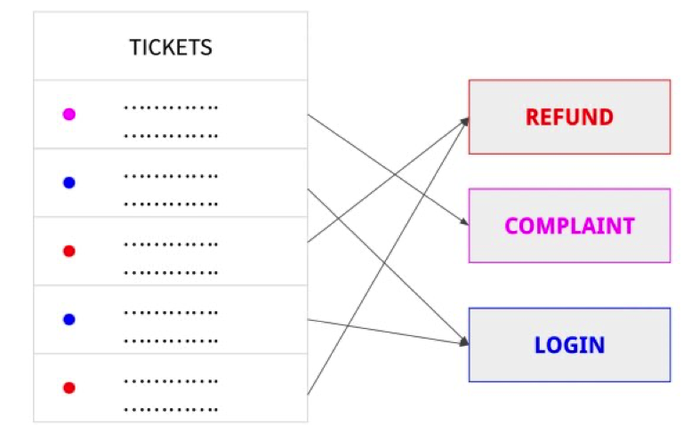
Applications- Customer Service
Routing customer service requests in a company to the appropriate support team
Urgent Detection
Sentiment detection
Source:www.opinosis-analytics.com

Slide 13
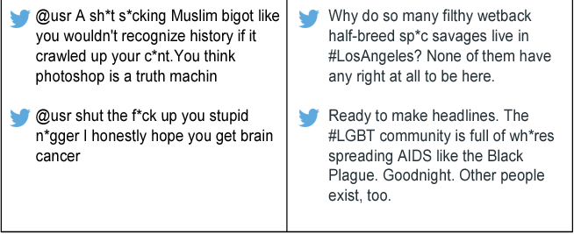
Hate Speech detection
Source: https://arxiv.org/pdf/1804.04257.pdf

Slide 14
Twitter Customer Service
Twitter classification Actionable tweets/ Non-Actionable tweets
| Just bought a new phone from XYZ brand, and it's a disaster! The battery drains so quickly. @XYZSupport, any solutions for this? #DisappointedCustomer |
| Had a great weekend with my new XYZ coffee machine! ☕️ #HappyCustomer |
| Loving the new ABC skincare products! My skin feels amazing. #SelfCare |

Slide 15

Banking
Routing of Security services documents to the corresponding department
Corporate Action
Payment
Subscription
Account Management
Swift Messages pdf documents
Scanned documents
Email
Settlement

Slide 16
Text Classification Pipeline
Data Acquisition
Pre-processing
Text representation
Model Building
Deployment
Monitoring and Improvement
Clean the Text
Stopwords Tokenization
Lemmatization
Random Forest
Naïve Bayes
LSTM
Transformers
TF-IDF
Embeddings

Slide 17
Practical Advice
Start with Pretrained Models: BERT,XL NET, Fast Text etc..
Balance the data- Down sample Majority class
Try Hybrid methods: Rule based+ Machine Learning
Keep Monitoring and Improve it: Model Drift and Data Drift

Slide 18

Named Entity Recognition

Slide 19
Named Entity Recognition
What are Named Entities?
Persons, Organizations, locations, times, quantities, Monnetay values, percentages, etc.
Example
Elon Musk, CEO of Tesla Inc., announced on January 1, 2021, that the company plans to
increase its production by 25% over the next year. This expansion includes opening a new
factory near Austin, Texas, with an investment of $1 billion. The project aims to produce
500,000 vehicles annually, addressing the growing demand for electric cars.

Slide 20
Named Entity Recognition
Input
Output
Elon Musk, CEO of Tesla Inc., announced on January 1, 2021, that the company plans to increase its production by 25% over the next year. This expansion includes opening a new factory near Austin, Texas, with an investment of $1 billion. The project aims to produce 500,000 vehicles annually, addressing the growing demand for electric cars.
Persons: Elon Musk
Organizations: Tesla Inc.
Date: January 1, 2021
Percentages: 25%
Locations: Austin, Texas
Monetary Values: $1 billion
Quantities: 500,000 vehicles
NER Model

Slide 21
Applications of NER
Machine Translation
Search Engines
Banking extract the entities from swift messages, customer documents, Loan agreements

Slide 22
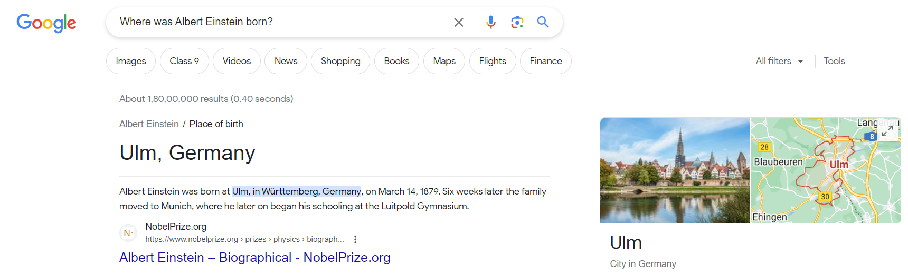
NER on Search Engines
Consider a scenario where the user asks a search query —“Where was Albert Einstein born?”—using Google search
To be able to show “Ulm, Germany” for this query, the search engine needs to decipher
that Albert Einstein is a person before going on to look for a place of birth.

Slide 23
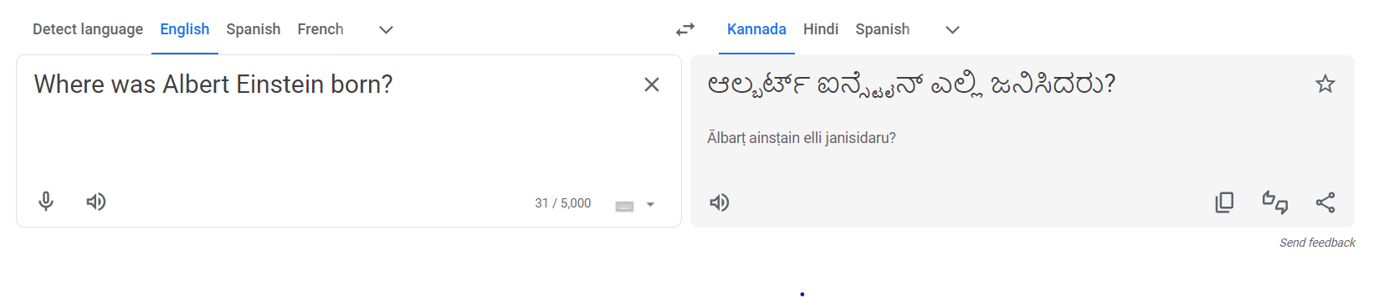
NER Machine Translation
NER is useful in machine translation, as names need not necessarily be translated while translating a sentence

Slide 24
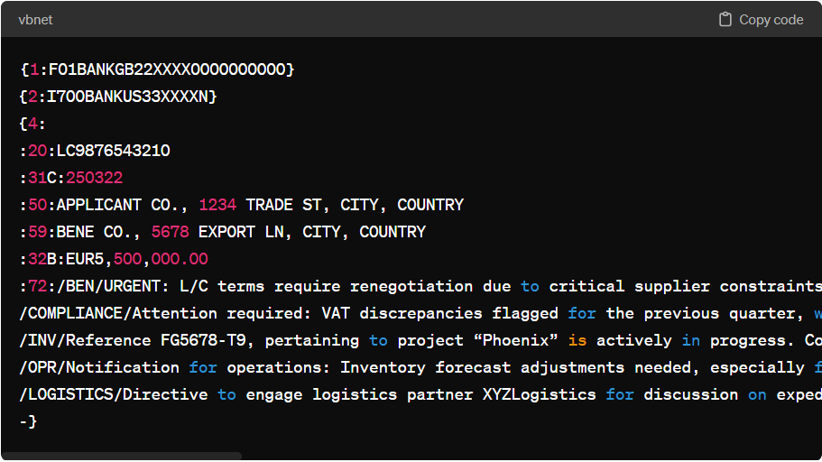
NER on Banking
Swift Message
Beneficiary Name: ABC export limited
Applicant Name: XYZ company limited
Beneficiary country: INDIA
Applicant country: USA
Amount: $500,000.00
LC Number: LC9876543210
Goods Description: “Electronic Goods”
Country of origin: India
From port: Chennai
To port: USA
NER Model

Slide 25
NER on Banking
Classification + Entity Extraction
Corporate Action
Entity Extraction
Payment
Entity Extraction
Subscription
Entity Extraction
Account Management
Entity Extraction
Swift Messages pdf documents
Scanned documents
Email
Settlement
Entity Extraction

Slide 26
NER on Medical documents
"Upon admission, the 58-year-old male presented with substernal chest pain radiating to the left arm, exacerbated by physical exertion and relieved by rest, suggestive of angina pectoris. Past medical history includes Type 2 DM, managed with Metformin, and hypertension controlled with Lisinopril. EKG demonstrated ST elevation in leads II, III, and aVF, consistent with an inferior wall MI. Troponin levels were elevated at 0.5 ng/mL. The patient underwent immediate PCI to the right coronary artery, revealing a 90% occlusion. Post-procedure, he was started on dual antiplatelet therapy with Aspirin and Clopidogrel, alongside Statin therapy for LDL management, recorded at 160 mg/dL pre-admission."
NER output
Patient Demographics
Age: 58-year-old
Gender: male
Symptoms
Symptom: substernal chest pain radiating to the left arm
Condition Trigger: exacerbated by physical exertion
Condition Relief: relieved by rest
Diagnoses
Diagnosis 1: suggestive of angina pectoris
Diagnosis 2: Type 2 DM (Diabetes Mellitus)
Diagnosis 3: Hypertension

Slide 27
NER on Finance
"During the audit of XYZ Corporation's financial statements for the fiscal year ended December 31, 2020, it was discovered that a series of transactions totaling $4.5 million were not properly disclosed. These transactions involved the sale of shares in subsidiary ABC Ltd. (stock symbol: ABCL) to a related party at significantly undervalued prices. The CFO of XYZ Corporation, Jane Doe, approved these transactions on April 15, 2020, without adequate documentation or board approval, raising concerns of potential fraud and violation of SEC regulations. Further investigation revealed that the proceeds from the sale were used to inflate the company's cash position ahead of the quarterly earnings report released on May 10, 2020."
Company Names:
XYZ Corporation
ABC Ltd. (Subsidiary)
Stock Symbols:
ABCL (ABC Ltd.)
Monetary Amounts:
$4.5 million (Total of undisclosed transactions)
Dates:
Fiscal year ended December 31, 2020
Transactions approved on April 15, 2020
Quarterly earnings report released on May 10, 2020
Persons:
Jane Doe (CFO of XYZ Corporation)

Slide 28

NER Modelling Approach
Is NER a supervised or unsupervised?
Is it a regression or classification?

Slide 29
NER Modelling Approach
Is NER a supervised or unsupervised?
Ans: Supervised
Is it a regression or classification?
Classification
Every word(token) should be classified in NER
If you want to classify every word, then every word should be labeled

Slide 30
Data Preparation for NER
BIO Tagging

Slide 31
BIO Tagging
Token | Annotation
Elon | B-PERSON
Musk | I-PERSON
, | O
CEO | O
of | O
Tesla | B-ORG
Inc. | I-ORG
, | O
announced | O
on | O
January | B-DATE
1 | I-DATE
, | I-DATE
2021 | I-DATE
Elon Musk, CEO of Tesla Inc., announced on January 1, 2021, that the company plans to increase its production by 25% over the next year. This expansion includes opening a new factory near Austin, Texas, with an investment of $1 billion. The project aims to produce 500,000 vehicles annually, addressing the growing demand for electric cars.
BIO tagging
B-Beginning
I-Inside
O-outside

Slide 32
Tools for BIO Tagging
BRAT (Brat Rapid Annotation Tool)
http://brat.nlplab.org/
Doccano
https://github.com/doccano/doccano

Slide 33

Question
Given an NER task where the size of X_train is (10000x100), indicating 10,000 sentences with up to 100 tokens each, what should be the size of y_train?
A) (10000x1)
B) (100x100)
C) (10000x100)
D) (1x10000)
Explanation:
In NER, each token in every sentence needs to be labeled (e.g., as a person, location, organization, or 'O' for outside any named entity). Therefore, the y_train should directly correspond to X_train in size, with a label for every token in every sentence, making the correct size (10000x100)

Slide 34
NER Training set Example
Input Sentence:
John Doe works at OpenAI in San Francisco
X_train:
["John", "Doe", "works", "at", "OpenAI", "in", "San", "Francisco", "."]
y_train:
["B-PER", "I-PER", "O", "O", "B-ORG", "O", "B-LOC", "I-LOC", "O"]

Slide 35
John Doe works at OpenAI in San Francisco
Jane Smith is employed by Google in New York City
Michael Johnson will speak at the conference in Los Angeles
[
["John", "Doe", "works", "at", "OpenAI", "in", "San", "Francisco", "."],
["Jane", "Smith", "is", "employed", "by", "Google", "in", "New", "York", "City", "."],
["Michael", "Johnson", "will", "speak", "at", "the", "conference", "in", "Los", "Angeles", "."]
]
[
["B-PER", "I-PER", "O", "O", "B-ORG", "O", "B-LOC", "I-LOC", "O"],
["B-PER", "I-PER", "O", "O", "O", "B-ORG", "O", "B-LOC", "I-LOC", "I-LOC", "O"],
["B-PER", "I-PER", "O", "O", "O", "O", "O", "O", "B-LOC", "I-LOC", "O"]
]

Slide 36






NER Training Pipeline
DataCollection
Preprocessing
Annotation
Vectorization
Model Training
Evaluation
public datasets
Scrapped data Internal docs
Text Cleaning
Tokenization
BIO Tagging
TF-IDF
Embeddings
CRF
LSTM
BERT
Precission
Recall F1Score

Slide 37
Models Used for NER
Model Type | Key Features | Use Case
CRF | - Statistical sequence modelling - Context-sensitive label prediction | Traditional NER tasks
BiLSTM with CRF | - Deep learning for context - Bidirectional context analysis - CRF for sequence modeling | Complex texts requiring nuanced context understanding
Transformer-based (BERT) | - Deep bidirectional context understanding - Pre-trained on large corpora for general understanding - Fine-tuning for specific NER tasks | State-of-the-art NER performance in diverse domains
Spacy NER, StandFord NER and Allen NLP are pretrained models

Slide 38
Evaluate NER
Precision: Measures the accuracy of the identified entities. It is the ratio of correctly identified entities to the total entities identified by the model
Recall: Measures the model's ability to identify all relevant entities in the dataset. It is the ratio of correctly identified entities to the total actual entities in the data.
F1 Score

Slide 39
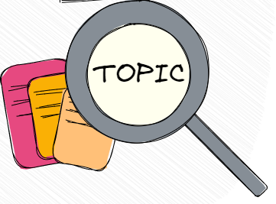
Topic Modelling

Slide 40
Topic Modelling -Introduction
Unveiling hidden themes:
Identifying Hidden structures from the large documents.
Imagine you have a massive library of books - it helps you identify recurring themes like "love," "war," or "environmentalism" without manually reading each book.
Data-driven insights:
Topic modeling is unsupervised, meaning it doesn't require pre-defined categories

Slide 41
Topic Modelling Applications
Review (Book): "This book was interesting and well-written. The author presented a unique perspective on the topic, and I learned a lot. However, the pacing was slow at times, and I wasn't fully invested in the characters. Overall, it was an okay read."
Topics: Interesting topic, well-written, unique perspective, slow pacing, average character development

Slide 42
Topic Modelling Theme park Reviews
Review (Theme Park): "We had a terrible experience at this theme park. The rides were all broken down, the lines were ridiculously long, and the staff was rude. The food was overpriced and inedible. It was a complete waste of money and time!"
Topics: Broken rides, long wait times, rude staff, expensive and bad food, disappointing experience

Slide 43
Customer Chat
Customer: "This app keeps crashing! I've lost all my progress and it's super frustrating. What's going on?"
Topics: Technical issue (app crashing), data loss, negative sentiment, frustration
Customer: "I waited over an hour for my order to arrive, and it's still not here! The tracking information hasn't updated either. This is unacceptable!"
Topics: Delivery issue (delay), lack of communication, negative sentiment, anger
Customer: "I spoke to a customer service representative earlier who gave me the wrong information. Now I'm back to square one and even more confused! Can you help?"
Topics: Misinformation, poor customer service, negative experience, frustration

Slide 44
Application
Identifying top 10 trends in Twitter
Identifying top 10 Searches in Google
Analyze large collections of scientific papers and identify emerging research areas and trends
Topics in Sentiment Analysis
Resume matching

Slide 45
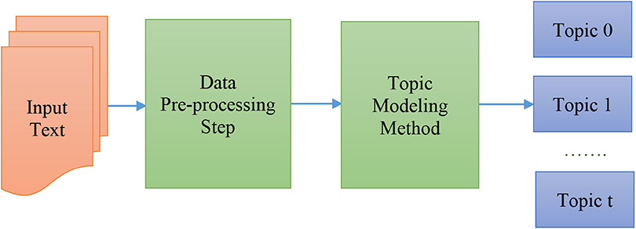
Topic Modelling Pipeline
Text Cleaning
Tokenisation Vectorization
LDA
LSTM
Transformers

Slide 46
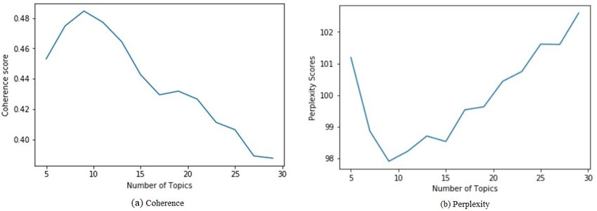
Topic Modelling Evaluation
Coherence Score : Higher should be better
Perplexity score : Lesser should be better

Slide 47
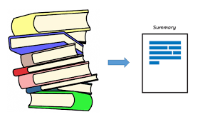
Text Summarisation

Slide 48
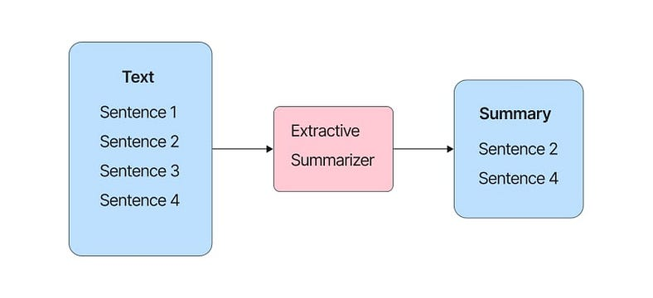
Text Summarization
Abstractive summarization
Extractive summarization
Summary
New text
generated
Abstractive
Summarizer
Abstractive summarization refers to the task of generating an abstract of the text; i.e., instead of picking sentences from within the text, a new summary is generated.
Extractive summarization refers to selecting important sentences from a piece oftext and showing them together as a summary

Slide 49
Example
A recent study published in Nature explored the impact of climate change on coral reefs. The researchers found that rising ocean temperatures are causing coral bleaching, a phenomenon where coral expel the algae that live within them and provide them with nutrients. This bleaching weakens the coral and makes it more susceptible to disease and death. The study also found that ocean acidification, another consequence of climate change, is making it more difficult for coral to build their skeletons. These findings highlight the urgent need to address climate change in order to protect coral reefs, which are vital ecosystems that support a wide variety of marine life.

Slide 50
Extractive Summarisation Example
A recent study published in Nature explored the impact of climate change on coral reefs. The researchers found that rising ocean temperatures are causing coral bleaching, a phenomenon where coral expel the algae that live within them and provide them with nutrients. This bleaching weakens the coral and makes it more susceptible to disease and death. The study also found that ocean acidification, another consequence of climate change, is making it more difficult for coral to build their skeletons. These findings highlight the urgent need to address climate change in order to protect coral reefs, which are vital ecosystems that support a wide variety of marine life.
Key sentence 1: Rising ocean temperatures are causing coral bleaching, a phenomenon where coral expel the algae that live within them and provide them with nutrients.
Key sentence 2: Ocean acidification is making it more difficult for coral to build their skeletons.

Slide 51
Abstractive Summarisation Example
A recent study published in Nature explored the impact of climate change on coral reefs. The researchers found that rising ocean temperatures are causing coral bleaching, a phenomenon where coral expel the algae that live within them and provide them with nutrients. This bleaching weakens the coral and makes it more susceptible to disease and death. The study also found that ocean acidification, another consequence of climate change, is making it more difficult for coral to build their skeletons. These findings highlight the urgent need to address climate change in order to protect coral reefs, which are vital ecosystems that support a wide variety of marine life.
Rising ocean temperatures trigger coral bleaching, weakening the reefs and making them vulnerable. Additionally, ocean acidification hinders their ability to build their skeletons. Protecting coral reefs, crucial marine ecosystems, requires urgent action against climate change.

Slide 52
Applications
Create the Minutes of Meeting for Teams meeting
News Articles Summarisation
Research paper summarisation

Slide 53
Practical Advice
Use the Pretrained Transformers
Evaluation Metrics: ROUGE Score
Range 0 to 1
1 means very good score
https://in.mathworks.com/help/textanalytics/ref/rougeevaluationscore.html

Slide 54
Useful Links
Transformers
https://github.com/nlp-with-transformers/notebooks
Textbook
Practical Natural Language Processing by Sowmya Vajjala
Hugging Face
https://huggingface.co/models
Public Datasets
https://datasetsearch.research.google.com/

Slide 55


Slide 56


