Slide 1
DATA ACQUISITION FOR UNIVERSITY RANKING APPLICATION
Under the guidance
of Dr.V.BHUVANESWARI,MCA.,M.Phil.,Ph.D., professor, Department of Computer Application.
R. YUVARAJ VIKNESH
II-MCA(BATCH II)
23CSEA77
THANGAPANDI
II-MCA(BATCH I)
23CSEA38

Slide 2
MODULE DESCRIPTION
MODULE 1: ADMIN MODULE
Admin Authentication (Secure login access)
User Management (View, Edit, Delete Users) and Data Management (View, Edit, Delete Data)
Generate Filtered Reports (Export as Excel)

Slide 3
MODULE DESCRIPTION
MODULE 2: FACULTY MODULE
User Authentication (Login, Registration)
Dashboard (Personalized view of user-specific data)
Allows users to create, edit, view, and download REPORTS in excel format.

Slide 4
MODULE DESCRIPTION
MODULE 3: DEPARTMENT MODULE
Department Authentication (Secure login access)
Dashboard (Comprehensive report management)
User Management (View, Edit, Delete Users)
Generate Filtered Reports (Export as Excel)
Allows Department to create, edit, view, and download REPORTS in excel format.

Slide 5
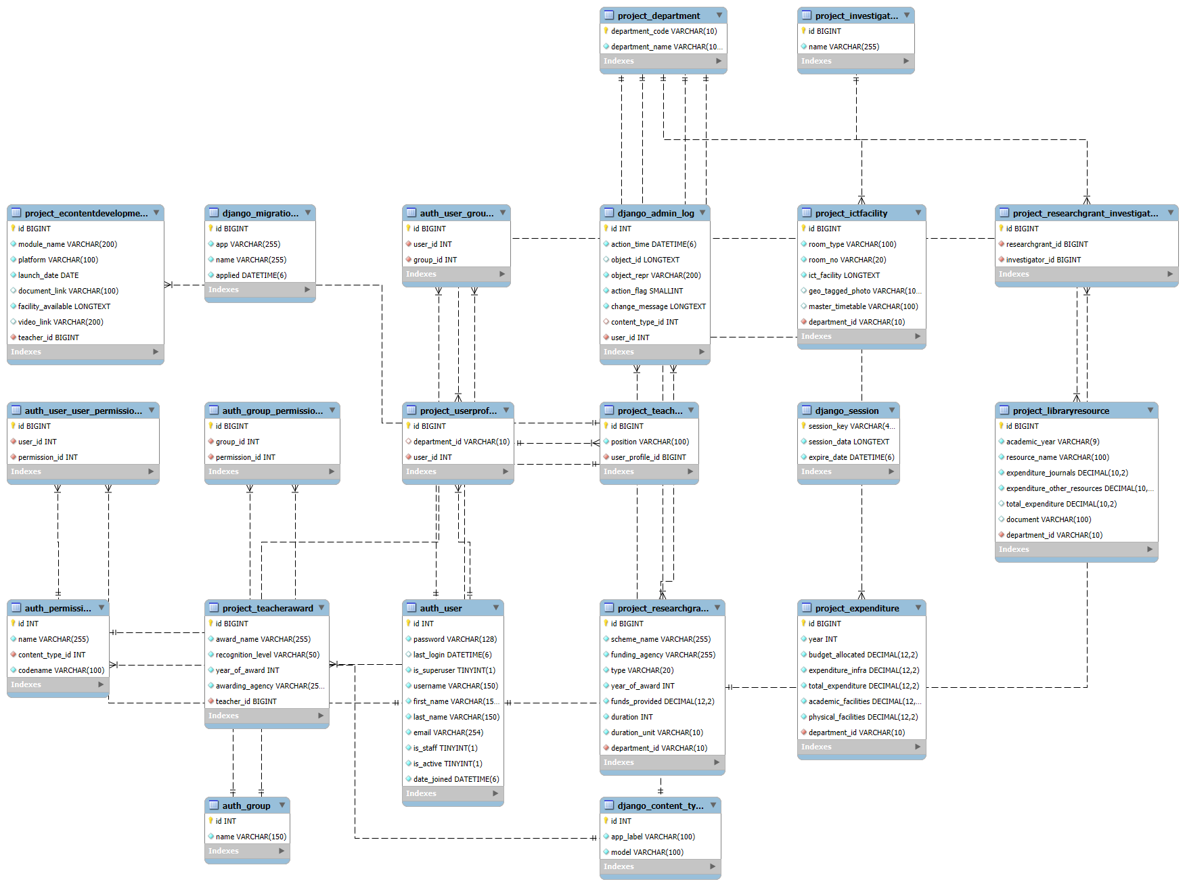
ER DIAGRAM :

