Slide 1
Used Car Price Prediction
By
Yuvarani N

Slide 2
Content
Problem Statement
Exploratory data analysis(EDA)
Data cleaning
Visualization
Model Building
Hyper parameter Tuning
How to save the Model
Conclusion
Findings and Insights

Slide 3
Problem statement
With the covid 19 impact in the market, we have seen lot of changes in the car market. Now some cars are in demand hence making them costly and some are not in demand hence cheaper. One of our clients works with small traders, who sell used cars. With the change in market due to covid 19 impact, our client is facing problems with their previous car price valuation machine learning models. So, they are looking for new machine learning models from new data. This model can help the client to understand the current status of the car market and car prices and based on this they can evaluate the car price for sale.

Slide 4
Exploratory data analysis(EDA)
Step 1: Import the dataset
Step 2: Perform statistical analysis like checking the shape and information about the data
Step 3: Check for null values in the dataset
Step 4: Dropped the columns with null values.
Step 5: Performed data cleaning process.

Slide 5
Data Cleaning
1. Converted all the words to the lower case in the fields ‘Brand’, ‘Model’,’Variant’,’Body type’, ‘location’ and ‘No.of.Owners’.It helps to remove the duplicate data with different cases.
Eg: Maruti, MARUTI – these two data are now considered as same word ‘maruti’
2. Removed the space and special characters from the above fields, and it also helped to remove the duplicates.
Eg: Mahindra-Renault, Mahindra Renault – these two are now considered as same word ‘mahindrarenault’
3. Removed the ‘,’ in between the numbers in the field of Km driven.
Eg: 11,410 – this data is now converted to 11410. Converted from object type to int type data.
4. Cleaned the manufacturing year field by applying round function on the data.
Eg: 2015.0 – now converted to 2015
5. Cleaned the target variable price. Converted from object type to int type data.
Eg: 4,70,000 – now converted to 470000
534999.0 – now converted to 534999

Slide 6
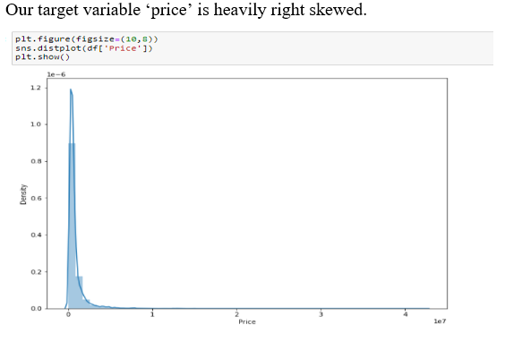
Visualization

Slide 7
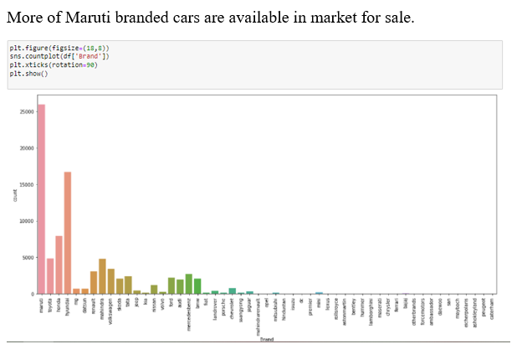

Slide 8
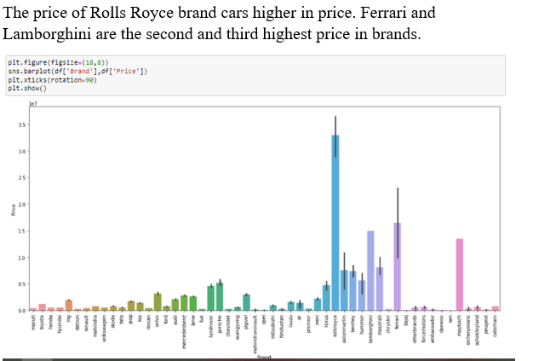

Slide 9
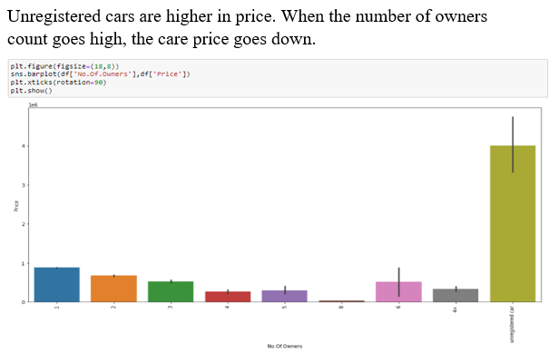

Slide 10
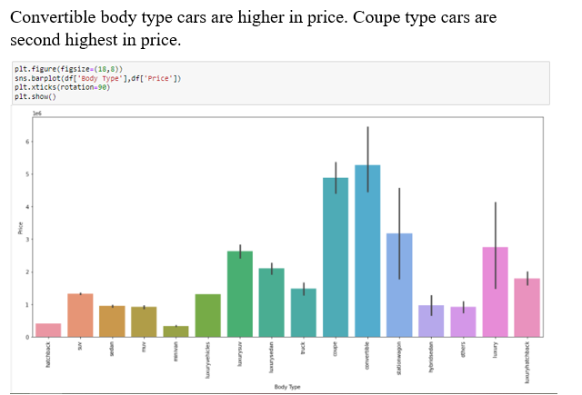

Slide 11
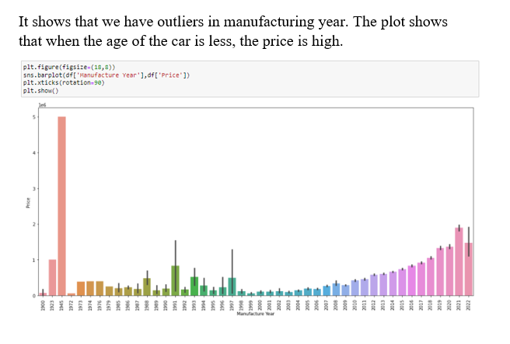

Slide 12
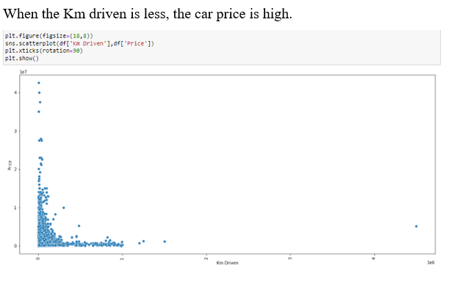

Slide 13
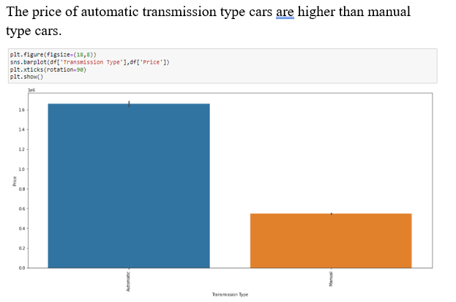

Slide 14
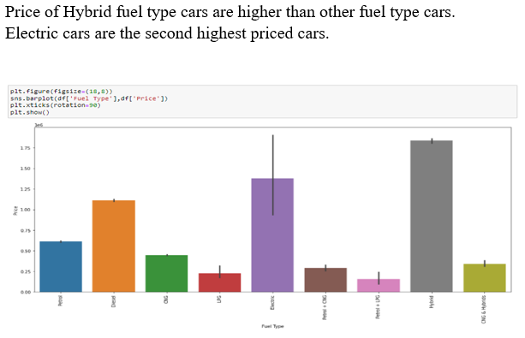

Slide 15
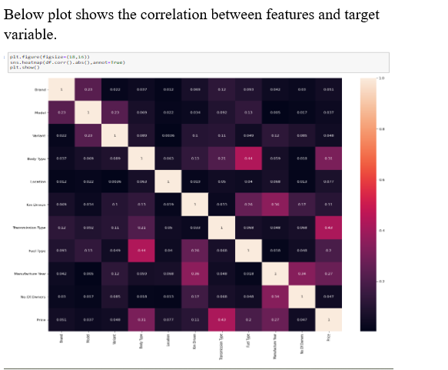

Slide 16
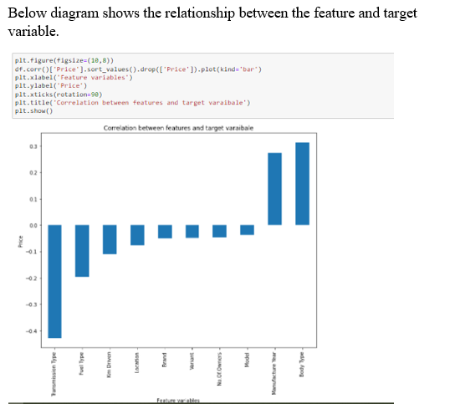

Slide 17
Model Building
Since our target variable is a continuous data, I have used below regression algorithms and used ‘r2_score’, ‘mean_absolute_error’ and ‘mean_squared_error’ and ‘root_mean_squared_error’ metrics to calculate the model accuracy and find the best model out of the below models. Also used cross validation technique to make sure the model is not overfitting.
LinearRegression
RandomForestRegressor
DecisionTreeRegressor
KNeighborsRegressor
GradientBoostingRegressor
XGBRegressor

Slide 18
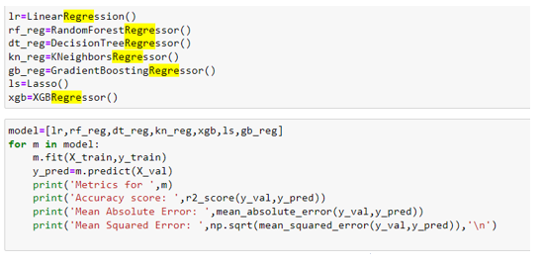
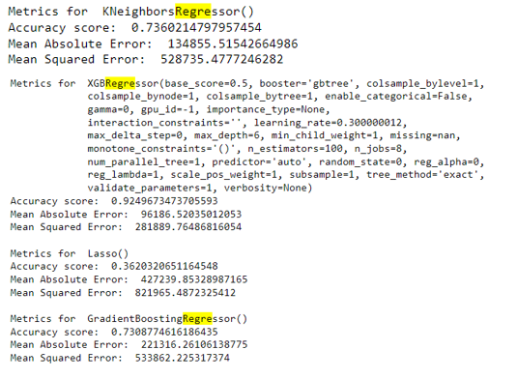
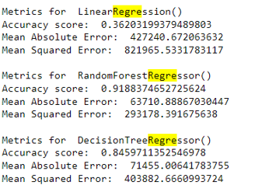

Slide 19
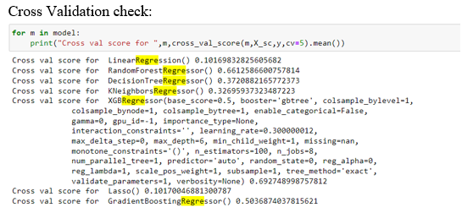

Slide 20
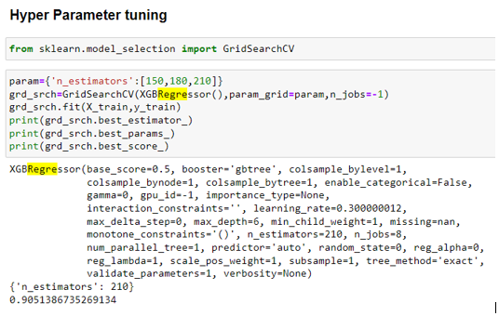

Slide 21
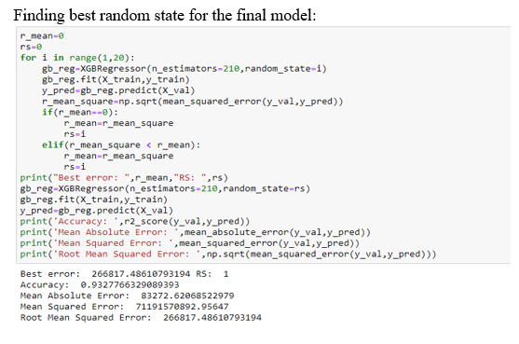

Slide 22
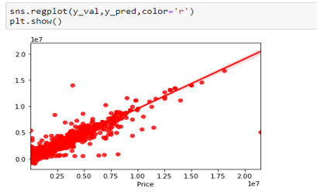
Conclusion
Based on the r2_score and root mean squared error and cross validation score, I have selected XGBRegressor as the best fit model to our data.
Hyper parameter tuning and finding best random state helped to improve the accuracy to 93% and reduce the Root mean squared error score.
Below is the best fit line generated by our model. It seems not too bad.

Slide 23
Finding and Insights
We have more maruthi brand cars in the market for sale. We can interpret this in such a way that people are do not want to use maruti cars anymore and they are seeking to explore new branded cars.
Price of Rolls royce cars are higher than other brand cars.
Price of Unregistered cars and 1st owner cars are higher than others.
When the number of owners increase, the price of the car is less.
The price of convertible body type cars are higher than other body types and followed by coupe.
When the Km driven is less, the car price is more.
The price of automatic transmission type cars are higher than manual cars.
The price of Hybrid fuel type cars are higher than other fuel type cars and followed by Electric cars and diesel cars.
RollsRoyce brand cars with automatic transmission type are costlier than other type of cars.

