Slide 1
Customer Retention Project
E-retail factors for customer activation and retention: A case study from Indian e-commerce customers

Slide 2
Contents
What is Customer Retention?
Why Customer Retention is Important?
Assumptions made about the data
Exploratory Data Analysis
Conclusion/Insights

Slide 3
What is Customer Retention?
Customer retention refers to a company’s ability to turn customers into repeat buyers and prevent them from switching to a competitor. It indicates whether your product and the quality of your service please your existing customers. It’s also the lifeblood of most subscription-based companies and service providers.

Slide 4
Why Customer Retention is important?
Retention is Cheaper than Acquisition
Loyal Customers are More Profitable
The Brand Will Stand Out from the Crowd
Retailers Earn More Word of Mouth Referrals
Engaged Customers Provide More Feedback
Customers Will Explore the Brand
Loyal Customers are More Forgiving
Retailers Earn Wiggle Room to Try New Things
It's Better for Employee Health

Slide 5
Assumptions about the data:
The Data set has list of 269 records with 71 attributes which are the information collected from the customers about their experience and satisfaction about the online retailers.
Customers rated their satisfactory information(rated like strongly agree/agree/etc..) regardless of the specific retailer. It is the common satisfaction rating about online shopping.
The assumption for the project idea is, when a customer is having good experience and satisfaction with any online shopping, they most likely to revisit and refer to their friends.
So the complete project is to focus on the customers enjoyment, satisfaction and the dissatisfaction area.

Slide 6
Exploratory Data Analysis
There is no null/missing values in the dataset.
We have done univariate analysis by visualizing the countplot for each attribute, and it gives the better idea about the customers experience and expectations.
Also we have done bivariate analysis between the features to understand the correlation between the features.
In the following slides will look into deep analysis and visualizations about the features.

Slide 7
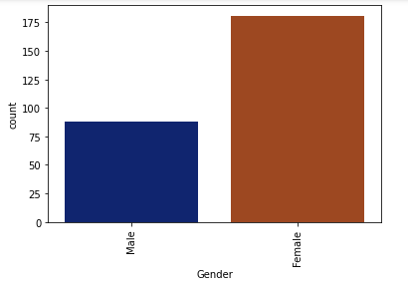
About the Customers personal information
We have more female customers than male customers.

Slide 8
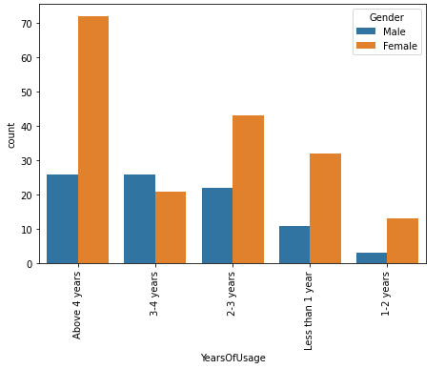
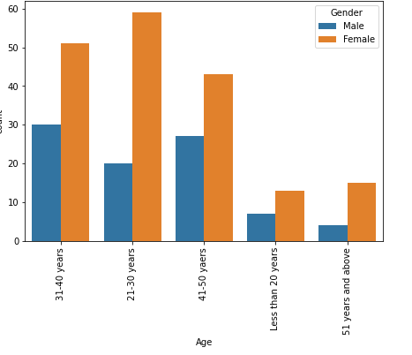
About the Customers personal information
We have more female customers who are using online retail stores for more than 4 years.
More number of female customers are between the age 21-40 years.

Slide 9
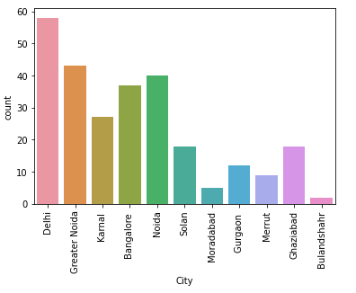
About Purchase
The highest number of online shopping is from the city Delhi. In the city Bullandshahr, its very less.

Slide 10
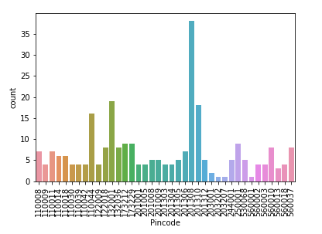
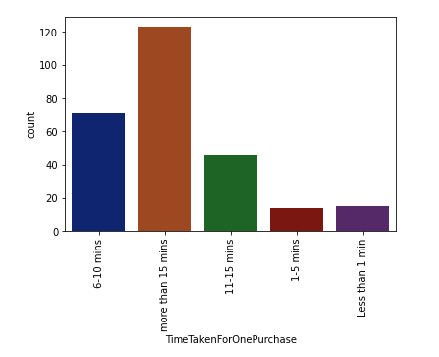
About Purchase
From the pincode 201308(Place in Greater Noida), we have high number of online shopping than other places.
Mostly one purchase takes more than 15 mins.

Slide 11
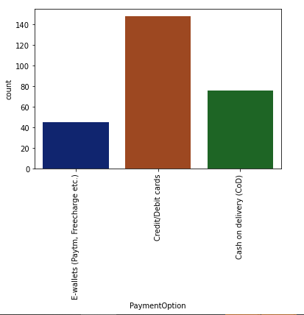
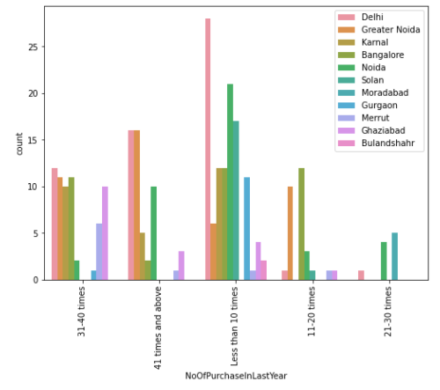
About Purchase
Most of the times credit/debit card used for payments.
In Delhi and Greater Noida more customers purchased more than 40 times in last 1 year.

Slide 12
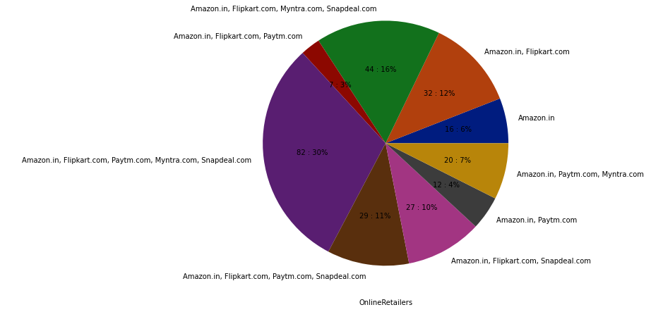
About Online Retailers and Customers Experience
More number of customers almost purchased in all the online stores (Amazon,Flipkart,Paytm,Myntra,Snapdeal).

Slide 13
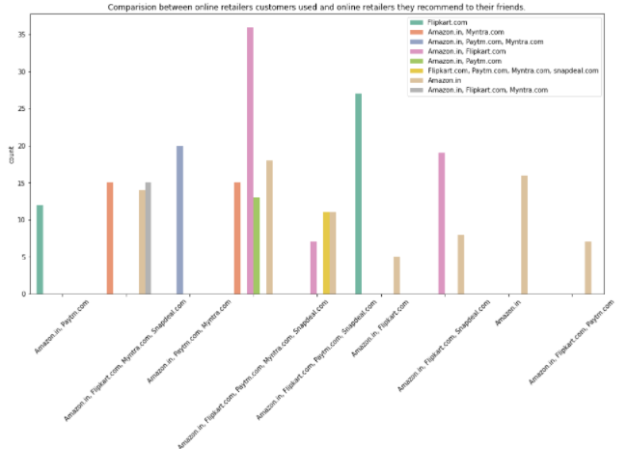
About Online Retailers and Customers Experience
The customers who used all the online shopping websites are mostly recommending Amazon to their friends and followed by Flipkart.

Slide 14
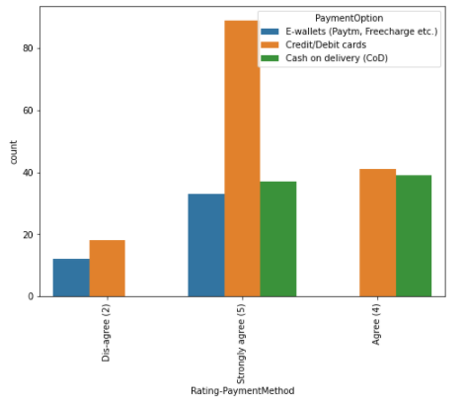
About Online Retailers and Customers Experience
Customers who uses credit/debit card payment options are strongly agree that the online retailers has convenient payment methods.

Slide 15
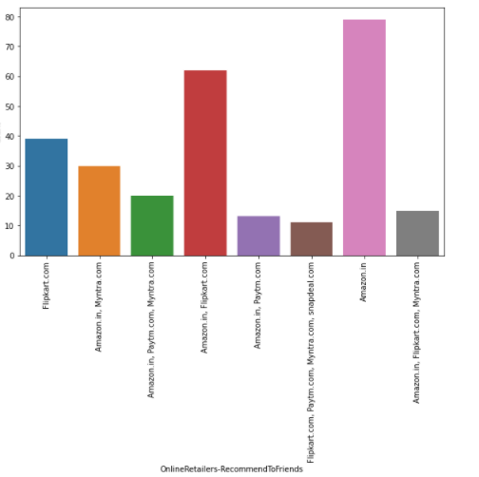
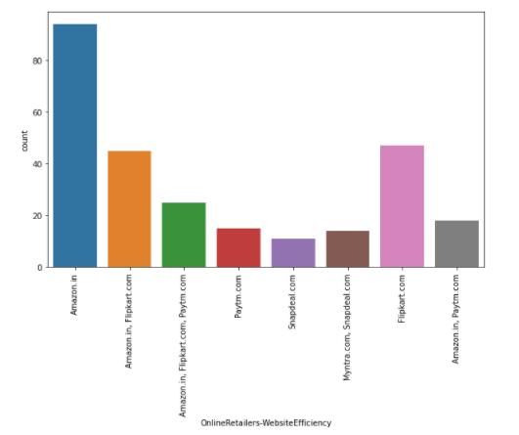
About Online Retailers and Customers Experience
More customers rated amazon has the better website efficiency.
The top recommended online retailer is Amazon.

Slide 16
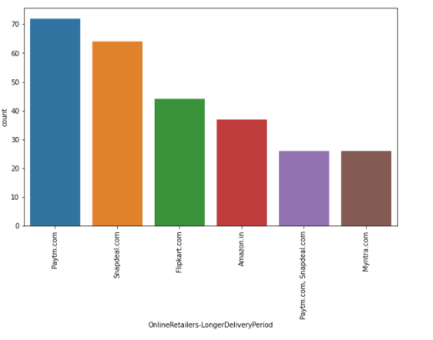
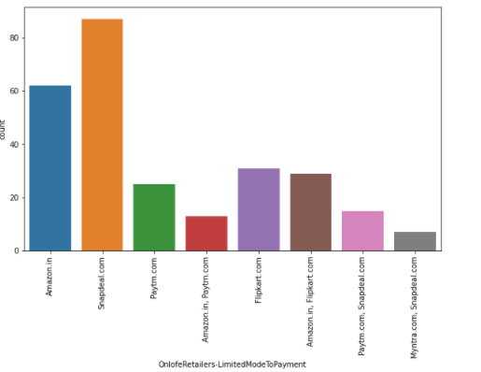
About Online Retailers and Customers Experience
Paytm takes longer time to deliver the products.
Snapdeal has limited mode of payment options for products.

Slide 17
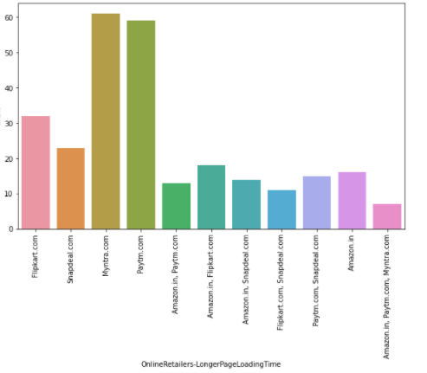
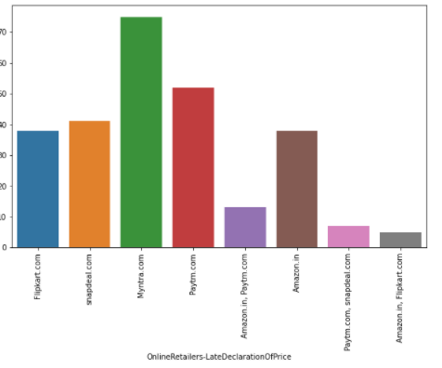
About Online Retailers and Customers Experience
Myntra and Paytm takes longer time to load the page.
Myntra does the late declaration on prices.

Slide 18
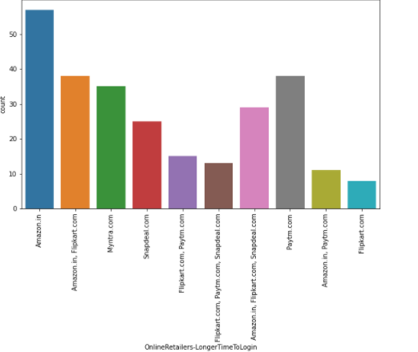
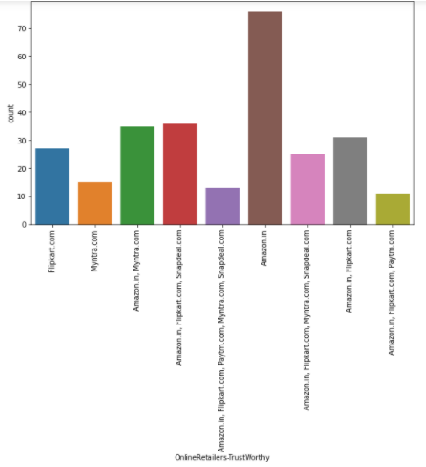
About Online Retailers and Customers Experience
Amazon takes longer time to get logged in.
Majority of customers says amazon is the trust worthier website for online shopping.

Slide 19
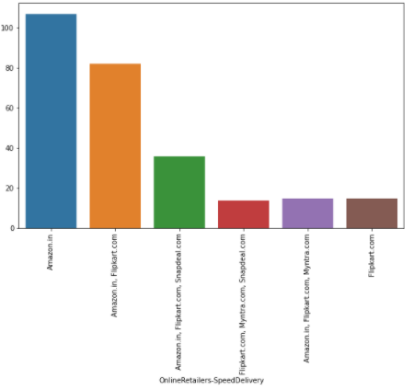
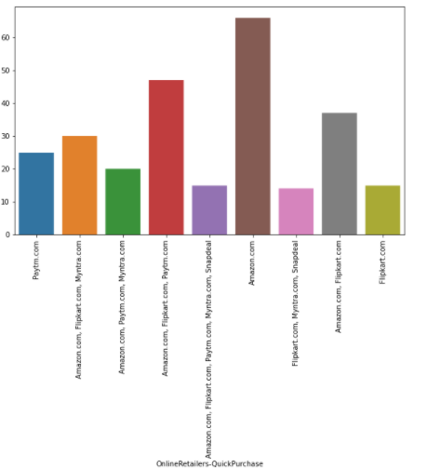
About Online Retailers and Customers Experience
Amazon does the speed delivery of products.
Amazon is rated by more customers for quick online purchase.

Slide 20
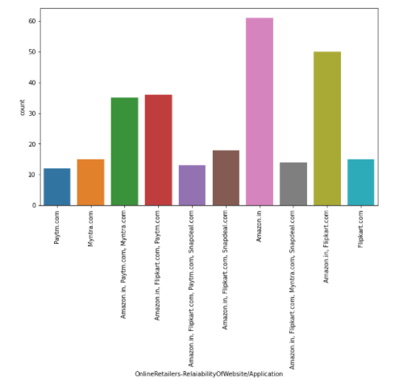
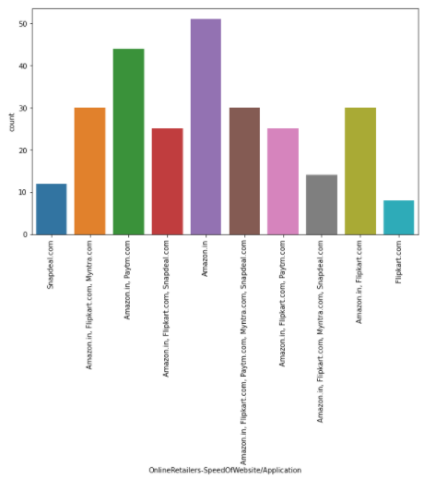
About Online Retailers and Customers Experience
Amazon rated as the best reliable website.
Speed of Amazon website/Application is faster than other retailers.

Slide 21
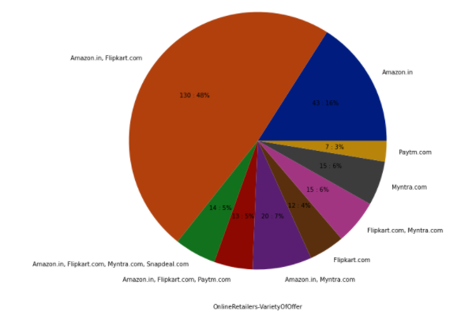
About Online Retailers and Customers Experience
Amazon and Flipkart provides more offers than other retailers.

Slide 22
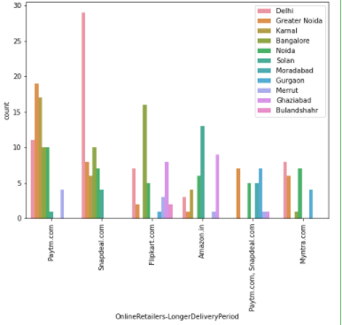
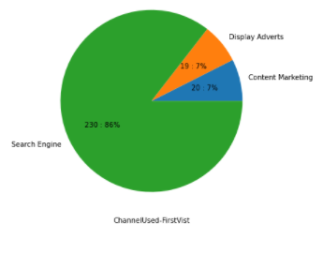
About Online Retailers and Customers Experience
Snapdeal takes longer time to deliver the orders in Delhi.
Customers uses search engines to visit the online stores for the first time.

Slide 23
Insights from the Analysis
Following are the few of improvement areas for online retailers to retain their customers. This is purely based on customers experience and the feedback given in the dataset.
Snapdeal:
Snapdeal has limited mode of payment options for products. It should not be the case for customer’s dissatisfaction.
Team should focus on reducing the delivery time.
Customers face frequent disruption with Snapdeal site/application. It shows that website instability. Team may focus on improving the website stability.
4. Team can focus on reducing the delivery time in Delhi and Bangalore.

Slide 24
Insights from the Analysis
Myntra:
Most of the customers says, Myntra does the late declaration on Prices. It will reduce the application reliability on the customers. So team can focus on reducing such kind of cases.
Team can focus on reducing the website/application loading time.
Team can focus on reducing the disruptions during the online shopping
Paytm:
Very smaller number of customers rated Paytm as reliable website/application. It shows that, customers may not feel Paytm as the reliable retailer. The team should try to create strong reliability within the customers.
Team can focus on reducing the website/application loading time.
Team can focus on reducing the delivery time.

Slide 25
Insights from the Analysis
Flipkart:
Very less customers rated website/application speed is better in Flipkart. It shows that they do not feel good about the website/application speed. May be the Flipkart team focus on improving the speed of the website/application.
May be the team can try to reduce the delay on loading images.
Flipkart should focus on reducing delivery time in Bangalore.
Amazon:
More customers feels amazon takes longer time to get logged in. May be amazon can look into that area to reduce the login time.
May be the application team look at the area to reduce the image loading time.
More number of customers says amazon has frequent disruption when moving from one page to another page. This may be because of more load on the website at a time, so application team may try to reduce this kind of disruption for the customers.
In the city Solan most the customers uses Amazon website/application for online shopping but the speed of delivery is very slow in this city. Amazon team may concentrate on reducing delivery time in this city.

Slide 26
Conclusion
Amazon is the top and highly recommended website/application for online shopping. Amazon is the customer’s primacy choice of online shopping websites for various reasons like website speed, quick online purchase, various payment options, speedy delivery, better website efficiency and more variety of offers for the products and etc.
Flipkart is the second top online shopping website for the reasons like providing better relevant product information, more payment options availability, provides more variety of offers and speed delivery in Delhi.
In Bangalore, Myntra also mostly used by customers, and it is recommended to their friends.

