Slide 1
Housing Price Prediction

Slide 2
Contents:
Problem Statement
Exploratory data analysis(EDA)
Visualization
Data cleaning
Model Building
Hyper parameter Tuning
How to save the Model
Conclusion

Slide 3
Problem statement:
A US-based housing company named Surprise Housing has decided to enter the Australian market. The company uses data analytics to purchase houses at a price below their actual values and flip them at a higher price. For the same purpose, the company has collected a data set from the sale of houses in Australia. The data is provided in the CSV file below.
The company is looking at prospective properties to buy houses to enter the market. You are required to build a model using Machine Learning in order to predict the actual value of the prospective properties and decide whether to invest in them or not.

Slide 4
Exploratory data analysis(EDA)
Step 1: Import the dataset
Step 2: Perform statistical analysis like checking the shape and information about the data
Step 3: Check for null values in the dataset

Slide 5
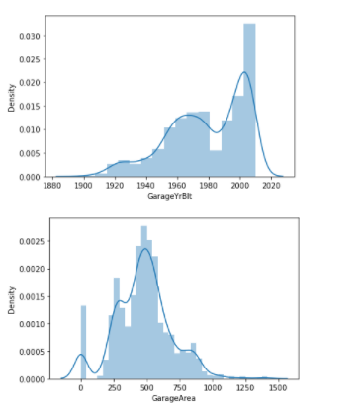
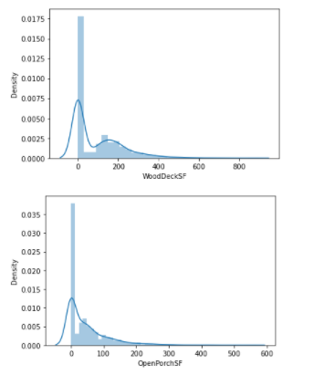
Visualization

Slide 6
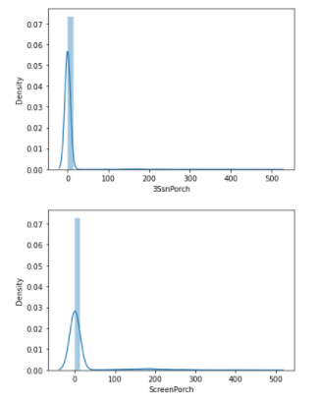
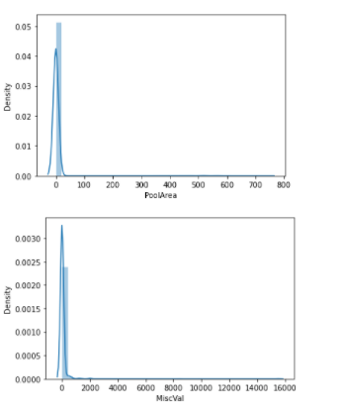
Visualization

Slide 7
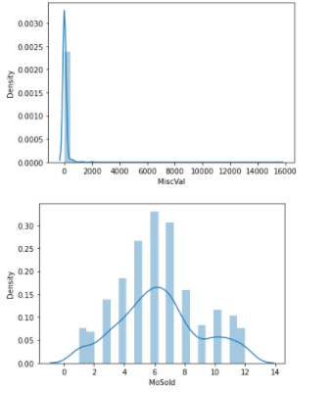
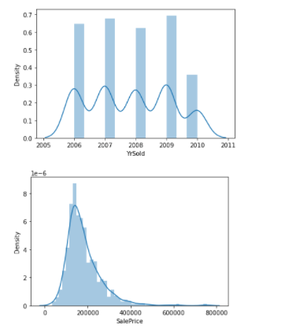
Visualization

Slide 8
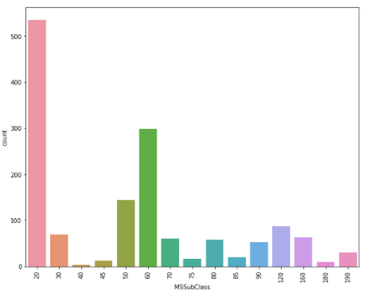
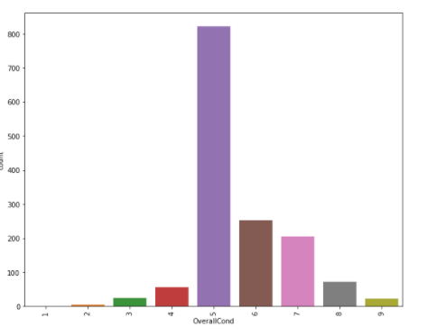
Visualization

Slide 9
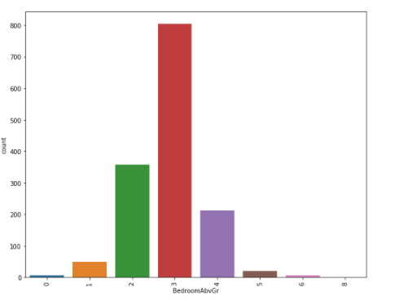
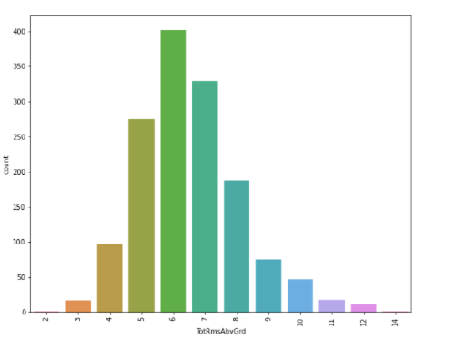
Visualization

Slide 10
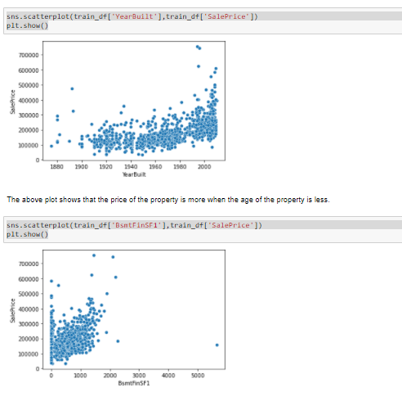
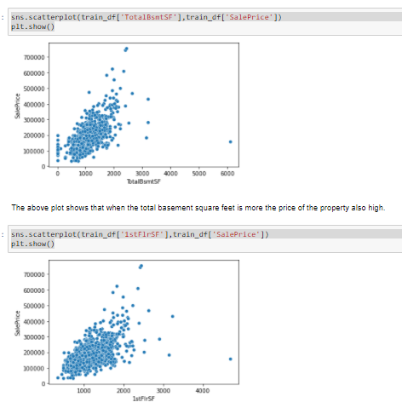

Slide 11
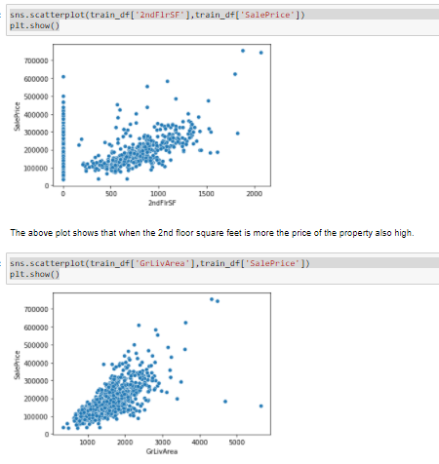
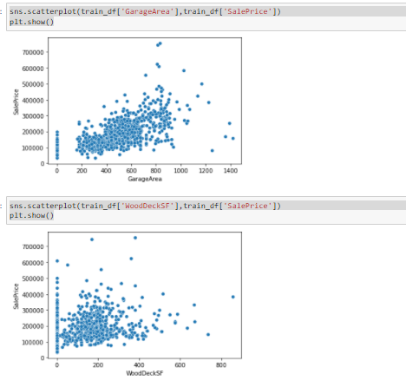

Slide 12
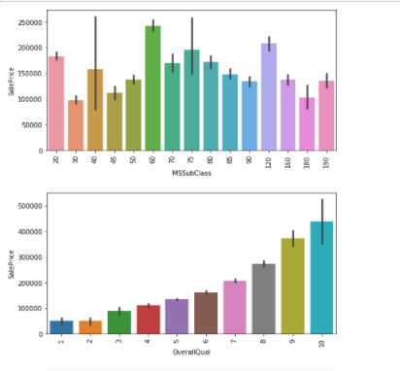
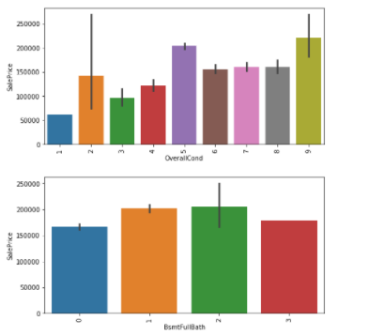

Slide 13
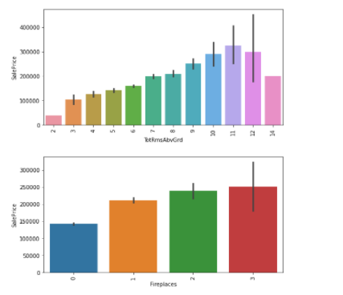
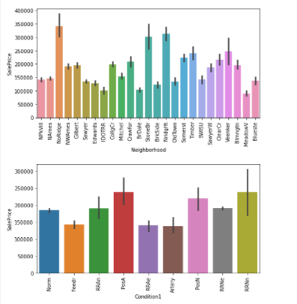

Slide 14
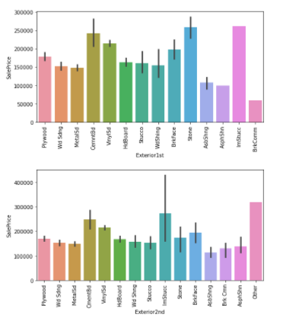
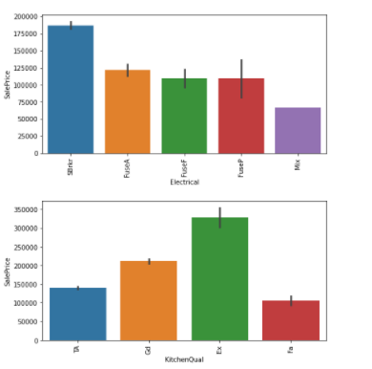

Slide 15
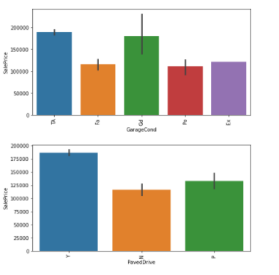
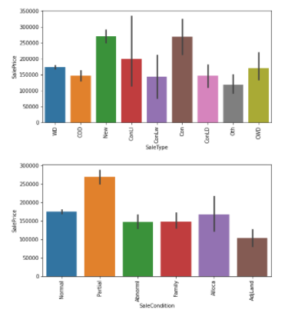

Slide 16
EDA Observations
1. There are majority of the properties are belongs to 1-STORY 1946 & NEWER ALL STYLES and followed by 2-STORY 1946 & NEWER
2. The quality of overall material and finish of the house is mostly average and followed by above average.
3. Majority of the properties are having average condition.
4. Most of the properites does not have full bathroom in basement and the second higest is with one bathroom at basement.
5.Majority of the properites does not have half bathrooms at basement.
6. Most of the properties are having 2 bathrooms above the basement and follwed by few properties with 1 bathroom.
7. Mostly there is no half bathrooms above basement and some properties with 1 half bathrooms.
8. Majority of the properites are having 3 bedrooms above the grade.
9. 1 kitchen is available for most of the properties.
10. Most of the properties are having 6 rooms above the basement and followed by properties with 7 rooms.

Slide 17
11. Most of the properties are having no fire place and followed by 1 fire place.
12. Most of the properites are with grage size of 2 cars.
13. Most of the properties are from the Residential Low Density zone.
14. Most of the properites are having paved street to the property.
15. Most of the properties are in regular shape
16. Majority of the properties are in near flat same level land counter
17. Almost the proerties are having all public utilities available at the property.
18. Majority of the properties are belongs to indie lot.
19. Majority of the properties are having gentle slope.
20. Most of the properites are Single-family Detached type of dwelling.

Slide 18
21. Most of the properties are belongs to 1 story house style
22. Majority of the properites are having Gable style roofs.
23. Mostly the roof material is Standard (Composite) Shingle.
24. Mostly the exterior covering is Vinyl Siding.
25. Most of the properties are with average quality of the material on the exterior.
26. Most of the properties are with average exterior condition.
27. Mostly the properties are having foundation type as Poured Contrete or Cinder Block.
28. Most of the time, the height of basement is average and good.
29. Most of the times the basement condition is Average.
30. Mostly the type of heating is Gas forced warm air furnace.

Slide 19
31. Most of the times Heating quality and condition is excellent.
32. Majority of the properties are having central Air conditioning.
33. Mostly the properties are having Standard Circuit Breakers & Romex electrical system.
34. Most of the times, the kitchen quality is average.
35. Mostly the Home functionality is typical.
36. Mostly the Garage is attached from home.
37. Most of the times the Interior finish of the garage is unfinished.
38. Mostly the garage quality is average.
39. Mostly the garage condistion is average.
40. Mostly the drive way is paved.
41. Mostly the type of sale is Warranty Deed - Conventional.
42. Mostly the sale condition is Normal.

Slide 20
Insights from EDA
1. When the type of property is 2-STORY 1946 & NEWER the price is higher and when the type is 1-STORY 1945 & OLDER the price is low.
2. When the overall material and finish of the house is excellent, the price is high.
3. When the garage size is big, the price of the property is high.
4. The price of the property is higher in the zones of Floating Village Residential and Residential Low Density.
5. Almost all the properties are having all public utilities available.
6. When the lot configuration is Cul-de-sac and Frontage on 3 sides of property, the the price of the property is high.
7. When the type of house is Frontage on 3 sides of property and Two story, then the price is more.
8. When the roof material is Wood Shingles then the price is more.
9. When the Exterior covering is Stone and Imitation Stucco the price of the house is higher.
10. When the Masonry veneer type is Stone, the price of the property is high.

Slide 21
11. When the quality of the material on the exterior is excellent, the price is higher.
12. When the present condition of the material on the exterior is excellent, the price of the property is high.
13. When the type of the foundation is Poured Contrete then the price is higher.
14. When the height of the basement is excellent, the price of the property is high.
15. When the basement finished area is Good Living Quarters, the price of the property is higher.
16. When the garage type is Built-In (Garage part of house - typically has room above garage), the price is higher.
17. When the garage quality is excellent, the price is higher.
18. When the sale type is Contract 15% Down payment regular terms and Home just constructed and sold then the price is higher.
19. When the sale condition is partial(Home was not completed when last assessed (associated with New Homes)), the price is higher.

Slide 22
Data cleaning
Removed the fields with more than 50% of null values.
Handled the remaining null values with respective values.
Encoded the non-numeric data to numeric values.
Checked the skewness and reduced the skewness by using PowerTansformer .

Slide 23
Model building
We will now use regression models since out target contains continous data. The below list algorithms are what I’ve used in my project.
LinearRegression
RandomForestRegressor
GradientBoostingRegressor
AdaBoostRegressor
KNeighborsRegressor
DecisionTreeRegressor
SVR
XGBRegressor

Slide 24
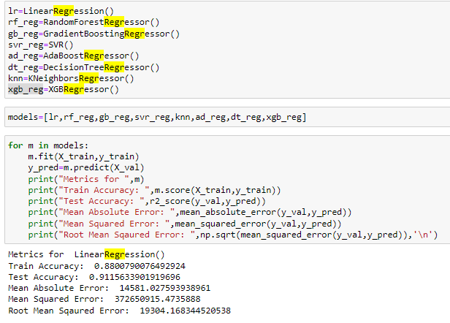
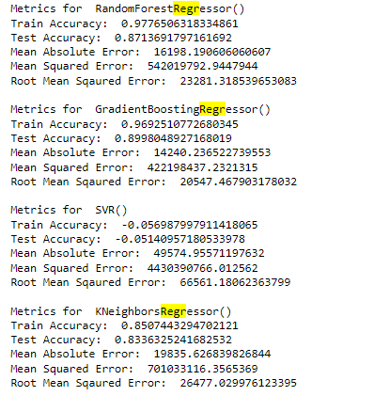

Slide 25
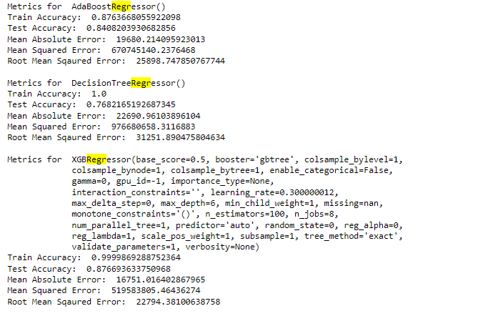

Slide 26
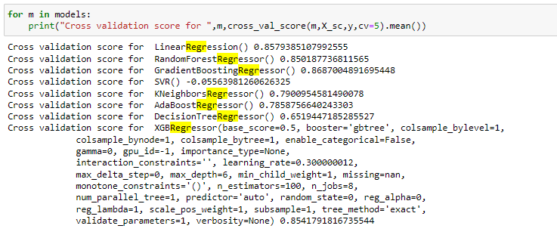
Cross Validation Check

Slide 27
Conclusion
Based on the model accuracy and cross validation XGBRegressor is having less difference. So lets select XGBRegressor as the final model to our dataset.

Slide 28
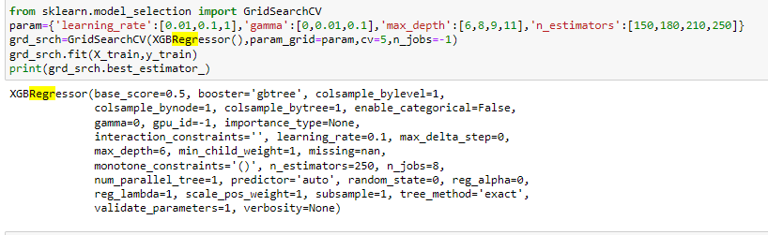
Hyper parameter tuning
Hyper parameter tuning helped to improve the accuracy from 88 to 89%.

Slide 29
Conclusion:
In this project, we have used different regression model to predict the sales price of the property.
After building different models, we came to conclusion that XGBRegressor is the best model for this project and gave us an accuracy score of 89%.
We also saved the best model and printed the prediction results according to our model.

