Slide 1
End-of-Year
Marketing Report
Sinclair Verde Lamp Company

Slide 2
Agenda
1. | __The Goal_____________
2. | ____End-of-year overview___________
3. | ____Holiday season report___________
4. | _Conclusion______________
5. | _______________

Slide 3
The Goal

Slide 4
The Goal
The three primary marketing goals for the Sinclair Verde Lamp Company are:
Create brand awareness
Drive visits to the physical store
Increase online holiday sales by 3 percent

Slide 5
End-of-Year Overview
Sinclair Verde Lamp Company targets customers between the ages of 30 and 55 in the United States and Canada. These individuals care about home decor and style. Social media activity has increased among these individuals during the start of the global pandemic.

Slide 6
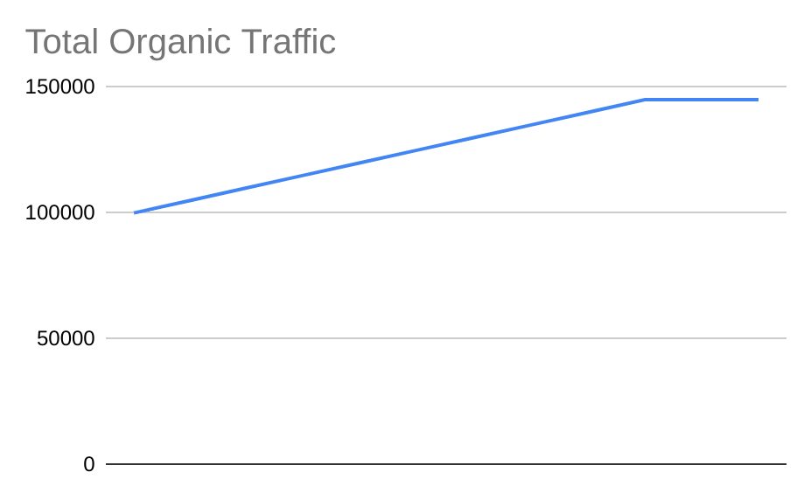
Organic traffic
In 2021, we experienced an overall increase organic traffic to the Sinclair Verde website.
In January, we started with 120000 organic searches.
We ended December with 170000 organic searches.
This is up 17.24% from last year.

Slide 7
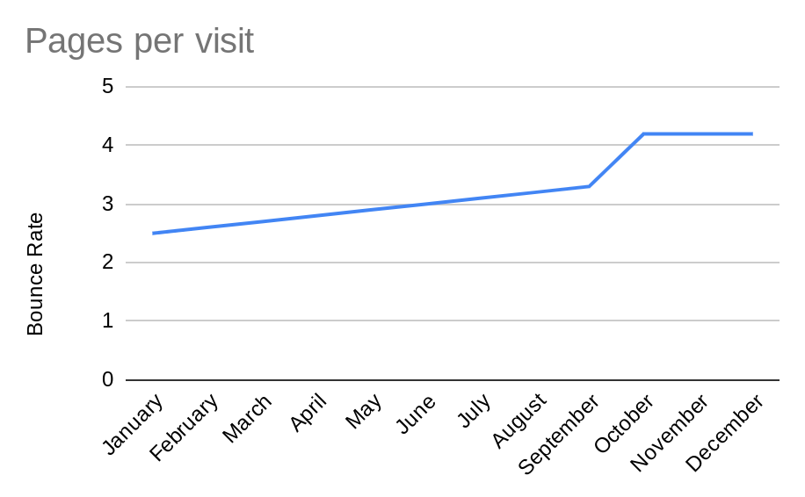

Slide 8
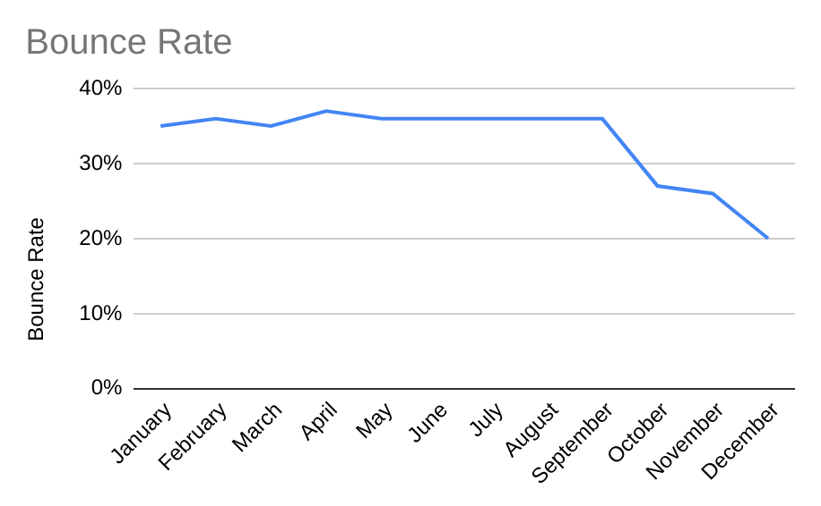

Slide 9
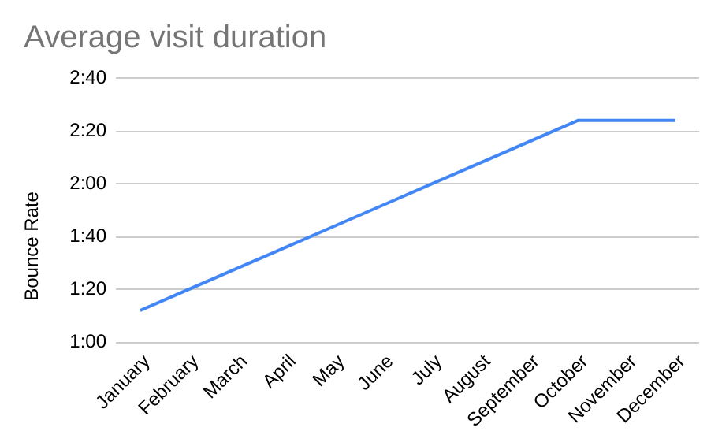

Slide 10
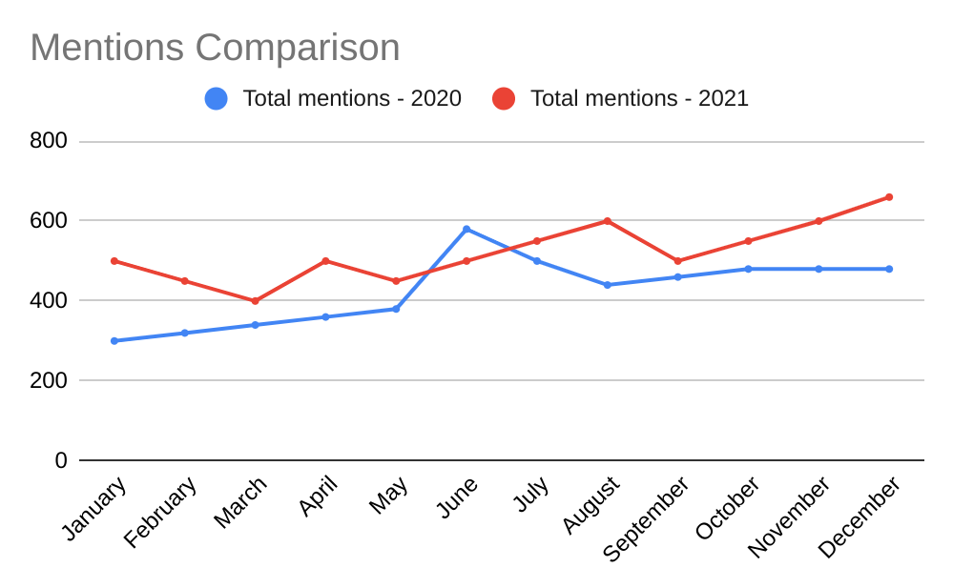
Social media mentions
In January, there were 500 social media mentions.
In December, there were 660 in 2021.

Slide 11
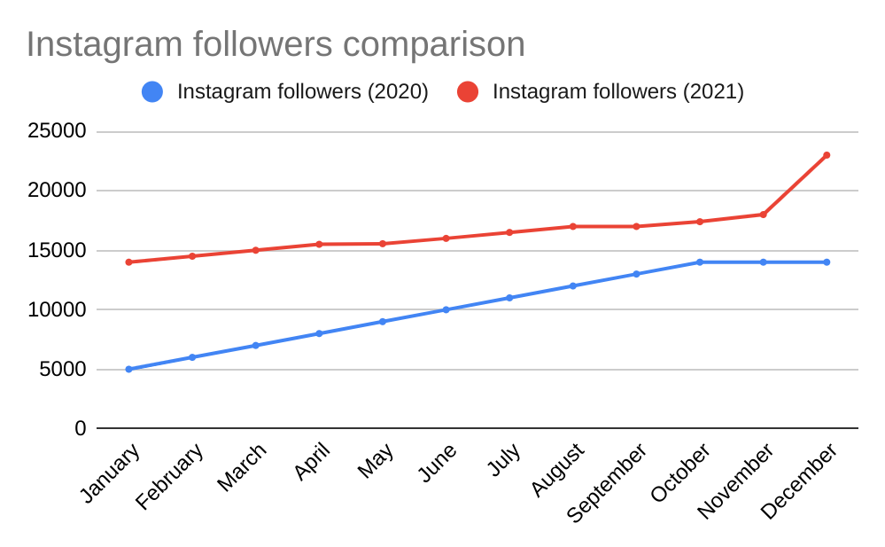
Instagram followers
Followers also increased. In 2021, the Sinclair Verde social media page gained 9000 followers.

Slide 12
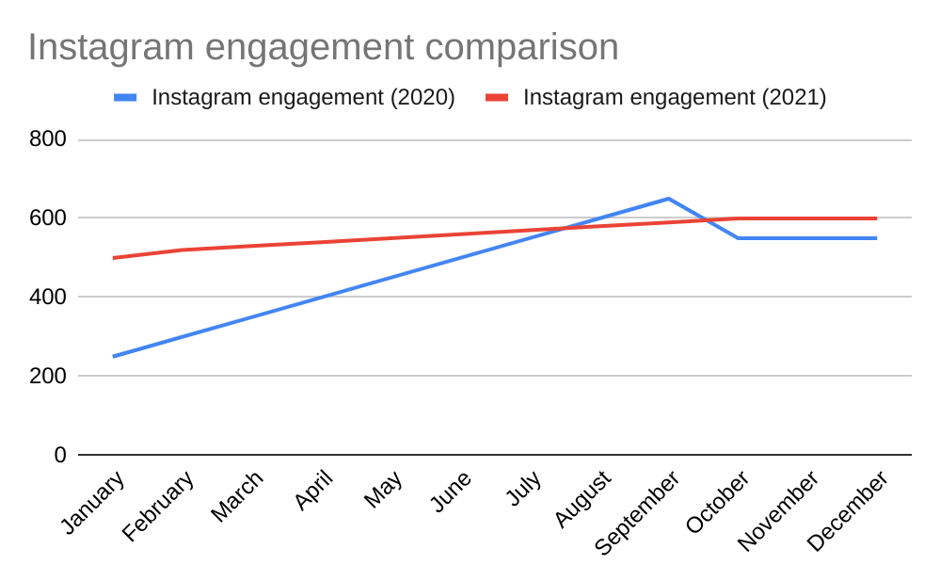
Instagram engagement
In January, there were 500 Instagram enegagements.
In December, there were 600 Instagram engagements.
This shows an increase from the previous year.

Slide 13
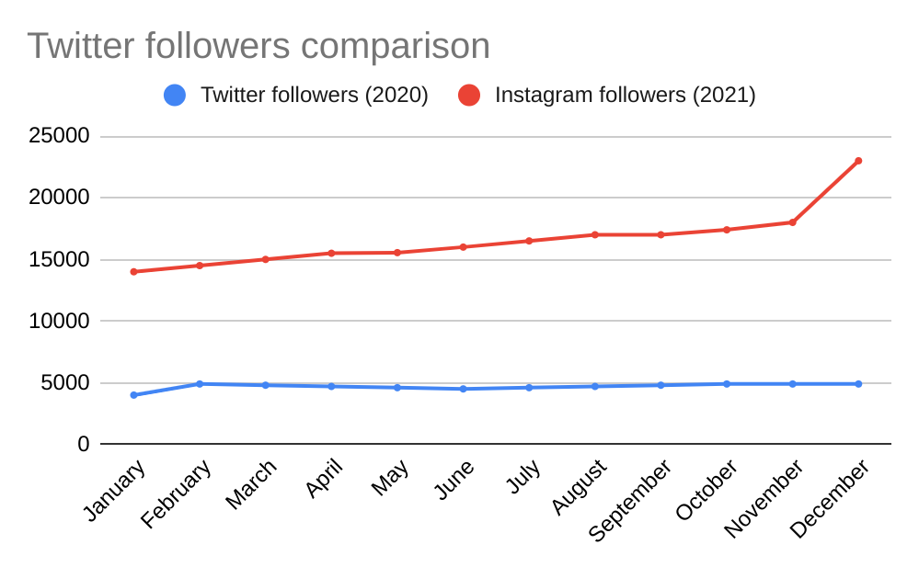
Twitter followers
In January, there were 5000 Twitter followers.
In December, there were 6800 Twitter followers.
This shows an increase from the previous year.

Slide 14
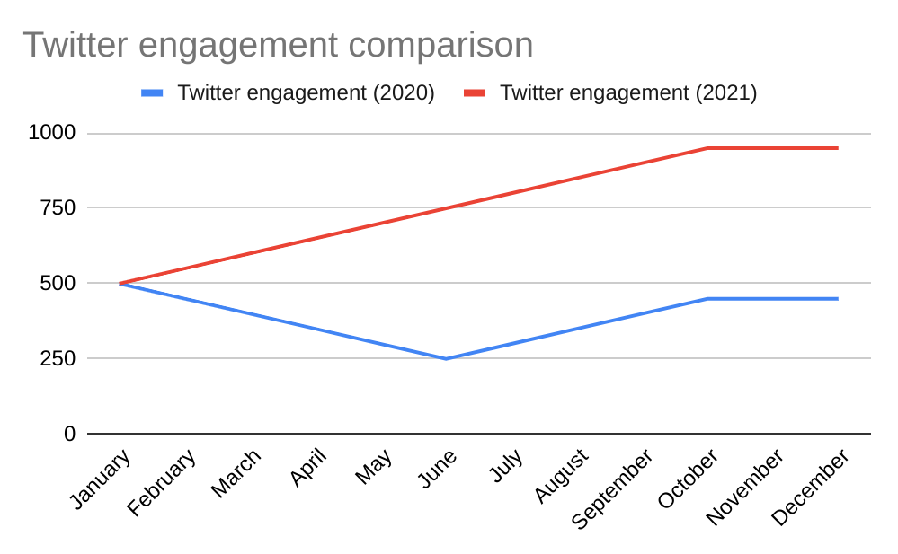
Twitter engagement
In January, there were 500 Twitter engagements.
In December, there were 950 Twitter engagements.
This shows an increase from the previous year.

Slide 15
Holiday Season Report
This section summarizes the data presented in the analytics report, specifically focusing on the months of November and December.

Slide 16
Organic Performance
 | November (Month 11) | December Month 12 | Net Growth:
2020 Holiday Season | 145000 | 145000 | 0.00%
2021 Holiday Season | 165000 | 170000 | 3.03%

Slide 17
Conclusion
We have created three times the amount of first time online buyers as the percentage of in-store first time buyers.

Slide 18
Conclusion
In conclusion, the overall marketing data suggests created three times the amount of first time online buyers as the percentage of in-store first time buyers with 0.00% net growth for the year 2021 for 2020 holiday season.
Based on this data, Good Mercury Marketing predicts that in the upcoming year, there is an increase in the percentage of in-store first time buyers.

