Slide 1
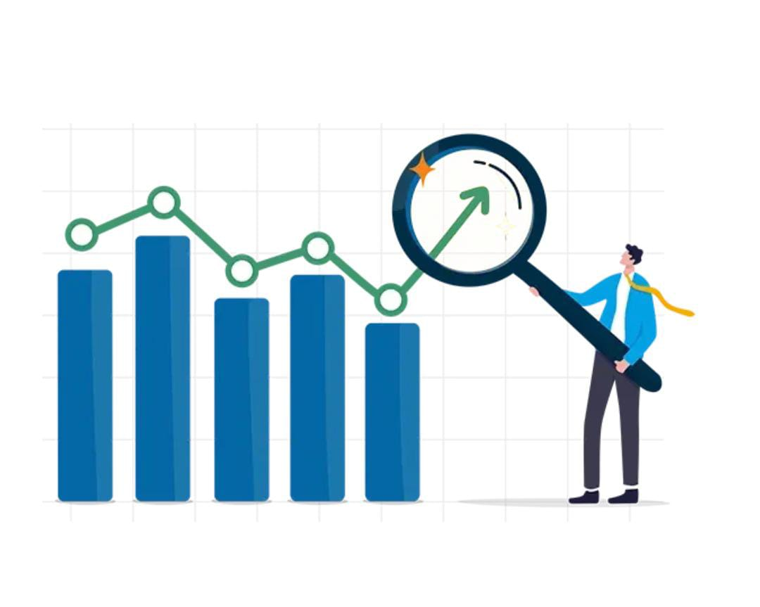
PROJECT DEMAND FORECASTING IN E-COMMERCE

Slide 2
Batch : 1 PRESENTED BY : YUVASHREE R MENTOR : LOKESH KUMAR DOMAIN : MACHINE LEARNING

Slide 3
ABSTRACT
This project focuses on demand forecasting in e-commerce using machine learning to optimize inventory and improve decision-making. A dataset with 676 rows and 30 features, including product details, pricing metrics, and temporal patterns, was analyzed. ARIMA captured time-series trends and seasonality.
The models effectively forecasted demand, with predictions showing a steady decline over the next 10 periods. Confidence intervals provided insights into variability, helping businesses prepare for uncertainties. This project demonstrates the potential of machine learning in streamlining operations and improving efficiency in the e-commerce sector.
Keywords: Demand Forecasting, E-commerce, ARIMA, Machine Learning, Predictive Analytics

Slide 4
OBJECTIVE
The objective of this project is to develop an effective demand forecasting system that enhances control and production scheduling by utilizing sales history . Inventory control and production scheduling by utilizing sales history and external factors.
By maintaining data accuracy and evaluating model performance through forecasted values and graph, the project seeks to optimize the supply chain, minimize waste, improve inventory management, and enhance customer satisfaction for the cardboard manufacturing company

Slide 5
Problem Statement
Problem:
The problem addressed in this project is the challenge of accurately forecasting demand in e-commerce. With fluctuating sales patterns influenced by various factors such as product details, pricing, and customer behavior, businesses often struggle with overstocking or understocking inventory. The goal is to develop a machine learning-based solution using historical sales data to predict future demand, optimize inventory management, and enable informed decision-making for pricing and stock replenishment.

Slide 6
EXISTING SYSTEM
Presently, e-commerce firms usually carry out their demand forecasting in a basic way through the use of he sales history and simple mathematical formulae. Regular techniques like moving averages or a seasonal pattern are often employed in sales projection. These methods often do not consider things like advertisements, changes in the occasion, or competitor’s action thereby making predictions less accurate.
Further, most of the current systems do not support real time forecasting of market conditions and hence the business cannot easily change its strategies to meet changing market conditions. As useful as such conventional tools may be in establishing some of the simplest trends, they are inadequate in capturing more intricate trends in sales data as observed in e-commerce applications.

Slide 7
PROPOSED SYSTEM
This project develops a machine learning-based demand forecasting model for e-commerce to optimize inventory and enhance decision-making. Using a dataset of 676 rows and 30 features, including product details, pricing, customer behavior, and temporal patterns, data was preprocessed for quality.
The ARIMA model was employed to capture trends, seasonality, and cyclic patterns in time-series data, generating forecasted demand values. The results include valuable insights on future demand, with confidence intervals indicating prediction variability. This solution helps businesses make accurate demand predictions, optimize inventory management, and make data-driven decisions for pricing and stock levels, ultimately improving operational efficiency and customer satisfaction.

Slide 8
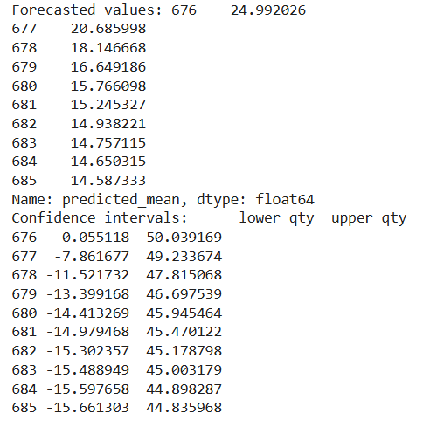
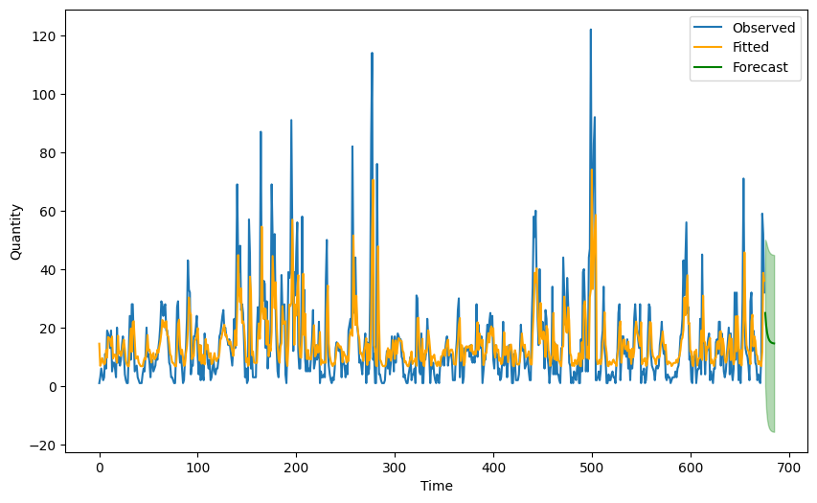
OUTPUT:

Slide 9
REFERENCES
[1] Vasiliki, K.; Vasileios, A.; Thomas, L.; George, F.; Elisavet, G.; Panagiotis, S. IDS for Industrial Applications: A Federated Learning Approach with Active Personalization. Sensors 2021, 21, 6743.
[2] Venkataramanan, K.; Kaza, S.; Annaswamy, A.M. DER Forecast using Privacy Preserving Federated Learning. arXiv 2021, arXiv:2107.03248.
[3] Susan Li (Jul 9, 2018) An End-to-End Project on Time Series Analysis and Forecasting with Python. https://towardsdatascience.com/an-end-to-end-project-on-time-seriesanalysis-and-forecasting-with-python-4835e6bf050b
[4] Mupparaju, Kalyan, Anurag Soni, Prasad Gujela, and Matthew A. Lanham. "A Comparative Study of Machine Learning Frameworks for Demand Forecasting." (2018).
[5]Demand Forecasting of E-Commerce Enterprises Based on Horizontal Federated Learning from the Perspective of Sustainable Development Juntao Li 1 , Tianxu Cui 1,* , Kaiwen Yang 1 , Ruiping Yuan 1 , Liyan He 1 and Mengtao Li 2

Slide 10
Thank you

