Slide 1
EMPLOYEE DATA ANALYSIS USING EXCEL
STUDENT NAME : SWATHY. L
REGISTER NO. : 312214957
DEPARTMENT : COMMERCE
COLLEGE NAME : ANNAI VEILANKANNI’S COLLEGE
FOR WOMEN

Slide 2
PROJECT TITLE
Empoyee Performance Analysis using Excel

Slide 3
AGENDA
Problem statement
Project Overview
End users
Our Solution and Prosposition
Dataset Description
Modelling Approach
Conclusion

Slide 4
PROBLEM STATEMENT
Accuracy evaluate employee performance
Identify strengts, weskness,opportunities and threats (SWOT Analysis)
Develop targeted interventions and training programs
Inform talent management decisios ( promotions seccessions )

Slide 5
PROJECT OVERVIEW
Analysis employee performance data to identify key drivers of performance and areas for areas for improvement
Focus on identifying key predictors of performance, area of improvement and opportunities for growth and development
Develop data – driven insights to inform talent management decisions, training program and leadership development initiatives

Slide 6
WHO ARE THE END USERS?
Line Managers
HR business partners
Senior leadership
Employees
Employee

Slide 7
ORU SOLUTION AND IT‘S VALUE PROPOSITION
1.SOLUTION:EMPOWER AI-EMPIOYEE PERFORMANCE INSIGHTS
2.VALUE PROPOSITIONS
3.IDENTIFY TOP PERFORMANCE
4.PINPOINT SKILLS GAPS
5.BOOST PRODUCTIVITY

Slide 8
DATASET DESCRIPTION
.DESCRIPTION :This date set contains information on employees performance demographics and development activities
FIELDS
1.Employee Id
2.Name
3.Department
4.performance rating
5.performance level

Slide 9
THE WOW IN OUR SOLUTION
1.Al driven predictive analytics for accurate forecasting and insights
2.Automated performance scoring for unbiased evaluation
3.Real-time feedback and coaching for continuous developmemt
4.lntitive and interactive dashboard for easy visualization and tracking

Slide 10
MODELLING
1.Regression analysis
2.Decision trees
3.clustering Analysis
4.predictive modeling
5.propensity scoring
6.survival Analysis
7.Network Analysis
8.Machine learning Algorithm
9.Simulation modeling
10.Bayesian networks

Slide 11
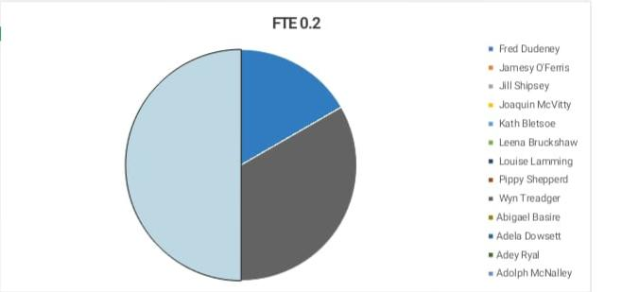
Result

Slide 12
CONCLUSION
Conclusion...
Employee performance analysis is a criticsl components of Talent management, enabling organizations to make date driven decisions, drive business outputs and enhance employee experience, By leveraging advanced analytics modelling techniques

