Slide 1
Employee data analysis using Excel
Student Name : Swetha belsy.S
Register no. : 312214958
Department : Commerce
College name : Annai veilankanni’s college for women

Slide 2
Project title
Employee Performance Analysis using Excel

Slide 3
AGENDA
Project Overview
End User
Problem Statement
Modelling approach
Data set description
Conclusion

Slide 4
Problem statement
Accuracy evaluate employee performance
Identify strength, weakness, opportunity and threads (swot analysis)
Develop targeted interventions and training program
Inform talent management decision (promotion, succession)

Slide 5
Project Overview
Analysis employee performance data to identify key drivers of performance and areas for improvement
Develop data-driven insights to inform talent management decision, training program and leadership development initiatives
Focus on identifying jey predictors of performance, areas of improvement and opportunities for growth and development

Slide 6
Who are the end users?
Line manager
Hr business partners
Senior leadership
Employee development teams
Compensation and benefits teams
Talents acquisition

Slide 7
Our solution and its value proposition
Solution : empower AI – employee performance insights
Value proportion:
Identify top performance
Pinpoint skill gaps
Enhance employee engagement
Inform data-driven decision
Boast productivity

Slide 8
Dataset description
Description:
This data set contains information on employee performance, demographics
And development activities
Fields:
Employee id
Name
Department
Salary

Slide 9
The “wow” in our solution
Ai driven predictive analytics for accurate forecasting and insights
Automated performance scoring for unbaised evaluation
Real-time feedback and coaching for continuous development
Personalised development plans for traget growth and improvement

Slide 10
Modelling
Regression analysis
Decision trees
Predictive modelving
Propensity scoring
Network analysis
Bayesian networks
Simulation modelling

Slide 11
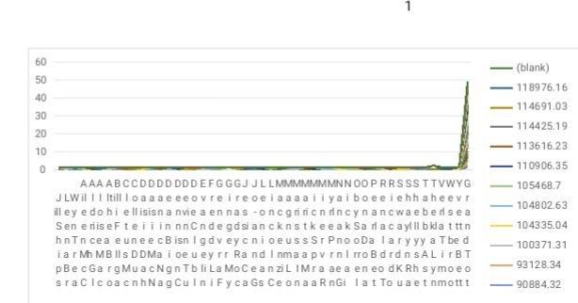
Result

Slide 12
Conclusion
Employee performance analysis is a critical component of tanlent management, enabling organization to make data driven decision, drive business outputs and enhance employee experience. By leveraging advanced modelling techniques.

